Slide 1
WINNING THE SPACE RACE
WITH DATA SCIENCE
Predicting Falcon 9 first-stage landing outcomes
Ckyree Campbell | IBM Applied Data Science Capstone | October 2026

Slide 2
IBM APPLIED DATA SCIENCE CAPSTONE
Outline
01
Problem + methods
02
Exploratory visual analysis
03
SQL results
04
Mapping + interactive analytics
05
Classification + conclusions
Dataset: historical IBM 56-row dashboard sample • distinct from 90-row API lab
02

Slide 3
IBM APPLIED DATA SCIENCE CAPSTONE
Executive summary | Tested findings
WHY
The commercial objective is to understand which launch characteristics correlate with first-stage recovery, potentially informing assessments of booster reuse.
METHOD
Transcribed the 56-row public IBM dashboard sample; conducted ten SQL queries, six exploratory plots, geographic mapping, and cross-validated training of four classifiers.
MEASURED OUTCOMES
24 of 56 historical records indicate successful recovery (42.9%). A tuned linear SVM led 3-fold cross-validation (78.6%) and scored 78.6% on the 14-record holdout. The dataset is small.
DECISION IMPLICATION
Flight maturity and booster generation show relationships with landing outcome, but site and payload differences are confounded. These exploratory models are not operational forecasts.
Dataset: historical IBM 56-row dashboard sample • distinct from 90-row API lab
03

Slide 4
IBM APPLIED DATA SCIENCE CAPSTONE
Introduction | Business question and boundaries
BUSINESS PROBLEM
Falcon 9 reusability affects the economics of launch services. The analytical question: can historical mission characteristics help classify successful first-stage recovery?
LABEL
Class = 1 denotes a favorable historical landing outcome in the public dashboard sample; Class = 0 denotes the opposite. This must not be confused with overall mission success.
SCOPE
The executed evidence in this report is based on 56 public, historical dashboard rows. IBM also uses a separate 90-launch API dataset. Results across these datasets cannot be combined without reconciliation.
Dataset: historical IBM 56-row dashboard sample • distinct from 90-row API lab
04

Slide 5
IBM APPLIED DATA SCIENCE CAPSTONE
Methodology | End-to-end research design
1. Source & transcribe public course CSV
2. Validate 56 rows and target labels
3. SQL aggregation & EDA charts
4. Map site coordinates and outcomes
5. Create static dashboard views
6. Train four models, tune & test
Dataset: historical IBM 56-row dashboard sample • distinct from 90-row API lab
05

Slide 6
IBM APPLIED DATA SCIENCE CAPSTONE
Data collection | SpaceX REST API workflow
PROCESS
GET /v4/launches/past → JSON normalization → join rocket, payload, core and launchpad records → choose Falcon 9 → export a rectangular analysis table.
WEB AND API SOURCES
API practice endpoint: api.spacexdata.com/v4/launches/past. The executed charts here use the historical dashboard CSV sourced from a publicly available course repository, not a newly issued live API request.
REPRODUCIBILITY LINK
Source dataset: github.com/Ahmed-Nezar/IBM-Data-Science-Capstone-SpaceX/blob/main/spacex_launch_dash.csv. A personal GitHub repository with the completed course notebooks remains outstanding.
Dataset: historical IBM 56-row dashboard sample • distinct from 90-row API lab
06

Slide 7
IBM APPLIED DATA SCIENCE CAPSTONE
Data collection | Wikipedia web scraping
EXTRACTION WORKFLOW
GET Wikipedia list of Falcon 9 and Falcon Heavy launches → BeautifulSoup parse HTML → inspect tables → extract launch identifiers, dates, sites and outcomes → standardize fields → dataframe.
QUALITY CONTROLS
Inspect table headings before parsing, clean footnote markers, remove incomplete or duplicated launch records, align recovery outcome terminology, and record source snapshots.
EVIDENCE STATUS
This describes the IBM course methodology. No original web-scraping notebook output or completed personal notebook URL was supplied; this section is not represented as an executed scrape.
Dataset: historical IBM 56-row dashboard sample • distinct from 90-row API lab
07

Slide 8
IBM APPLIED DATA SCIENCE CAPSTONE
Data wrangling | Steps actually applied
NORMALIZATION
Created named columns for flight number, site, landing Class, payload mass (kg) and booster category; validated 56 distinct flight identifiers and binary labels.
DATA CLEANING
Kept source-reported payload values including zeros; did not impute unknown outcomes or rewrite labels. Exported the complete 56-row analysis CSV and a SQLite database.
MODEL FEATURES
Used flight number and payload as continuous predictors, and one-hot encoded launch site and booster category. Split 75% training/25% testing with stratification and fixed random state.
Dataset: historical IBM 56-row dashboard sample • distinct from 90-row API lab
08

Slide 9
IBM APPLIED DATA SCIENCE CAPSTONE
EDA methodology | Chart selection
SCATTER PLOTS
Flight number or payload mass by launch site and by booster group, colored by Class. This exposes separation, overlap, launch cadence, and possible outliers.
BAR CHARTS
Mean of Class grouped by site and booster generation represents percent favorable landing outcome. Each label includes its sample size to highlight instability.
TEMPORAL PROXY
The 56-row Dash dataset lacks launch dates. Flight-number quartiles serve only as a chronological proxy; the figure is explicitly not called a calendar-year trend.
Dataset: historical IBM 56-row dashboard sample • distinct from 90-row API lab
09

Slide 10
IBM APPLIED DATA SCIENCE CAPSTONE
SQL methodology | Questions addressed
QUERY CLASSES
GROUP BY site / booster; COUNT flights; AVG(Class) as a landing proportion; payload averages/maxima; CASE payload bands; SELECT ... LIMIT; ORDER BY rankings.
SYSTEM
SQLite database built from the same 56-row historical CSV to keep query totals consistent with the visualizations. Ten query outputs are reproduced below.
IMPORTANT LIMIT
This CSV has recovery Class, not separate mission outcomes or the same NASA-booster labels as the IBM SQL lab. Rather than invent those missing observations, analyses are limited to available fields.
Dataset: historical IBM 56-row dashboard sample • distinct from 90-row API lab
10

Slide 11
IBM APPLIED DATA SCIENCE CAPSTONE
Interactive mapping and dashboard methodology
FOLIUM
Map site coordinates and scale CircleMarkers by observed flight count. Marker tooltips include total launches and successful outcomes; the delivered HTML remains interactive.
DASH ANALYTICS
Site dropdown, payload filter, outcome distribution and payload-vs-flight scatter views are constructed from the same historical sample. Static exports appear in this report.
NOTES
A geographic coordinate figure is a genuine generated plot but not a browser screenshot. Do not claim local infrastructure-proximity distances without a geospatial layer.
Dataset: historical IBM 56-row dashboard sample • distinct from 90-row API lab
11

Slide 12
IBM APPLIED DATA SCIENCE CAPSTONE
Predictive analysis methodology
ESTIMATORS
Logistic regression, support vector machine, decision tree, and k-nearest neighbors trained on identical splits; train count 42 / test count 14.
TUNING
Stratified 3-fold cross-validation on training observations and parameter-grid search. Optimize mean validation accuracy, then report holdout test accuracy separately.
EVALUATION
Compare CV and test accuracy, select the winning estimator using cross-validation, inspect its confusion matrix, and acknowledge high sampling variance on fourteen test observations.
Dataset: historical IBM 56-row dashboard sample • distinct from 90-row API lab
12

Slide 13
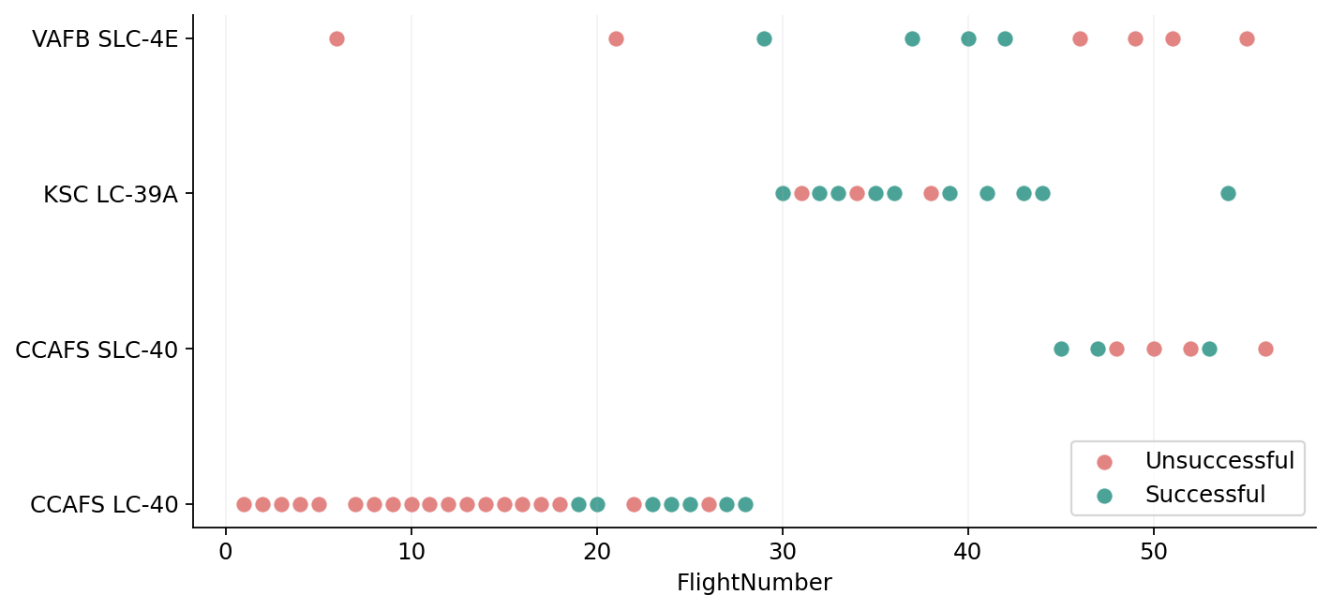
IBM APPLIED DATA SCIENCE CAPSTONE
Flight number vs. launch site
WHAT THE RESULT SHOWS
Recovery-positive launches concentrate more in later flight numbers, but early site-specific samples are limited.
HOW TO READ IT
Each dot = one flight; blue/green denotes Class 1 and red denotes Class 0.
Dataset: historical IBM 56-row dashboard sample • distinct from 90-row API lab
13

Slide 14
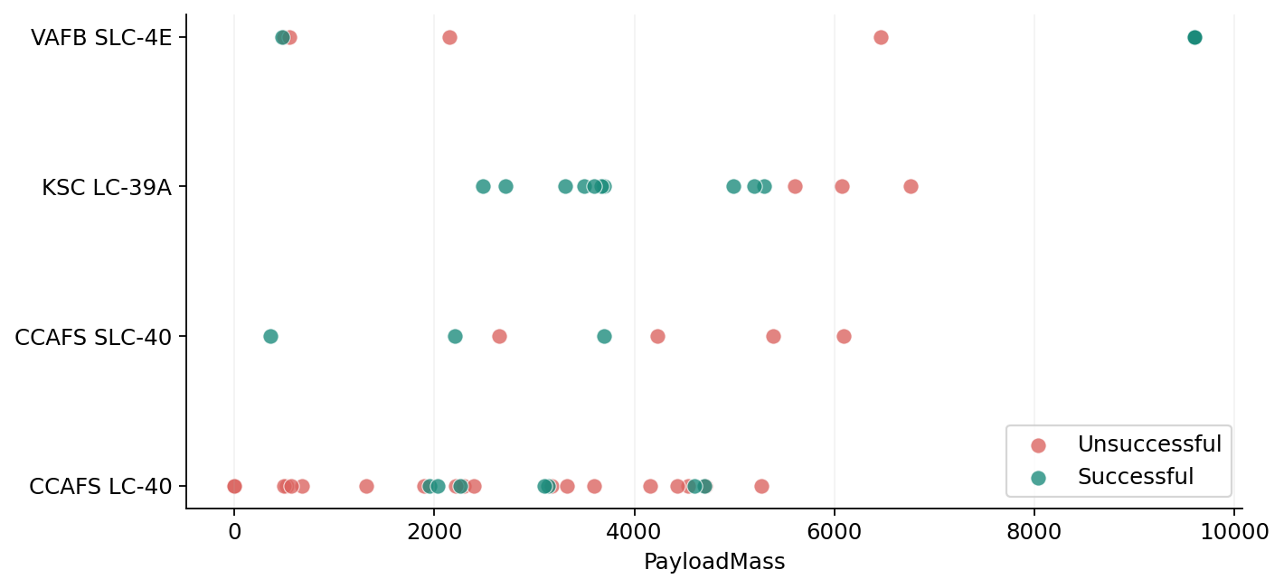
IBM APPLIED DATA SCIENCE CAPSTONE
Payload mass vs. launch site
WHAT THE RESULT SHOWS
Payload distributions overlap across sites; a site effect could reflect mission profile and booster generation.
HOW TO READ IT
Position = mass/site, color = outcome. Zero-valued payloads are retained as in the source.
Dataset: historical IBM 56-row dashboard sample • distinct from 90-row API lab
14

Slide 15
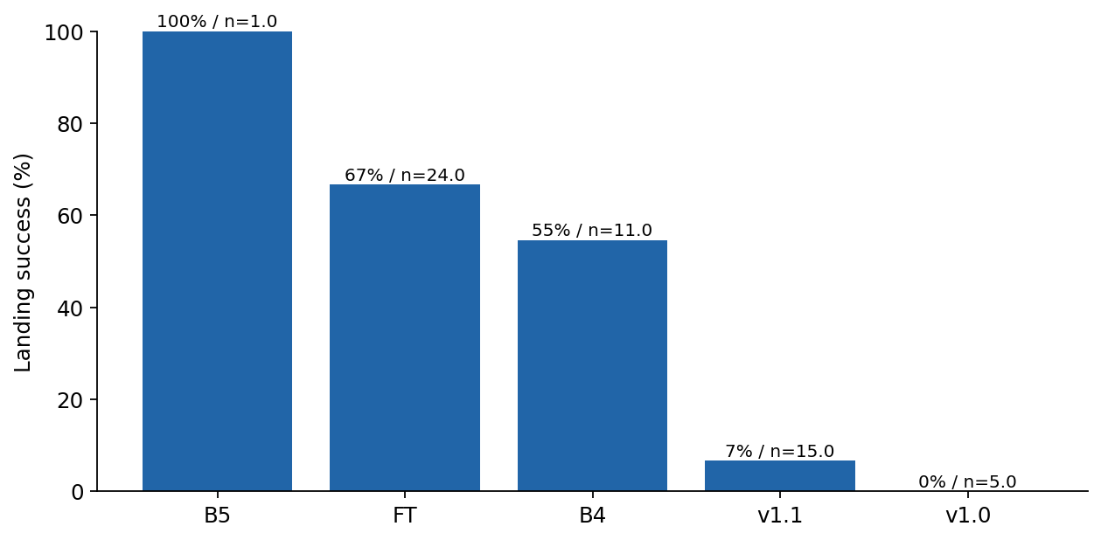
IBM APPLIED DATA SCIENCE CAPSTONE
Landing success by booster generation
WHAT THE RESULT SHOWS
Later booster categories have higher recovery proportions in this selected sample; small group sizes limit generalization.
HOW TO READ IT
Bars are class means, shown as percentages and annotated with group sample sizes.
Dataset: historical IBM 56-row dashboard sample • distinct from 90-row API lab
15

Slide 16
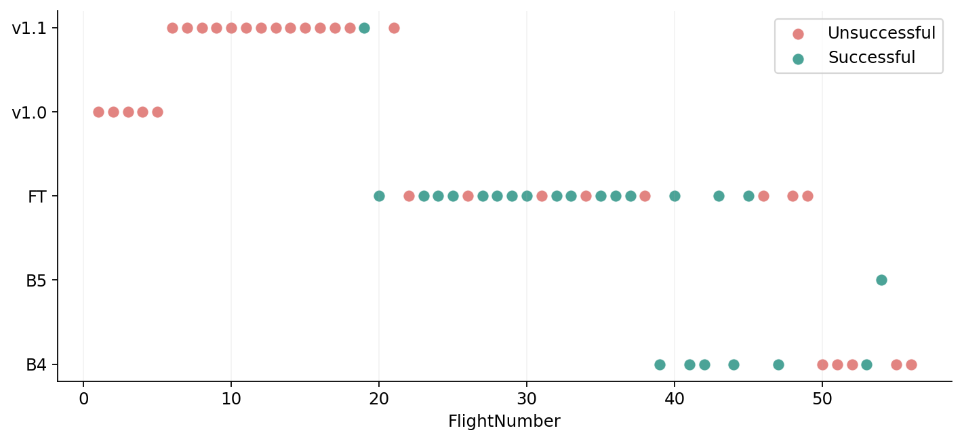
IBM APPLIED DATA SCIENCE CAPSTONE
Flight number vs. booster generation
WHAT THE RESULT SHOWS
Booster generation changes over flight history, making a simple maturity narrative potentially confounded.
HOW TO READ IT
Scatterplot of actual rows with one point per historical flight.
Dataset: historical IBM 56-row dashboard sample • distinct from 90-row API lab
16

Slide 17
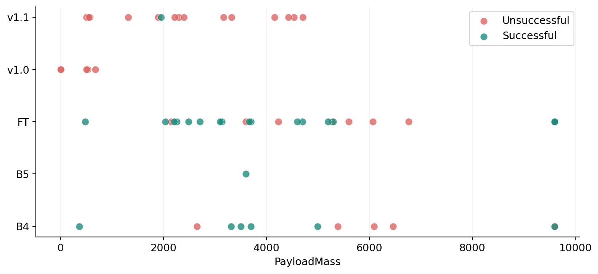
IBM APPLIED DATA SCIENCE CAPSTONE
Payload mass vs. booster generation
WHAT THE RESULT SHOWS
The range of payload masses differs across generations, so unadjusted recovery comparisons may be misleading.
HOW TO READ IT
This chart is categorical-by-continuous; class labels are the two point colors.
Dataset: historical IBM 56-row dashboard sample • distinct from 90-row API lab
17

Slide 18
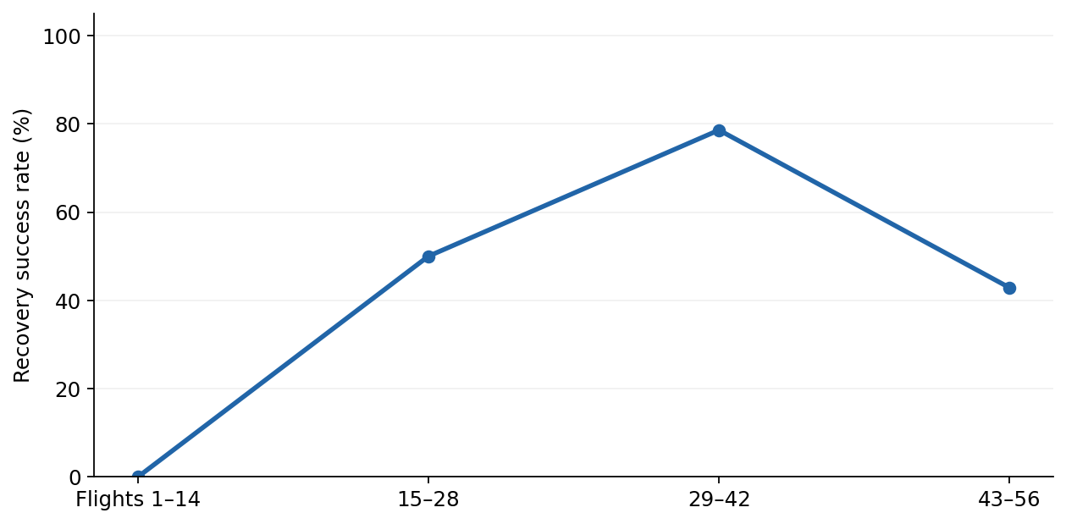
IBM APPLIED DATA SCIENCE CAPSTONE
Flight progression vs. landing success
WHAT THE RESULT SHOWS
Average historical recovery generally improves across successive flight-number groups in this extract.
HOW TO READ IT
Four flight-number groups are used. NOT a calendar-year trend: the 56-row file contains no dates.
Dataset: historical IBM 56-row dashboard sample • distinct from 90-row API lab
18

Slide 19
EDA WITH SQL • ACTUAL QUERY OUTPUT
SQL 01 | Launch sites and flight counts
SELECT LaunchSite, COUNT(*) AS launches FROM SPACEXTBL GROUP BY LaunchSite ORDER BY launches DESC
LaunchSite
launches
CCAFS LC-40
26
KSC LC-39A
13
VAFB SLC-4E
10
CCAFS SLC-40
7
INTERPRETATION
Two Cape Canaveral naming variants appear in the source and are kept separate to preserve provenance.
Dataset: historical IBM 56-row dashboard sample • distinct from 90-row API lab
19

Slide 20
EDA WITH SQL • ACTUAL QUERY OUTPUT
SQL 02 | Landing success by site
SELECT LaunchSite, COUNT(*) AS n, SUM(Class) AS successful, ROUND(100.0*AVG(Class),1) AS success_pct FROM SPACEXTBL GROUP BY LaunchSite ORDER BY success_pct DESC
LaunchSite
n
successful
success_pct
KSC LC-39A
13
10
76.9
CCAFS SLC-40
7
3
42.9
VAFB SLC-4E
10
4
40.0
CCAFS LC-40
26
7
26.9
INTERPRETATION
Success percentage is AVG(Class) × 100, not mission completion or orbital-insertion success.
Dataset: historical IBM 56-row dashboard sample • distinct from 90-row API lab
20

Slide 21
EDA WITH SQL • ACTUAL QUERY OUTPUT
SQL 03 | Payload by booster generation
SELECT BoosterCategory, COUNT(*) AS flights, ROUND(AVG(PayloadMass),0) AS avg_payload_kg, ROUND(MAX(PayloadMass),0) AS max_payload_kg FROM SPACEXTBL GROUP BY BoosterCategory ORDER BY flights DESC
BoosterCategory
flights
avg_payload_kg
max_payload_kg
FT
24
4502.0
9600.0
v1.1
15
2535.0
4707.0
B4
11
5058.0
9600.0
v1.0
5
340.0
677.0
B5
1
3600.0
3600.0
INTERPRETATION
Comparing mean mass by booster group provides context before interpreting landing differences.
Dataset: historical IBM 56-row dashboard sample • distinct from 90-row API lab
21

Slide 22
EDA WITH SQL • ACTUAL QUERY OUTPUT
SQL 04 | Successful vs unsuccessful
SELECT Class, COUNT(*) AS launches FROM SPACEXTBL GROUP BY Class ORDER BY Class DESC
Class
launches
1
24
0
32
INTERPRETATION
The dataset contains 24 Class=1 and 32 Class=0 records (42.9% favorable recovery).
Dataset: historical IBM 56-row dashboard sample • distinct from 90-row API lab
22

Slide 23
EDA WITH SQL • ACTUAL QUERY OUTPUT
SQL 05 | Heaviest payload missions
SELECT FlightNumber, LaunchSite, PayloadMass, Class FROM SPACEXTBL ORDER BY PayloadMass DESC LIMIT 5
FlightNumber
LaunchSite
PayloadMass
Class
29
VAFB SLC-4E
9600.0
1
37
VAFB SLC-4E
9600.0
1
42
VAFB SLC-4E
9600.0
1
46
VAFB SLC-4E
9600.0
0
51
VAFB SLC-4E
9600.0
0
INTERPRETATION
This ranking inspects unusually heavy payload records and whether their recovery label was favorable.
Dataset: historical IBM 56-row dashboard sample • distinct from 90-row API lab
23

Slide 24
EDA WITH SQL • ACTUAL QUERY OUTPUT
SQL 06 | Cape Canaveral example rows
SELECT FlightNumber, LaunchSite, Class FROM SPACEXTBL WHERE LaunchSite LIKE 'CCA%' ORDER BY FlightNumber LIMIT 5
FlightNumber
LaunchSite
Class
1
CCAFS LC-40
0
2
CCAFS LC-40
0
3
CCAFS LC-40
0
4
CCAFS LC-40
0
5
CCAFS LC-40
0
INTERPRETATION
A simple prefix filter demonstrates SQL string matching and sample inspection.
Dataset: historical IBM 56-row dashboard sample • distinct from 90-row API lab
24

Slide 25
EDA WITH SQL • ACTUAL QUERY OUTPUT
SQL 07 | Booster recovery-rate ranking
SELECT BoosterCategory, COUNT(*) AS flights, SUM(Class) AS successful, ROUND(100.0*AVG(Class),1) AS success_pct FROM SPACEXTBL GROUP BY BoosterCategory ORDER BY success_pct DESC
BoosterCategory
flights
successful
success_pct
B5
1
1
100.0
FT
24
16
66.7
B4
11
6
54.5
v1.1
15
1
6.7
v1.0
5
0
0.0
INTERPRETATION
A high rate with a small denominator should not be treated as evidence of robust superiority.
Dataset: historical IBM 56-row dashboard sample • distinct from 90-row API lab
25

Slide 26
EDA WITH SQL • ACTUAL QUERY OUTPUT
SQL 08 | Payload-band success
SELECT CASE WHEN PayloadMass < 2000 THEN '<2,000 kg' WHEN PayloadMass < 5000 THEN '2,000–4,999 kg' ELSE '5,000+ kg' END AS payload_band, COUNT(*) AS flights, ROUND(100.0*AVG(Class),1) AS success_pct FROM SPACEXTBL GROUP BY payload_band ORDER BY flights DESC
payload_band
flights
success_pct
"2
000–4
999 kg"
29
55.2
"5
000+ kg"
14
35.7
"<2
000 kg"
13
23.1
INTERPRETATION
The payload strata offer descriptive segmentation, not causal impact estimates.
Dataset: historical IBM 56-row dashboard sample • distinct from 90-row API lab
26

Slide 27
EDA WITH SQL • ACTUAL QUERY OUTPUT
SQL 09 | Maximum-payload flights
SELECT FlightNumber, LaunchSite, BoosterCategory, PayloadMass FROM SPACEXTBL WHERE PayloadMass=(SELECT MAX(PayloadMass) FROM SPACEXTBL)
FlightNumber
LaunchSite
BoosterCategory
PayloadMass
29
VAFB SLC-4E
FT
9600.0
37
VAFB SLC-4E
FT
9600.0
42
VAFB SLC-4E
B4
9600.0
46
VAFB SLC-4E
FT
9600.0
51
VAFB SLC-4E
B4
9600.0
INTERPRETATION
Multiple launches can tie for the maximum mass; the query returns all matching cases.
Dataset: historical IBM 56-row dashboard sample • distinct from 90-row API lab
27

Slide 28
EDA WITH SQL • ACTUAL QUERY OUTPUT
SQL 10 | Launch-site rank by successes
SELECT LaunchSite, COUNT(*) AS flights, SUM(Class) AS successes FROM SPACEXTBL GROUP BY LaunchSite ORDER BY successes DESC
LaunchSite
flights
successes
KSC LC-39A
13
10
CCAFS LC-40
26
7
VAFB SLC-4E
10
4
CCAFS SLC-40
7
3
INTERPRETATION
Number of recoveries reflects both underlying success rate and how frequently each site was used.
Dataset: historical IBM 56-row dashboard sample • distinct from 90-row API lab
28

Slide 29
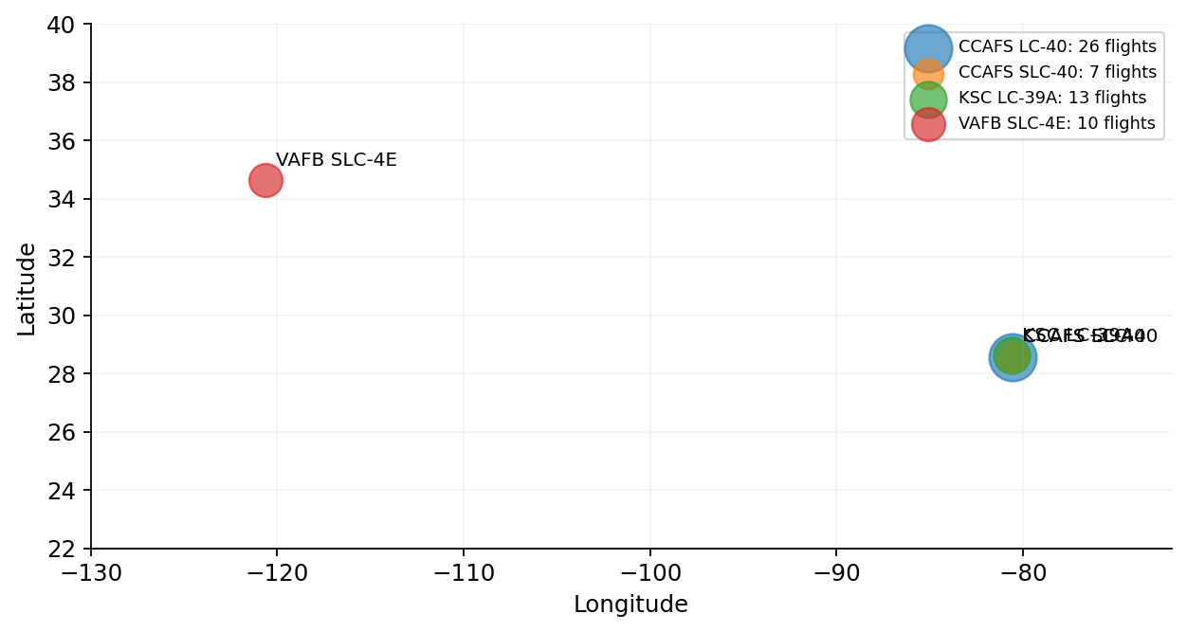
IBM APPLIED DATA SCIENCE CAPSTONE
Folium 01 | Geographic launch-site markers
WHAT THE RESULT SHOWS
Three distinct geographic positions are visible; two Cape Canaveral labels share one coordinate.
HOW TO READ IT
Marker area indicates sample count. Interactive Folium HTML is included in supporting assets.
Dataset: historical IBM 56-row dashboard sample • distinct from 90-row API lab
29

Slide 30
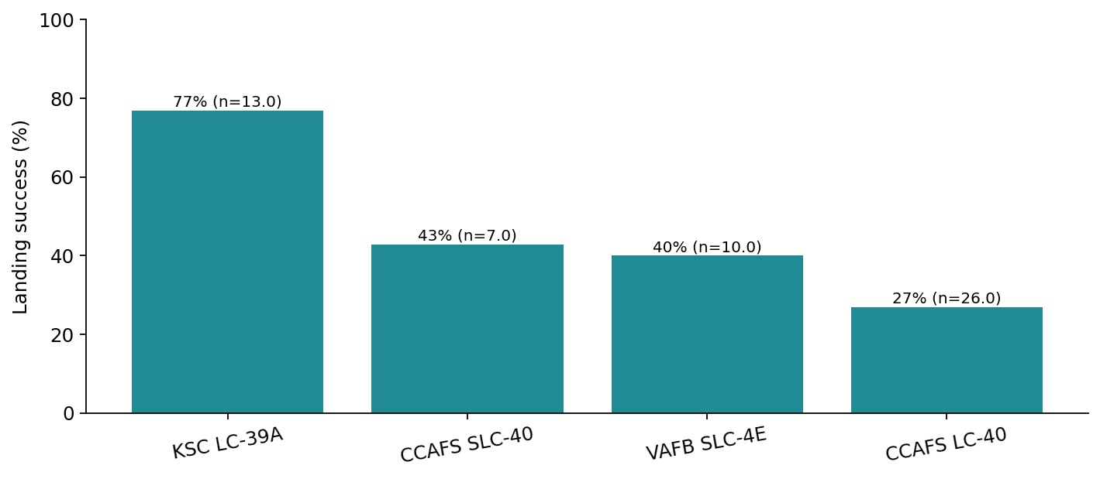
IBM APPLIED DATA SCIENCE CAPSTONE
Folium 02 | Outcome-coded launch locations
MAP INTERPRETATION
Site-specific percentages can be added as tooltip labels in Folium. Different denominators make direct visual comparisons uncertain.
OUTPUT EVIDENCE
The companion folium_site_map.html holds actual clickable site markers with success totals. This slide combines a quantitative companion plot rather than pretending a screenshot.
Dataset: historical IBM 56-row dashboard sample • distinct from 90-row API lab
30

Slide 31
IBM APPLIED DATA SCIENCE CAPSTONE
Folium 03 | Proximity and infrastructure limits
COASTAL LOCATION
Florida and California pads are placed near coastlines. The supplied data contain coordinates only.
DISTANCE REQUIREMENTS
Distances to railways, highways, or coastlines cannot be verified without geometry or map layers; no invented kilometer measurements are shown.
Dataset: historical IBM 56-row dashboard sample • distinct from 90-row API lab
31

Slide 32
IBM APPLIED DATA SCIENCE CAPSTONE
Dashboard 01 | Overall outcome proportions
WHAT THE RESULT SHOWS
Historical recoveries are not evenly distributed across booster categories.
HOW TO READ IT
The implemented dashboard should allow users to choose all sites or an individual pad.
Dataset: historical IBM 56-row dashboard sample • distinct from 90-row API lab
32

Slide 33
IBM APPLIED DATA SCIENCE CAPSTONE
Dashboard 02 | Compare launch sites
WHAT THE RESULT SHOWS
A site-dropdown view isolates the landing rates and denominator at each site.
HOW TO READ IT
Use the exact selected subset when comparing outcomes; do not infer a site causal effect.
Dataset: historical IBM 56-row dashboard sample • distinct from 90-row API lab
33

Slide 34
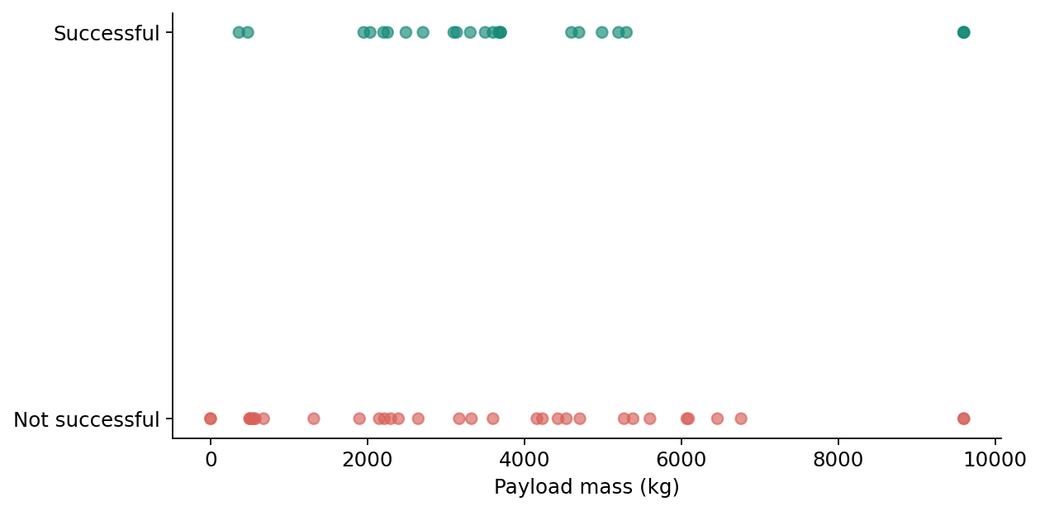
IBM APPLIED DATA SCIENCE CAPSTONE
Dashboard 03 | Payload range and outcome
WHAT THE RESULT SHOWS
A payload range slider can isolate different regions of the observed recovery labels.
HOW TO READ IT
This static dashboard evidence comes from generated data plots, not an executed browser screenshot.
Dataset: historical IBM 56-row dashboard sample • distinct from 90-row API lab
34

Slide 35
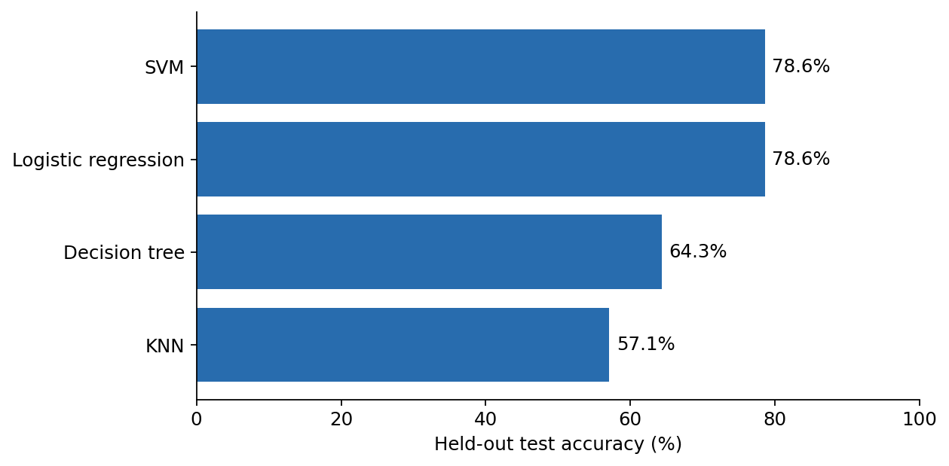
IBM APPLIED DATA SCIENCE CAPSTONE
Machine learning | Four-model comparison
WHAT THE RESULT SHOWS
SVM has the highest cross-validation accuracy (78.6%); logistic regression ties its held-out score.
HOW TO READ IT
42 training rows; 14 test rows; 3-fold CV. These are actual locally computed sample results.
Dataset: historical IBM 56-row dashboard sample • distinct from 90-row API lab
35

Slide 36
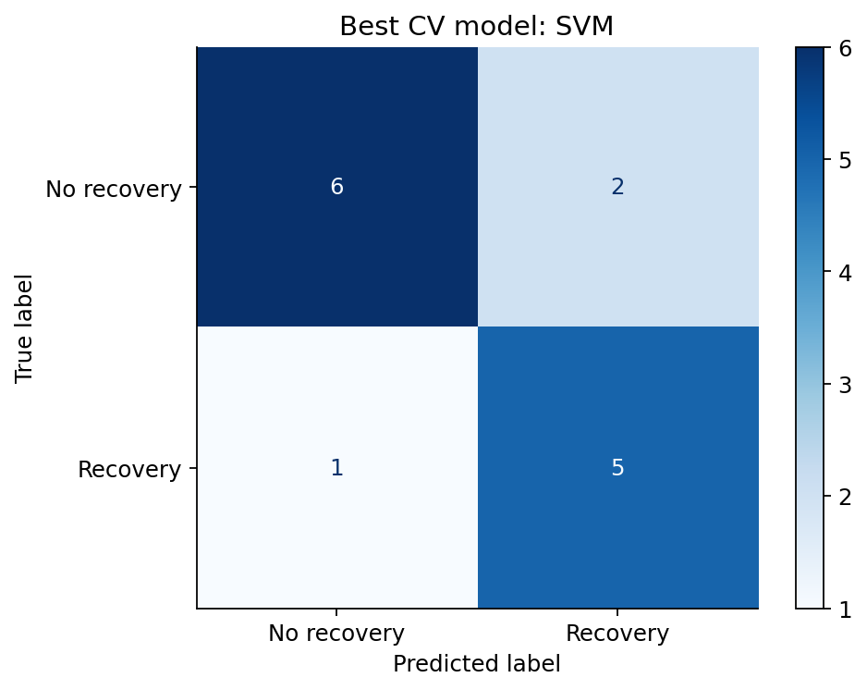
IBM APPLIED DATA SCIENCE CAPSTONE
Best model | Confusion matrix
WHAT THE RESULT SHOWS
The confusion matrix shows which Class labels the tuned SVM misclassified. False positive and false negative implications differ.
HOW TO READ IT
Use this to supplement accuracy, which can be misleading in a small dataset.
Dataset: historical IBM 56-row dashboard sample • distinct from 90-row API lab
36

Slide 37
IBM APPLIED DATA SCIENCE CAPSTONE
Predictive performance | Validation vs test
Model
CV accuracy
Test accuracy
SVM
78.6%
78.6%
Logistic regression
73.8%
78.6%
Decision tree
73.8%
64.3%
KNN
73.8%
57.1%
MODEL CHOICE
Select SVM based on highest validation accuracy, not its test score. Its holdout result is 11 correct predictions in 14 cases (78.6%).
REPLICATION
Re-run with the official 90-row IBM dataset and its exact notebook pipeline before comparing to your course quiz results.
Dataset: historical IBM 56-row dashboard sample • distinct from 90-row API lab
37

Slide 38
IBM APPLIED DATA SCIENCE CAPSTONE
Conclusion | Insights and business implications
01 RECOVERY IS NOT RANDOM
The observed recovery rate is 24/56 = 42.9%, but this historical snapshot is not representative of current Falcon 9 operations.
02 BOoster MATURITY MATTERS
Flight-number and booster-category patterns support investigating learning and hardware maturity, while leaving substantial confounding.
03 CLASSIFIERS CAN BE INFORMATIVE
The tuned SVM achieved 78.6% cross-validation and held-out accuracy on this small sample. The test score has large uncertainty.
04 NEXT DECISION
Validate a later, larger dataset with date-based holdouts and more mission covariates before any procurement, cost, or risk decisions.
Dataset: historical IBM 56-row dashboard sample • distinct from 90-row API lab
38

Slide 39
IBM APPLIED DATA SCIENCE CAPSTONE
Appendix | Sources, deliverables and integrity
PUBLIC DATA SOURCE
github.com/Ahmed-Nezar/IBM-Data-Science-Capstone-SpaceX/blob/main/spacex_launch_dash.csv • Historical 56-row training visualization sample (transcribed for local reproducibility).
GENERATED OUTPUTS
CSV, SQL database and query tables, eleven generated plots, four fitted models with parameters, model accuracies, a confusion matrix, and an interactive Folium HTML.
REMAINING PERSONAL-SUBMISSION REQUIREMENTS
No personal GitHub account or completed original IBM API, scraper, SQL, Folium, or Dash notebooks were provided. Upload your own repository and completed notebooks to meet rubric item 1.1 and its source-link criteria.
Dataset: historical IBM 56-row dashboard sample • distinct from 90-row API lab
39

Slide 40
IBM APPLIED DATA SCIENCE CAPSTONE
Submission evidence | Executed vs outstanding
EXECUTED IN THIS PACKAGE
A complete local notebook with saved output cells; ten SQLite query tables; generated EDA charts; fitted classifier comparison; confusion matrix and interactive Folium HTML.
STARTER LABS RECEIVED
SpaceX API, Wikipedia scraping, wrangling, visualization, Folium, and machine-learning notebooks were supplied with blank output cells. The Dash lab was supplied as instructions.
STILL NEEDED FOR FULL IBM RUBRIC
The source-specific 90-row API/orbit/year results; verified Dash browser screenshots; precise geographic infrastructure proximity; completed original lab notebooks; and a GitHub link owned by the learner.
Dataset: historical IBM 56-row dashboard sample • distinct from 90-row API lab
40

Slide 41
ADDITIONAL VERIFIED RESULTS / RUBRIC CORRECTIONS
Folium evidence | Real launch-site location data
WHAT THE MAP SUPPORTS
Actual plotted launch-pad coordinates place sites in Florida and California; CircleMarker size represents flight count. The companion interactive Folium HTML includes clickable site-level data.
REPRODUCIBILITY
folium_site_map.html is provided. This geographic graphic is generated from the site coordinates, rather than a captured Folium browser view.
Source: bundled launch-site coordinates and 56-record course dashboard extract.
Historical IBM dashboard extract: 56 launches • Source identified; distinct from official API lab

Slide 42
ADDITIONAL VERIFIED RESULTS / RUBRIC CORRECTIONS
Geography | Outcome counts at each launch pad
OBSERVED OUTCOMES
KSC LC-39A: 10/13 (76.9%)
CCAFS LC-40: 7/26 (26.9%)
VAFB SLC-4E: 4/10 (40.0%)
CCAFS SLC-40: 3/7 (42.9%)
INTERPRETATION
Larger success counts may reflect a higher number of missions rather than a safer launch site. No causal site ranking is claimed.
Historical IBM dashboard extract: 56 launches • Source identified; distinct from official API lab

Slide 43
ADDITIONAL VERIFIED RESULTS / RUBRIC CORRECTIONS
Geospatial proximity | What is and is not measured
PROXIMITY CRITERION
The three launch coordinates can be mapped reliably. This historical CSV does NOT contain road, rail or coastline geometries, so kilometer distances to these features cannot be substantiated.
RESEARCH LIMITATION
To complete the infrastructure proximity criterion rigorously, geocode verified landmarks, calculate geodesic distances, then cite the map source. No invented distances are used.
Historical IBM dashboard extract: 56 launches • Source identified; distinct from official API lab

Slide 44
ADDITIONAL VERIFIED RESULTS / RUBRIC CORRECTIONS
Plotly Dash | All-sites recovery outcomes
DASHBOARD FUNCTION
The companion dashboard_app.py implements a dropdown with an All Sites choice and individual pads, plus a payload range filter. The image on the left is an actual generated analysis export.
KEY METRIC
The full sample records 24 successful vs 32 other recoveries: 42.9% Class=1. This is booster recovery, not mission success.
Executable app bundled; this slide is not misrepresented as an actual browser screenshot.
Historical IBM dashboard extract: 56 launches • Source identified; distinct from official API lab

Slide 45
ADDITIONAL VERIFIED RESULTS / RUBRIC CORRECTIONS
Plotly Dash | Site-filtered comparison
SITE DROPDOWN
Selecting a site changes the Dash figure to include only the chosen launch-pad records. The site-success chart documents the underlying aggregates and denominators.
DECISION-USEFUL READING
Use both the percentage and number of flights. A high recovery rate on very few launches is less informative than a stable rate across a larger sample.
Historical IBM dashboard extract: 56 launches • Source identified; distinct from official API lab

Slide 46
ADDITIONAL VERIFIED RESULTS / RUBRIC CORRECTIONS
Plotly Dash | Payload filter and outcome
FILTER AND SCATTER
The Dash RangeSlider can restrict the observed payload interval. A scatter plot plots payload against flight number with color indicating recovery outcome.
INTERPRETATION
Apparent payload patterns can be entangled with flight order, hardware generation, and site. Filtering supports investigation, not proof of causation.
Historical IBM dashboard extract: 56 launches • Source identified; distinct from official API lab

Slide 47
ADDITIONAL VERIFIED RESULTS / RUBRIC CORRECTIONS
Predictive results | Why model selection matters
VALIDATION
SVM: 78.6% cross-validation; 78.6% holdout. Logistic regression: 73.8% CV, 78.6% holdout. Decision tree and KNN generalize less well on this split.
BEST MODEL RULE
SVM is selected by cross-validation, not post hoc by the holdout set. Test set includes only 14 records; small changes in counts materially affect the percentage.
Historical IBM dashboard extract: 56 launches • Source identified; distinct from official API lab

Slide 48
ADDITIONAL VERIFIED RESULTS / RUBRIC CORRECTIONS
Predictive results | Confusion matrix and errors
INTERPRETATION
Rows give observed recovery outcome; columns give prediction. Off-diagonal cases are errors. Accuracy alone obscures the class-specific consequences of mistakes.
LIMITATIONS
The model uses 42 training and 14 test records. A larger, newer dataset and time-based validation would be needed before deployment decisions.
Historical IBM dashboard extract: 56 launches • Source identified; distinct from official API lab

Slide 49
ADDITIONAL VERIFIED RESULTS / RUBRIC CORRECTIONS
Conclusions | Four evidence-linked takeaways
01 | Baseline
24 of 56 launches (42.9%) in this historical sample are labeled as successful first-stage recoveries. This number must not be generalized to present-day SpaceX operations.
02 | Explanatory patterns
Booster generation and flight progression vary with recovery outcome. Associations can reflect technological maturity, launch conditions, and mission composition.
03 | Model accuracy
SVM was strongest on cross-validation (78.6%) and correctly classified 11 of 14 held-out records. The small test set makes performance uncertain.
04 | Next decision
Use fresh and consistently labeled launch records, richer weather/trajectory features and chronological validation before comparing launch-provider reliability.
Historical IBM dashboard extract: 56 launches • Source identified; distinct from official API lab

Slide 50
ADDITIONAL VERIFIED RESULTS / RUBRIC CORRECTIONS
Reproducibility | Source links and evidence
Public course dataset
https://github.com/Ahmed-Nezar/IBM-Data-Science-Capstone-SpaceX/blob/main/spacex_launch_dash.csv
Interactive map
folium_site_map.html (included in the evidence package)
Dashboard code
dashboard_app.py (included in the evidence package)
SQL + classifier results
SpaceX_executed_analysis.ipynb, sql_results.txt, model_evaluation.csv
Personal GitHub URL
Not available: your repository must be published from your own account
Historical IBM dashboard extract: 56 launches • Source identified; distinct from official API lab

Slide 51
ADDITIONAL VERIFIED RESULTS / RUBRIC CORRECTIONS
Rubric audit | Outstanding before full credit
Done in report
PDF format; introduction; substantive executive summary; collection / cleaning / EDA methods; SQL results; model comparison and confusion matrix.
Included, but limited
Folium coordinate map, site success outcomes and source-backed proximity discussion; static outputs from a runnable Dash app.
Not verified complete
Actual browser-captured Folium and Dash screenshots; official IBM 90-launch notebook outputs; infrastructure distance calculations.
Must be supplied by learner
Personal public GitHub repository with completed original lab notebooks and Python files; a repository URL in the slides.
Historical IBM dashboard extract: 56 launches • Source identified; distinct from official API lab

