Slide 1
Web scraping with Python, Selenium and XPath
Mitch Parry

Slide 2
HTML
<!DOCTYPE html> <html>
<body> <table><tbody>
<tr>
<th>Title</th>
<th>Author</th>
<th>Year</th>
<th>Price</th>
</tr>
<tr>
<td>Gone Girl</td>
<td>Gillian Flynn</td>
<td>2012</td>
<td>14.09</td>
</tr>
</tbody></table>
</body>
</html>

Slide 3
<body>
<table>
<tbody>
<tr>
<tr>
<th>
<th>
<th>
<th>
<td>
<td>
<td>
<td>
text:
“Title”
“Author”
“Year”
“Price”
“Gone Girl”
“Gillian Flynn”
“2012”
“14.09”
Nested tags create a hierarchy
Arrows point from ‘parent’ to ‘children’
Children with same parent are ‘siblings’
Ancestors are parent, parent’s parent, etc.
Descendants are children, children’s children, etc.

Slide 4
Text
<body>
“Title Author Year Price Gone Girl Gillian Flynn 2012 14.09”
<table>
“Gone Girl Gillian Flynn 2012 14.09”
<tbody>
“Title Author Year Price”
<tr>
<tr>
<th>
<th>
<th>
<th>
<td>
<td>
<td>
<td>
text:
“Title”
“Author”
“Year”
“Price”
“Gone Girl”
“Gillian Flynn”
“2012”
“14.09”
Each node has a text field
text(): whatever text is within that node

Slide 5
Position
<body>
<table>
1
<tbody>
1
2
<tr>
<tr>
<th>
<th>
<th>
<th>
<td>
<td>
<td>
<td>
position:
1
2
3
4
1
2
3
4
Each node has a position field
position: relative position within siblings

Slide 6
XPath
XPath is query language used to navigate documents with tagged, possibly nested content like XML and HTML.
To specify an xpath starting at the root and descending to a particular node: ‘/html/body/h1’

Slide 7
XPath
/html/body
/ = start at the outermost part of the document
html = look for all nodes named ‘html’
/ = start at the node(s) we just found
body = look for all nodes named ‘body’

Slide 8
HTML
<!DOCTYPE html> <html>
<body>
<h1>Scrappy’s Bookstore</h1>
<div id='address'>1000 Chisel Lane</div> <table><tbody>
<tr>
<th>Title</th>
<th>Author</th>
<th>Year</th>
<th>Price</th>
</tr>
<tr>
<td>Gone Girl</td>
<td>Gillian Flynn</td>
<td>2012</td>
<td>14.09</td>
</tr>
</tbody></table>
</body>
</html>
XPath: /html

Slide 9
HTML
<!DOCTYPE html> <html>
<body>
<h1>Scrappy’s Bookstore</h1>
<div id='address'>1000 Chisel Lane</div> <table><tbody>
<tr>
<th>Title</th>
<th>Author</th>
<th>Year</th>
<th>Price</th>
</tr>
<tr>
<td>Gone Girl</td>
<td>Gillian Flynn</td>
<td>2012</td>
<td>14.09</td>
</tr>
</tbody></table>
</body>
</html>
XPath: /html/body

Slide 10
HTML
<!DOCTYPE html> <html>
<body>
<h1>Scrappy’s Bookstore</h1>
<div id='address'>1000 Chisel Lane</div> <table><tbody>
<tr>
<th>Title</th>
<th>Author</th>
<th>Year</th>
<th>Price</th>
</tr>
<tr>
<td>Gone Girl</td>
<td>Gillian Flynn</td>
<td>2012</td>
<td>14.09</td>
</tr>
</tbody></table>
</body>
</html>
XPath: /html/body/h1

Slide 11
XPath
//h1
// = start anywhere in the document
h1 = find the nodes named ‘h1’

Slide 12
HTML
<!DOCTYPE html> <html>
<body>
<h1>Scrappy’s Bookstore</h1>
<div id='address'>1000 Chisel Lane</div> <table><tbody>
<tr>
<th>Title</th>
<th>Author</th>
<th>Year</th>
<th>Price</th>
</tr>
<tr>
<td>Gone Girl</td>
<td>Gillian Flynn</td>
<td>2012</td>
<td>14.09</td>
</tr>
</tbody></table>
</body>
</html>
XPath: //h1

Slide 13
HTML
<!DOCTYPE html> <html>
<body>
<h1>Scrappy’s Bookstore</h1>
<div id='address'>1000 Chisel Lane</div> <table><tbody>
<tr>
<th>Title</th>
<th>Author</th>
<th>Year</th>
<th>Price</th>
</tr>
<tr>
<td>Gone Girl</td>
<td>Gillian Flynn</td>
<td>2012</td>
<td>14.09</td>
</tr>
</tbody></table>
</body>
</html>
XPath: //tr

Slide 14
HTML
<!DOCTYPE html> <html>
<body>
<h1>Scrappy’s Bookstore</h1>
<div id='address'>1000 Chisel Lane</div> <table><tbody>
<tr>
<th>Title</th>
<th>Author</th>
<th>Year</th>
<th>Price</th>
</tr>
<tr>
<td>Gone Girl</td>
<td>Gillian Flynn</td>
<td>2012</td>
<td>14.09</td>
</tr>
</tbody></table>
</body>
</html>
XPath: //td

Slide 15
XPath Predicates: @ttributes
//div[@id=‘phone’]
// = start anywhere in the document
div = find the node(s) named ‘div’
[…] = select the ‘div’ nodes that have… @id=‘phone’ an attribute named ‘id’ with the value ‘phone’

Slide 16
<!DOCTYPE html> <html>
<body>
<h1>Scrappy’s Bookstore</h1>
<div id='address'>1000 Chisel Lane</div> <div id='phone'>828-555-5555</div> <table><tbody>
<tr>
<td>Gone Girl</td>
<td>Gillian Flynn</td>
<td>2012</td>
<td>14.09</td>
</tr>
<tr>
<td>The Signal and the Noise</td>
<td>Nate Silver</td>
<td>2012</td>
<td>16.00</td>
</tr> </tbody></table>
</body>
</html>
XPath: //div[@id=‘phone’]

Slide 17
XPath Predicates: position
//table//td[position()=2]
// = start anywhere in the document
table = find the node(s) named ‘table’
//td = find descendants named ‘td’
[…] = select the ‘td’ nodes that have… position()=2 the second position among other ‘td’ siblings

Slide 18
<!DOCTYPE html> <html>
<body>
<h1>Scrappy’s Bookstore</h1>
<div id='address'>1000 Chisel Lane</div> <div id='phone'>828-555-5555</div> <table><tbody>
<tr>
<td>Gone Girl</td>
<td>Gillian Flynn</td>
<td>2012</td>
<td>14.09</td>
</tr>
<tr>
<td>The Signal and the Noise</td>
<td>Nate Silver</td>
<td>2012</td>
<td>16.00</td>
</tr> </tbody></table>
</body>
</html>
XPath: //table//td[position()=2]

Slide 19
XPath: Expanded Syntax
<axis>::<node_test>[<predicate>]
axis = where to look
child, parent, ancestor, descendant, following/preceding sibling(s), …
node_test = what type(s) of nodes to look for
Any node name (table, tr, td, div, etc.)
predicate = which specific node(s) to select
[@id=?]
[position()=?]
[text() = ?]
[contains(text(), ?)]

Slide 20
Python
It’s installed on cs and student server
https://www.python.org
Currently two parallel releases:
Version 2.7.9
Version 3.4.3
If you want to use it for number crunching or a replacement for MATLAB, I would suggest using Scientific Python.
I have Anaconda Python installed on student: /u/classes/3535/modules/anaconda/bin

Slide 21
Selenium
Browser automation framework: https://code.google.com/p/selenium/
Emulates Chrome, Firefox, or Internet Explorer
Supports Java, Ruby, Python, C# and Javascript
I installed the Python modules from here: https://pypi.python.org/pypi/selenium
Available through Anaconda python on student server.

Slide 22
Python Command Line
$ python
-- Linux command prompt

Slide 23
Python Command Line
$ python
Python 2.7.8 |Anaconda 2.1.0 (64-bit)| (default, Aug 21 2014, 18:22:21)
[GCC 4.4.7 20120313 (Red Hat 4.4.7-1)] on linux2
Type "help", "copyright", "credits" or "license" for more information.
Anaconda is brought to you by Continuum Analytics.
Please check out: http://continuum.io/thanks and https://binstar.org
>>>

Slide 24
Python Command Line
$ python
Python 2.7.8 |Anaconda 2.1.0 (64-bit)| (default, Aug 21 2014, 18:22:21)
[GCC 4.4.7 20120313 (Red Hat 4.4.7-1)] on linux2
Type "help", "copyright", "credits" or "license" for more information.
Anaconda is brought to you by Continuum Analytics.
Please check out: http://continuum.io/thanks and https://binstar.org
>>>
-- Python command line

Slide 25
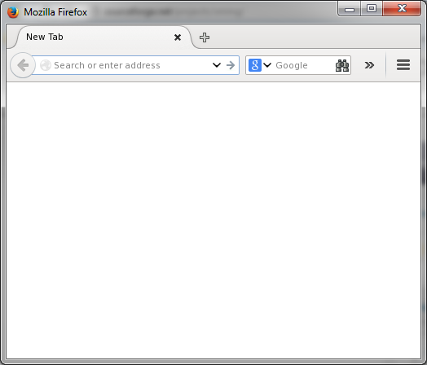
Selenium: Starting a Web Browser
>>> from selenium import webdriver
>>> driver = webdriver.Firefox() You might need: http://sourceforge.net/projects/xming/

Slide 26
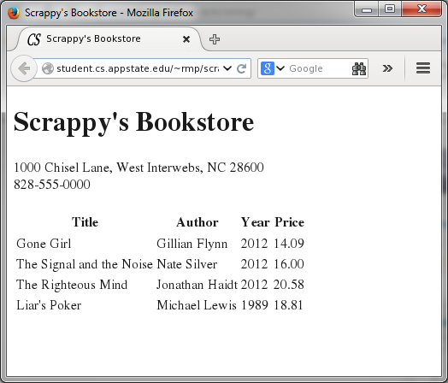
Selenium: Open a Webpage
>>> start_url = “http://student.cs.appstate.edu/~rmp/scrape/bookstore.html"
>>> driver.get(start_url)

Slide 27
Selenium: Using XPath
>>> xpath = "//div[@id='phone']"
xpath is a variable to contain the XPath query
find all ‘div’ nodes that have the ‘id’ of ‘phone’

Slide 28
Selenium: Using XPath
>>> xpath = "//div[@id='phone']"
>>> phone_node = driver.find_element_by_xpath(xpath)
find_element_by_xpath is a function that runs the XPath query and returns the first node that matches.

Slide 29
Selenium: Using XPath
>>> xpath = "//div[@id='phone']"
>>> phone_node = driver.find_element_by_xpath(xpath)
phone_node is a WebElement object that contains the resulting node.

Slide 30
Selenium: Using XPath
>>> xpath = "//div[@id='phone']"
>>> phone_node = driver.find_element_by_xpath(xpath) >>> phone_text = phone_node.text
phone_node is a WebElement object that contains the resulting node.
WebElements have a text field with all text contained within that node of the HTML.

Slide 31
Selenium: Using XPath
>>> xpath = "//div[@id='phone']"
>>> phone_node = driver.find_element_by_xpath(xpath) >>> phone_text = phone_node.text
>>> print “The phone number is”, phone_text
The phone number is 828-555-0000
>>>
print! To screen

Slide 32
Selenium: Using XPath
>>> xpath = "//table//td[position()=2]"
Find all ‘td’ nodes within all ‘table’ nodes and select those that are the second siblings

Slide 33
Selenium: Using XPath
>>> xpath = "//table//td[position()=2]"
>>> author_nodes = driver.find_elements_by_xpath(xpath)
find_elements_by_xpath finds all elements that satisfy the XPath.

Slide 34
Selenium: Using XPath
>>> for author_node in author_nodes:
... print author_node.text
...
Gillian Flynn
Nate Silver
Jonathan Haidt
Michael Lewis
This is a for-each loop that cycles through the list of WebElements that represent the author nodes and prints them.
Notice the colon instead of curly-brace and four-space indentation without closing punctuation.
The ellipsis (…) indicates that Python expects the statement to continue on the next line.

Slide 35
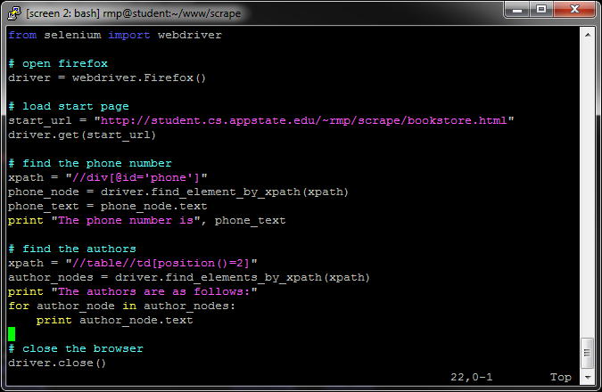
scrape_book.py

Slide 36
Example: NC Public Health Inspections

Slide 37
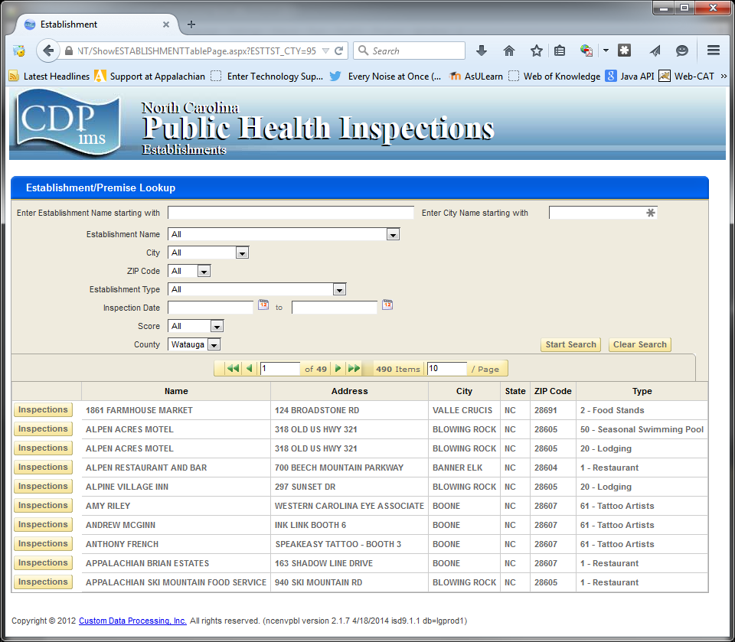

Slide 38
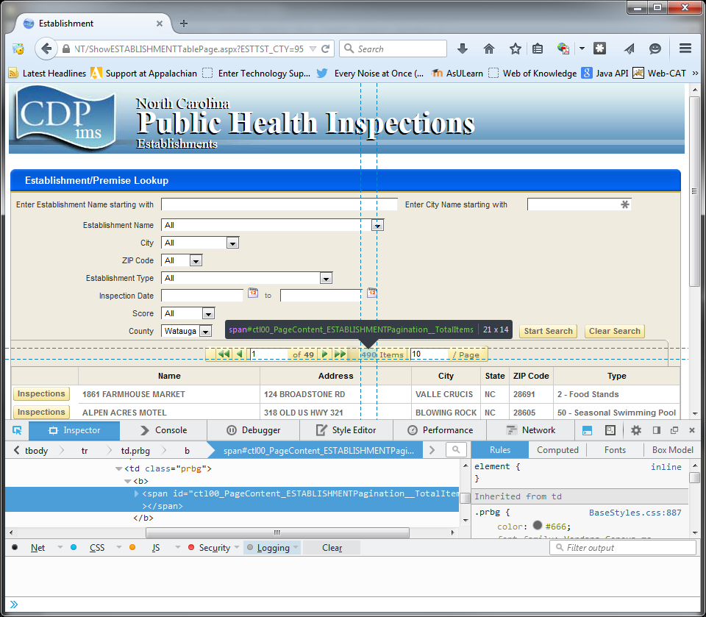
Get the total number of establishments

Slide 39
Get the total number of establishments
>>> xpath = "//span[@id='ctl00_PageContent_ESTABLISHMENTPagination__TotalItems']"
Query the ‘span’ node that has the correct ‘id’

Slide 40
Get the total number of establishments
>>> xpath = "//span[@id='ctl00_PageContent_ESTABLISHMENTPagination__TotalItems']" >>> num_establishments = int(driver.find_element_by_xpath(xpath).text)
Get the ‘text’ from the ‘span’ node that has the correct ‘id’ and transform it into an integer (int)

Slide 41
Get the total number of establishments
>>> xpath = "//span[@id='ctl00_PageContent_ESTABLISHMENTPagination__TotalItems']" >>> num_establishments = int(driver.find_element_by_xpath(xpath).text)
>>> print "There are", num_establishments,"establishments."
There are 490 establishments. Print the result.

Slide 42
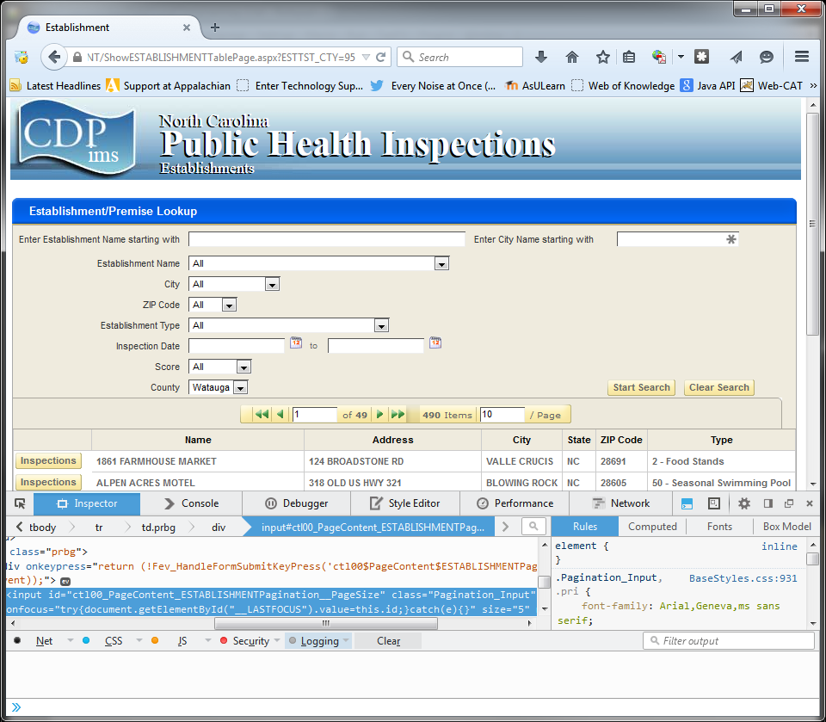
Set the number of items per page

Slide 43
Set the number of items per page
xpath = "//input[@id='ctl00_PageContent_ESTABLISHMENTPagination__PageSize']"
input = driver.find_element_by_xpath(xpath)
input.clear()
input.send_keys(num_establishments)
input.send_keys(Keys.RETURN)
Clear the contents of the text input
Send the key strokes necessary to enter the number of establishments into the box
Send the return key to update the page.

Slide 44
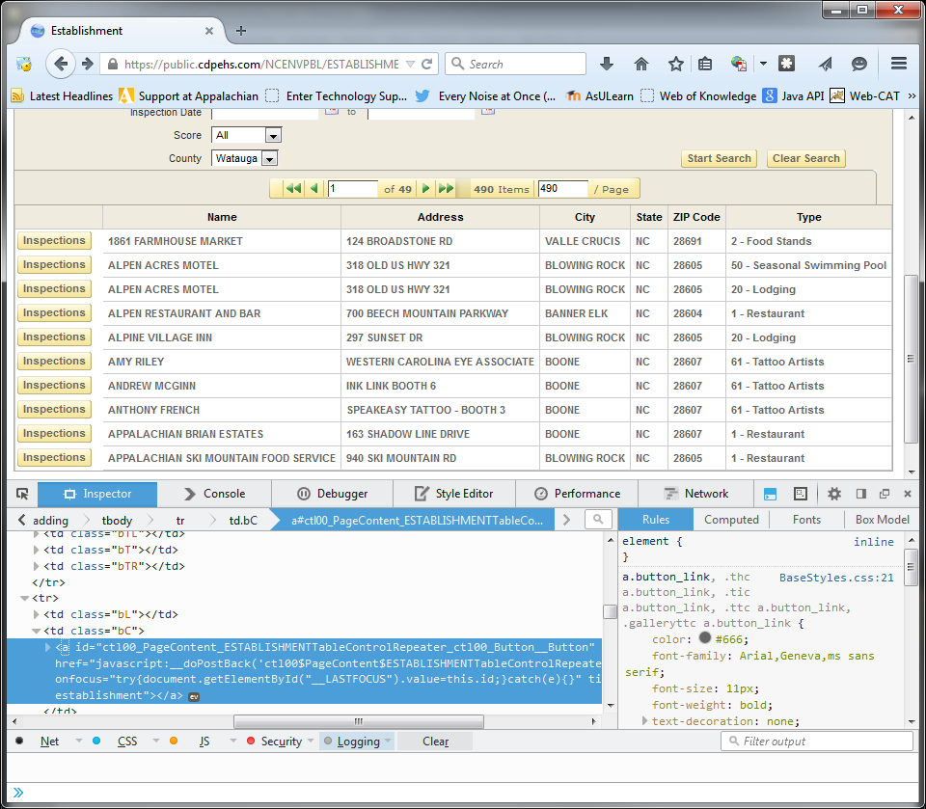
Click the first ‘Inspections’ link

Slide 45
Click the first ‘Inspections’ link
xpath = "
"
input = driver.find_element_by_xpath(xpath) input.click()

Slide 46
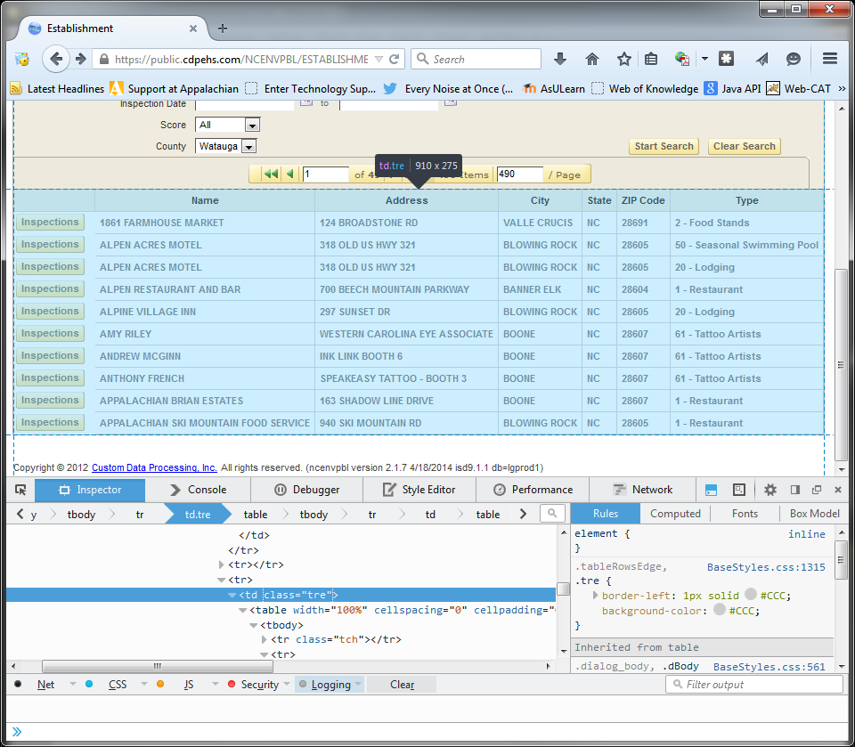
Click the first ‘Inspections’ link

Slide 47
Click the first ‘Inspections’ link
xpath = " //td[@class='tre']
"
input = driver.find_element_by_xpath(xpath) input.click()
There’s only one ‘td’ with @class ‘tre’

Slide 48
Click the first ‘Inspections’ link

Slide 49
Click the first ‘Inspections’ link
xpath = " //td[@class='tre']/table/tbody
"
input = driver.find_element_by_xpath(xpath) input.click()
There’s only one ‘td’ with @class ‘tre’
With a child table and grandchild tbody

Slide 50
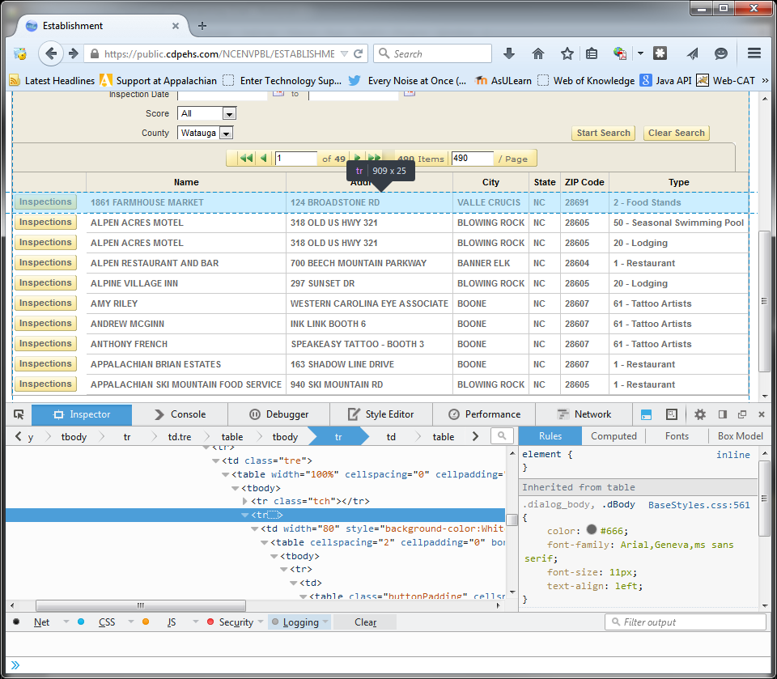

Slide 51
Click the first ‘Inspections’ link
xpath = " //td[@class='tre']/table/tbody /tr[position()=2]
"
input = driver.find_element_by_xpath(xpath) input.click()
There’s only one ‘td’ with @class ‘tre’
With a child table and grandchild tbody
Select the second ‘tr’(after the headings)

Slide 52
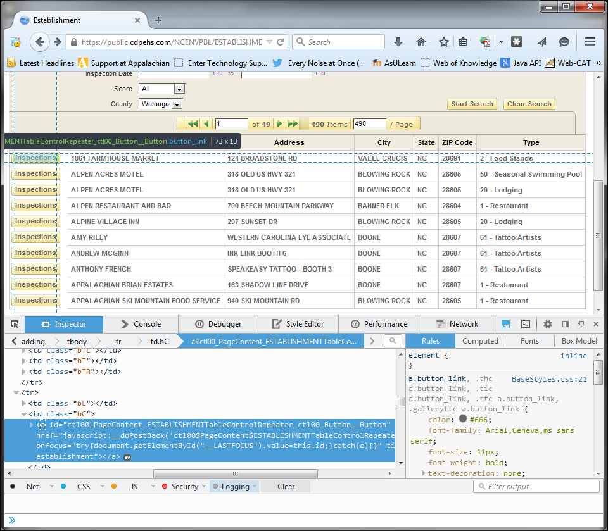

Slide 53
Click the first ‘Inspections’ link
xpath = " //td[@class='tre']/table/tbody /tr[position()=2]//a[text()=‘Inspections’]
"
input = driver.find_element_by_xpath(xpath) input.click()
There’s only one ‘td’ with @class ‘tre’
With a child table and grandchild tbody
Select the second ‘tr’(after the headings)
Get any link ‘a’ with ‘Inspections’ text

Slide 54
Click the first ‘Inspections’ link
xpath = " //td[@class='tre']/table/tbody /tr[position()=2]//a[text()=‘Inspections’]
"
input = driver.find_element_by_xpath(xpath) input.click()
There’s only one ‘td’ with @class ‘tre’
With a child table and grandchild tbody
Select the second ‘tr’(after the headings)
Get any link ‘a’ with ‘Inspections’ text
And click it!

Slide 55
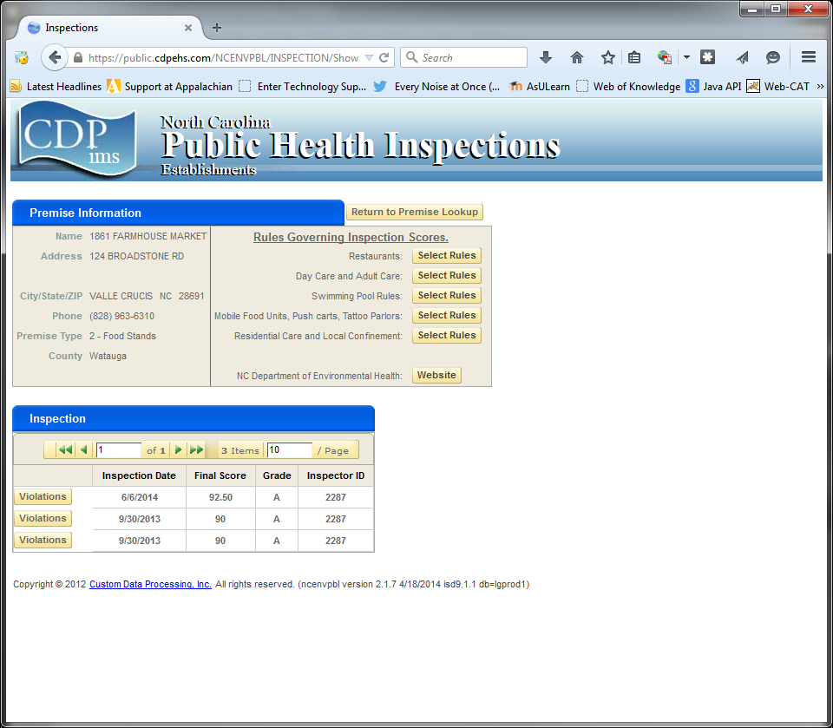

Slide 56
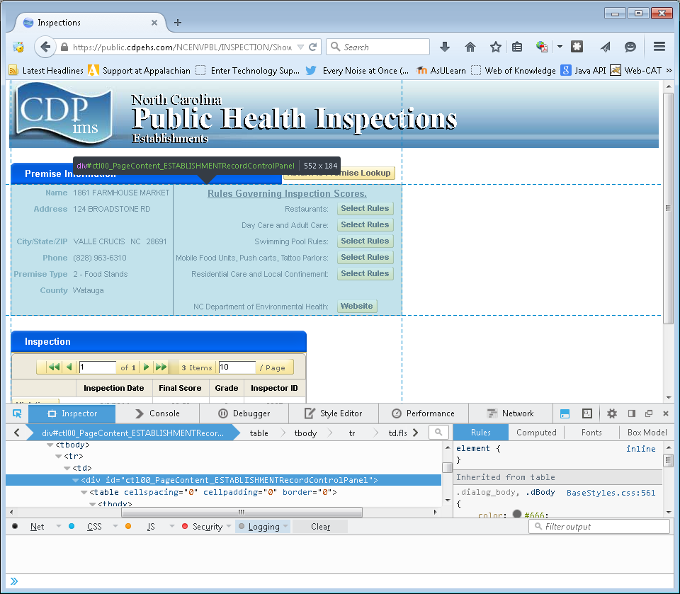
Set the number of items per page

Slide 57
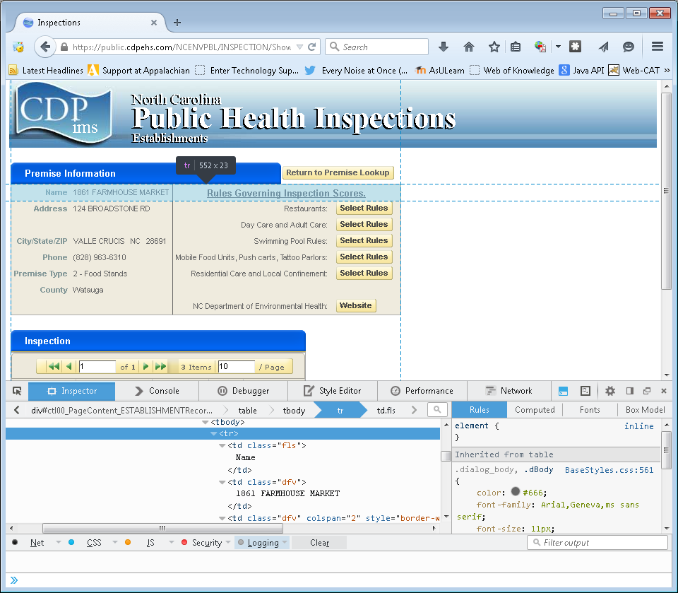
Get Establishment Information

Slide 58
Get Establishment Name

Slide 59
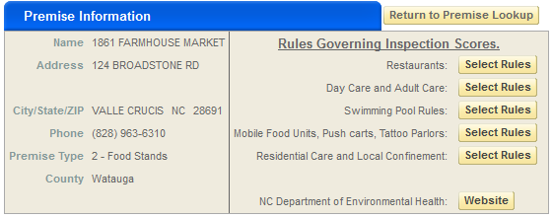
Get Establishment Name
Name / Value pairs in columns of table
Find ‘td’ with text(): ‘Name’
The next ‘td’ sibling contains the name of the establishment

Slide 60
Get Establishment Name
xpath = "
"
element = driver.find_element_by_xpath(xpath) name = element.text
Start in the area containing the “Premise Information”

Slide 61
Get Establishment Name
xpath = " //div[@id='ctl00_PageContent_ESTABLISHMENTRecordControlPanel']
"
element = driver.find_element_by_xpath(xpath) name = element.text
Start in the area containing the “Premise Information”

Slide 62
Get Establishment Name
xpath = " //div[@id='ctl00_PageContent_ESTABLISHMENTRecordControlPanel']
"
element = driver.find_element_by_xpath(xpath) name = element.text
Start in the area containing the “Premise Information”
Find any (the only) ‘td’ containing the text ‘Name’

Slide 63
Get Establishment Name
xpath = " //div[@id='ctl00_PageContent_ESTABLISHMENTRecordControlPanel']//td[text()='Name']
"
element = driver.find_element_by_xpath(xpath) name = element.text
Start in the area containing the “Premise Information”
Find any (the only) ‘td’ containing the text ‘Name’

Slide 64
Get Establishment Name
xpath = " //div[@id='ctl00_PageContent_ESTABLISHMENTRecordControlPanel']//td[text()='Name']
"
element = driver.find_element_by_xpath(xpath) name = element.text
Start in the area containing the “Premise Information”
Find any (the only) ‘td’ containing the text ‘Name’
Get the very next ‘td’ in the same row.

Slide 65
Get Establishment Name
xpath = " //div[@id='ctl00_PageContent_ESTABLISHMENTRecordControlPanel']//td[text()='Name']/following-sibling::td
"
element = driver.find_element_by_xpath(xpath) name = element.text
Start in the area containing the “Premise Information”
Find any (the only) ‘td’ containing the text ‘Name’
Get the very next ‘td’ in the same row.

Slide 66
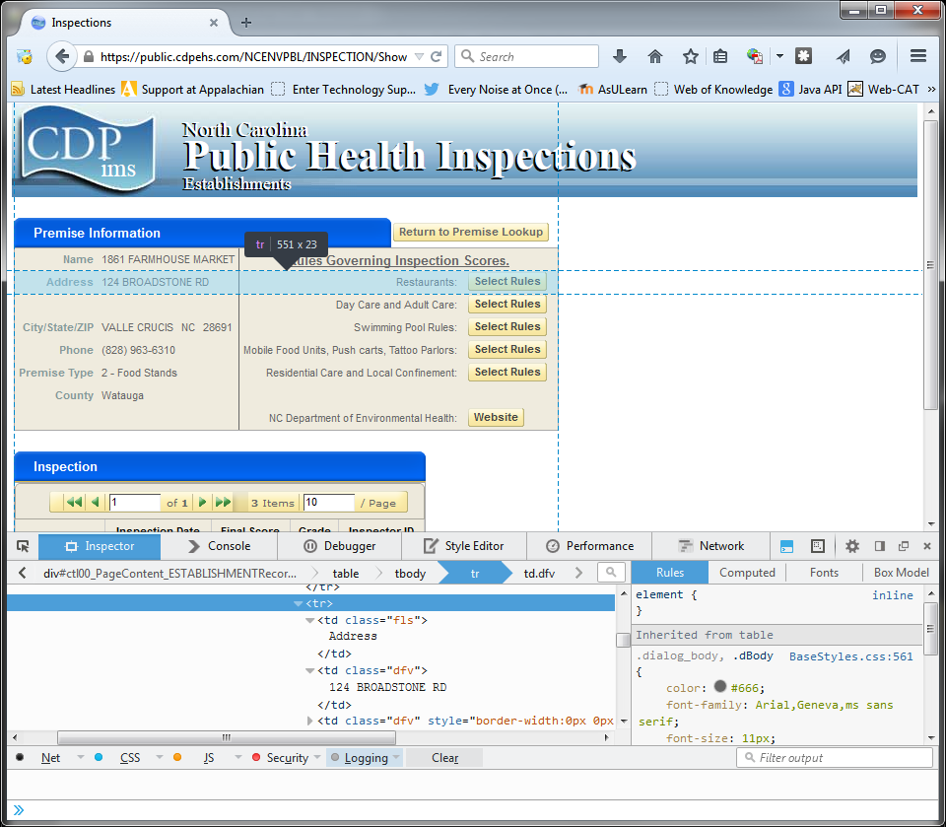
Get Establishment Address

Slide 67
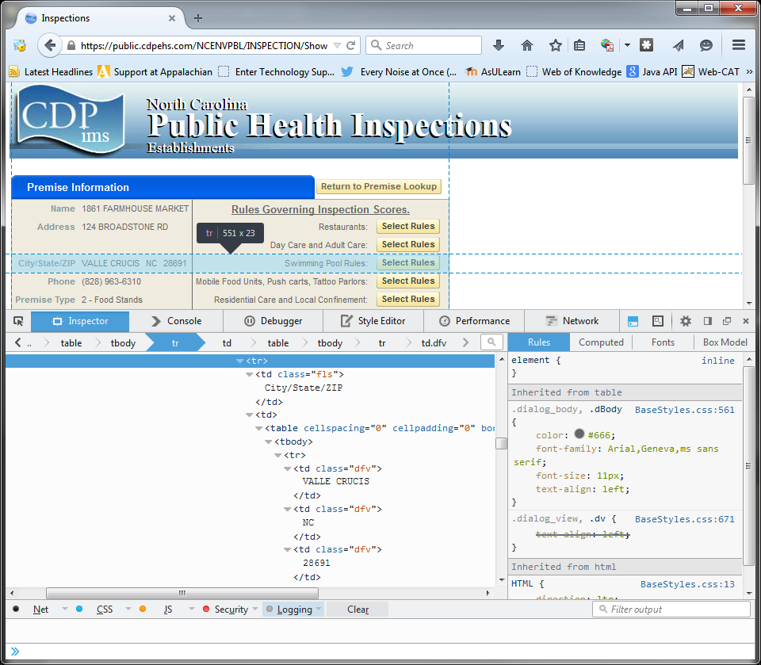
Get Establishment City/State/ZIP

Slide 68
Storing Data with JSON
The two main data structures in Python are lists and dictionaries
One convenient way to store establishment information is with a dictionary: d = { ‘name’: ‘1861 Farmhouse Market’, ‘address’: ‘124 Broadstone Rd’, ‘city’: ‘Valle Crucis’, ‘state’: ‘NC’, ‘zip_code’: 28691, ‘phone’: ‘(828) 963-6310’, ‘premise_type’: ‘2 – Food Stands’, ‘county’: ‘Watauga’ }

Slide 69
Storing Data with JSON
We can accumulate the establishment information for multiple establishments by appending each dictionary to a list:
import json data=[]
for establishment in establishments: # put establishment information # in dictionary ‘d’
# …
data.append(d) with open(‘ncphi.json’,’w’) as output:
json.dump(data, output)

Slide 70
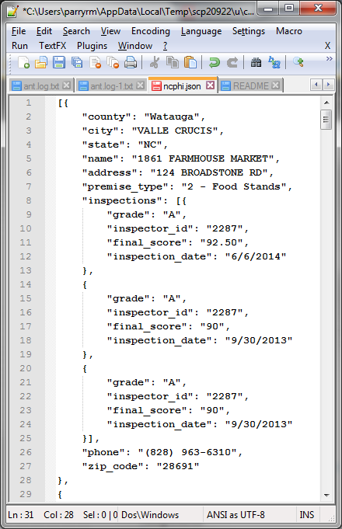
Generates a text file containing the data.

Slide 71
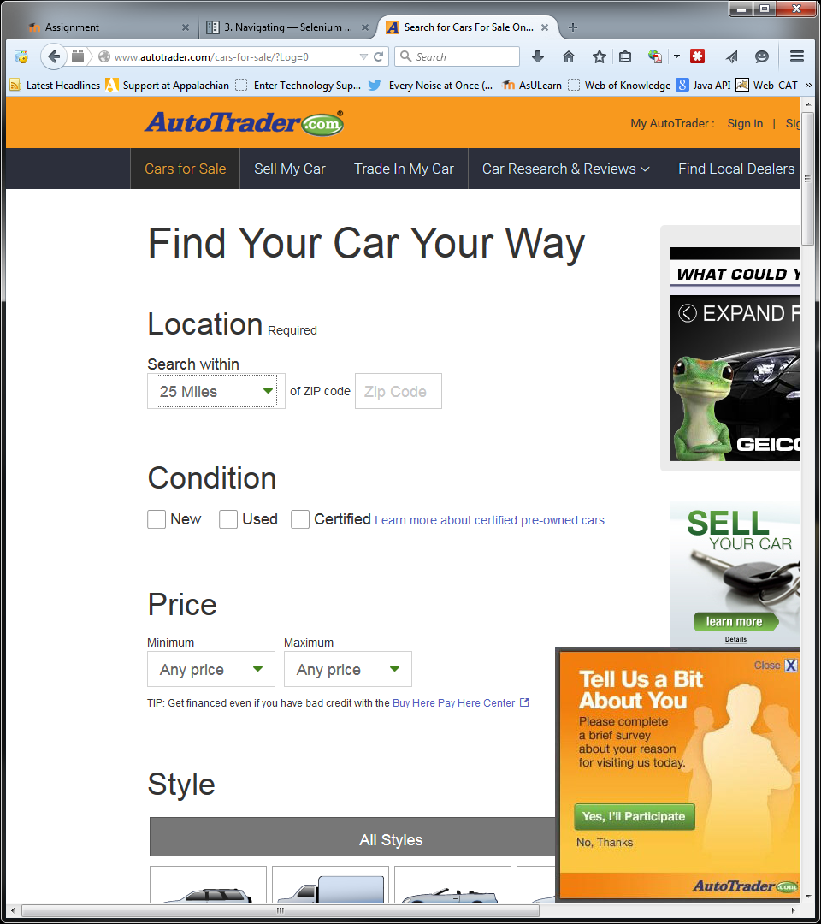
Selecting from a Dropdown Box

Slide 72
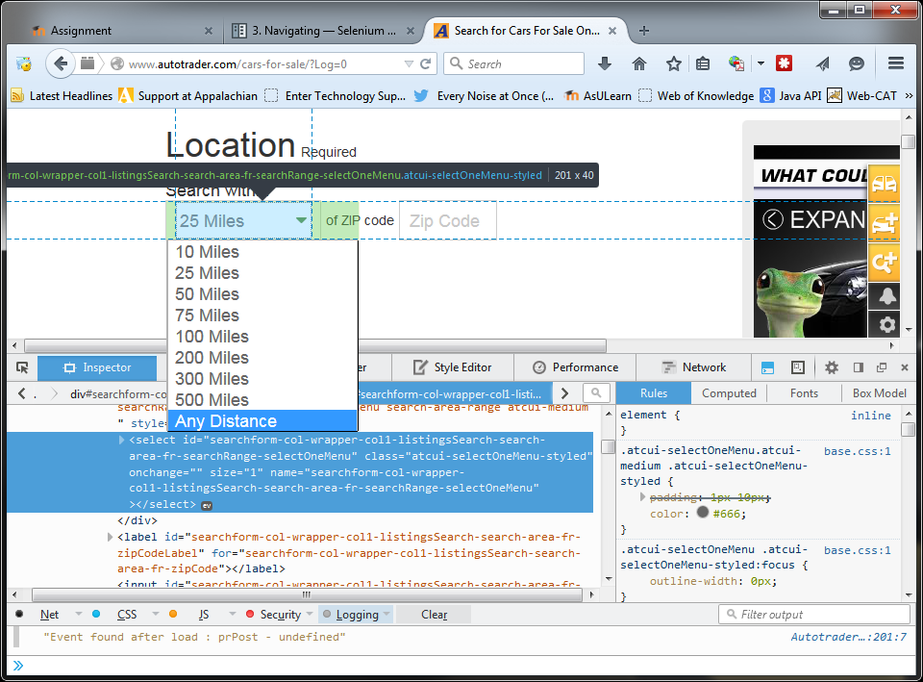
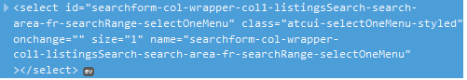

Slide 73
Select 100 Miles
xpath = " //select[@id='searchform-col-wrapper-col1-listingsSearch-search-area-fr-searchRange-selectOneMenu']
"
element = driver.find_element_by_xpath(xpath) Select(element).select_by_value(‘100 Miles’)

Slide 74
There be Dragons
selenium.common.exceptions.StaleElementReferenceException: Message: Element is no longer attached to the DOM
Needing to execute javascript to scroll
Needing javascript to select checkbox that isn’t visible unless hovering

Slide 75
Resources
http://www.w3schools.com/xpath/
http://selenium-python.readthedocs.org/en/latest/index.html
http://www.codecademy.com/en/tracks/python

