Slide 1
NIST Big Data Public Working Group
NIST Big Data Interface
Volume 8
Gregor von Laszewski, lasewski@gmail.com
NIST Campus
Gaithersburg, Maryland
June 1, 2017

Slide 2
Acknowledgement
NSF for support of Comet (SDSC, Indiana University)
Members of the NSF comet project
NBDRA WG members
Tuesday meetings and discussions have considerably contributed to this effort
We still need to add your names … please e-mail me at laszewski@gmail.com …
Prior effort conducted as part of cloudmesh at Indiana University

Slide 3
Volume 8 –Opportunities for Contribution
Volume 8 is in draft stage.
We look for additional contributors to the volume 8
We want to keep the initial part of the draft as simple as possible and develop contributions based on ASCII text modifications.
Contributions can be conducted in multiple ways
A) Make modifications to the PDF document with PDF augmentation tools such as Adobe or Skim, send via e-mail.
B) Make modifications in ASCII while specifying the section you like to modify (section header, new paragraph, line numbers), send via e-mail.
C) Make modifications through git pull requests

Slide 4
Presentation Overview
Volume Presentation Outline
Volume 1, Definitions
Volume 2, Taxonomy
Volume 3, Use Cases
Volume 6, Big Data Reference Architecture
Volume 4, Big Data Security and Privacy
Volume 8, Reference Architecture Interface
Reference Architecture Software Implementation Environment and Demonstration
Volume 7, Standards Roadmap
Volume 9, Adoption and Modernization

Slide 5
Current Working Group Influences
Interfaces
Use Cases
Vol 3
Architecture
Vol 8
Security & Privacy
Vol 3
Definitions Vol 1
Taxonomy Vol 2
Cloudmesh
& Cloudmesh Comet
Working Group Volumes
Cloudmesh
Cloudmesh Comet @ SDSC/IU

Slide 6
Document Structure
1
Interface Requirements
3
Specification Paradigm
4
Specifications
Introduction
2
Appendix
A
4.1
Data
4.3
Virtual Cluster
4.4
IaaS
Identity
4.2
Compute Services
4.5
Containers
4.6
Others to be added
4.7
Deployment
4.8
Map Reduce
4.9
Microservices

Slide 7
Volume 6: NIST Big Data Reference Architecture
INFORMATION VALUE CHAIN
Management Fabric
Security and Privacy Fabric
System Orchestrator
Big Data Application
DATA
Preparation/ Curation
Analytics
Visualization
DATA
Data Provider
Data Consumer
SW
Collection
Access
SW
DATA
SW
Big Data Framework Provider
IT VALUE CHAIN
Processing: Computing and Analytic
Batch
Interactive
Streaming
Platforms: Data Organization and Distribution
Messaging/Communications
Indexed Storage
Resource Management
File Systems
Infrastructures: Networking, Computing, Storage
Virtual Resources
Physical Resources
K E Y :
DATA
Big Data Information Flow
Service Use
SW
Software Tools and Algorithms Transfer

Slide 8
Volume 8 – Document Scope
Established operational interfaces
for management interactions and dataflow with needed resources between NBDRA components
Described and defined specific interfaces and the interactions
between NBDRA components
Developed a set of interfaces defined through examples
that can be used to create schema based definitions of objects that are manipulated through Big Data design patterns

Slide 9
Volume 8 – Possible Version 3 Topics
Formalization of the interfaces defined by example
Validate the interfaces
Verifying select use cases
Working with domain experts
to identify workflow and interactions among the NBDRA components and fabrics
Exploring and modeling interactions
within a small-scale, manageable, and well-defined confined environment
Aggregating the common data workflow and interactions
between NBDRA components and fabrics and package them into general interfaces.

Slide 10
Reference Architecture Software Implementation Environment and Demonstration
Cloudmesh provides a first reference implementation
Features include IaaS, Hadoop, and software stack deployment.
It was tested based on Application from Use Case document.
Code is hosted in github and is available.
Focus on Cloudmesh command shell and REST service as it is
Scriptable
Interpretable into other frameworks
Accessible through other frameworks via REST.
Disclaimer: we move from our original cm implementation to cms to distinguish the two efforts. The new implementation can use the NIST specification and generates a REST service automatically.

Slide 11
Cloudmesh Arcitecture
Abstraction essential to Cloudmesh design
Abstractions at different levels and interaction points
IaaS
Container
HPC
PaaS
Virtual Cluster
Integration with Providers
IU OpenStack, NSF Chameleon cloud, NSF Comet, AWS, Azure, SLURM/XSEDE, …
Used by hundreds of users

Slide 12
Cloudmesh Layered Architecture
Easy extensibility
Developed with command shell in mind
Developed with REST in mind
Horizontal Integration
Access – Data – Compute
Vertical Integration
`Security - Choreography

Slide 13
Deployment Abstractions
Possible interaction with different DevOps frameworks
Leveraging large DevOps community
Warning we found that there are many DevOps “templates” but not all of them are usable:
lack generality
do not work
too complex
not properly documented

Slide 14
Continuous Improvement vs. Continuous Deployment via DevOps
DevOps is integrated
Leads to improvement when not only targeting application but also deployment environment.

Slide 15
Simple Interface Usecase: Boot a vm on

Slide 16
Simple Interface Usecase: Boot & Provision

Slide 17
Phase 1: Interface Objects

Slide 18
Specification -> Reference implementation
1. Github
2. Specifications
3. Document Source
4. PDF
Semi-Automated Process
(Review is not automated, integration with NIST publication framework)
1. Specification
2. Cloudmesh schema
3. Schema
4. Rest Service
Vol 8. Specification
Cloudmesh schema generates …
… a valid schema from the specification
The schema is used to automatically generate a REST service

Slide 19
Design by example
{
"profile": {
"description": "The Profile",
"uuid": "jshdjkdh...",
"context:": "resource",
"email": "laszewski@gmail.com",
"firstname": "Gregor",
"lastname": "von Laszewski",
"username": "gregor",
"publickey": "ssh ...."
}
Simple to understand
Encourages discussion
Generation of rest service can be automatized
Types are derived from types of the attributes

Slide 20
Design by example (cont.)
profile = {
’schema’: {
’username’: {’type’: ’string’},
’context:’: {’type’: ’string’},
’description’: {’type’: ’string’},
’firstname’: {’type’: ’string’},
’lastname’: {’type’: ’string’},
’publickey’: {’type’: ’string’},
’email’: {’type’: ’string’},
’uuid’: {’type’: ’string’},
}
}
GET profile - get list
GET profile/12 - get obj.
POST profile - upload
PUT profile/12 - upload
PATCH profile/12 - change
DELETE profile/12 - delete

Slide 21
Showcase document
https://laszewski.github.io/papers/NIST.SP.1500-8-draft.pdf

Slide 22
Account Management

Slide 23
Account Management Example: Extension to Architecture
Accounting across hybrid services
Integrating of accounting records for individuals (in case group account does not provide this feature)
User Management issues
Removal of “Dracula Users”: I suck you dry and consume all your hours as I will ignore your policies will fully (yes, they do exist)
Removal of “Uniformed User”: let the know what an experiment costs upfront before you start it.
Provider Management Issues
Provide feedback to providers: We found that some providers gave us incomplete information in regards to their accounting practice
Comparison of cost between providers
Application Benchmarking
If we do make it too easy some will ignore alternatives, Expose benchmarking results to the community

Slide 24
Account Management

Slide 25
Account management
Register
Deposit
Use
Deactivation

Slide 26
Fingerprint Example
Gregor von Laszewski, laszewski@gmail.com Badi’ Abduhl-Wahid

Slide 27
Fingerprint Application
Requires
Application knowledge
Deployment/DevOps knowledge
What if application user could do also the deployment?
Use newest software
Use newest hardware
Benchmark different setups

Slide 28
Use Case Fingerprint: Deployment is complex

Slide 29
Cloudmesh Shell – Make Booting Simple
$ emacs cloudmesh.yaml
$ cms default cloud=NAME
$ cms default image=NAME
$ cmd default flavor=NAME
$ cms vm boot
$ cms vm login
$ cms vm delete
Prepare defaults
Boot
Login
Management
cloudmesh.yaml
…

Slide 30
Cloudmesh Shell – Manage Hybrid Clouds
$ cms aws boot
$ cms vm boot
$ cms default cloud=chameleon
$ cms vm boot
$ cms default cloud=IUCloud
$ cms vm boot
Boot Cloud B
Boot Cloud A
Boot Cloud C

Slide 31
Cloudmesh Shell – Create a Hadoop Cluster
$ cm default cloud=chameleon
$ cm cluster define - -count=10
- -flavor=m1.large
$ cm hadoop define spark
$ cm hadoop sync # ~30 sec
$ cm hadoop deploy # ~ 7 min
Define cluster
Define hadoop Cluster
Set cloud
Deploy the cluster
Sync definition to db

Slide 32
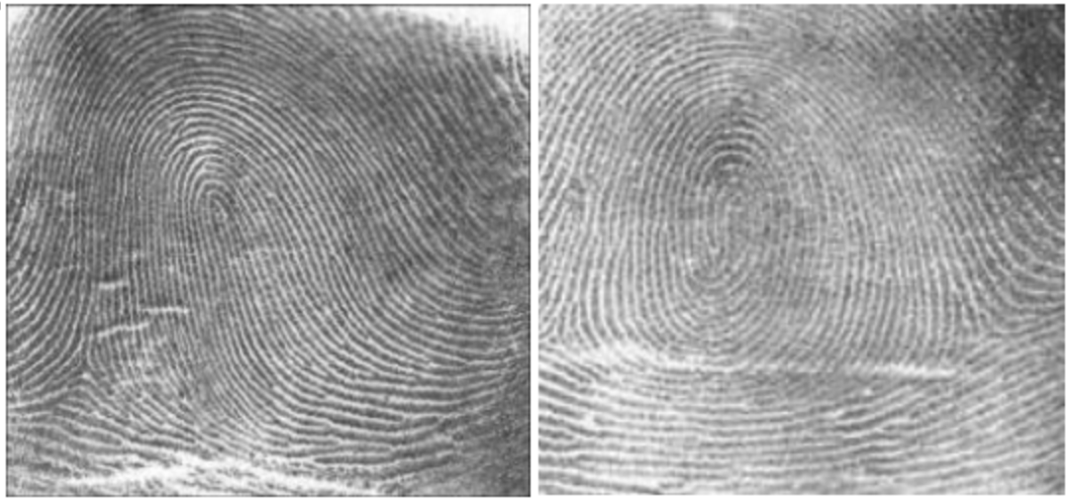
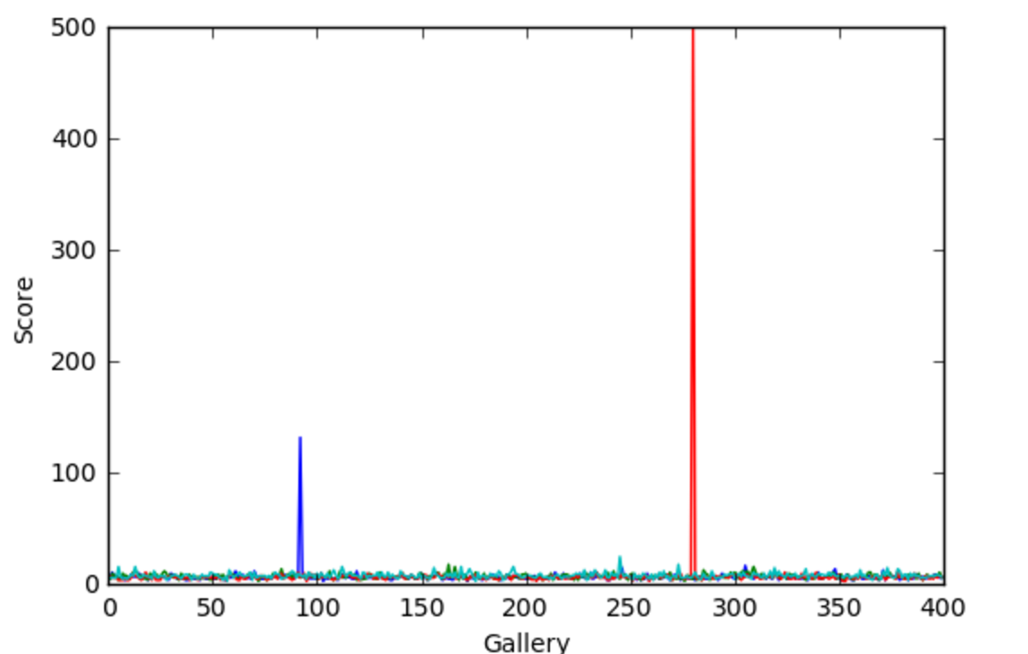
Cloudmesh Shell – Create a Hadoop Cluster
$ cm default cloud=IUCloud
$ cm cluster define - -count=10
- -flavor=m1.large
$ cm nist fingerprint # ~ 30 min
Define cluster
Set cloud
Run NIST usecase
Additional resources:
https://github.com/cloudmesh/classes/blob/master/docs/source/notebooks/fingerprint_matching.ipynb

