Slide 2

Clusterf#@k to the Poor House

Slide 3
The Economy & Social Work
How the Economic Downturn Effects Social Service Agencies

Slide 4
Overview of the Problem
Some general effects of an economic downturn

Slide 5
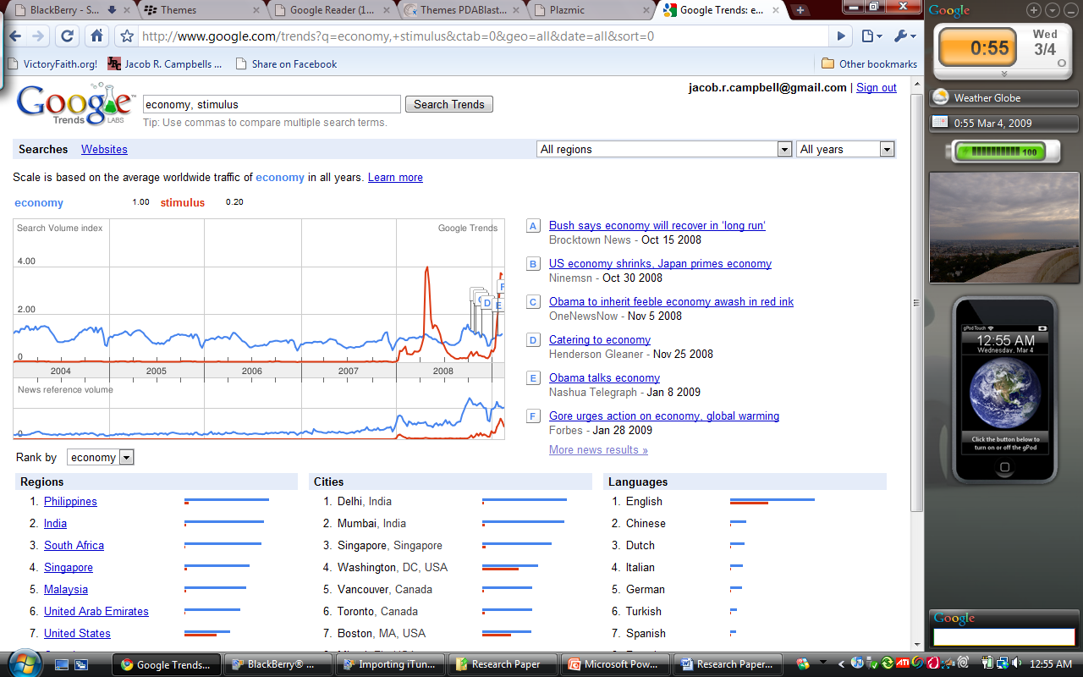
Overview of the Problem
Societies focus on money
GoogleTrends

Slide 6
Overview of the Problem
Loss of sleep
16% personal financial
15% economy
10% employment
Increase stress
66% significant rise since April
Social Service Industry

Slide 7
Trouble Abroad
A Global Perspective of the Economic Downturn

Slide 8
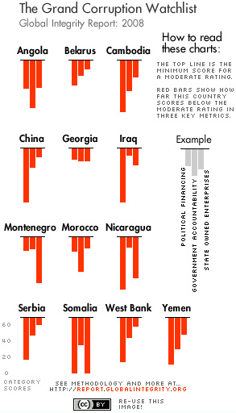
Trouble Abroad
Country | Stimulus Package
United States: | $825 billion
China: | $586 billion
Japan: | $250 billion
Germany: | $80 billion
Spain: | $50 billion
France: | $35 billion
United Kingdom: | $30 billion
Canada: | $45 billion
India: | $20 billion
Australia: | $20 billion
Korea: | $11 billion
Brazil: | $5 billion
Thailand: | $3 billion
Singapore: | $3 billion
Chile: | $3 billion
If global economy does decline for 2009, first time since 1930’s
Many nations with stimulus packages

Slide 9
Trouble @ Home
A National Perspective of the Economic Downturn

Slide 10
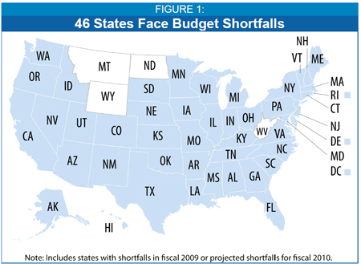
Trouble @ Home
Forty-seven states in America are facing shortfalls on their budget.
Combined this shortfall is $51 billion.
Forty-three states are already projecting budget shortfalls for their 2010 budgets

Slide 11
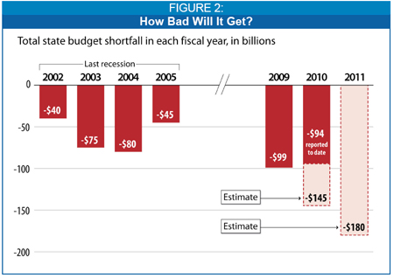
Trouble @ Home

Slide 12
Trouble @ Home
TABLE 1: STATES WITH MID-YEAR FY2009 BUDGET GAPS
 | Size of Gap | Percent of FY2009 General Fund
Alabama | $1.1 billion | 12.7%
Alaska | $360 million | 6.8%
Arizona | $1.6 billion | 15.9%
California | $13.7 billion | 13.6%
Colorado | $604 million | 7.7%
Connecticut | $1.7 billion | 10.1%
District of Columbia | $258 million | 4.1%
Delaware | $226 million | 6.2%
Florida | $2.3 billion | 9.0%
Georgia | $2.2 billion | 10.3%
Hawaii | $232 million | 4.0%

Slide 13
Trouble @ Home
Idaho | $218 million | 7.4%
Illinois | $4.2 billion | 14.8%
Indiana | $1.1 billion | 8.0%
Iowa | $134 million | 2.1%
Kansas | $186 million | 2.9%
Kentucky | $456 million | 4.9%
Louisiana | $341 million | 3.7%
Maine | $140 million | 4.6%
Maryland | $691 million | 4.6%
Massachusetts | $2.4 billion | 8.4%
Michigan | $200 million | 0.9%
Minnesota | $426 million | 2.5%

Slide 14
Trouble @ Home
Mississippi | $175 million | 3.4%
Missouri | $342 million | 3.8%
Nevada | $536 million | 7.3%
New Hampshire | $50 million | 1.6%
New Jersey | $2.1 billion | 6.5%
New Mexico | $454 million | 7.5%
New York | $1.7 billion | 3.0%
North Carolina | $2.0 billion | 9.3%
Ohio | $1.2 billion | 4.2%
Oregon | $442 million | 6.6%
Pennsylvania | $2.3 billion | 8.1%
Rhode Island | $372 million | 11.4%

Slide 15
Trouble @ Home
South Carolina | $871 million | 12.7%
South Dakota | $27 million | 2.2%
Tennessee | $884 million | 7.8%
Utah | $620 million | 10.4%
Vermont | $66 million | 5.4%
Virginia | $1.1 billion | 6.7%
Washington | $509 million | 3.4%
Wisconsin | $594 million | 4.2%
TOTAL | $51.1 billion | 10.5%

Slide 16
The Long-term Perspective
A Historical View of Economic Downturns

Slide 17
The Long-term Perspective
History of modern economics
Recession: significant decline in the economic activity spread across the economy, lasting more than a few months (two quarters)

Slide 18
The Long-term Perspective
History of U.S. Recessions
Depression of 1807
Panic of 1837
1870's Recession
Panic of 1907
Recession 1926
Panic of 1797
Panic of 1819
Panic of 1857
1890's Recession
Post World War I Recession
The Great Depression
Notes:
The United States suffered its first recession back in the years between 1797 and 1800. It was called the panic of 1797, and it was primarily caused by the deflating effects of the Bank of England as they crossed the Ocean to American soil. This disrupted commercial real estate markets in the U.S. Britain’s economy was in a strained state already, because it was fighting France in the French Revolutionary wars at the time. This is just one example of how the effects of recession on one country can travel quickly to another. Economists all agree that what effects one country, especially a key country, will affect the rest of the world in at least one way, shape, or form, before the recession is over. Recession history has shown that U.S. economic recession history is full of trials that have helped bring about many other recessions since the Panic of 1797. Luckily though, the Panic of 1797 was the last recession of the 1700s.
The next recession confirmed occurred in the years between 1807 and 1814, and was called the Depression of 1807. This depression was primarily caused by the Embargo Act of 1807, signed into effect by then President Thomas Jefferson. This act destroyed a good part of the shipping related industries, and it was fought hard by the Federalists, who allowed smuggling to take effect in New England as a result of the Act.
The Panic of 1819 soon followed. This was considered the first major financial crisis to unveil itself before the relatively new U.S. economy. This panic brought with it widespread foreclosures, failing banks, huge unemployment rates, and a gigantic slump in manufacturing and agriculture that caused havoc among Americans. This recession also marked the end of great economic expansion that had taken place following the War of 1812.
Economic recessions in America continued with the Panic of 1837. This recession can really be attributed to failing banks, and to the lack of confidence people had in paper currency, which was becoming popular at the time. Banks stopped paying out in gold and silver, which really took its toll on American confidence.
The Panic of 1857 followed not long after. With the failure of the Ohio Life Insurance and Trust Company (which at the time was one of the biggest in the United States) came the explosion of a European confidence bubble in the U.S. This greatly affected the railroads and U.S. banks, causing over 5,000 businesses in America to fail in the first year of the panic alone. Unemployment rose, and protest meetings became popular.

Slide 19
The Long-term Perspective
History of U.S. Recessions
Recession of 1945
2007-2009
Early 1950's Recession
Early 1960's Recession
1970's Oil Crisis
1990's Recession
Late 1940's Recession
Late 1950's Recession
Late 1960's Recession
1980's Recession
Late 2000's Recession
Early 2000's Recession
Notes:
Recessions continued to plague not only America, but the rest of the world as well. Considered part of the natural cycle of the modern economic system, no one can really escape recession in the long run. Countries like Germany, the U.K., China, and Japan have all had trouble with recessions. In fact, economists say that Germany is in for what might be the biggest recession in all of German history not too far down the road. Japanese economic recession has also played a huge part in their history. Japanese recession, just like economic recessions in America, can be linked to the dreadful cycle of imbalanced inflation, money supply, and interest rates that keep things in balance, rolling, and functioning properly.
In the year 2001, the early 2000s recession hit America. The collapse of the dot.com bubble was truly the cause of these recessions, as well as the attacks that occurred on September 11th on the World Trade Center Towers in New York City. Accounting scandals also ran rampant, contributing to the overall downward financial spiral that America faced. Everyone remembers the attacks on America’s soil, and nobody will forget how, despite economic trouble, the attacks brought Americans together, more united than ever. And with that kind of perseverance, America was led out of that struggle to a new future of prosperity.
And lastly, America has been hit by what has been called the Late 2000s recession. The collapse of the housing market really set this one off on a bad note, and it, coupled with bank collapses in the U.S. and Europe, have caused consumer confidence and credit availability to plummet to new lows. Hopefully, things will turn around. But for now, the modern economic cycle again comes around to purge itself of the problems put on it by humanity, and unfortunately, that purge is known to us as recession.

Slide 20
Implications
The Intended & Unintended Consequences

Slide 21
Implications -- Non-profit Sector
Drop in charitable giving
Merging of various organizations
Decrease in non-profit agencies
In times of economic boom an increase in non-profit agencies

Slide 22
Implications -- Public Sector
Increase in services provided by the public sector
Cuts to low-income and human-services programs
Increase of unemployment
Reduce spending in programs that serve low-income residents.
Washington State loosing 12% of DSHS budget

Slide 23
Implications -- Public Sector
Loss of agencies
DSHS break up
Shake up of DSHS
2,600 State employees cut in Governors budget
SCRC / CRC’s
Detox
Health and Safety Network (Family Policy Counsel)
Substance Abuse treatment

Slide 25
Framework For Analyzing Policy
Components of Policy
Paradigms Involved in Policy
Problem
Goals
Policy and legislation
Implementation
Affected populations
Impact
Intended
Unintended
Values
History
Economics
Organizational and structural relationships
Consequences
Intended
Unintended

