Slide 1


TTC decoding tests in EMF
Alessandra Camplani – Università degli Studi e INFN Milano
18-05-17

Slide 2
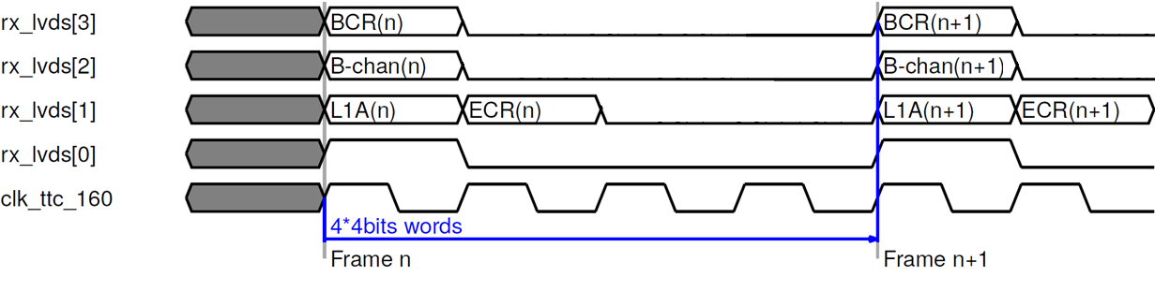
Expected protocol
Expected protocol between Carrier and Latome on the LVDS links:
(ECR and BCR in standard configuration)

Slide 3
Test1 and test2
TEST 1
Latome – ttc firmware:
no pin swap
ttc signals (ecr and bcr) swap
rising edge
old Nico repo
Carrier – Kade not integrated firmware
(Carrier_GBT-v4p1_16p4_amcClkPh180)
Pin swap
Updates in timing
TEST 2
Latome – ttc firmware:
no pin swap
ttc signals (ecr and bcr) swap
falling edge
old Nico repo
Carrier – Kade not integrated firmware
(Carrier_GBT-v4p1_16p4_amcClkPh180)
Pin swap
Updates in timing
Only difference

Slide 4
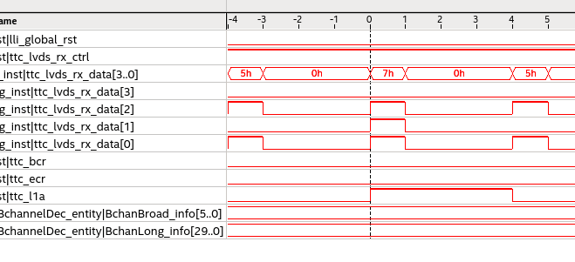
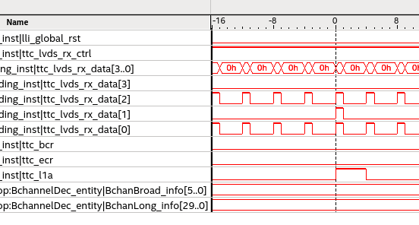
L1A comparison
TEST 1
L1A signal ok: 4 clk cycles long
TEST 2
L1A signal ok: 4 clk cycles long
(as expected)

Slide 5
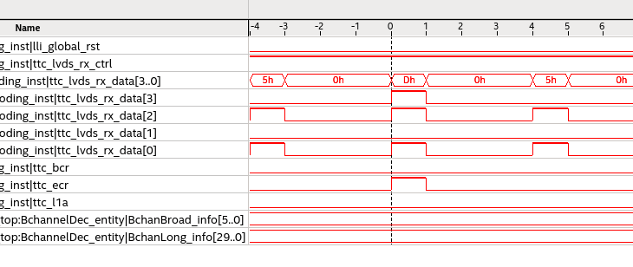
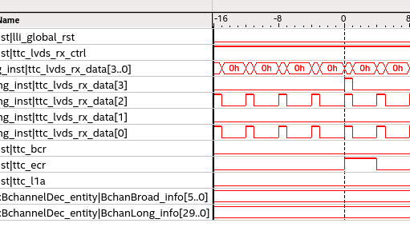
ECR comparison
TEST 1
ECR signal not ok: 1 clk cycle long
TEST 2
ECR signal ok: 4 clk cycles long
(as expected)

Slide 6
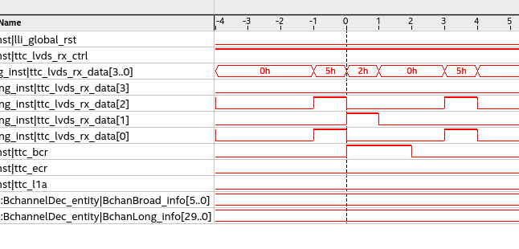
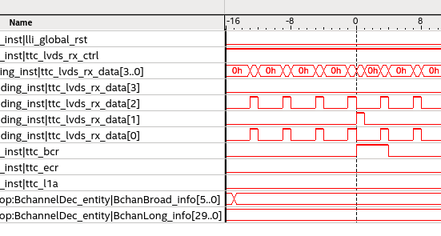
BCR comparison
TEST 1
BCR signal not ok: 2 clk cycles long
TEST 2
BCR signal ok: 4 clk cycles long
(as expected)

Slide 7
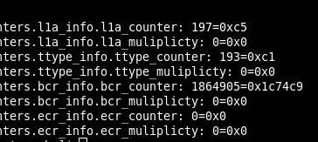
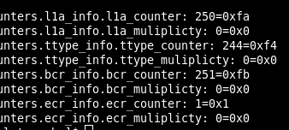
TType comparison
TEST 1
TType signal not ok
TEST 2
TType signal not ok
But this value needs a better understanding also from the system point of view
Already under investigation

