Slide 1


TTC decoding tests in EMF
Alessandra Camplani – Università degli Studi e INFN Milano
18-05-17

Slide 2
Test1 and test2
TEST 1
Latome – ttc firmware:
no pin swap
ttc signals (ecr and bcr) swap
rising edge
old Nico repo
Carrier – Kade not integrated firmware
(Carrier_GBT-v4p1_16p4_amcClkPh180)
Pin swap
Updates in timing
TEST 2
Latome – ttc firmware:
no pin swap
ttc signals (ecr and bcr) swap
falling edge
old Nico repo
Carrier – Kade not integrated firmware
(Carrier_GBT-v4p1_16p4_amcClkPh180)
Pin swap
Updates in timing
Only difference

Slide 3
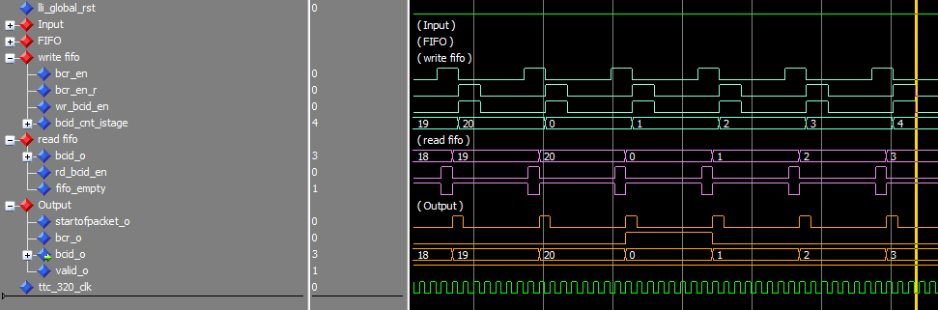
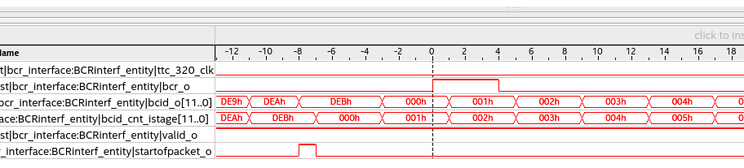
ISTAGE protocol

