Slide 1
TTC decoding tests in EMF
Alessandra Camplani – Università degli Studi e INFN Milano
30-03-17

Slide 2
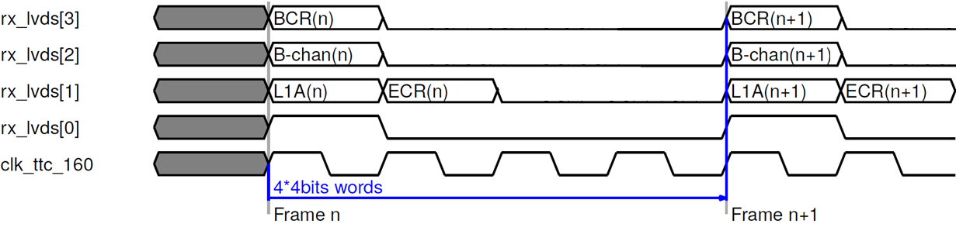
Expected protocol
Expected protocol between Carrier and Latome on the LVDS links:

Slide 3
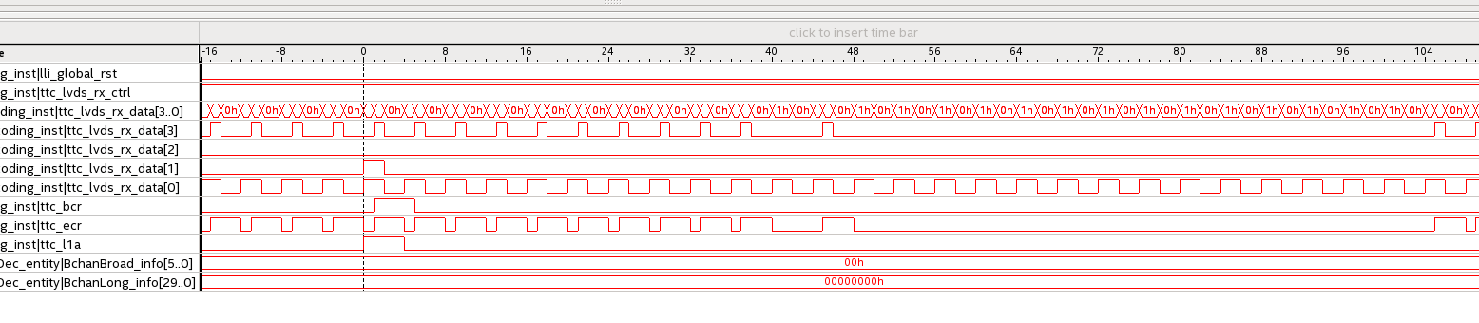

Signals on Latome (test during LAr week)
Input signals of ttc_decoding module

Slide 4
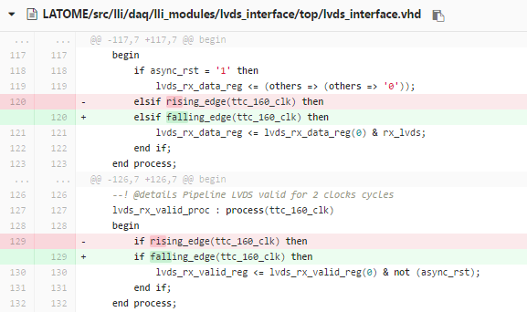
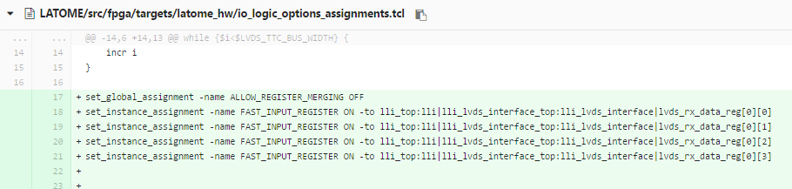
Constraints and code updates
Changed clk edge in lvds interface processes
Added constraints between the input pin and the first register on the LVDS lines

Slide 5
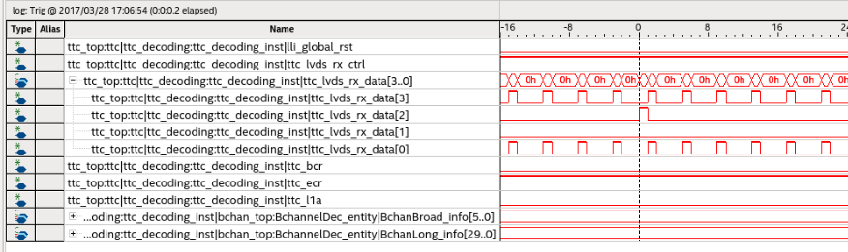
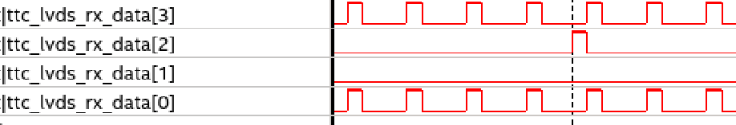
Signals on Latome (test this week)
Input signals of ttc_decoding module
This is obtained requesting a BCR signal on TTCvi..

Slide 6
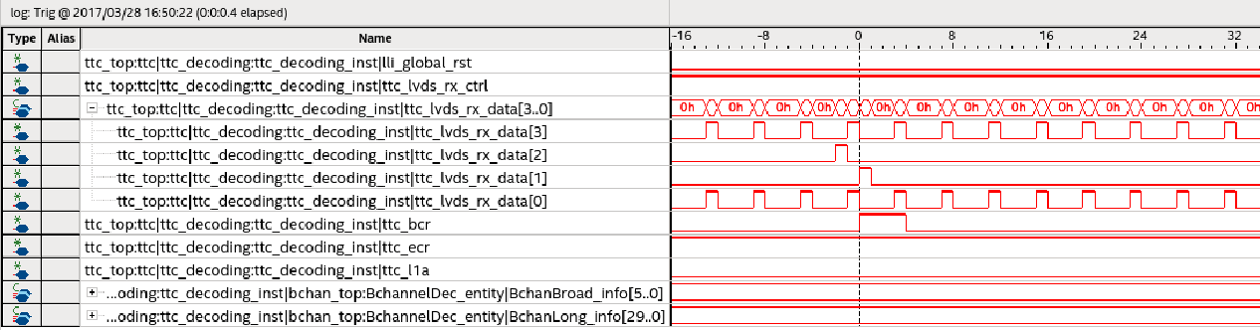
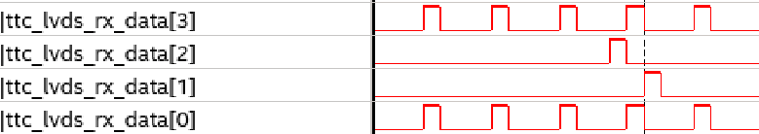
Signals on Latome (test this week)(2)
Input signals of ttc_decoding module
This is obtained requesting both ECR and BCR signals on TTCvi..

Slide 7
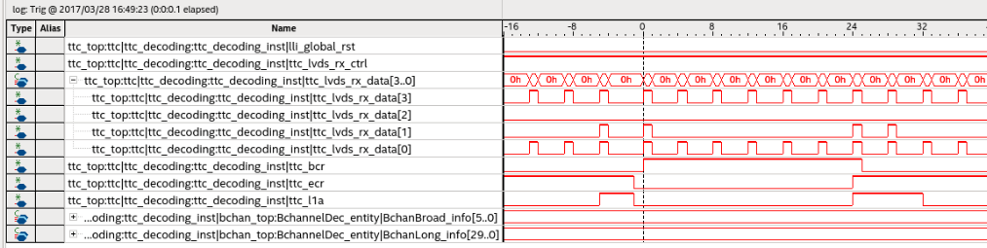
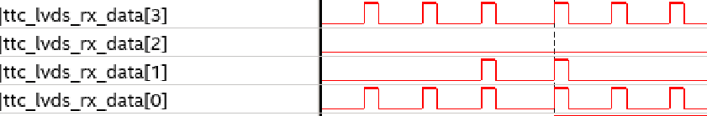
Signals on Latome (test this week)(3)
Input signals of ttc_decoding module
Immediately after requesting ECR and BCR signals on TTCvi..

Slide 8
Conclusions
We are improving!
Thanks to Nico&Nico and Ken
Pins check
Constraints check on the Carrier as well
Implementation of registers to monitor the counters (for M4)
More debug on my side with the simulation
Locked state to be better checked (to avoid issues if the sync period is longer)
Some more test will be done in the next weeks

