Slide 1


TTC decoding tests in EMF
Alessandra Camplani – Università degli Studi e INFN Milano
13-04-17

Slide 2
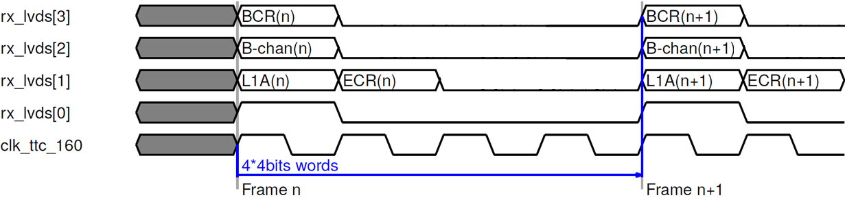
Expected protocol
Expected protocol between Carrier and Latome on the LVDS links:

Slide 3
Carrier and Latome onstraints
Carrier constraints
From an email from Kade:
«Keep in mind that this project, only extracts the TTC information, and forwards it to the AMC LVDS pairs. The Stony Brook ATCA Clock project is still required to setup the clock, as this isn't built in.»
Latome constraints
Added constraints between the input pin and the first register on the LVDS lines
Falling edge in lli processes to be improved
From Nico DD email:
The "preserve" synthesis directive works to disable registers merging only for the LVDS registers. We will use it for the LVDS synchronization in the LLI/daq/lli_modules/lvds_interface (Nico DD email)

Slide 4
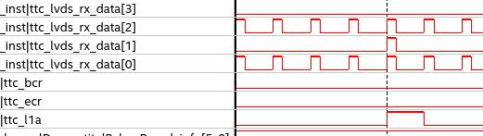
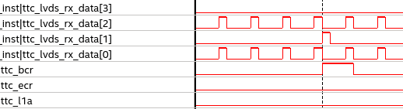
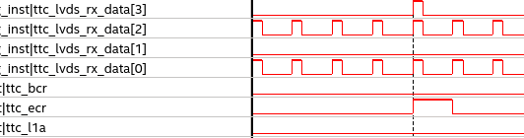
TTC signals decoding
Constraints on the Carrier and Latome
With a swap on pins for LVDS2 and LVDS3
With lli processes working on falling edge
With a swap on ECR and BCR on firmware side
L1A
BCR
ECR

Slide 5
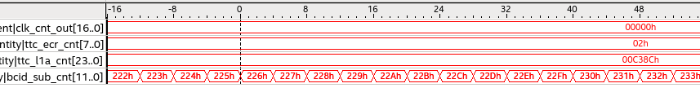
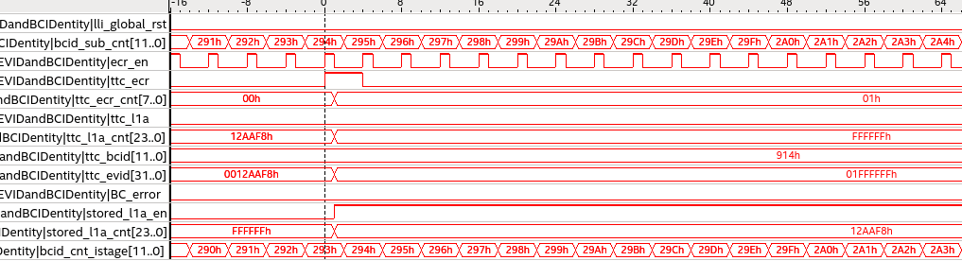
TTC signals decoding (2)
Constraints on the Carrier and Latome
With a swap on pins for LVDS2 and LVDS3
With lli processes working on falling edge
With a swap on ECR and BCR on firmware side

Slide 6
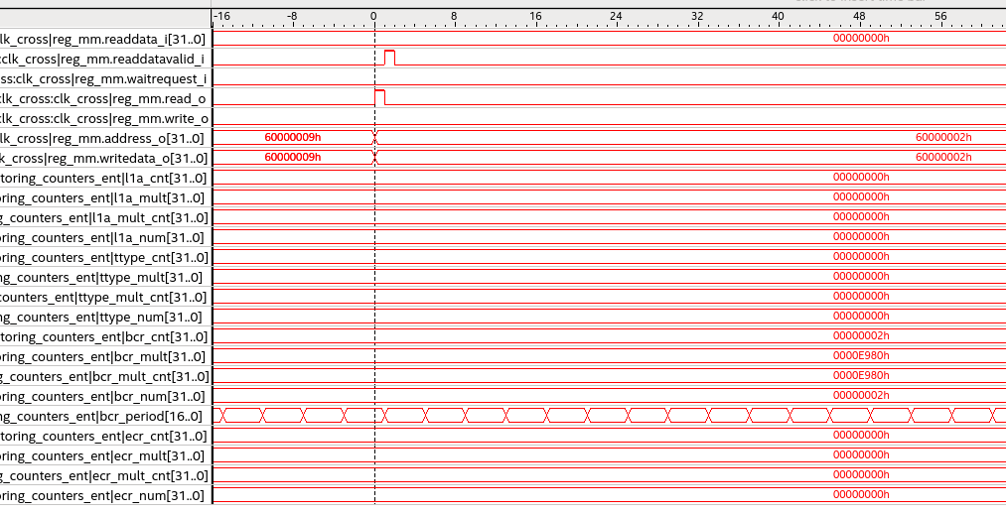
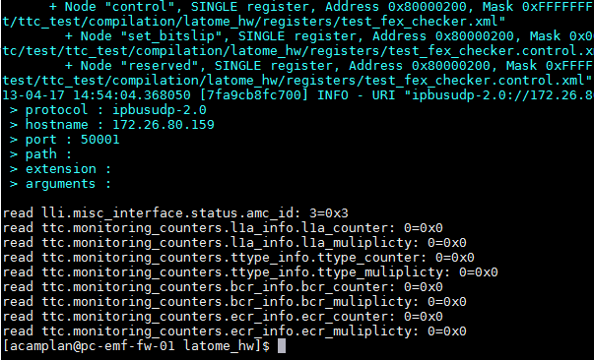
TTC registers

Slide 7
Conclusions
We are improving! Thanks to everybody!
L1A, ECR, BCR received properly and decoded
Ttype still to be checked but bchannel broadcast and long address are visible
Improving with the TTC registers
Implemented and readable
Still some troubles: reading zero instead of the correct value
Falling edge is going to be addressed
Constraints on both sides seems ok
What about the swap?
For the moment using a file provided by Nico C. with the swap
More tests: run for some time and compare the counters value (for L1A, BCR, ECR and TType) in the partition and in the registers
Latome not respoding after few minutes

