Slide 1
TTC decoding tests in EMF
Alessandra Camplani – Università degli Studi e INFN Milano
16-03-17

Slide 2
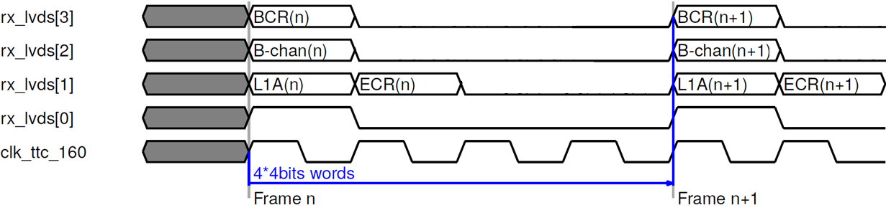
Expected protocol
Expected protocol between Carrier and Latome on the LVDS links:

Slide 3
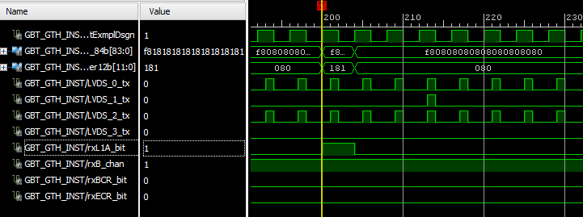
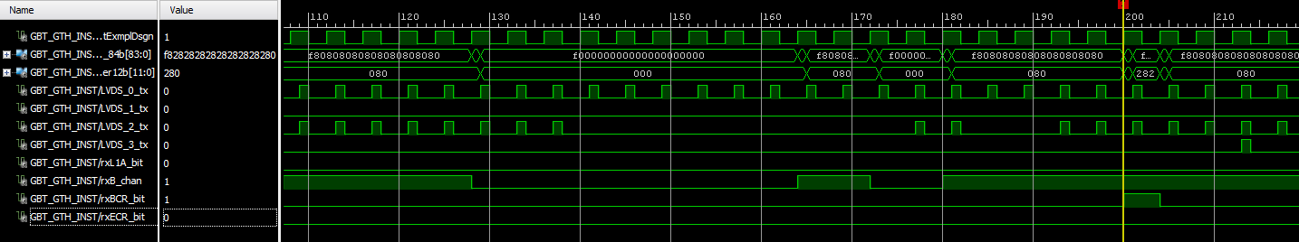
L1A and BCR signals on the Carrier
L1A bit
B channel - broadcast
BCR bit

Slide 4

ECR signal on the Carrier
B channel - broadcast
ECR bit

Slide 5
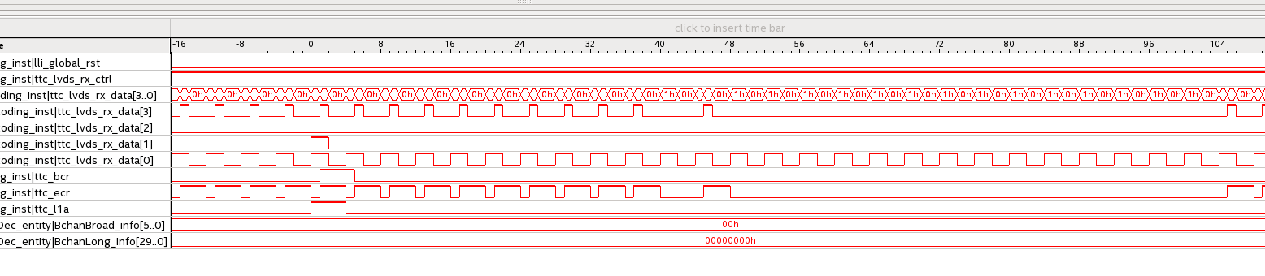

Signals on Latome
Input signals of ttc_decoding module

Slide 6
Conclusions
Carrier: L1A, BCR and ECR (broadcast B channel)
Decoded from GBT and re-encoded properly on the LVDS protocol
Long address B channel to be tested on Latome to see the TType
Latome: signals are not received properly on the LVDS link
Swap in pins assignment?
Already in contact with Nico DD to solve this issue
Thanks to..
Charlie, Bernard, Dirk, Franck, Nour, Daniele..

