Slide 1
ABBA firmware vs. data status
Alessandra Camplani – Università degli Studi di Milano

Slide 2
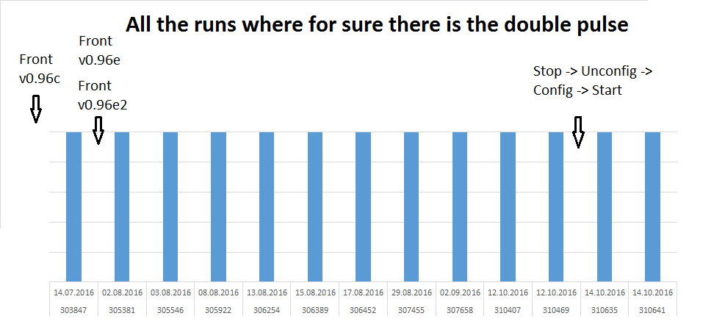
Firmware version vs. data
Thanks to Adriana and Laura for the scripts!

Slide 3
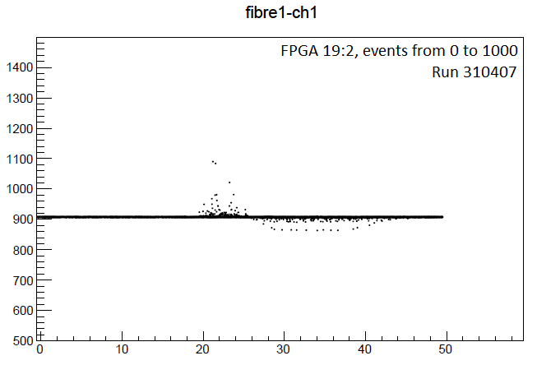
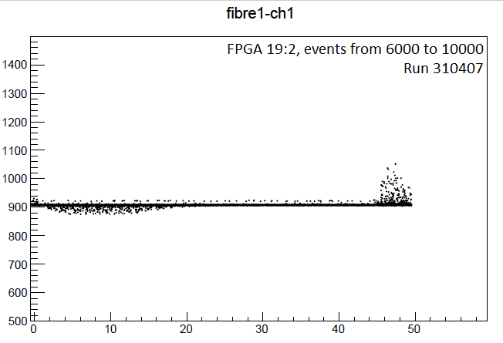
What is happening (1)
At the beginning of the run the pulse could be in the correct position and after some time it is starting at a different sample:
Always shifted from around sample 20 to around sample 48

Slide 4
What is happening (2)
It seems that there is a rotation in reading the data.
TAIL of the pulse
START of the pulse
It’s the same pulse!

Slide 5
Where in the (front FPGA) firmware

Slide 6
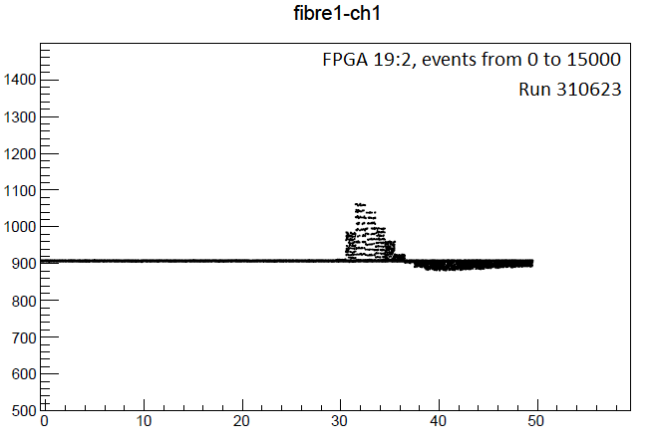
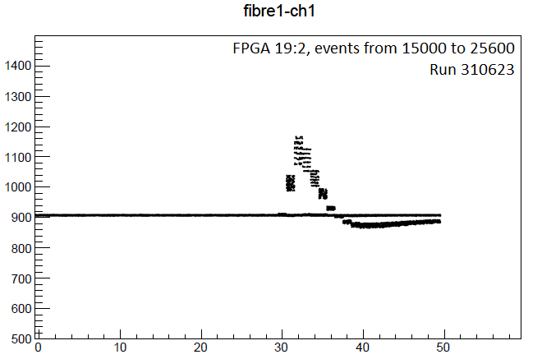
Calibration runs
Some calibration runs taken: 310619, 310621, 310623, 310625, 310627 (for more details ELOG).
High Ramp, 25600 events, different trigger rates.
No pulse issue in all the runs (firmware version used v0.96e2)

Slide 7
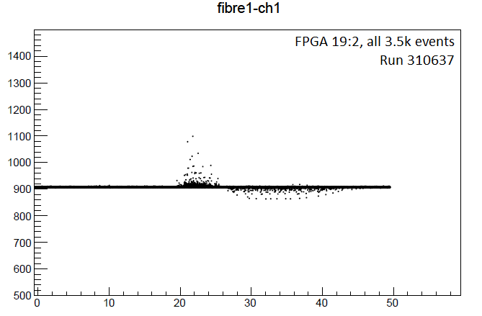
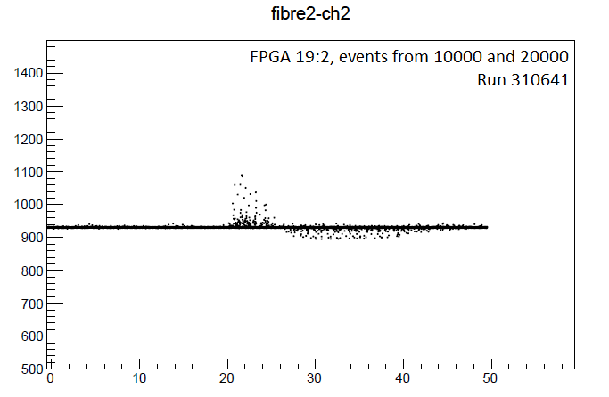
Recent Physics runs
The most recent Physics runs (310637, 310639, 310641, 310695, 310731) where collected with:
STOP -> UNCONFIG -> CONFIG -> START
instead of STOP -> START

Slide 8
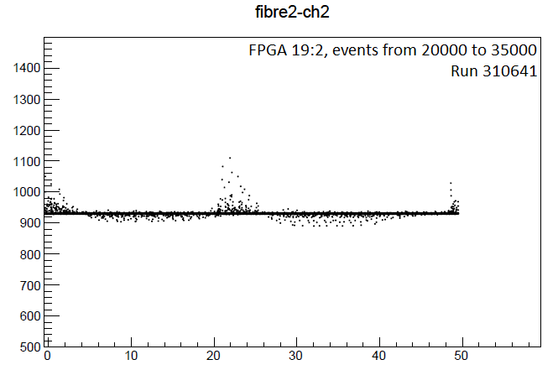
But.. Later in the data..

Slide 9
Recent updates and TODO
New instructions for the shifter:
always use STOP -> UNCONFIG -> CONFIG -> START per each ABBA run
take about 20000 events per each run (about 5000 per FPGA)
Reverted to an older firmware version v0.96c (but just yesterday evening I discovered that this issue is there also in this version)
Open question: since which version the issue is there?
TODO: find out how to solve it in the firmware

