Slide 1
ABBA: old run check
Alessandra Camplani – Università degli Studi di Milano

Slide 2
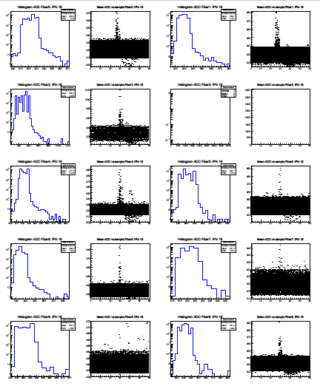
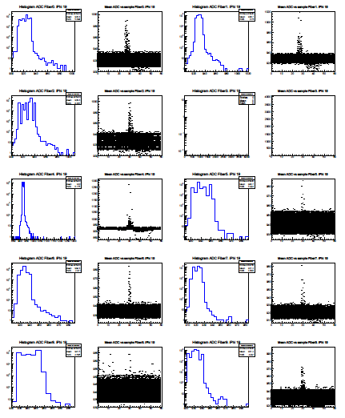
Run 301976
Thanks to
Laura’s script!
Run taken with a simple dead time of 15.
Latency setting: 0x56
(BNL LDTB)
Page4, run301976, EOS 04
Page4, run301976, EOS 24

Slide 3
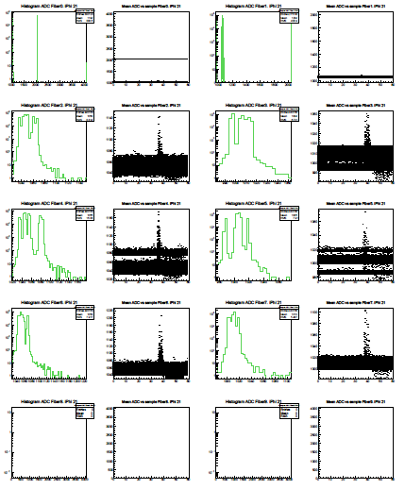
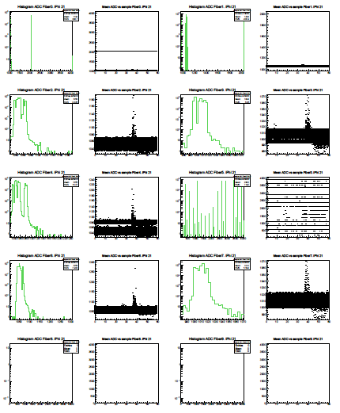
Run 301976
Run taken with a simple dead time of 15.
Latency setting: 0x56
(LAL LTDB)
Page8, run301976, EOS 04
Page8, run301976, EOS 24

Slide 4
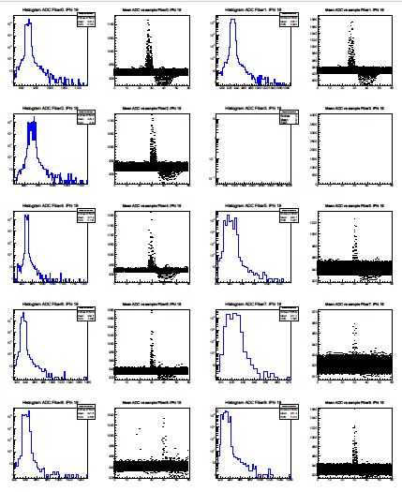
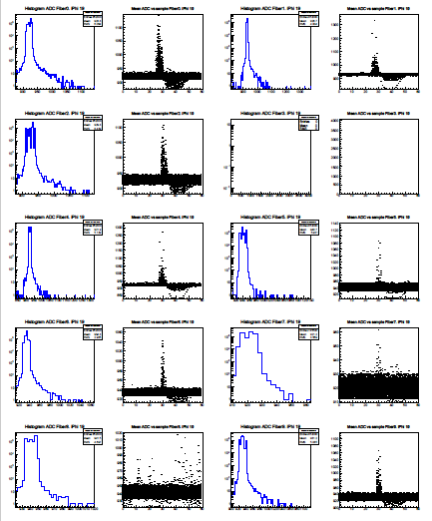
Run 302054
Standard deadtime run, immediately later.
Only 2 EOS files.
Latency setting: 0x56
(BNL LTDB)
Page 8: no data on LAL
Empty graphs.
Page4, run302054, EOS 01
Page4, run302054, EOS 02

Slide 5
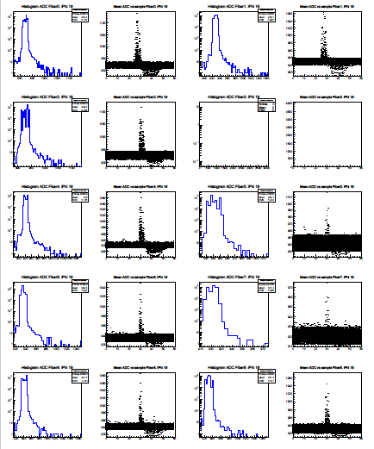
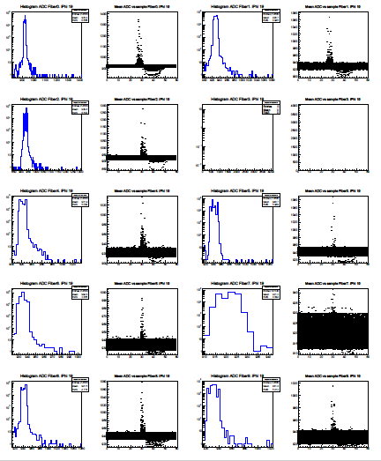
Run 302266
Standard deadtime run, immediately later.
Only 2 EOS files.
Latency setting: 0x56
(BNL LTDB)
Page4, run302266, EOS 01
Page4, run302266, EOS 02

Slide 6
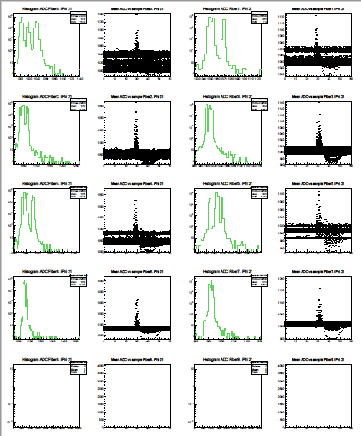
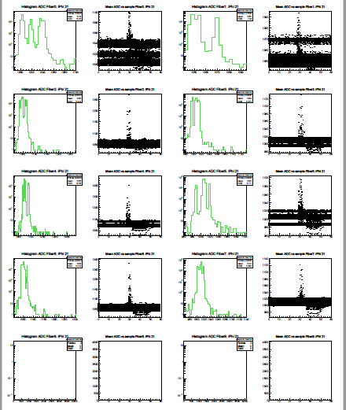
Run 302266
Latency setting: 0x56
(LAL LTDB)
To be noticed:
Pulse starting at 30
Page8, run302266, EOS 01
Page8, run302266, EOS 02

Slide 7
Some notes
RUN 311976
With a latency of 0x56
BNL should start at around 20 (but starting at 30)
LAL should start at around 30 (but starting at 40)
Special run on going? Latency not changed for ABBA?
RUN 30226
With a latency of 0x56
Both starting at 30… (a typo in the twiki?)

