Slide 1
ABBA firmware: status and outlook
Alessandra Camplani – universita’ degli studi di milano

Slide 2
2016: A year of a lot of improvements
Identified source of blockage: added length check in the UDP_module to prevent forwarding garbage data from Front FPGA to outer world:
ABBA readout very stable (no “dying” of FPGAs)
no reprogramming
Improved design constraints on both Front and Back FPGAs
Solving the pedestal hop issue in the data
Introduced more specific reset commands via IPbus
Introduced ID for tracing packets between Front and Back FPGA
New simulations available for Front FPGA firmware
Implemented protection against early readout
Solving latency issue in the data
Thanks to
all the firmware
people!!

Slide 3
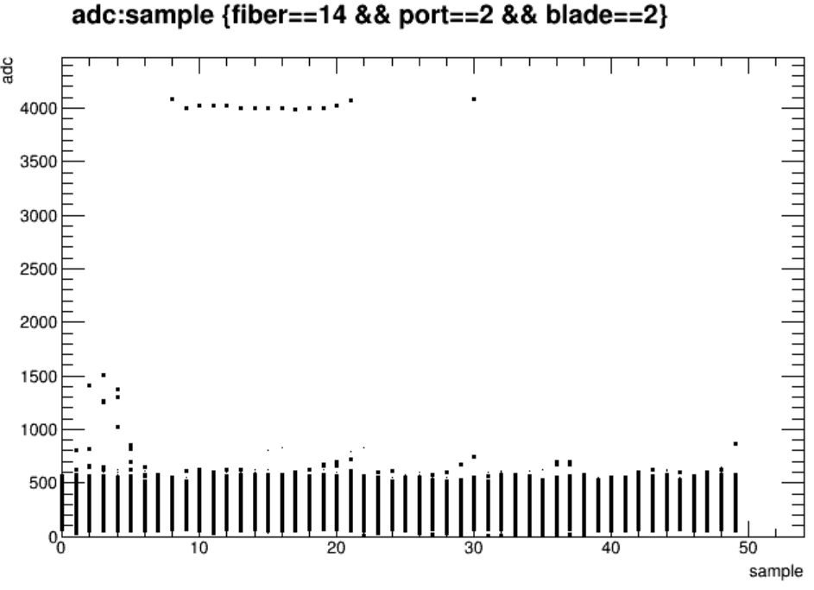
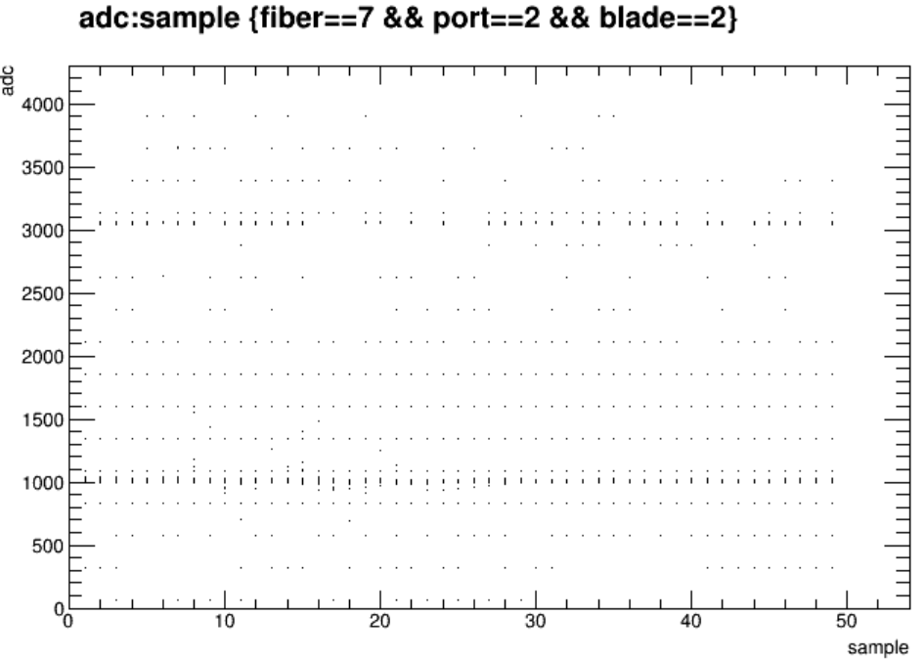
We can still do a lot (Front firmware)
From the Front FPGA point of view:
Once a fiber is unlocked, the data pattern shown is random
A fixed data pattern will be provided in the data
(Maybe something can be done also at software level e.g. a flag in the header to declare an unlock fiber, as a cross check)
Thanks Laura for the plots!
Two unlocked fibers from run 307712 between LAL LTDB and FPGA 18:2

Slide 4
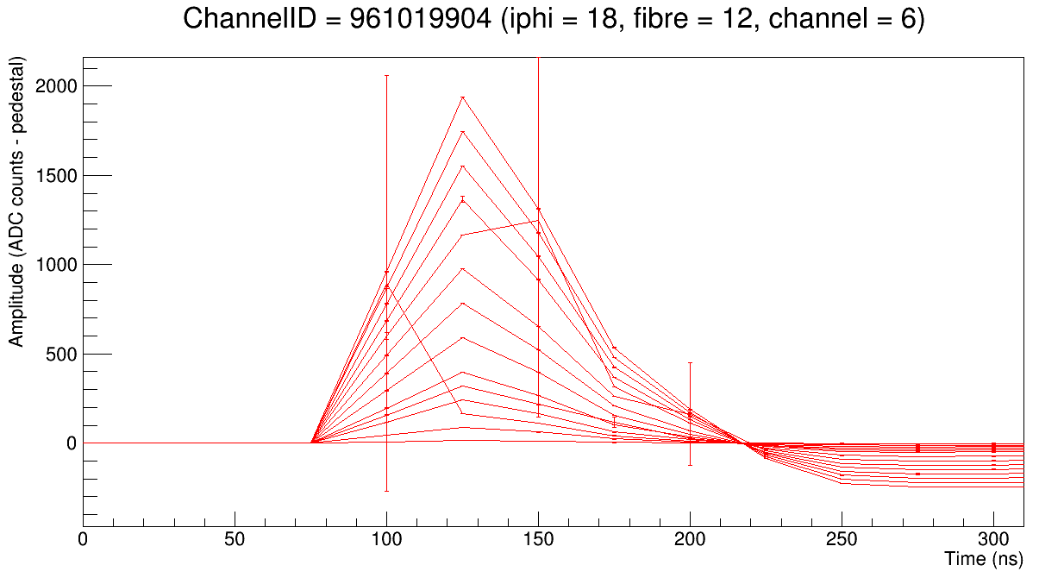
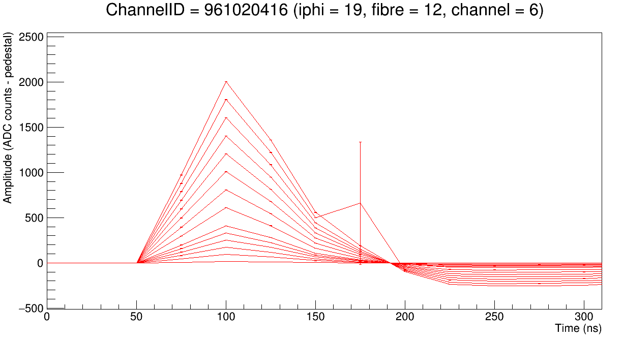
We can still do a lot (Front firmware)
Have a fixed latency upon fiber locking
As Nicolas DD was suggesting:
Have a register with the latency difference between the TTC BCR and the LTDB BCR (K-code)
Knowing the latency used to read the data buffer, the difference between this value and the one in the register is -1, you add +1 to the latency used to read the data buffer
FPGA 19:2
FPGA 20:2
Thanks Peter for the plots!

Slide 5
We can still do a lot (Back firmware)
From the Back FPGA point of view:
Now that the ID tracing is implemented between Front and Back FPGA:
It can be possible to monitor and count the packets lost between the Front and Back FPGAs
To monitor we need registers and IPbus in the Back FPGA
A basic implementation is already there but something more is needed..
Re-use the IPbus code already implemented in the Front FPGA firmware

Slide 6

Thanks for your attention!
Questions?
Merry Christmas and Happy New Year!

