Slide 1
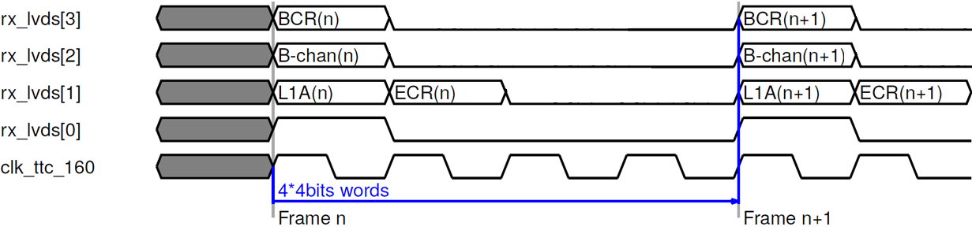
TTC protocol
Input from Carrier to Latome (and decoded inside LATOME firmware):
Clock frequency 160 MHz
16 bits available per frame (4 words)
4 bits of data received from Carrier
rx_lvds[1], rx_lvds[2], rx_lvds[3] for data trasmission: L1A, Channel B, BCR, ECR
rx_lvds[0] for the synchronization: 1 on the first word and 0 on the others.

Slide 2
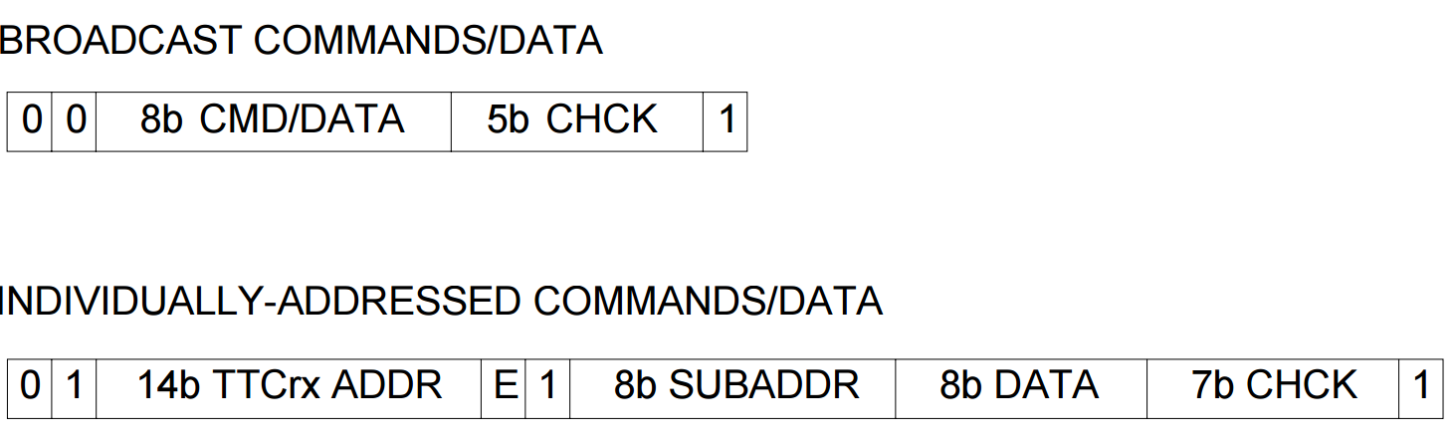
B channel
B channel: short broadcast or long addressed commands.
Decoded inside LATOME firmware.
Short Broadcast, 16 bits: 00TTDDDDEBHHHHH1
T=test command, 2 bits. D=Command/Data, 4 bits. E=Event Counter Reset, 1 bit. B=Bunch Counter Reset, 1 bit. H=Hamming Code, 5 bits.
Long Addressed, 42 bits: 01AAAAAAAAAAAAAAE1SSSSSSSSDDDDDDDDHHHHHHH1
A= TTCrx address, 14 bits. E= internal(0)/External(1), 1 bit. S=SubAddress, 8 bits. D=Data, 8 bits. H=Hamming
From the B channel the TType will be decoded.
(It’s coming inside the Long Address)

Slide 3
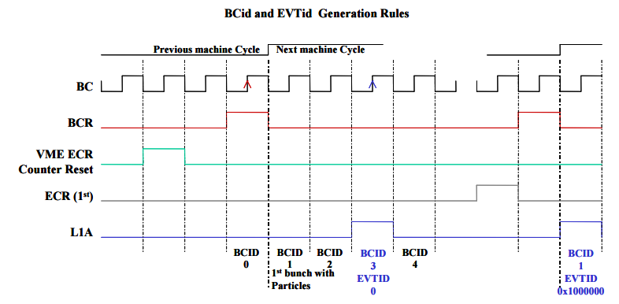
BCID & EVID
BCID and EVID values are also calculated inside LATOME firmware.
BCID details: 12 bit vector
Every time that a BCR signal is received the counter is going back to zero.
If no BCR is received the counter continues to count until the next BCR.
BCID value is needed every time that a L1A is received.
EVID details: 32 bit vector made of two counters
31 downto 24: ECR sub-counter
23 downto 0: L1A sub-counter
How to count:
Every time that an ECR is received the ECR sub-counter is increased while the L1A sub-counter is set to 1.
Every time that a L1A is received the L1A sub-counter is increased.
From a document provided by Guy

