Slide 1
TTC status
Alessandra Camplani – Università degli Studi di Milano
01/08/2016

Slide 2
Decoding TTC from Carrier
Decoding has been divided into two parts:
TTC decoding
Bchannel decoding (as a sub-part of the main TTC decoding part)
Status:
TTC decoding (L1A, ECR, BCR): code and simulation are ready
Bchannel decoding (Ttype): code ongoing

Slide 3
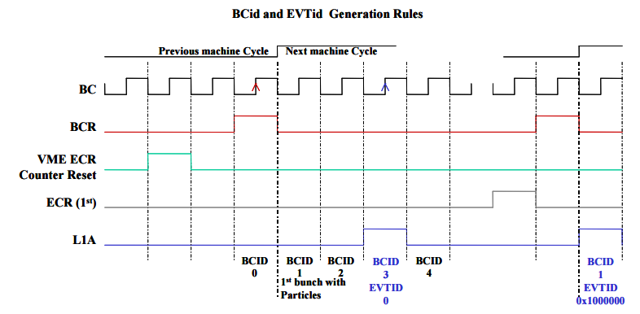
EVID and BCID
Implemented counters for BCID and EVID (looking at what was already done in ABBA firmware).
From a document
provided by Guy

