Slide 1
ABBA firmware (and partition) status
Alessandra Camplani – Università degli Studi di Milano
05/07/2016

Slide 2
Improvements in front FPGA
Version v0.96b
Solved all the remaining timing constraints (thanks to Kenta!)
Version v0.96b1 (test version)
Improved reset structure: several soft_resets are now available to reset different interfaces, registers and counters (more details in the next slides).
New registers implemented.
Version v0.96c
Released version for v0.96b1
2

Slide 3
New reset structure in front FPGA
A new reset structure has been implemented and is now available in front FPGA firmware.
The soft_resets signal is a 32 bit vector and each bit is able to reset a specific register/counter/memory in front FPGA firmware (more detailed table in the next slide).
These resets can be used from the standalone tool, selecting the command “fpga_reset” and the FPGA:
./fpga_resets 10.145.91.19 1
A hexadecimal parameter will be required for the reset, for example:
1f to reset LTDB interface
7f00 to reset ABBA configuration
1000000 to reset the TTC decoder
60000000 to reset the interface to the back FPGA
These resets are now also implemented in the ABBA partition at CONFIG and START level.
3

Slide 4
Available soft_resets bits
byte | bit | reset name | dedicated to |  | byte | bit | reset name | dedicated to
0 | 0 | rst_int_ltdb | LTDB interface |  | 2 | 16
 | 1 | rst_mem_ltdb |  |  |  | 17
 | 2 | rst_reg_ltdb_ctrl |  |  |  | 18
 | 3 | rst_reg_ltdb_dec |  |  |  | 19
 | 4 | rst_cnt_ltdb_err |  |  |  | 20
 | 5 |  |  |  |  | 21
 | 6 |  |  |  |  | 22
 | 7 |  |  |  |  | 23
1 | 8 | rst_reg_l1a_latency | ABBA configuration |  | 3 | 24 | rst_int_ttc | TTC interface
 | 9 | rst_mem_abba |  |  |  | 25 | rst_int_AV | avalon interface
 | 10 | rst_reg_header |  |  |  | 26 | rst_int_XAUI | XAUI interface
 | 11 | rst_cnt_l1a |  |  |  | 27 | rst_int_osc01 | (not yet implemented)
 | 12 | rst_cnt_pkg_write |  |  |  | 28 | rst_int_osc23 | oscillator interface
 | 13 | rst_cnt_pkg_diff |  |  |  | 29
 | 14 | rst_cnt_pkg_sent |  |  |  | 30
 | 15 |  |  |  |  | 31
4

Slide 5
New registers implemented
Two new registers have been implemented in the front FPGA firmware to monitor the packets:
Register name | Register address | Internal variable name | Read_counters interface name
L1A_TTYPE_CNT_REG_ADD* | 16011 | l1a_ttype_cnt | l1a received counter
L1A_ADC_PACKET_WR_CNT_REG_ADD | 16013 | l1a_adc_packet_wr_cnt | l1a packet built counter
L1A_ADC_PACKET_RD_CNT_REG_ADD | 16014 | l1a_adc_packet_rd_cnt | l1a packet trasmitted counter
* was called L1A_TTC_CNT_STATUS_REG_ADD and was used for both l1a received counter and l1a packet built counter.
Also in this case, the counters can be displayed from the standalone tool, with the command “read_counters”, selecting the FPGA:
./read_counters 10.145.91.19 1
They are also available now on the ABBA partition panel per each FPGA that is recording data.
5

Slide 6
Latency and n°samples changes
Two major changes in the default settings for ABBA partition have been done on 28 June:
Number of samples read out changed to 50 (instead of 60)
Changed done to because we were losing 50% of data
After this change data lost were only 1…5 (after 200 ... 300 events)
Latency settings changed to 0x42 (instead of 56, for all fibers):
Changed done because the pulse tail is partially cut
Moving the pulse into the new readout window
Result of this change presented in the next slides
6

Slide 7
Latency settings issue (1)
After the latency change some issues have been found.
More details about the starting sample for the pulses are shown in the table:
Pulse starting at sample....
 | 28 May run 300346 latency = 56 | 28 June run 302942 latency = 42 before partition update | 30 June run 303060 latency = 42 after partition update | 3 July run 303265 latency = 56 after partition update
LAL LTDB | 28 | 33 | sample 6 | 28
BNL LTDB | 20 | 25 | sample 0 or before | 19
More tests to be done (in EMF) to find the reason of this behaviour!
7

Slide 8
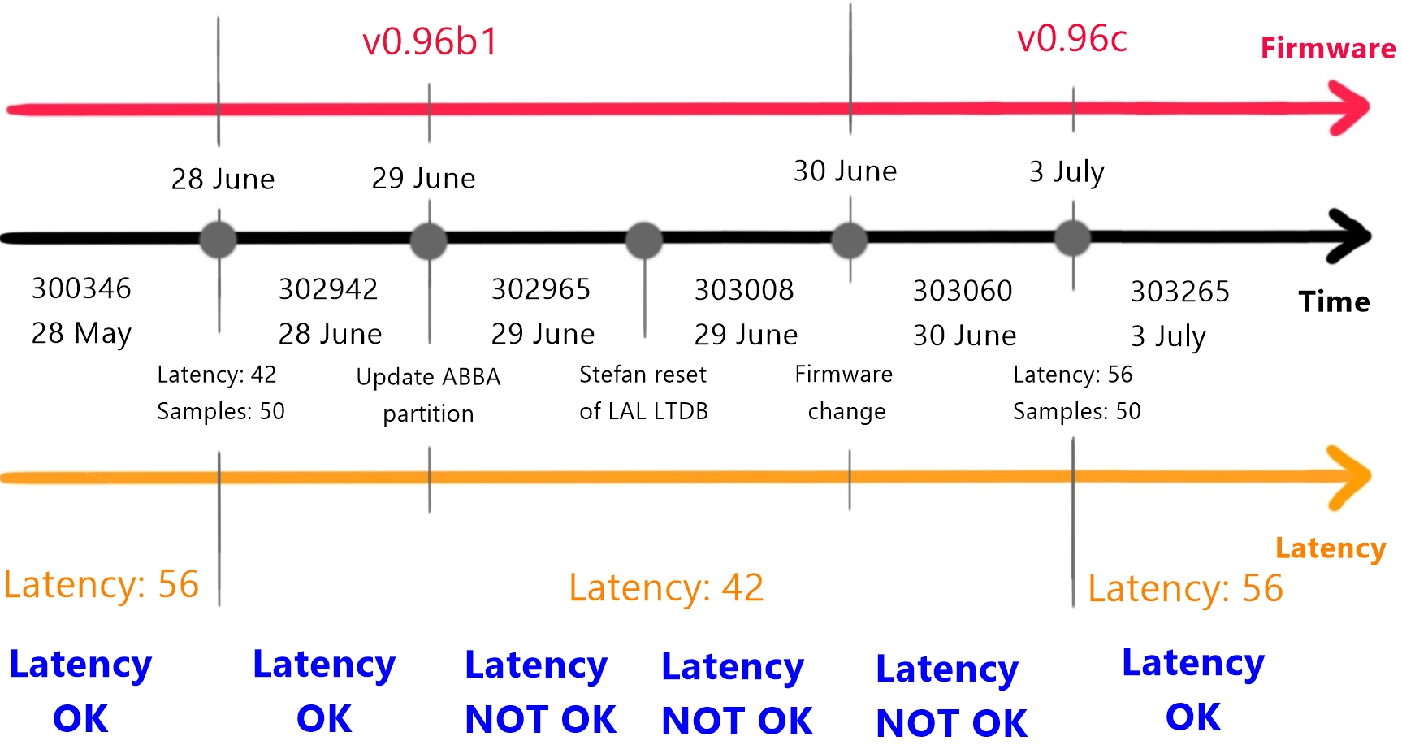
Latency settings issue (2)
Thanks to Adriana!
8

Slide 9
Conclusion and outlook
Stable data taking: no need to send reset or reconfigure the FPGAs.
New firmware versions for front FPGA:
Timing constraint solved
New reset structure
New registers for packet monitoring
Solved: bad readings in the first sample
Thanks to the new reset structure in front FPGA firmware
Ongoing
Latency check and pulse position to be understood
Still searching the reason of the HOP
9

Slide 10
BACKUP SLIDES

Slide 11
Updates in ABBA partition
Last updates in ABBA partition:
27 June
Loaded v0.96b1 on all our 4 Front FPGAs of the ABBA and applied a TDAQ patch for the ABBA package to use the new firmware features.
28 June
The transition Stop -> Start was not enough to bring back ABBA into normal data taking mode. Instead the transition Stop -> Unconfig -> Config -> Start is the way to go.
29 June
New patches have been added to:
- restore the standart transition Stop -> Start for data taking (more details in next slides)
- read the l1a received counter
- read the l1a packet built counter
- read the l1a packet trasmitted counter
11

Slide 12
Reset in ABBA partition
at pressing CONFIG
Issue reset 0x01_FF_FF_FF
Read back the "configuration fully done" register: Expect 0.
Configure all settings (TType, # samples etc.)
at pressing START:
At prepare for run reset value 0x7A 00
Set "configuration fully done"; read back, expect 1
at pressing STOP:
Nothing, should remain how it is now
at pressing UNCONFIG:
Unset "configuration fully done"; read back, expect 0
12

Slide 13
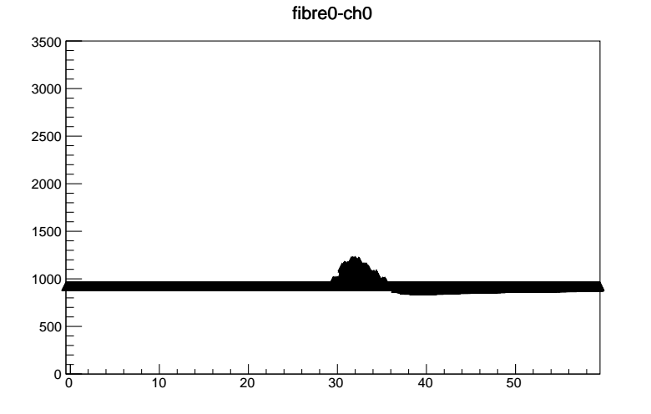
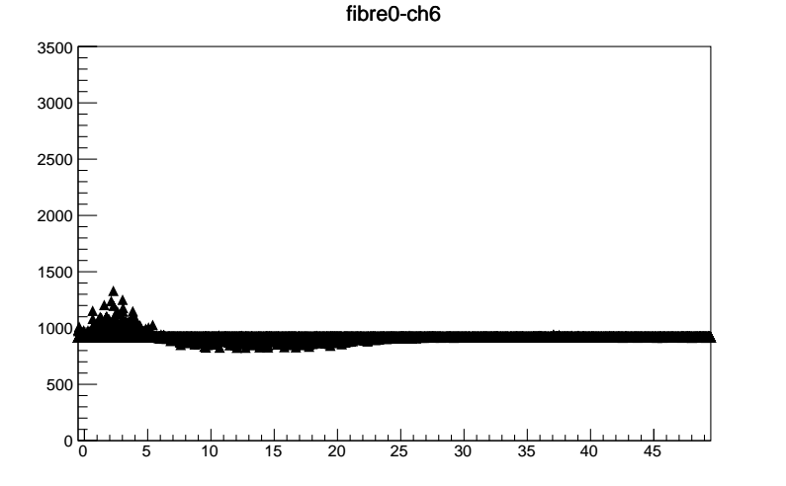
Pulses position
Run 302611 (22 june)
Run 303060 (30 june)
13

