Slide 1
TTC status
Alessandra Camplani – Università degli Studi di Milano
01/08/2016

Slide 2
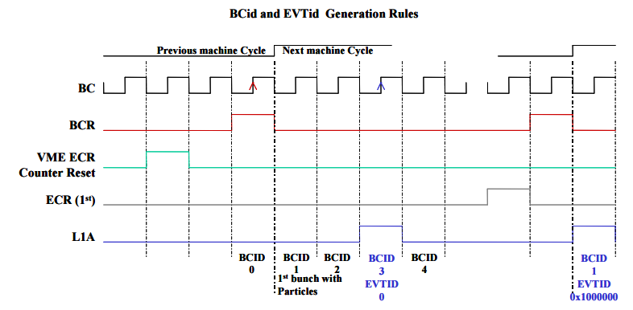
Decoding TTC from Carrier
Decoding has been divided into two parts:
TTC decoding
Bchannel decoding (as a sub-part of the main TTC decoding part)
Status:
TTC decoding (L1A, ECR, BCR): code and simulation are ready
Bchannel decoding (Ttype): code ongoing
Implemented counters for BCID and EVID (looking at what was already done in ABBA firmware).
From a document provided by Guy

Slide 3
EVID and BCID: some details
BCID details: 12 bit vector
Every time that a BCR signal is received the counter is going back to zero
If no BCR is received the counter continues to count until the next BCR
BCID value is needed every time that a L1A is received
EVID details: 32 bit vector made of two counters
31 downto 24: ECR sub-counter
23 downto 0: L1A sub-counter
How to count:
Every time that an ECR is received the ECR sub-counter is increased while the L1A sub-counter is set to 1
Every time that a L1A is received the L1A sub-counter is increased

