Slide 1


ABBA firmware: latency correction
Alessandra Camplani – Università degli Studi e INFN Milano
17-01-2017

Slide 2
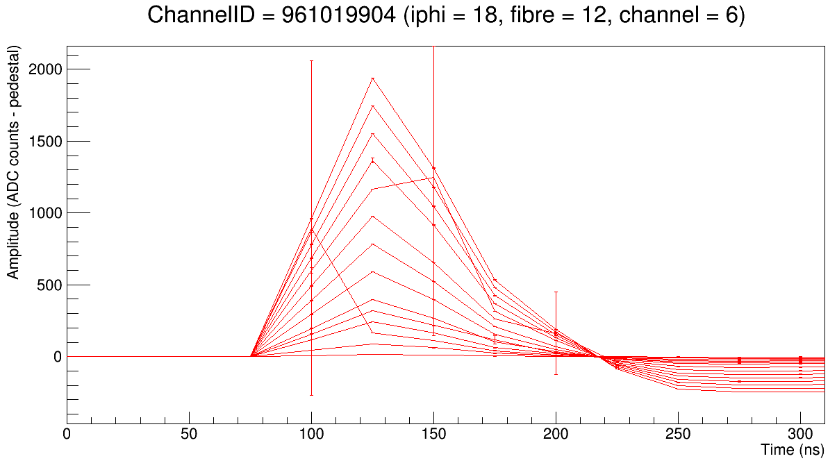
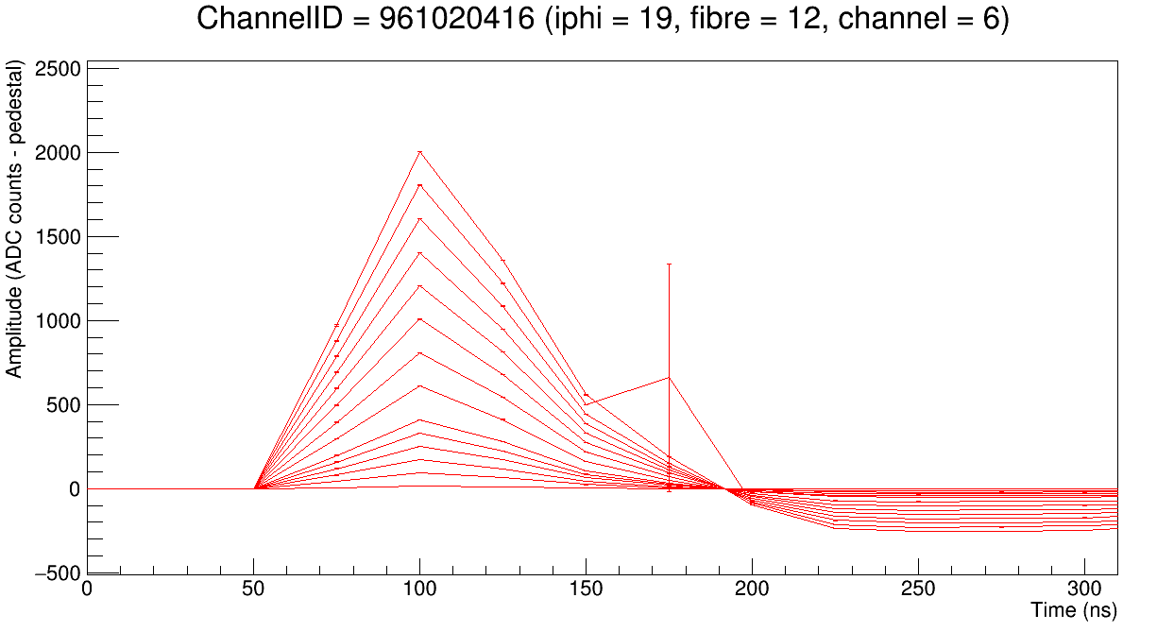
Latency fiber to fiber issue
The peak position of the pulse can be off by 1BC:
Fiber to fiber in the same run
On the same fiber in different runs
Reason: uncertainty of phase of the hardware transceivers after reset
Goal: have a fixed latency upon fiber locking to avoid these misalignments
FPGA 19:2
FPGA 20:2
Thanks Peter for the plots!

Slide 3
How to improve
Key value: the latency difference between the TTC BCR in ABBA and the LTDB BCR (K-code)
Measured by Nicolas DD a long time ago: LAr Week March 2015
The delay between TTC BCR in ABBA and LTDB BCR is 0x44
If we assume 0x44 to be the “real” latency value between the two boards, then we can calculate fiber by fiber:
Lreal – Lmeasured = Correction_value
which could be either positive or negative.
But this is not the end….

Slide 4
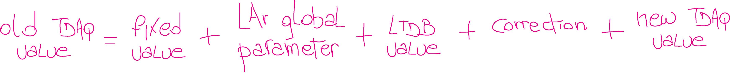
New values
TDAQ value used now (to have the pulse peak at position 20 in the readout window) for:
Physics BNL = 0x56
Physics LAL = 0x4e
In the firmware this value will be substituted by this combination of values:
Set in the firmware and calculated to comply the LAr global and the new TDAQ value: it will be -46
For example, 104 for LAr Physics, to be set through TDAQ
Set in the firmware, it will be 8 for BNL LTDB and 0 for LAL LTDB, according to the latency between the two boards
Set in the firmware, it is the value explained previously
To have the pulse at position 20 in the readout window, this value will be set directly to 20 in the panel

Slide 5
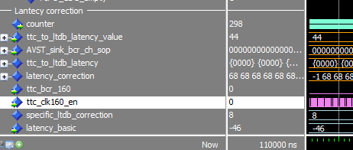

Firmware preparation
From the firmware point of view:
The correction calculation is ready, for the moment just simulated on fiber 0
Two values used in the equation are set
Here is 8 because the BNL LTDB case was simulated.
0x44 is 68 in decimal

Slide 6
Conclusion
The development to solve the latency fiber to fiber is started
The Latency correction and the firmware values fixed value, and LTDB value are ready
To be done: implement/modify registers for the values set in TDAQ
Sum these numbers to read properly the circular buffer
What about LAL LTDB?
Some tests (some calibration runs in EMF or in USA15) must be done before releasing the new firmware.
Only when infrastructures are back

