Slide 1


ABBA firmware: latency correction
Alessandra Camplani – Università degli Studi e INFN Milano
31-01-2017

Slide 2
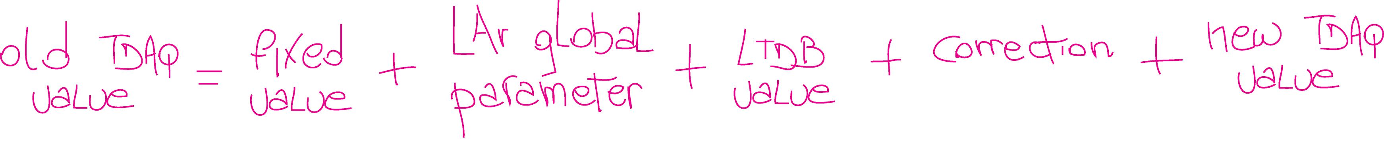
As a reminder..
TDAQ value used until now (to have the pulse peak at position 20 in the readout window) for:
Physics BNL = 0x56
Physics LAL = 0x4e
In the firmware these value have been substituted by this combination of values:
Set in the firmware and calculated to comply the LAr global and the new TDAQ value: it will be -46
For example, 104 for LAr Physics, to be set through TDAQ
Set in the firmware, it will be 8 for BNL LTDB and 0 for LAL LTDB, according to the latency between the two boards
Set in the firmware, it is the value explained previously
To have the pulse at position 20 in the readout window, this value will be set directly to 20 in the panel

Slide 3
Firmware development
Firmware development to solve the latency fiber to fiber:
Set latency values in the firmware:
Latency correction, fixed value and LTDB values are ready
Implemented register to read the two TDAQ values
Only one register was actually implemented with the sum the TDAQ values
Implemented new set of registers to monitor the latency correction per each fiber and per each FPGA (visible on TDAQ panel)
Re-used the old address values used to set the old latency
As soon as the simulations were ok, a first calibration run in EMF was taken (314958).

Slide 4
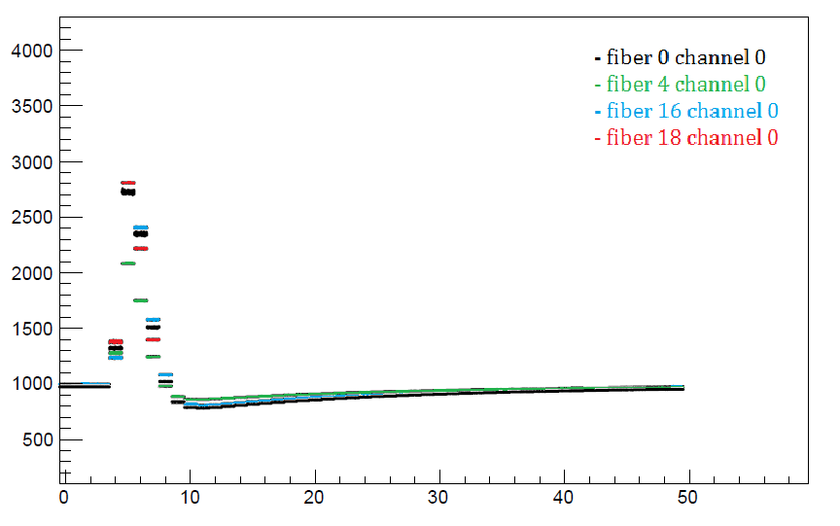
Very first check: ramp run in EMF
FPGA 0 on new Tokio board:
IP address 168.192.10.3
Latency value in TDAQ: 104
All the pulses are centered on the same bunch crossing: BC 5
Fibers 10 to 13 and 17 are unlocked.
Plotting some channels:

Slide 5
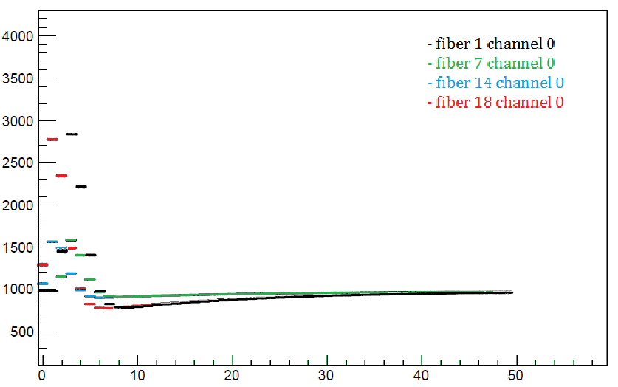
Very first check: ramp run in EMF (2)
FPGA 1 on new Tokio board:
IP address 168.192.10.3
Latency value in TDAQ: 100
Two groups of pulse peak:
until fiber 9: peak at BC 1
from fiber 14: peak at BC 3
The correct one should be at BC 1 (4 BCs from the other TDAQ value).
For some reason some of them (from fiber 14 to 19) are peaked at BC 3.
Fibers 10 to 13 are unlocked.
Plotting some channels:

Slide 6
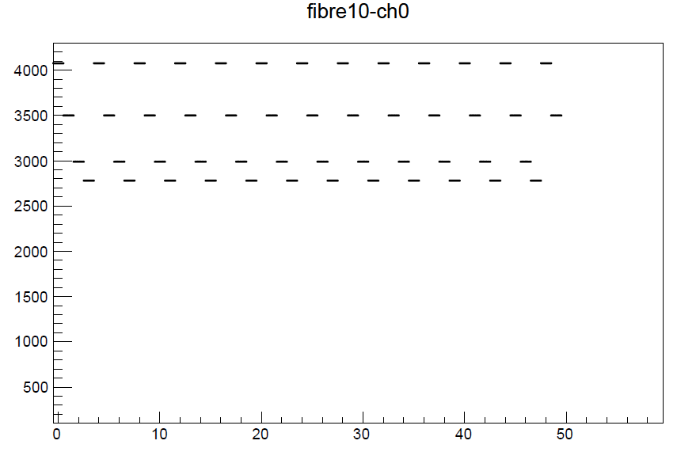
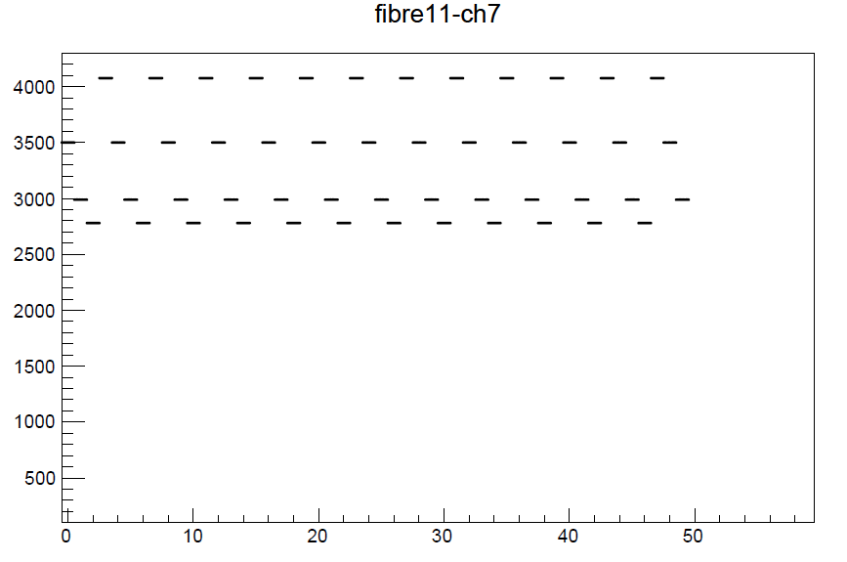
Unlocked fibers pattern
Another important update in the firmware:
when a fiber is unlocked now a fixed pattern is appearing.
Four words are rotating:
x"BAD" = 2989
x"DAC" = 3500
x"FEB" = 4075
x"ADC" = 2780
Again from the EMF run

Slide 7
Conclusion
From the latency correction point of view
Firmware is roughly ready: first test run in EMF was taken
FPGA 0 is ok, all the pulses are aligned on the very same BC
FPGA 1: two groups of peak on two different BCs
Could be hardware/fiber related? (should try with another ABBA)
(not sure about some fibers behaviour because they are unlocked)
From the fiber locked point of view
Firmware is ready
From EMF runs the pattern is appearing correctly
TODO
More calibration runs to be taken in EMF and USA15
Understand why two peak corrections in FPGA1

Slide 8
Back up slides

Slide 9
EMF Run: FPGA 2
FPGA 2 behaviour in EMF calibration run, fiber per fiber:
fiber 0 not pulsed
fiber 1 pulse at BC 3
fiber 2 pulse at BC 3
fiber 3 not pulsed
fiber 4 not pulsed
fiber 5 pulse at BC 3
fiber 6 pulse at BC 3
fiber 7 pulse at BC 3
fiber 8 pulse at BC 3
fiber 9 pulse at BC 3
fiber 10 unlocked
fiber 11 unlocked
fiber 12 unlocked
fiber 13 unlocked
fiber 14 pulse at BC 1
fiber 15 not pulsed
fiber 16 pulse at BC 1
fiber 17 unlocked
fiber 18 pulse at BC 1
fiber 19 pulse at BC 1

