Slide 1


ABBA firmware: latency correction
Alessandra Camplani – Università degli Studi e INFN Milano
28-02-2017

Slide 2
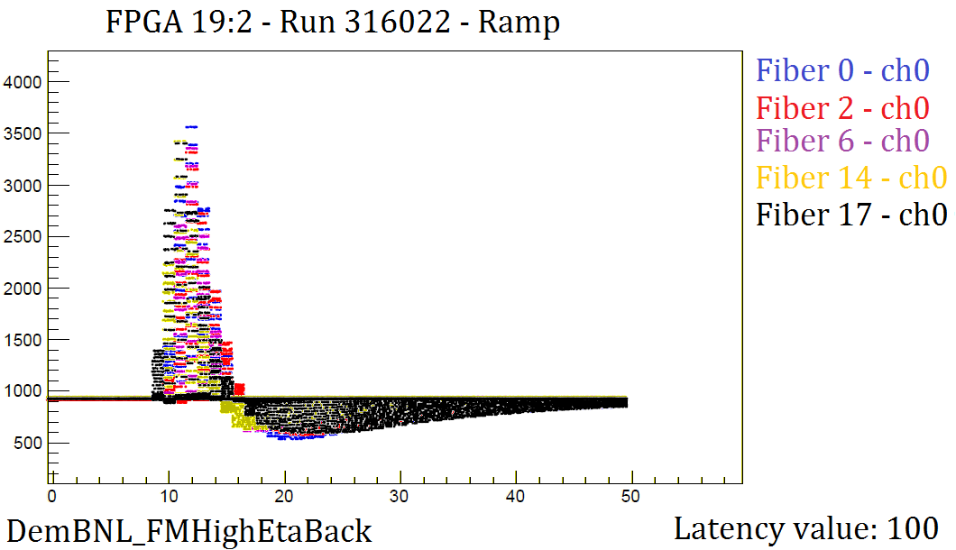
Ramp taken on 17.02.2017
Two peak positions:
BC 12 for fiber 0 to 9
BC 11 for fiber 14 and 19

Slide 3
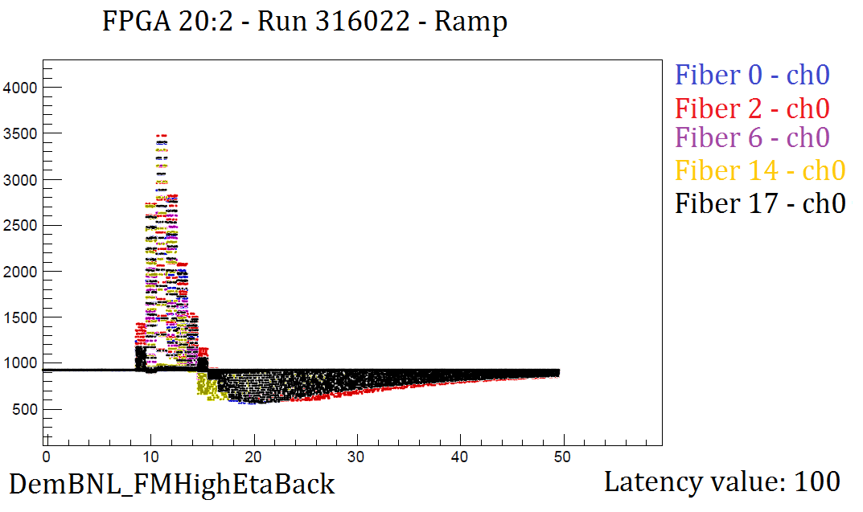
Ramp taken on 17.02.2017
All pulses aligned properly.

Slide 4
Since 21.2.2017
Funny behaviour also if the correction is applied:
Pulse peak moving fiber by fiber
Pulse peak moving channel by channel
This happened for more than one run taken on 21.2.2017
Very similar moving pattern for:
All the 19:2 files from different runs
All the 20:2 files from different runs

Slide 5
For example..
Run 316131 - 19:2 – latency value 105
Fiber 0 -> pulse peak BC 16/17
Fiber 1 to 2 -> pulse peak BC 17
Fiber 3 -> pulse peak BC 18
Fiber 6 to 9 -> pulse peak BC 17
Fiber 10 to 13 -> unlocked
Fiber 14 to 16 -> pulse peak BC 16
Fiber 18 -> pulse peak BC 17
Fiber 19 -> pulse peak BC 16
Run 316131 - 20:2 – latency value 105
Fiber 0 -> pulse peak BC 16
Fiber 1 -> pulse peak BC 15
Fiber 2 -> pulse peak BC 15/16
Fiber 4 -> pulse peak BC 15
Fiber 5 -> pulse peak BC 15/16
Fiber 6 -> pulse peak BC 16/17
Fiber 8 to 9 -> pulse peak BC 16
Fiber 10 to 13 -> unlocked
Fiber 14 -> pulse peak BC 16
Fiber 15 -> pulse peak BC 17
Fiber 16 to 19 -> pulse peak BC 16
Behaviour is very similar in next runs..

Slide 6
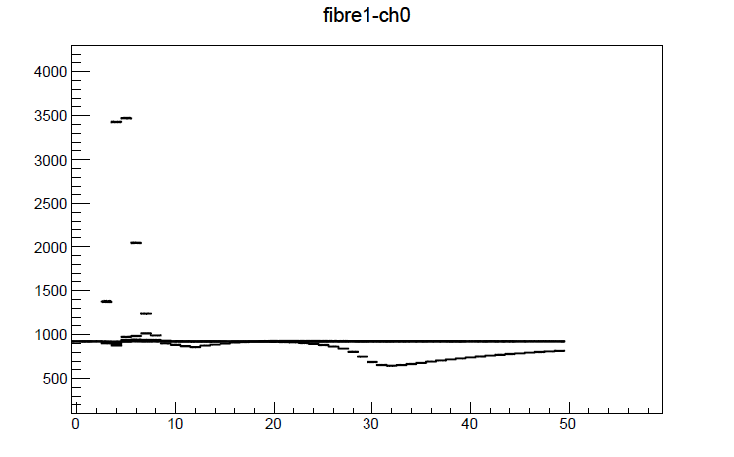
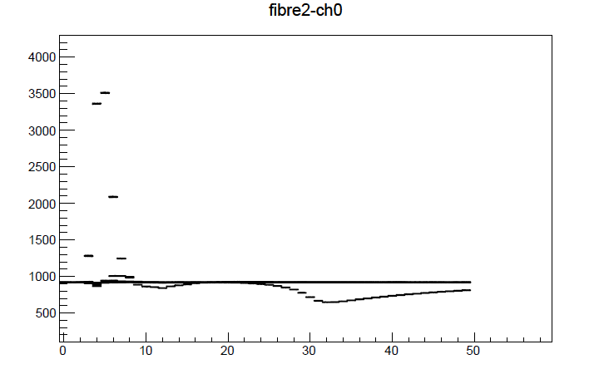
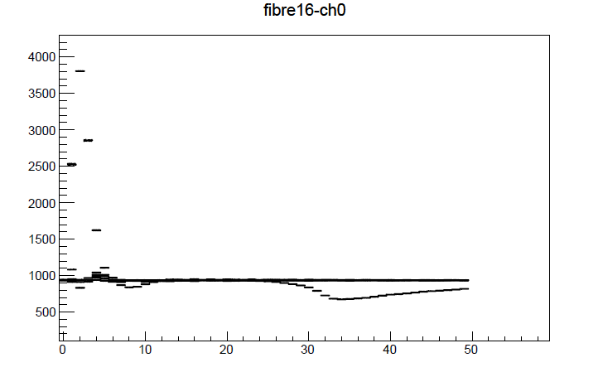
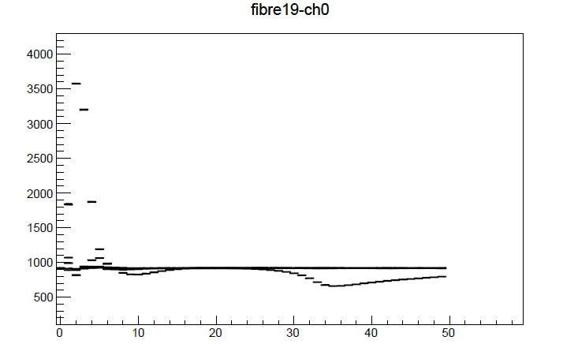
New calibrations from today
Run 316794
FPGA 19:2
Only one DAC value.
But with the
DemBNL_FMhighEtaBack
Parameter file.

Slide 7

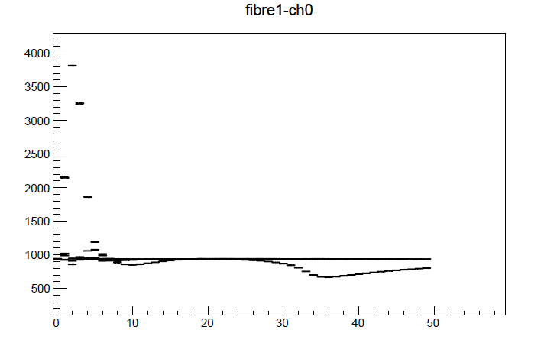
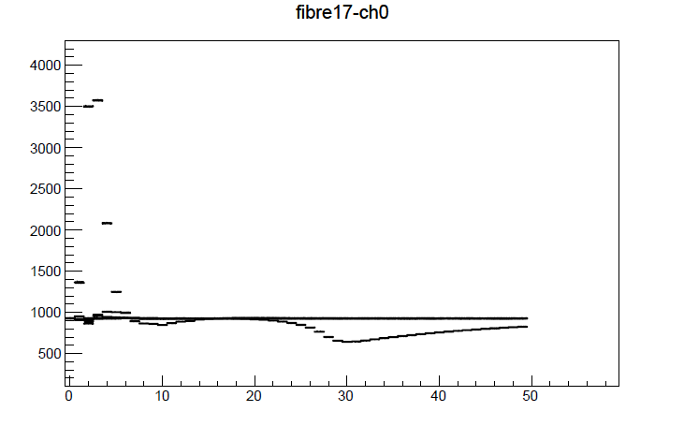
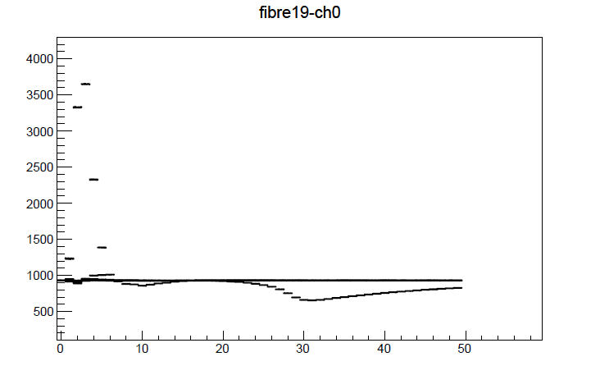
New calibrations from today (2)
Run 316794
FPGA 20:2
Only one DAC value.
But with the
DemBNL_FMhighEtaBack
Parameter file.

