Slide 1


ABBA firmware and system checks
Alessandra Camplani – Università degli Studi e INFN Milano
09-05-2017

Slide 2
Getting ready
Firmware version (official released) v0.99 (re)tested in USA15 on all FPGAs.
(No changes on the back FPGA firmware version for the moment)
With the help of Stefan Simion also the French LTDB has been properly reprogrammed.
More information about the procedure that we used to check the status are now in a dedicated section of the Demonstrator twiki.
Software on call (Adriana) took a calibration run on 28th of April: run number 321355 with the usual pattern for firmware tests.

Slide 3
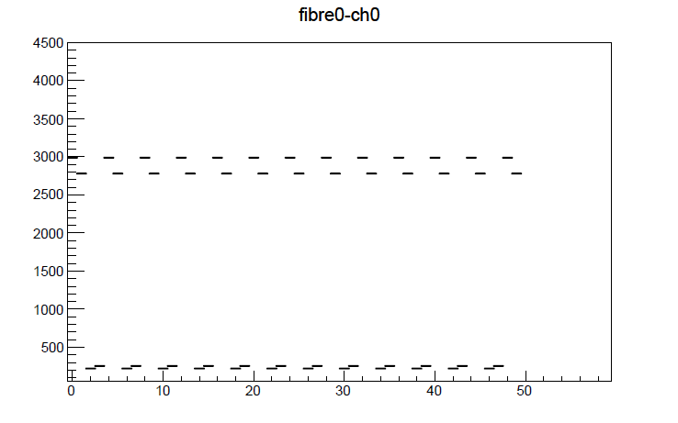
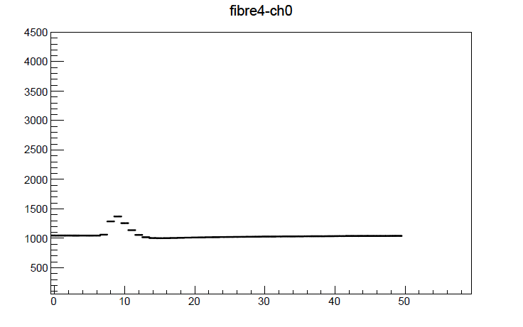

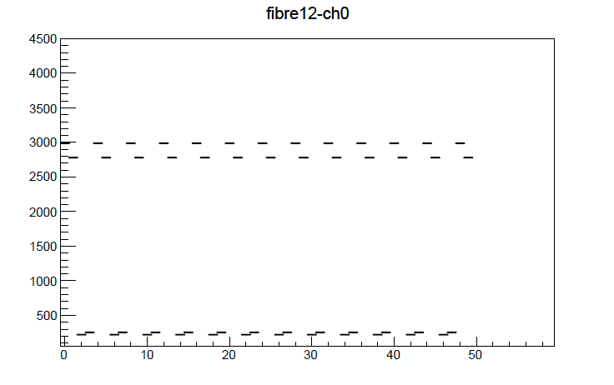
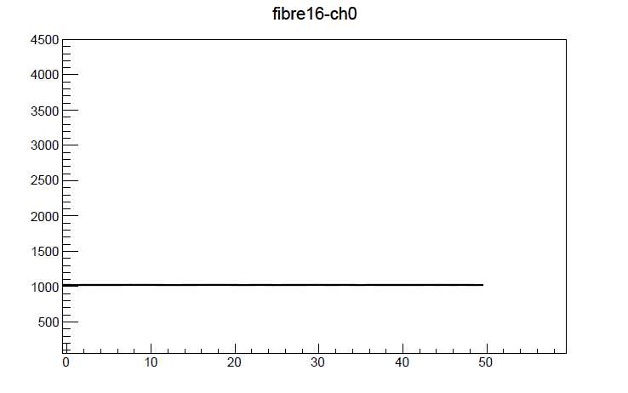

Run 321355 – FPGA 18:2 (French LTDB)

Slide 4

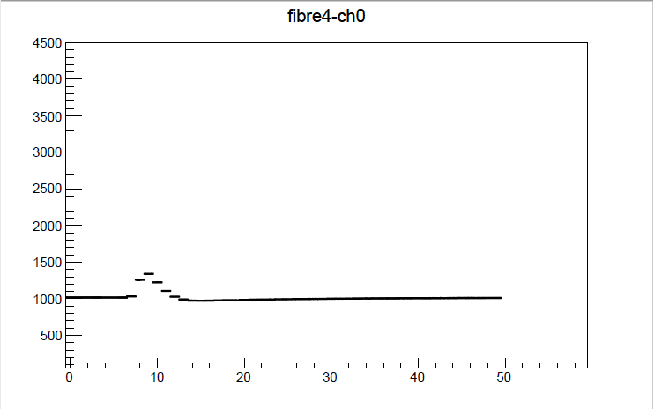


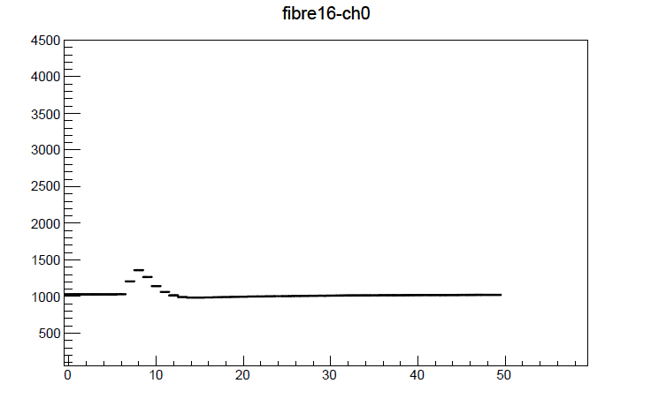

Run 321355 – FPGA 19:1 (French LTDB)

Slide 5
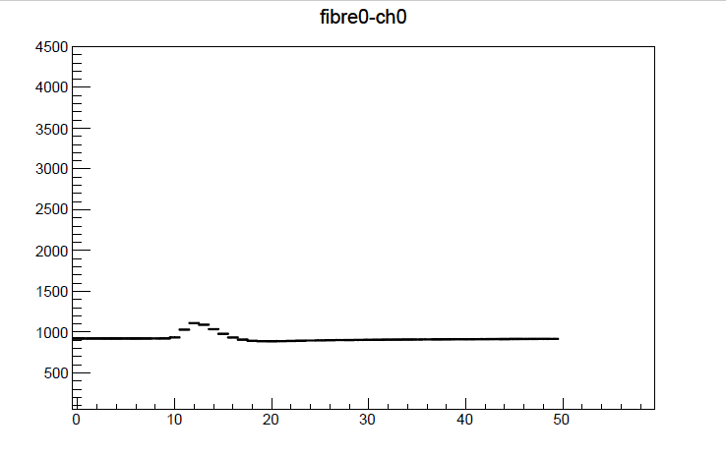
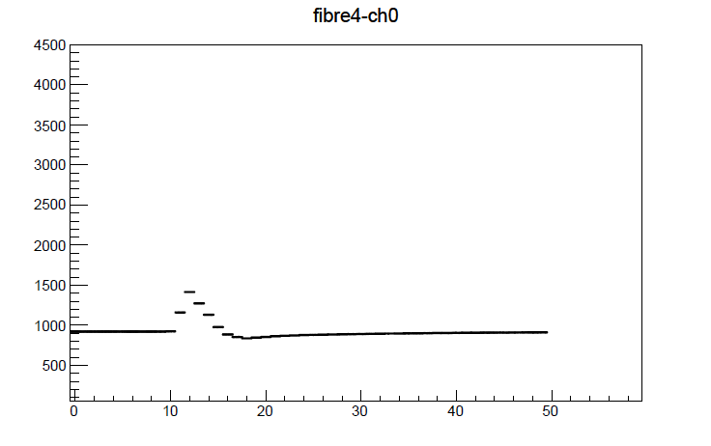

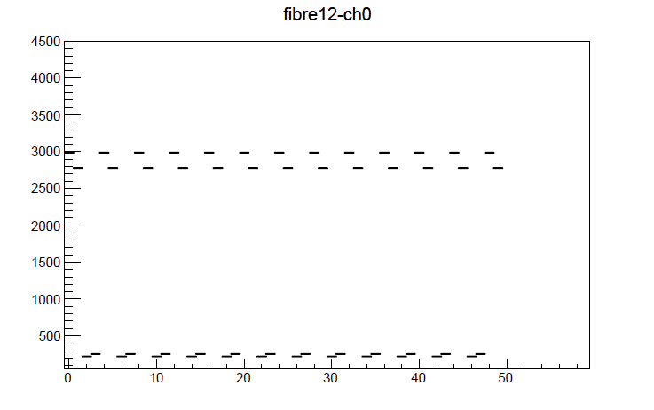


Run 321355 – FPGA 19:2 (BNL LTDB)

Slide 6



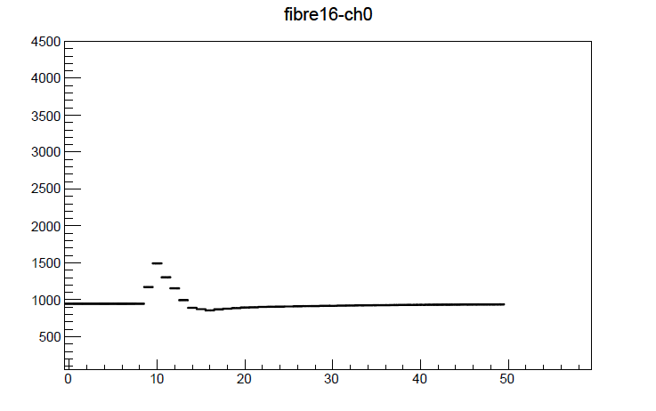

Run 321355 – FPGA 20:2 (BNL LTDB)

