Slide 1


ABBA firmware and system checks
Alessandra Camplani – Università degli Studi e INFN Milano
23-05-2017

Slide 2
Getting ready
Firmware version (official released) v0.99 (re)tested in USA15 on all FPGAs.
(No changes on the back FPGA firmware version for the moment)
Software on call (Jue) took a new set of calibration run on 16th of May: run number 323511 with the usual pattern for firmware tests.
Check the BNL pulses stability
Check the peak position and eventually correct the internal value in the firmware
Set in the panel the correct peak position

Slide 3
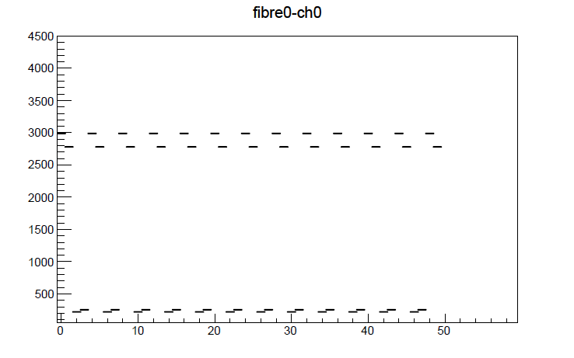
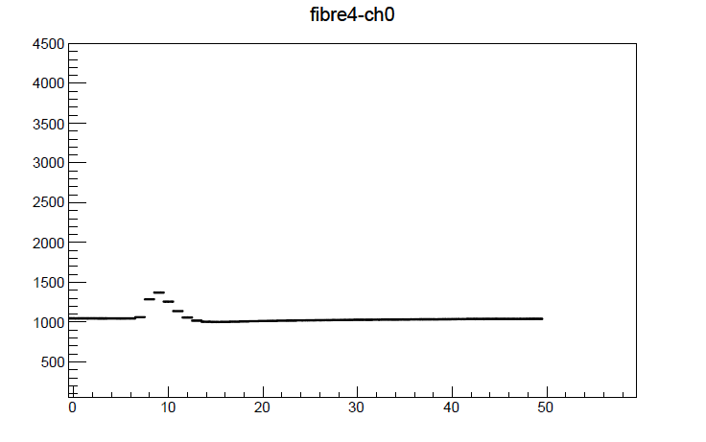

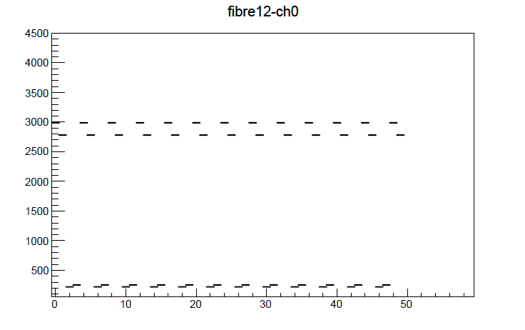
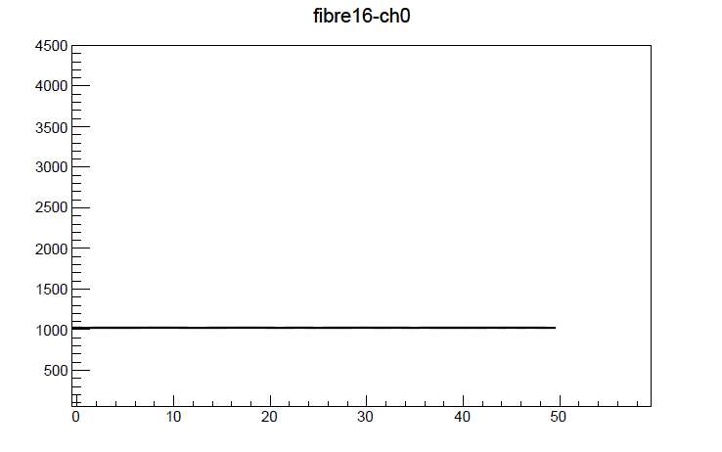

Run 321355 (28th of April) – FPGA 18:2 (French LTDB)

Slide 4
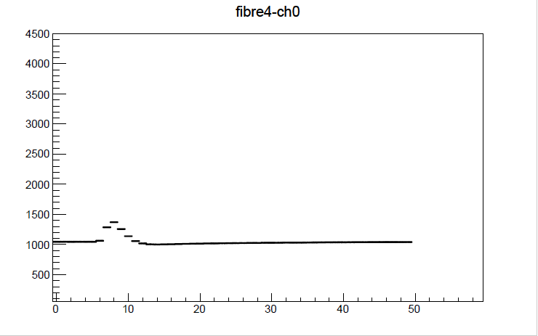
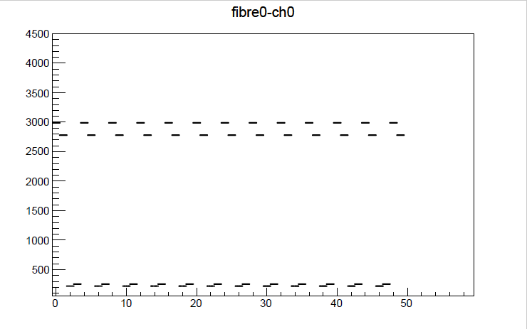
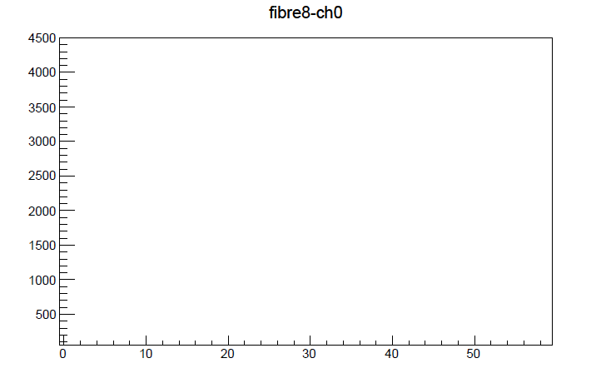

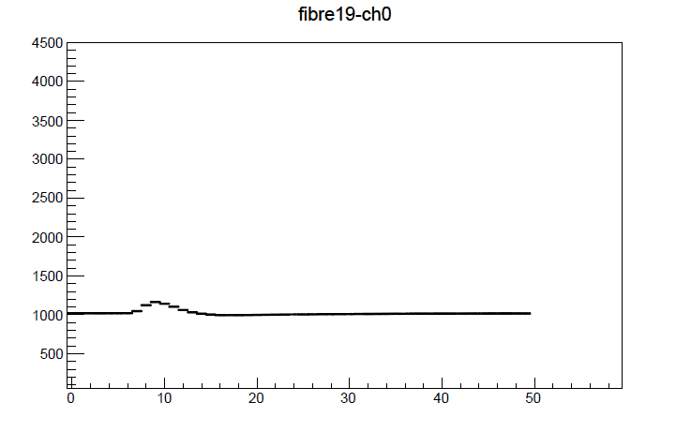
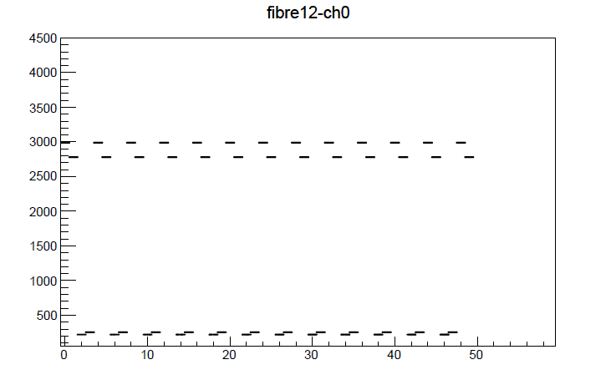
Run 323511 (16th of May) – FPGA 18:2 (French LTDB)

Slide 5

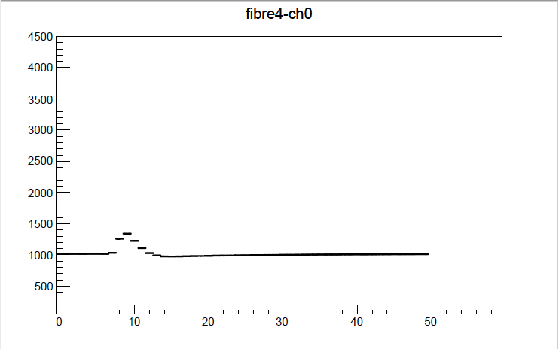




Run 321355 (28th of April) – FPGA 19:1 (French LTDB)

Slide 6
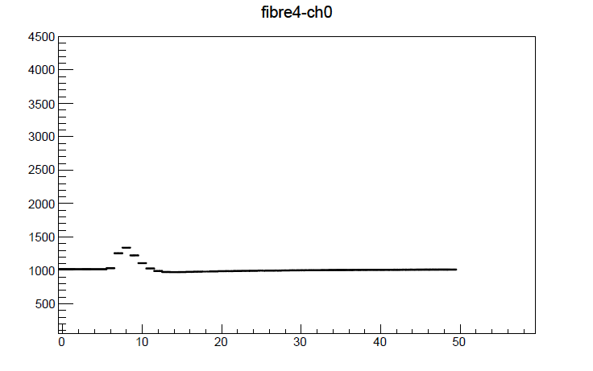
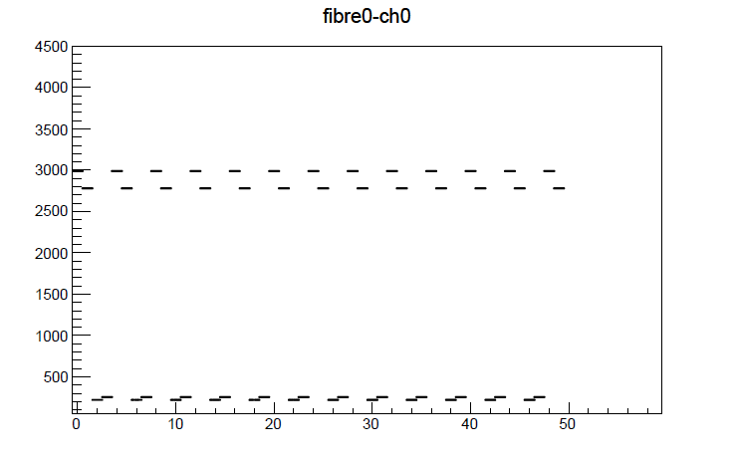




Run 323511 (16th of May) – FPGA 19:1 (French LTDB)

Slide 7
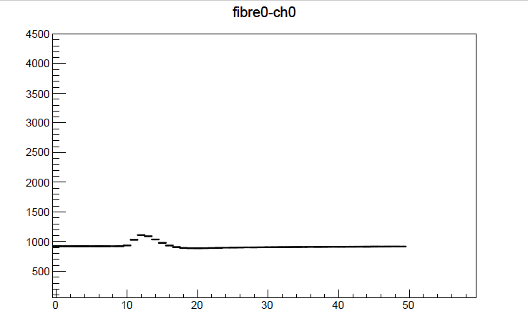
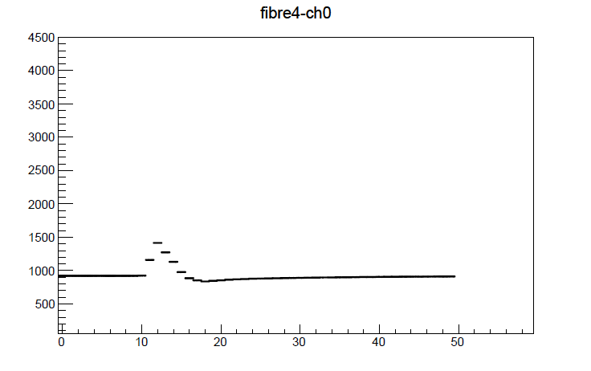




Run 321355 (28th of April) – FPGA 19:2 (BNL LTDB)

Slide 8

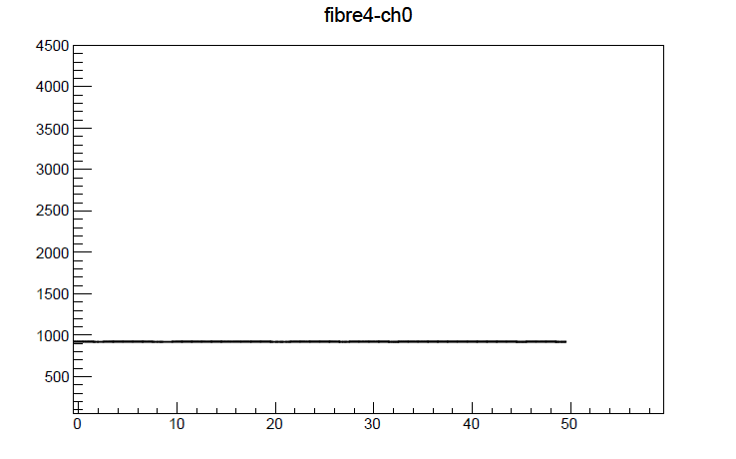
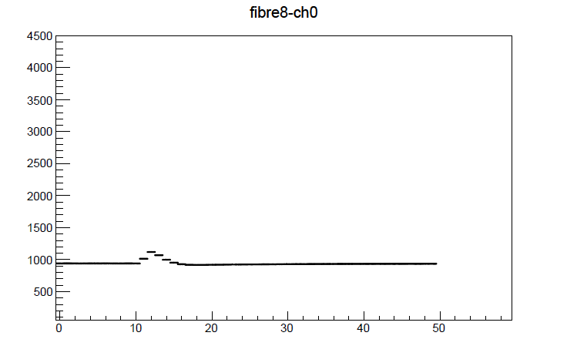



Run 323511 (16th of May) – FPGA 19:2 (BNL LTDB)

Slide 9



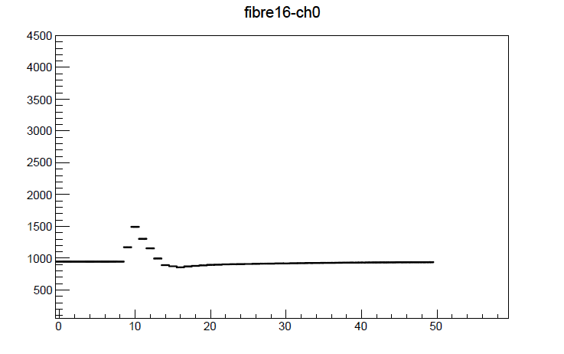

Run 321355 (28th of April) – FPGA 20:2 (BNL LTDB)

Slide 10






Run 323511 (16th of May) – FPGA 20:2 (BNL LTDB)

Slide 11

Conclusion
BNL pulses are stable
The latency setting inside the panel was set to 8 while the calibrations were taken
From the picture: the pulse peak is at 10
Before the official restart of the data taking the firmware will have to be recompiled
Fixed value has to be corrected: it is off by 2 BC
BNL 20:2

