Slide 1
ABBA firmware status
Alessandra Camplani – Università degli Studi di Milano

Slide 2
Firmware version: back FPGA
Firmware Version: 0.68
  Cleaned up and simplified the git repository structure
  Added firmware version for the back FPGA (Signal Tap only).
  UDP module now removes empty data bytes from paddedEthernet frames.
Firmware Version: 0.68a
  Added length check in the UDP module to prevent forwarding garbage data from Front FPGA to outer world.
  Abort frame transmission (by marking eof error) in IP module if the frame from the UDP module is longer than 1500 bytes.
  No overhead traffic when the Front FPGA send "random" data.
2

Slide 3
Details for version 0.68: padded data
An Ethernet packet (i.e. a request sent from a PC to the front FPGA) has a minimum number of bytes: 64 bytes
If there is less than 64 bytes, for example 45 bytes of data, extra padding data are added to the packet by the network card (on the PC)/by the MAC core on the back FPGA.
These extra data are part of our packet but should not be
(Maybe this was caused by a default option not deleted during the regeneration of the XGMAC core in Quartus 13.1)
The front FPGA is expecting a certain number of words but it is receiving a different number!
Body of the frame (64 bytes)
Header |  |  | Data | Footer
Destination MAC Address | Source MAC Address | Protocol | Payload | Cyclic Redundancy Check (CRC)
6 bytes | 6 bytes | 2 bytes | 46 to 1500 bytes | 4 bytes
Extra padding data: deleted in the UDP module
Back FPGA firmware
Front FPGA
NO extra padding data
UDP module
Extra padding data
Request
from the PC
3

Slide 4
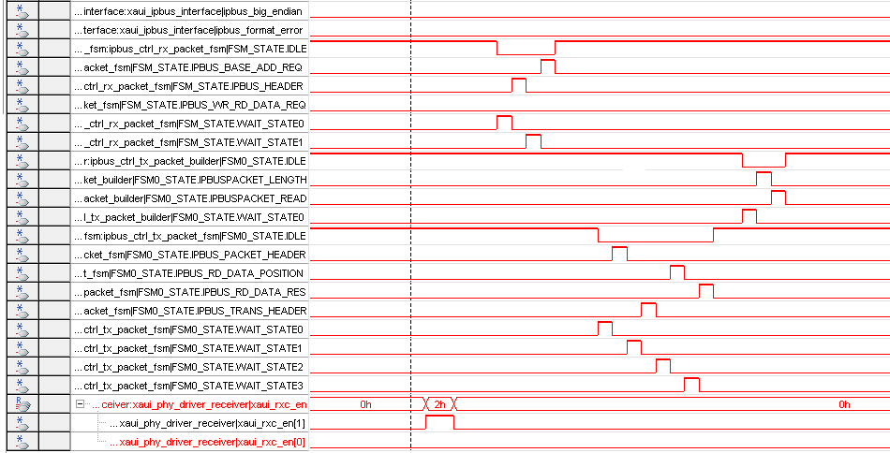
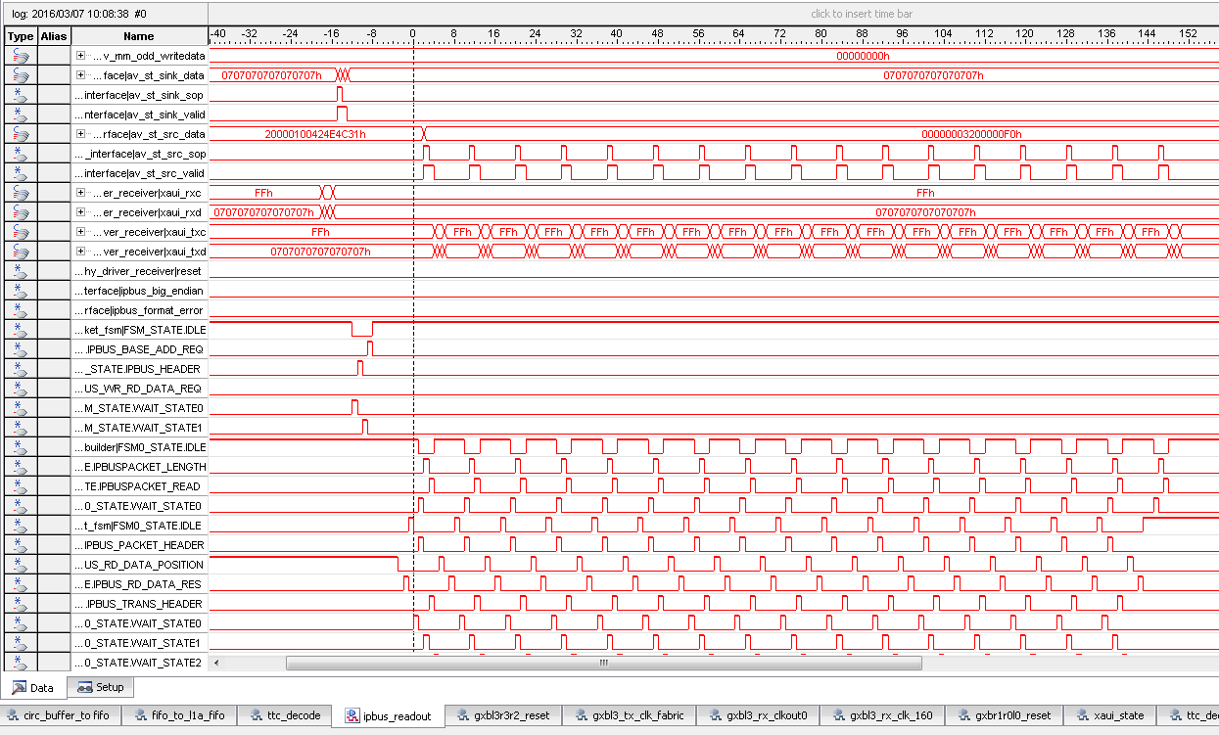
Front FPGA firmware: Ipbus state machine
State machine in front FPGA firmware:
creating response to the IPbus requests from PC
The same IPbus packet is sent to the front FPGA.
  Correct behaviour:
  Wrong behaviour:
The state machine is sending more than one response to the pc.
In the back FPGA: random words misinterpreted by the UDP module.
4

Slide 5
Details for version 0.68a: length check
FPGA 0 from ABBA 91.18 was sending some random data (see previous slide) that affect FPGA 1 on the same board, but also the other board:
FPGA 0 on ABBA 91.18 continuously sent very long packet of random data (data and addresses not known)
Back FPGA tried to identify the IP addresses and sent a ARP broadcast request to all the other modules (also to the other ABBA board)
No one was recognising the addresses: the system was blocked
The length check implemented in UDP and IP modules now avoids to transmission of garbage!
FPGA1
10.145.91.18
Back
?
FPGA0
correct length value: 0x0014=20
FPGA1
10.145.91.19
wrong length value: 0x0707 = 1799
Back
FPGA0
5

Slide 6
Firmware version: front FPGA
Firmware Version: 0.95
  Verified correct behaviour of optical reset in combination with oscillator auto-adjustment after cleaning and sorting of source files and libraries for ABBA Front FPGA.
Firmware Version: 0.95a
  Re-added L1A_TTC_CNT_STATUS_REG_ADD which got lost in version 0.94h.
Firmware Version: 0.95b
  Replaced mgwz_lib PLLs in ABBA_front_top with ALTERA_PLL.
6

Slide 7
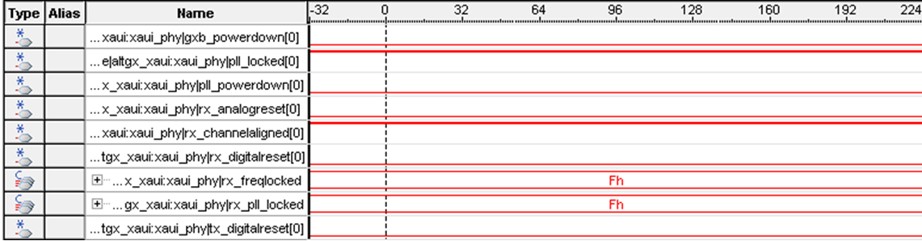
Details for version 0.95b: PLL change
Why this change:
Make the firmware uniform: try to use the same components
The picture shows the XAUI interface for communication with Back FPGA
Correct behaviour
Observed on FPGA 0 of ABBA 91.18 and FPGA 0 and 1 on ABBA 91.19, before and after the PLL change
7

Slide 8
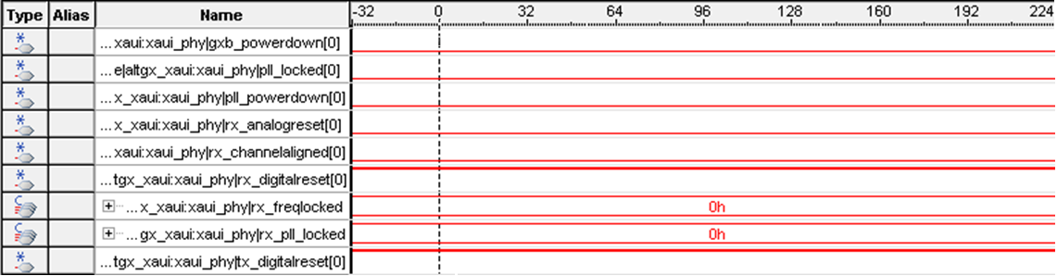
FPGA 0 on ABBA 91.18 in USA15
FPGA 0 from ABBA 91.18: XAUI interface for communication with Back FPGA
Non-understood behaviour both in version 0.95a and 0.95b:
The XAUI interface to the back FPGA does not lock!
We are still investigating the issue..
8

Slide 9
Conclusion and outlook
Version 0.95b for the front FPGAs and version 0.68a for the back FPGA are stable
  Now there is more control on data sent from and to the PC
From the state machine point of view: a simulation for this part is ready and we can reproduce this "strange" behaviour when injecting not 100% expected data (frame delimiters are not respected properly)
  For the future: have a look in more detail in its behaviour and possibly rewrite the RX and TX state machines.
  This will probably also include the ID for tracing packets from the Back FPGA to stabilize further packet exchange.
FPGA 0 on ABBA 91.18 in USA15 strange behaviour: still investigating..
  Plans to solve this issue (suggested by Nicolas Dumont-Dayot):
  Try to use a different (better) clock source: oscillator
  Try to change the XAUI transceiver (There are two pairs of XAUI transceivers interconnecting Front and Back FPGAs on ABBA => try the other..)
Started to investigate «critical warnings» in timing constraints
  Thanks again to Nicolas Dumont-Dayot who gave a crash course in investigating timing issues and addressing them.
9

