Slide 1
Firmware and other updates
Alessandra Camplani – Università degli Studi di Milano

Slide 2
Updates from the firmware
Back FPGA firmware is compiling.
With Steffen: debugging the code and found an issue
An Ethernet packet (i.e. a request sent from a PC to the front FPGA) has a minimum number of bytes: 64 bytes
If there is less than 64 bytes, for example 45 bytes of data, extra padding data are added to the packet.
These extra data should not be added to our packet
(Maybe caused by a default option not deleted during the regeneration of the XGMAC core in Quartus 13.1)
The front FPGA is expecting a certain number of words but it is receiving a different number!
Body of the frame (64 bytes)
Header |  |  | Data | Footer
Destination MAC Address | Source MAC Address | Protocol | Payload | Cyclic Redundancy Check (CRC)
6 bytes | 6 bytes | 2 bytes | 46 to 1500 bytes | 4 bytes

Slide 3
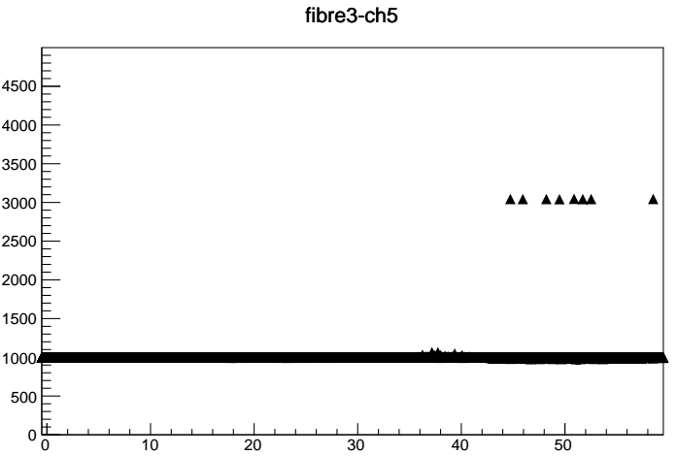
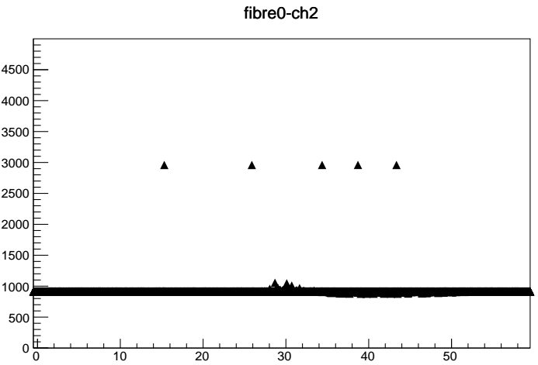
Updates from the K code
With Adriana: looking on the K code in the pedestal
The K comma symbol (also called "K code") is an 8 bit pattern that can be used to find and verify the boundaries of a bitstream and for synchronization. Both LTDBs use the symbol K28.5
 | DEC | HEX | BIN
K28.5 | 188 | BC | 10111100
On each LTDB channel, 12 bit frames (with the pedestal info) are sent.
The K comma pattern, once issued, will replace the 11th bit of each channel.
 | CH7 | CH6 | CH5 | CH4 | CH3 | CH2 | CH1 | CH0
11th bit | 1 | 0 | 1 | 1 | 1 | 1 | 0 | 0
More details on the twiki page: https://twiki.cern.ch/twiki/bin/view/LAr/EMFDemonstrator#K_comma_symbol_in_fibers
It will affect only channels 7, 5, 4, 3, 2 and in these channels the ADC value will became:
pedestal value ( ~1000) + 2048 = ~ 3000
(where 2048 in decimal is equal to 1000 0000 0000 in bit, the 11th bit is the most significant bit in the ADC frame)

Slide 4
Other updates
Trying to load the firmware from the flash memory
Two files needed :
- Programmer Object File (.pof) for the flash memory
- Programmer Object File (.pof) for the CPLD
Quartus convert the .sof file (the one used to load the firmware on the FPGA) into the .pof file.
There are still some errors in the generation on the .pof file for the CPLD.
Implemented a remote desktop with a pc at EMF
Using a Windows PC, it is possible to connect remotely to the desktop of the Windows PC at EMF.
This PC in connected to both ABBA boards.
Quartus Programmer and Quartus Signal Tap can be used remotely.
Flash
memory
FPGA
CPLD

