Slide 1
Firmware updates
Alessandra Camplani – Università degli Studi di Milano

Slide 2
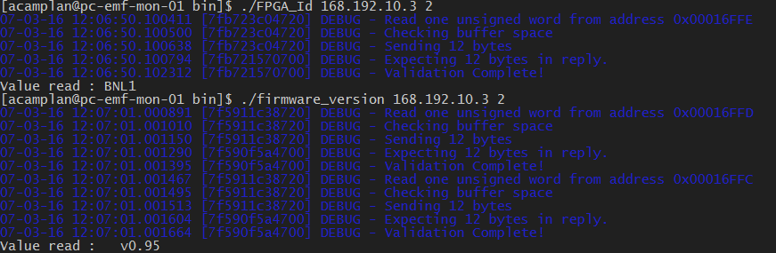
Extra padding data
Problem of extra padding data: SOLVED
Back FPGA firmware
Request
From the PC
Extra padding data
UDP module
NO extra padding data
Front FPGA
Correct response for commands:
FPGA_Id
firmware_version

Slide 3
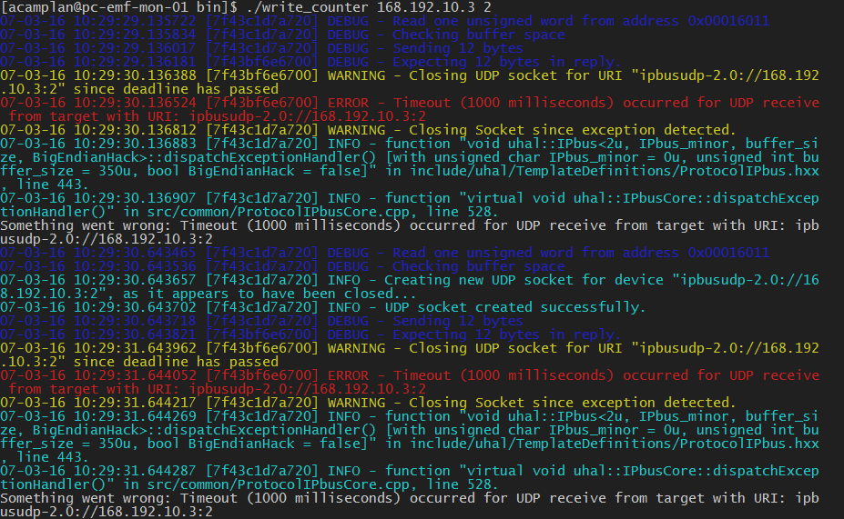
Still some errors
Command: write_counter
After this command, FPGA_Id and firwmare_version commands don’t work anymore.

Slide 4
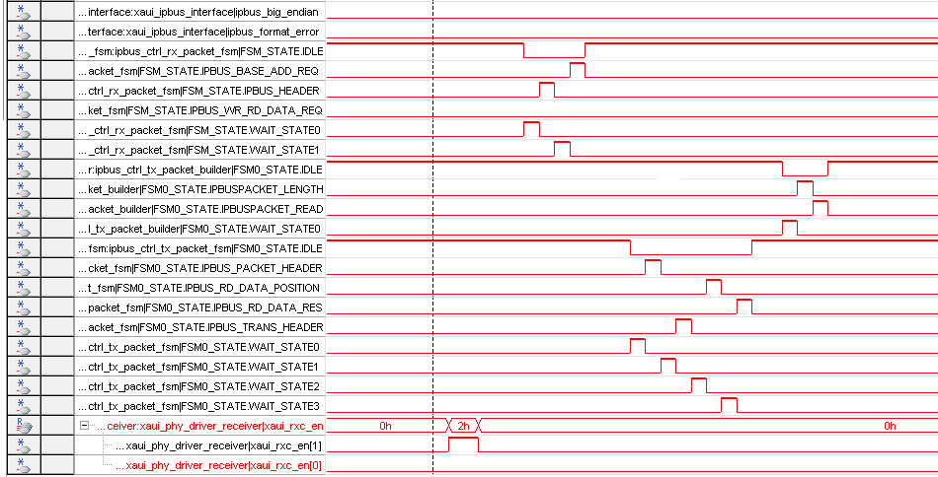
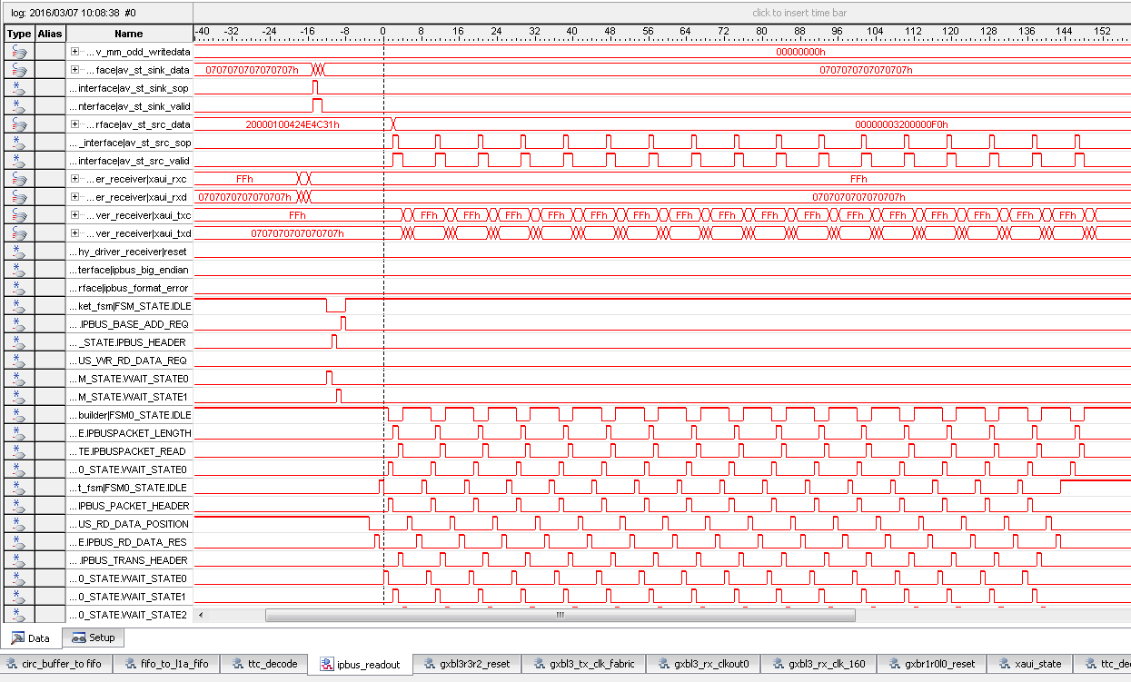
State machine with SignalTap
State machine (front FPGA firmware, response to the IPbus): comparison between the correct and the un-correct behaviour:
Board in slot 2 (168.192.10.3)
FPGA_Id command
Board in slot 4 (168.192.10.4)
Write_counter command
FPGA_Id command
So, the same IPbus packet is sent to the front FPGA.
It is possible to notice a complete different behaviour.

Slide 5
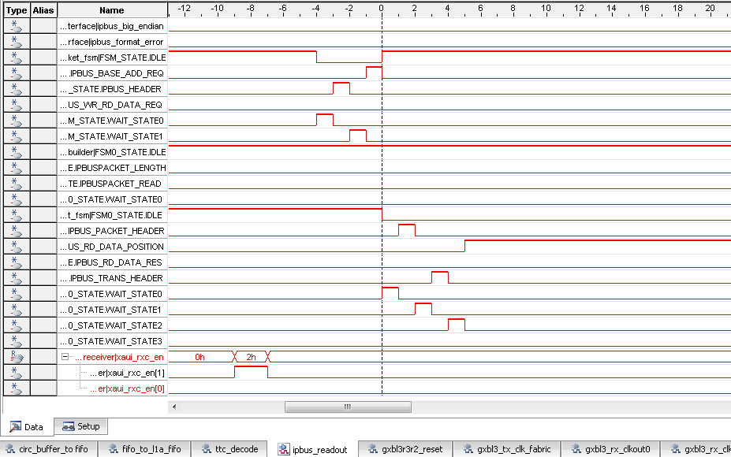
State machine with SignalTap
State machine (front FPGA firmware, response to the IPbus): comparison between the correct and the un-correct behaviour:
Board in slot 2 (168.192.10.3)
FPGA_Id command
Board in slot 4 (168.192.10.4)
Write_counter command
FPGA_Id command
So, the same IPbus packet is sent to the front FPGA.
It is possible to notice a complete different behaviour.

Slide 6
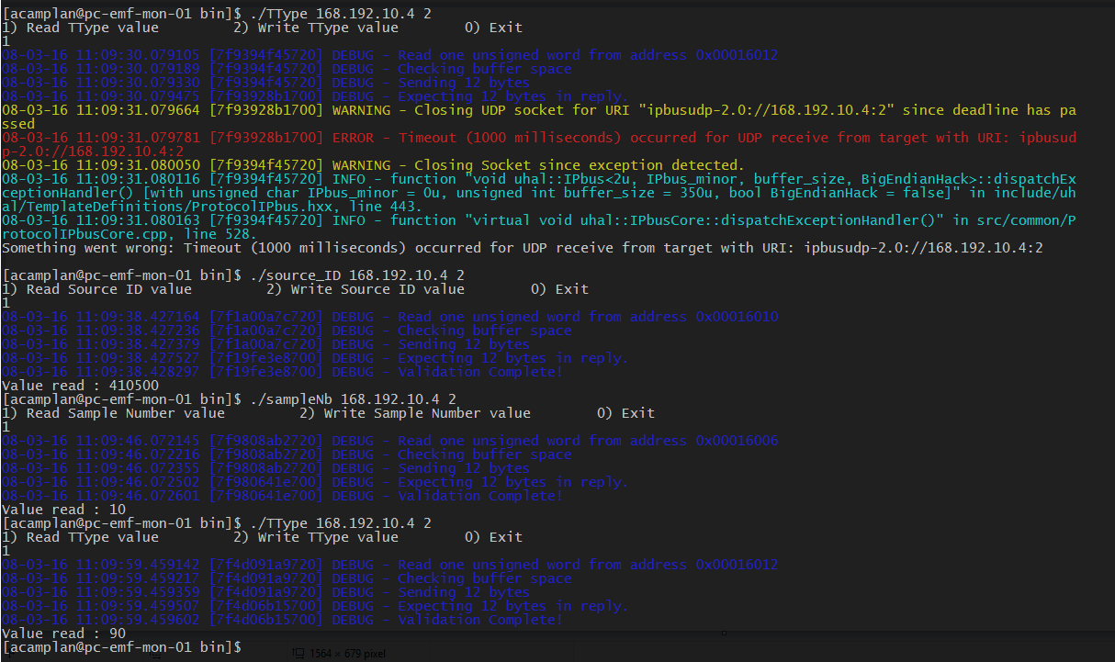
Strange commands behaviour
SOMETIMES
Sending the same command after re-loading the firware on both FPGAs

Slide 7
Conclusions
State machine problem solved: there was a missing register signal in the firmware
The strange behaviour is probably due to the fact that the FPGA is not yet in a «locked state»
The front FPGA state machine must be modified to avoid a bad response from FPGA

