Slide 1
ABBA firmware status
Alessandra Camplani – Università degli Studi di Milano
10/05/2016

Slide 2
Firmware version: front FPGA
Test firmware version: v 0.95b1
Solved "critical warnings" for timing constraints and improved reset structure in front fpga firmware.
Test firmware version: v 0.95b2
Changed reset from asynchronous to synchronous in front FPGA top level processes.
Test firmware version: v 0.95b3
Reorganisation of writing procedure for front FPGA registers (to simplify the code).
Test firmware version: v 0.95b4
Combination of writing and reading procedure: new entity defined (to simplify the code).
Test firmware version: v 0.95b5
Changed reset from asynchronous to synchronous in IPBUS front FPGA files.
2

Slide 3
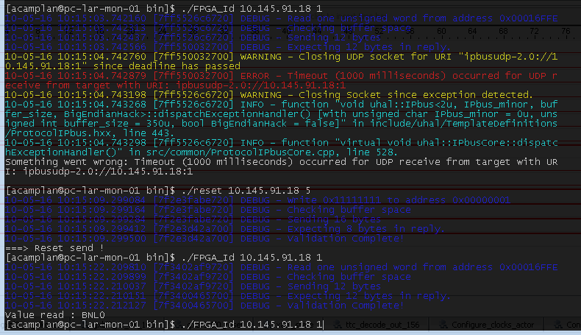
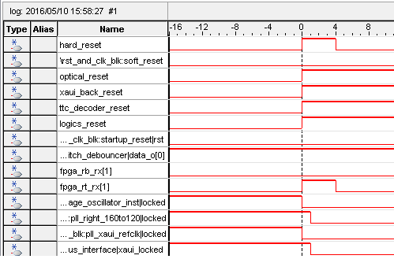
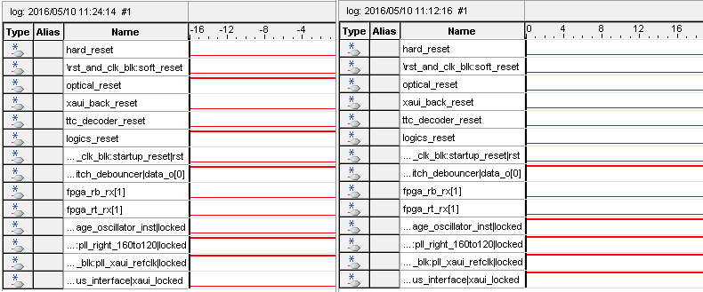
Improvements with new Front versions
With the new reset structure (from v 0.95b1):
FPGA 18:1 is not working
Send a reset to back FPGA => connected to hard_reset in front FPGA
Wait for 10 sec for the reset to go back from high to low
FPGA 18:1 responding again
Trying further improvements:
changing reset in processes from asynchronous to synchronous
3

Slide 4
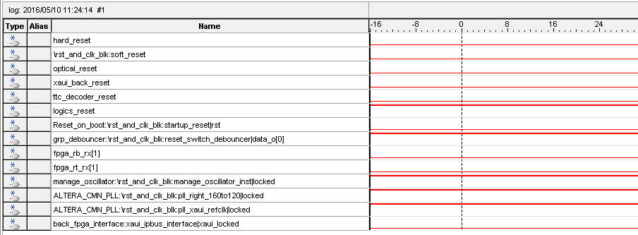
FPGA 18:1 issue
When XAUI (connection between front and back FPGA) is not locked then logics_reset is high.
Signal xaui_locked is directly connect to channelaligned: so after some time channels are no more aligned.
Just started investigating on this issue..
3

Slide 5
Firmware version: back FPGA
New stable firmware version for back FPGA: v 0.69
Back FPGA STP file and constraint files reworked:
- no more timing warnings
- no more unconstrained paths
- no complaints of unconnected signals in Signal Tap
Minor update in interface merger process (sensitivity list) for ready signal
4

Slide 6
New version: CPLD
New stable version for CPLD: ABBA-CPLD_v1.00
Simplified top level: uncommented unused pins, removed component declaration. Cured most warnings.
Recompiled and tested again at EMF with new front FPGA firmware version
Now CPLD code is available on git
On the twiki:
https://twiki.cern.ch/twiki/bin/view/LAr/EMFDemonstrator#Programming_the_firmware
Subsection - Programming the Flash memory
Subsection - Firmware Versions: CPLD
5

Slide 7
Conclusion and outlook
New version 0.69 for the back FPGA: stable
Timing constraints «critical warnings»: solved both on front and back FPGA firmware
FPGA 0 on ABBA 91.18 in USA15: still working to make it even more stable
Oscillator solution (supposed to be a better clock source): not solving the issue
Improved reset structure in front fpga firmware: issue partially solved
Ongoing: changing reset in processes from asynchronous to synchronous in front FPGA files
Next step (options):
Implement some “auto-recovery” for XAUI transceiver when channels are not aligned
Use “the other” XAUI transceiver (There are two pairs of XAUI transceivers interconnecting Front and Back FPGAs on ABBA => try the other..)
6

