Slide 1
News about TTC
Alessandra Camplani – Università degli Studi di Milano

Slide 2
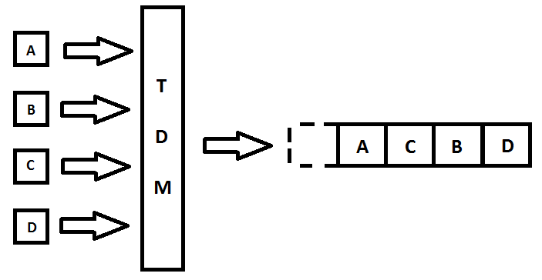
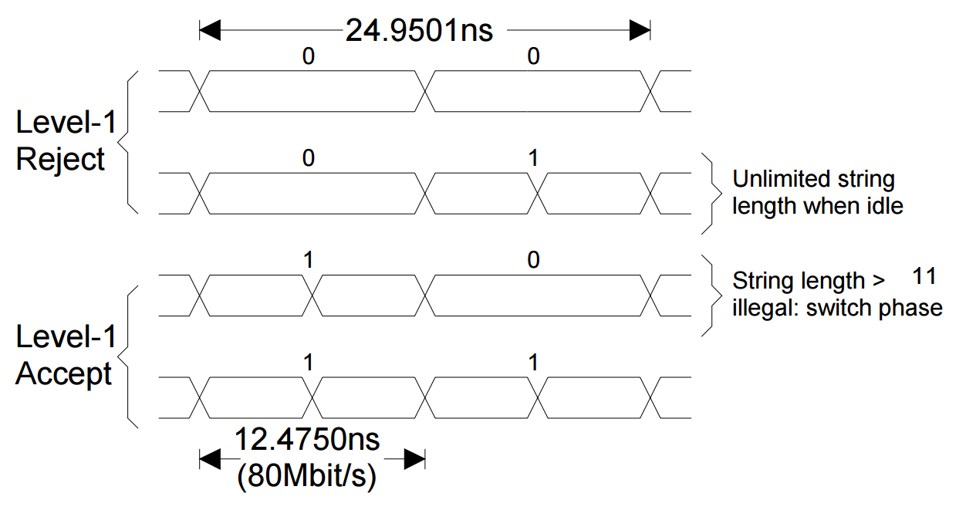
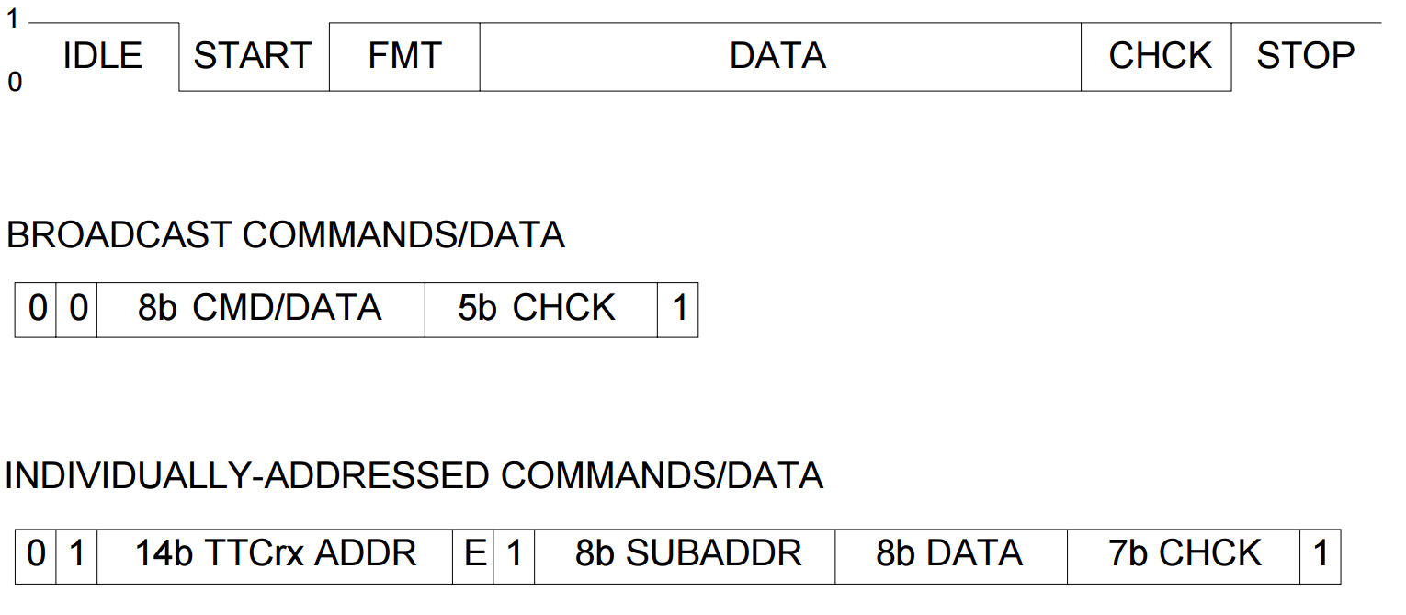
TTC details
TTC has two communication channels that are Time Division Multiplexed:
Channel A - exclusively dedicated to broadcast the first-level trigger-accept (L1A) decisions, delivering a one-bit decision for every bunch crossing.
Channel B - used to broadcast data to all or specific system destinations.
Data in channel B can be of two types:
Broadcast commands - used to distribute messages to ALL TTC destinations in the system
Individually addressed commands/data - implemented in the system to transmit user-defined data and commands over the network to specific addresses.
FMT defines which type of command should be sent on channel 2: broadcast or individually addressed command.
DATA could be:
Bunch counter reset
Event counter reset
Other commands

Slide 3
Information – Felix and Carrier Board
Email exchange with: Robert Dean Schamberger, Kenneth Johns
In particular, Kenneth Johns gave me some information:
TTC info come to Felix and here data are decoded
In the Felix, TTC data are inserted into a GBT frame
He is not sure about the exact format of this data other than it fits into the 80 bit GBT frame word
Data are sent to the Carrier Board
Here clock is extracted and sent to the LATOME boards
At this point two choices:
To extract the needed info and send it to LATOME
To send a copy of all data on a serial line to LATOME
Felix
Carrier Board

Slide 4
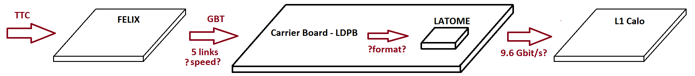
Information – Link speed
Continuing from Kenneth email:
Originally the links (from Felix to the Carrier) should run at 4.8 Gbit/s
However now L1Calo demands to run at 9.6 Gbit/s
BUT 9.6 Gbit/s is not compatible with GBT format
More details: there are 5 links that arrive at the Carrier Board
One will definitely be GBT format
The other four are meant to go to/from the AMC cards (LATOME)
Originally the carriers was going to send the TTC info via those links
If links are running at 9.6 there will be problems

Slide 5
Conclusion
Understand which speed is going to be used and the protocol that will be adopted
From an email exchange with Yuji, the data from the TTC that he needs are:
Clock
Information from channel A (Level 1 accept)
Information from channel B (Bunch Counter Reset, Event Counter reset..)
(TTC is made of channel A and channel B. Maybe we can receive a copy of all data from the carrier board)
I will start looking at the TTC decoder now used on the ABBA board

