Slide 1
TTC cores and data
Alessandra Camplani – Università degli Studi di Milano

Slide 2
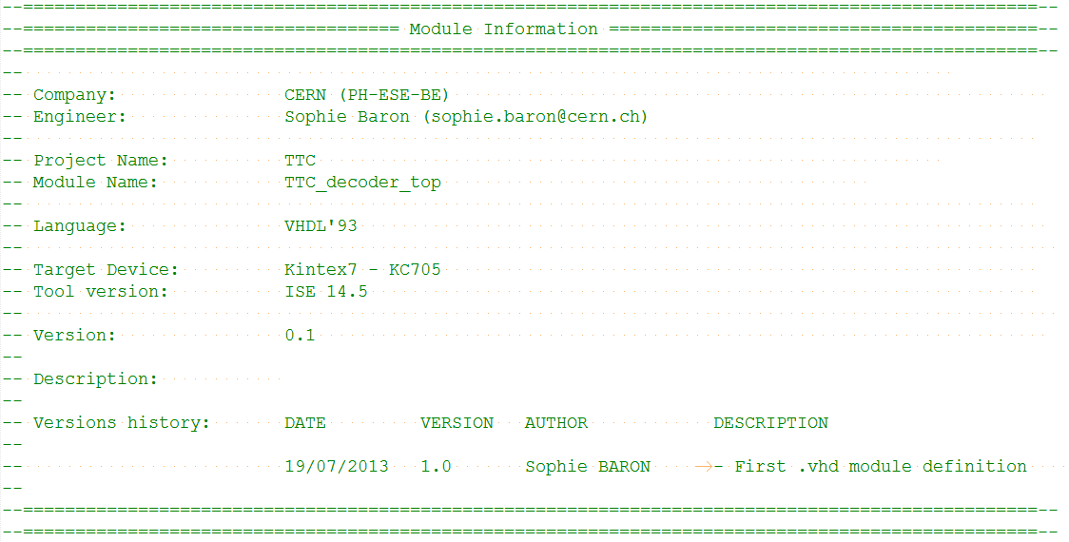
TTC decoder core
TTC decoder core provided by Sophie Baron

Slide 3
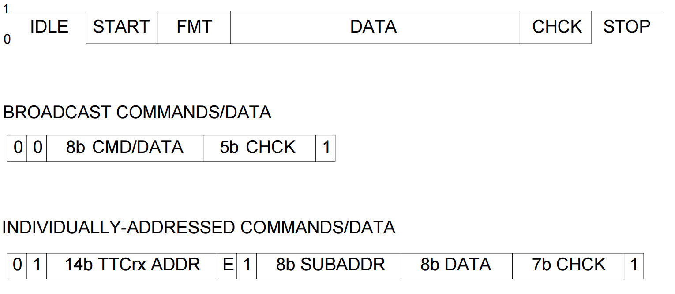
Information from TTC
Short Broadcast commands, 16 bits:
00TTDDDDEBHHHHH1:
T=test command, 2 bits.
D=Command/Data, 4 bits.
E=Event Counter Reset, 1 bit.
B=Bunch Counter Reset, 1 bit.
H=Hamming Code, 5 bits.
Long Addressed commands, 42 bits
01AAAAAAAAAAAAAAE1SSSSSSSSDDDDDDDDHHHHHHH1:
A= TTCrx address, 14 bits.
E= internal(0)/External(1), 1 bit.
S=SubAddress, 8 bits.
D=Data, 8 bits.
H=Hamming Code, 7 bits.
Channel B
Broadcast commands - used to distribute messages to ALL TTC destinations in the system
Individually addressed commands/data - implemented in the system to transmit user-defined data and commands over the network to specific addresses.

Slide 4
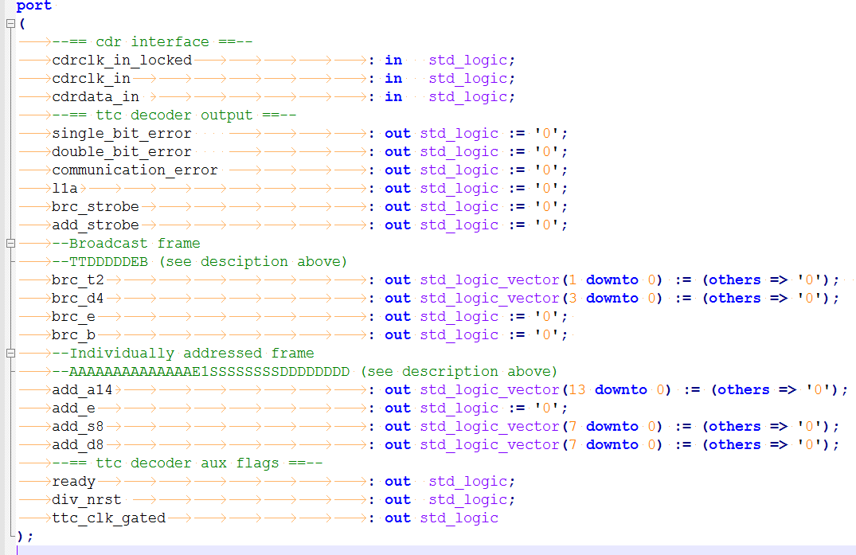
Signals and data
Looking in ttc_decoding_struct file (from ABBA firmware)
Two output signals are the bunch crossing reset and the event reset:
brc_e => bccnt_reset
brc_b => evcnt_reset
Counting on the two reset signals it is possible to obtain:
BCID (Bunch Crossing ID)
EVID (Event ID)
Signal add_d8 should indicate the trigger type
TTC decoder core port map:

Slide 5
Conclusion
Could be useful to maintain the TTC format to:
use Sophie Baron TTC_core
get ideas from ABBA TTC decoding part

