Slide 1
TTC input format
Alessandra Camplani – Università degli Studi di Milano

Slide 2
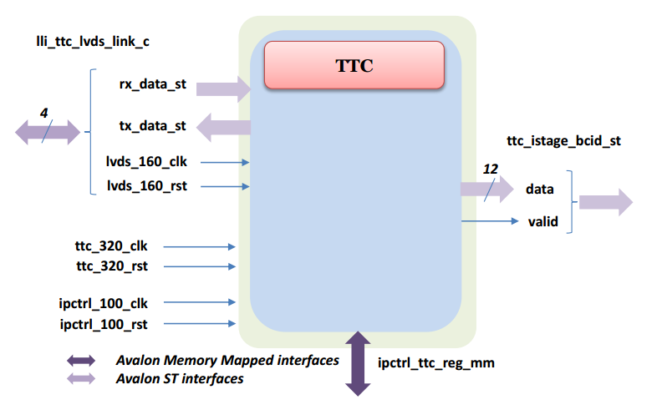
TTC block diagram
This block represents the top level of the TTC entity

Slide 3
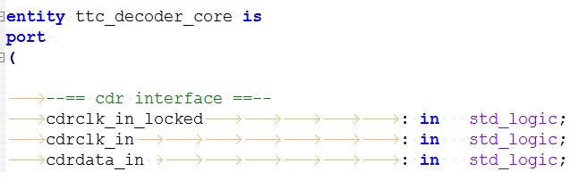
Input data option
If the input data are in standard TTC format I can use Sophie Baron core:
Sophie Baron core
TTC top block
TTC standard input format
If the input data are NOT in standard TTC format:
Sophie Baron core
Core used by someone else: carrier board?
…….
TTC top block
TTC standard input format
NOT TTC standard input format

Slide 4
Conclusion
TTC cores are in the repository (latome_ttc branch)
If TTC input data are not in standard format:
  Sophie Baron decoding core (and maybe also the decoding structure used by ABBA) is used by …?
Is there any way to receive the standard TTC format?
To be decided: list of TTC info that latome firmware will need

