Slide 1
TTC status
Alessandra Camplani – Università degli Studi di Milano

Slide 2
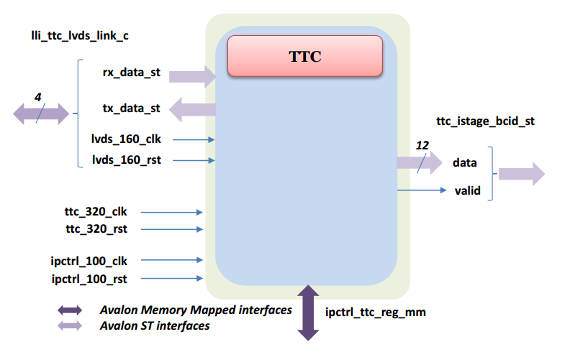
How to send data – on going with Kenneth
Carrier
Latome
Decoding
Rx between latome and carrier – valid, l1a, ecr, bcr..
Do we have more than 4 LVDS link?
8 LVDS link?
Maybe also some tx from latome to carrier..

Slide 3
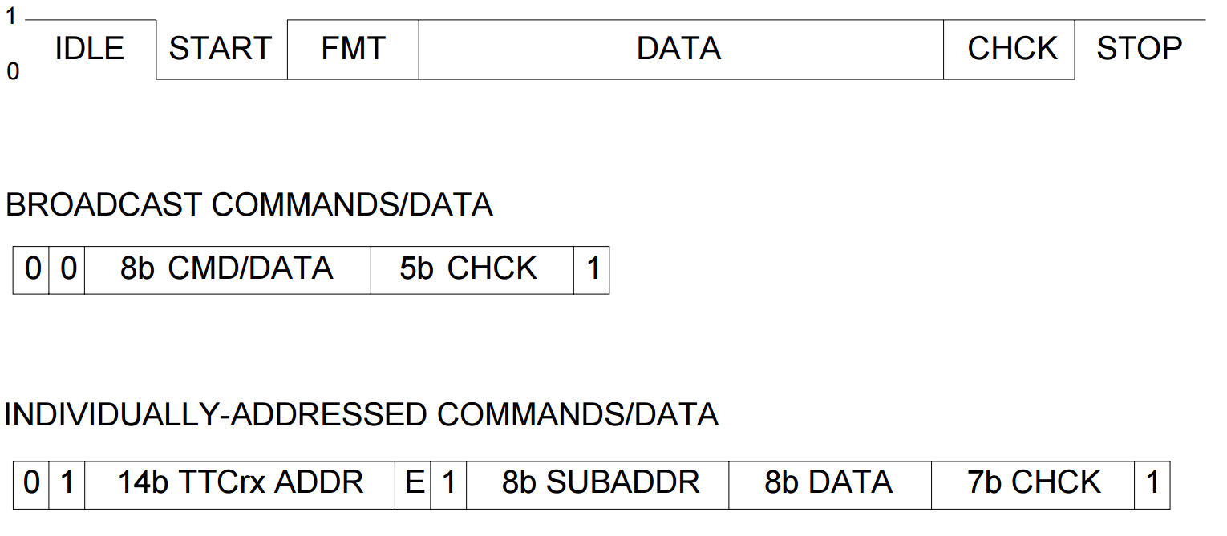
Information from TTC
Short Broadcast commands, 16 bits:
00TTDDDDEBHHHHH1:
T=test command, 2 bits.
D=Command/Data, 4 bits.
E=Event Counter Reset, 1 bit.
B=Bunch Counter Reset, 1 bit.
H=Hamming Code, 5 bits.
Long Addressed commands, 42 bits
01AAAAAAAAAAAAAAE1SSSSSSSSDDDDDDDDHHHHHHH1:
A= TTCrx address, 14 bits.
E= internal(0)/External(1), 1 bit.
S=SubAddress, 8 bits.
D=Data, 8 bits.
H=Hamming Code, 7 bits.
Channel B
Broadcast commands - used to distribute messages to ALL TTC destinations in the system
Individually addressed commands/data - implemented in the system to transmit user-defined data and commands over the network to specific addresses.

Slide 4
Decoding and enconding
Carrier
Latome
Decoding TTC
Encoding
Decoding
Carrier
Latome
Decoding
Why not?
Decoding TTC

