Slide 1
TTC status
Alessandra Camplani – Università degli Studi di Milano
02/06/2016

Slide 2
FELIX/Carrier

Slide 3
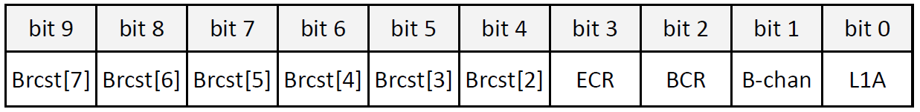

TTC decoding in FELIX
FELIX decodes 10 bits of TTC data @ 40MHz :
(where Brcst are the 8 TTC broadcast bits, Brcst[1] is ECR and Brcst[0] is BCR)
FELIX can send TTC information on any E-link declared as a “TTC” E-link.
All the info from:
How E-links are defined by FELIX:
GBT goal is to aggregate many (up to 41) low speed links (as low as 80Mb/s), called E-links
E-links can be “bonded” together to make higher bandwidth “lanes”.
Any E-link can carry TTC information
“TTC” E-links can be 80, 160 or 320 Mb/s E-links
Data are sent with FIXED latency
…

Slide 4
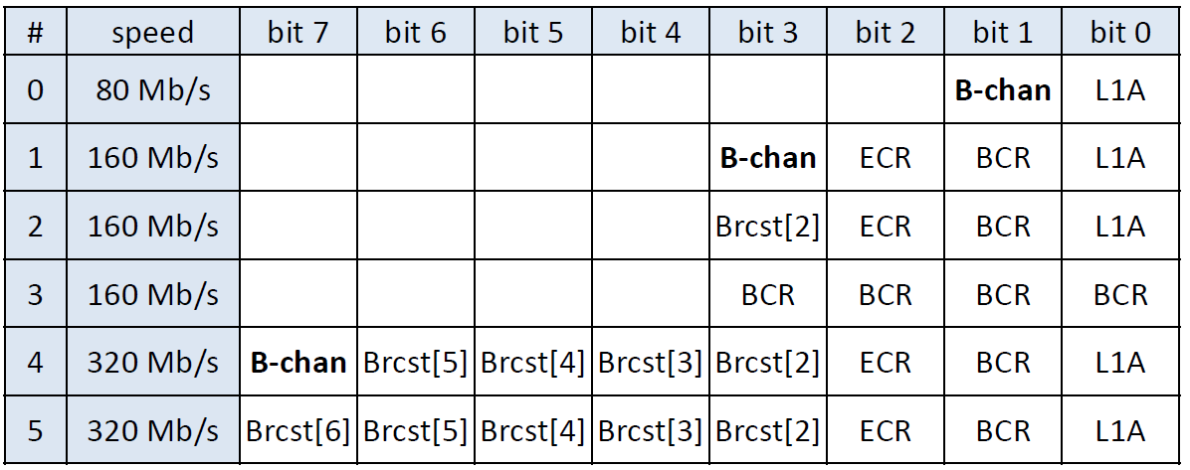
Possible TTC formats from FELIX
Content and format of a TTC E-link is decided in discussion with the users and can be chosen from 10 bits of decoded TTC data.
2 bit @ 80 Mb/s
4 bit @ 160 Mb/s
All the info from:
8 bit @ 320 Mb/s
In Phase 2 FELIX will provide the formats used in Phase 1 with L1A replaced by L0A.

Slide 5
Possible TTC formats from FELIX
Content and format of a TTC E-link is decided in discussion with the users and can be chosen from 10 bits of decoded TTC data.
2 bit @ 80 Mb/s
4 bit @ 160 Mb/s
All the info from:
8 bit @ 320 Mb/s
In Phase 2 FELIX will provide the formats used in Phase 1 with L1A replaced by L0A.

Slide 6
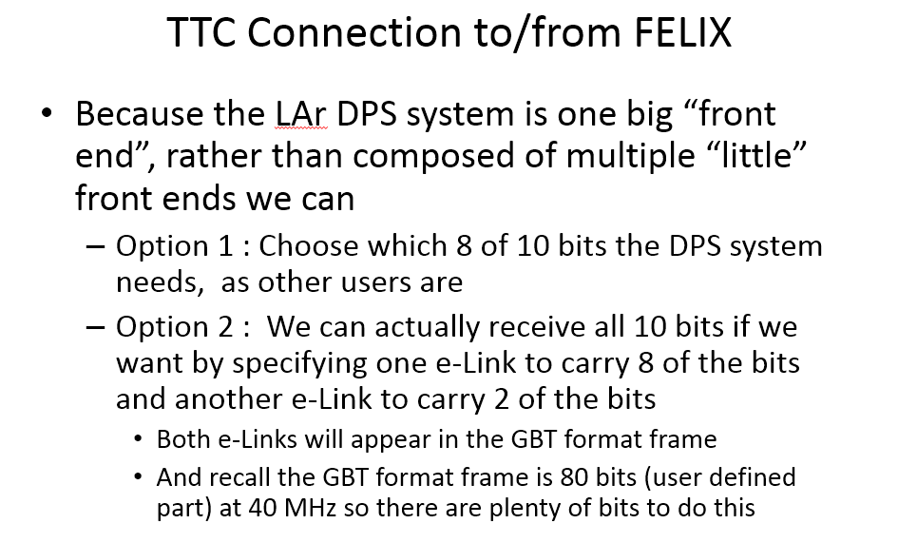

What Carrier will receive
From the last discussion with Kenneth:
Two options were proposed.
Option 2 will be considered, because LATOME would like to receive all 10 bits of data for the TTC.
And from a recent discussion: FELIX would be open to decoding the trigger type?
But do we need other info from B-Channel?

Slide 7
Carrier/LATOME

Slide 8
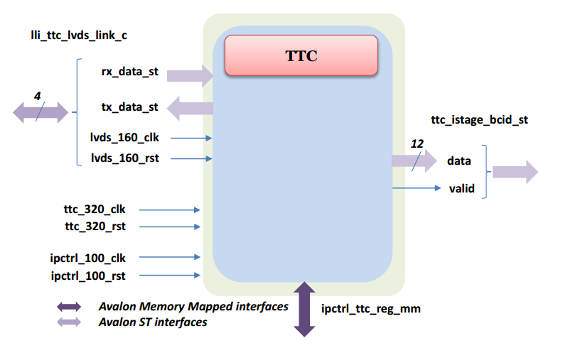
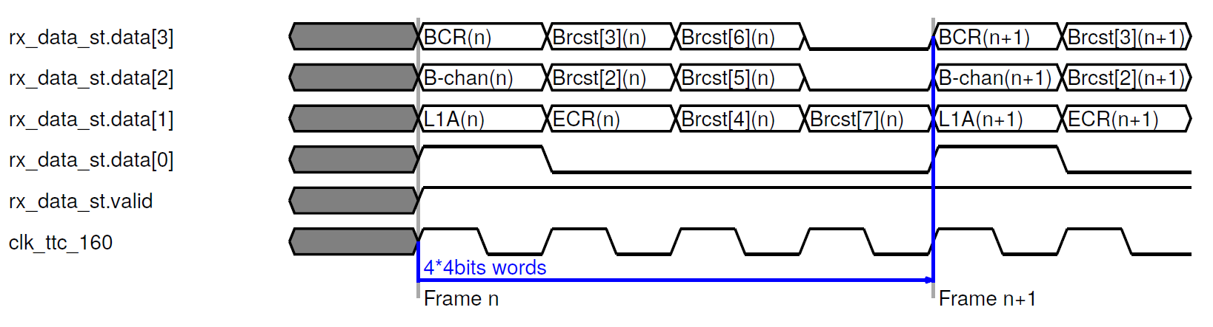
LATOME TTC component
Most interesting part to be described:
4 LVDS links (rx_data_st + tx_data_st)
lvds_160_clk
lvds_160_rst
More in detail:
rx_data_st
data: data bus synchronized to lvds_160_clk clock.
valid: TTC data valid, high active. Controlled only from LLI meaning the LVDS module in LLI is ready. Not connected whatsoever to LVDS data content. If not active, should discard the data.
rx_lvds interface timing diagram:

Slide 9
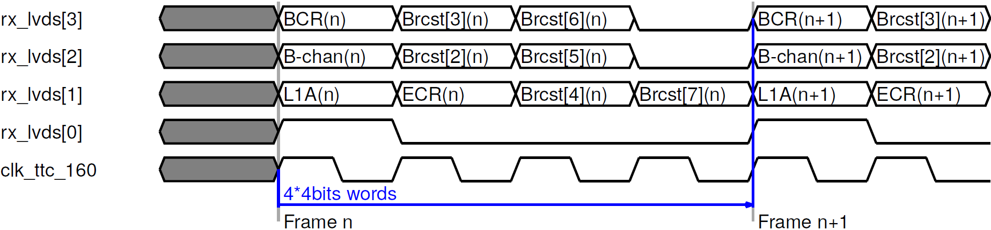
Carrier to LATOME
Defined the TTC transmission format between Carrier and LATOME:

Slide 10
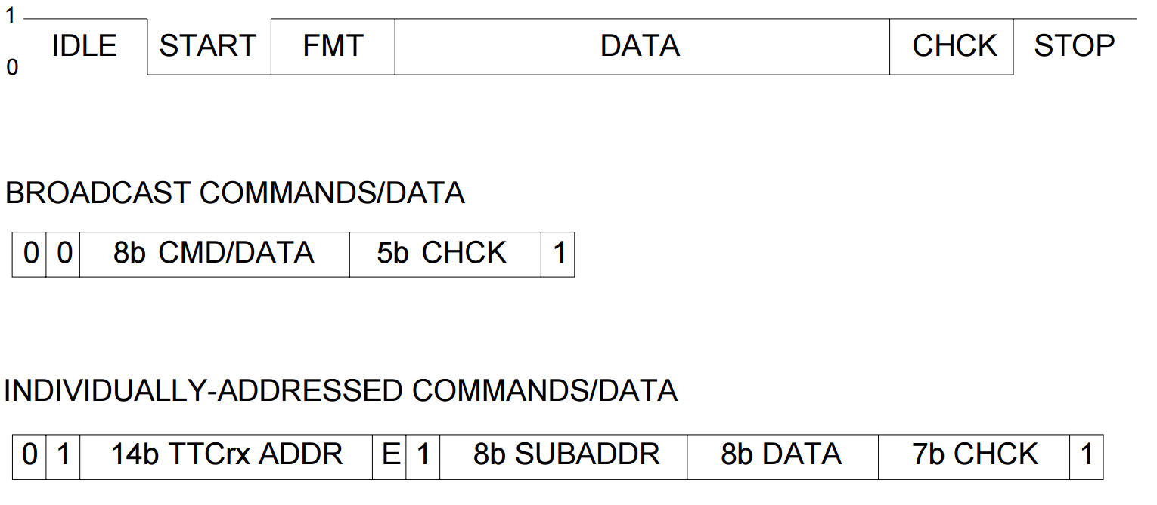
Format details
Clock frequency 160 MHz
16 bits available per frame (4 words)
10 bits of data received from Carrier
rx_lvds[1], rx_lvds[2], rx_lvds[3] for data trasmission: L1A, Channel B, BCR, ECR and broadcast
rx_lvds[0] for the synchronization: 1 on the first word and 0 on the others.
Two empty bits can still be used for other info.
Empty
Empty
Channel B bit, what we will receive:
Long Addressed, 42 bits: 01AAAAAAAAAAAAAAE1SSSSSSSSDDDDDDDDHHHHHHH1
A= TTCrx address, 14 bits. E= internal(0)/External(1), 1 bit. S=SubAddress, 8 bits. D=Data, 8 bits. H=Hamming
Only DATA are interesting: for example the Trigger-Type.

Slide 11
Conclusion

Slide 12
Conclusion
FELIX decodes 10 bits of TTC data @ 40MHz
Carrier will receive all the 10 bits
The data format between carrier and LATOME has been decided
Still two bits are available
Open question:
Other info from the TTC? We already have L1A, ECR, BCR, broadcast and TType (from B channel)
TType decoded by FELIX?

Slide 13
Backup slides

Slide 14
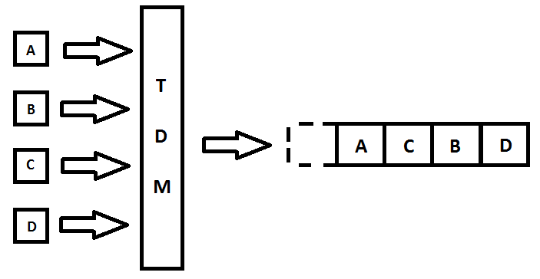
TTC Channels(1)
TTC has two communication channels that:
Channel A - exclusively dedicated to broadcast the first-level trigger-accept (L1A) decisions, delivering a one-bit decision for every bunch crossing.
Channel B - used to broadcast data to all or specific system destinations.
Data in channel B can be of two types:
Broadcast commands - used to distribute messages to ALL TTC destinations in the system
Individually addressed commands/data - implemented in the system to transmit user-defined data and commands over the network to specific addresses.
FMT defines which type of command should be sent on channel 2: broadcast or individually addressed command.
DATA could be:
Bunch counter reset
Event counter reset
Other commands

Slide 15
TTC Channels(2)
A channel: 1=trigger, 0=no trigger. No encoding, minimum latency.
B channel: short broadcast or long addressed commands. Hamming check bits
Short Broadcast, 16 bits: 00TTDDDDEBHHHHH1
T=test command, 2 bits. D=Command/Data, 4 bits. E=Event Counter Reset, 1 bit. B=Bunch Counter Reset, 1 bit. H=Hamming Code, 5 bits.
Long Addressed, 42 bits: 01AAAAAAAAAAAAAAE1SSSSSSSSDDDDDDDDHHHHHHH1
A= TTCrx address, 14 bits. E= internal(0)/External(1), 1 bit. S=SubAddress, 8 bits. D=Data, 8 bits. H=Hamming

