Slide 1
ABBA firmware status
Alessandra Camplani – Università degli Studi di Milano
06/06/2016

Slide 2
Firmware version
Last firmware versions presented during the Upgrade Week in April 2016:
front FPGA: v0.95b
back FPGA: v0.68a
For more details
Upgrade Week: ABBA firmware status
Current versions used to take data:
front FPGA: v0.96
back FPGA: v0.69a
2

Slide 3
Improvements in front FPGA
Test firmware version: v0.95b1
Solved "critical warnings" for timing constraints and improved reset structure in front fpga firmware
Test firmware version: v0.95b2
Changed reset from asynchronous to synchronous in front FPGA top level processes
Test firmware version: v0.95b3
Reorganisation of writing procedure for front FPGA registers (to simplify the code)
Test firmware version: v0.95b4
Combination of writing and reading procedure for registers: new entity defined (to simplify the code)
Test firmware version: v0.95b5
Changed reset from asynchronous to synchronous in IPBUS front FPGA files
After some tests, v0.95b5 (test) upgraded to production version v0.96
3

Slide 4
Known issue with FPGA 18:0 in USA15 (part 1)
In USA15:
two “identical” ABBAs
3 “identical” FPGAs per board (all Stratix IV from ALTERA)
2 front FPGAs
1 back FPGA
All 4 front FPGAs using the SAME firmware version:
only one not responding (FPGA 18:0)
Reminder from ATLAS Upgrade Week:
FPGA 0 from ABBA 91.18 was sending some random data that affect FPGA 1 on the same board, but also the other board
v0.68a: length check in UDP and IP module now avoids transmission of garbage!
Stabilized readout with 3 remaining FPGAs
Front
FPGA
1
Back
FPGA
18
Front
FPGA
0
Front
FPGA
1
Back
FPGA
19
Front
FPGA
0
4

Slide 5
Known issue with FPGA 18:0 in USA15 (part 2)
Front
FPGA
1
Issue hidden but not solved …
Looking with Signal Tap Altera tool in front FPGA:
the signal which is blocking if the FPGA is aligned_status:
coming from the ALTERA XAUI CORE
connected to channelaligned signal in the back FPGA interface
The issue is coming from the communication between front and back FPGA.
Back
FPGA
18
Front
FPGA
0
Front
FPGA
1
Back
FPGA
19
Front
FPGA
0
5

Slide 6
Known issue with FPGA 18:0 in USA15 (part 3)
To solved this issue different strategies have been adopted:
Solved timing critical warnings
Used a different (better) clock source: oscillator
Improved reset structure
Changing reset in most important processes from asynchronous to synchronous
All these attempts didn’t solve the issue.
Last chance was:
Two pairs of XAUI transceivers interconnecting front and back FPGAs on ABBA
Tried the second XAUI transceiver
Neither this solution recovered the FPGA.
Conclusion: hardware issue (also the TTC is behaving differently here!)
Finally (27/05/2016): added a new ABBA in USA15 to substitute FPGA 18:0
Front
FPGA
18:1
Back
FPGA
Front
FPGA
18:0
Default XAUI links
Second XAUI link
New XAUI link used
6

Slide 7
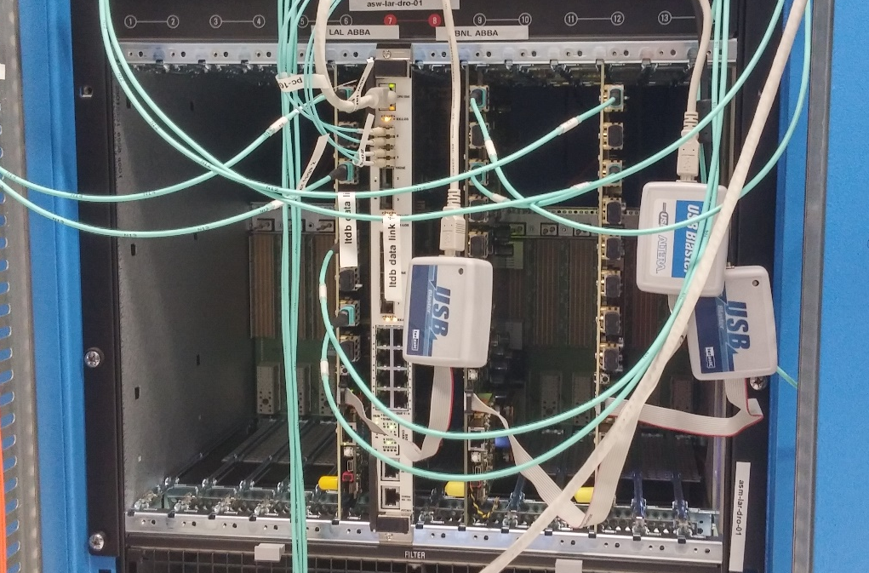
Improvements in back FPGA
Firmware version v0.69:
Back FPGA STP file and constraint files reworked:
- no more timing warnings
- no more unconstrained paths
- no complaints of unconnected signals in Signal Tap
Minor update in interface merger process (sensitivity list) for ready signal
Firmware version v0.69a:
As said before, another board has been installed in USA15.
New IP and MAC addresses added in the firmware.
Added a new item to the MAC_IP_selector generic:
selects the pair of MAC and IP address of the Back FPGA
IP -.19
IP -.18
IP -.20
Actually back FPGAs with IP -.18 and -.19 are using (and can remain with) version v0.69.
Only FPGA with IP -.20 is using version v0.69a.
7

Slide 8
Conclusion and outlook
v0.69a for the back FPGA and v0.96 for the front FPGA: STABLE!
No needs to reprogram the FPGAs during the data taking
Issue with FPGA 0 on ABBA 91.18 in USA15
After many trials new (Oregon) board installed
Previously installed in EMF
No firmware (or hardware) issues on the new board
Collecting data with all 4 FPGAs
Next step:
Some data already analysed: found bad readings
To be investigated …
8

