Slide 1
TTC status
Alessandra Camplani – Università degli Studi di Milano
10/11/2016

Slide 2
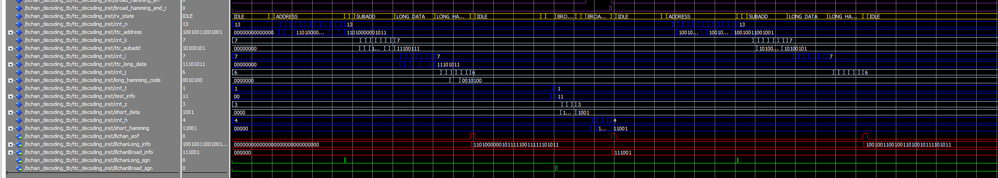
Updates
Now decoding also the data coming on the broadcast command
Preliminary check on the BCID counter
Counting of clock periods between 2 consecutive BC
Ongoing:
Identification and decoding of the trigger type
Long address command decoding
Broadcast command decoding

