Slide 1
TTC status
Alessandra Camplani – Università degli Studi di Milano
24/11/2016

Slide 2
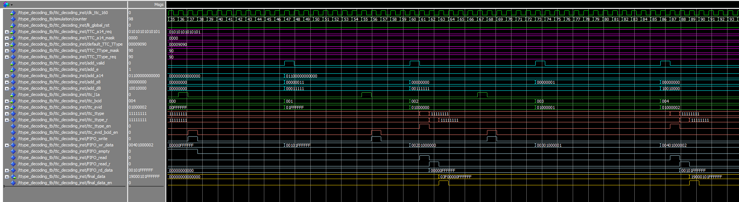
Updates
The TType decoding is ongoing: a very basic simulation is implemented and seems good
TODO: improve the simulation and then implement the entity inside the ttc_decoding.
A TType is received, but not the one required:
The data transmitted are:
0 + TType + BCID&EVID
A TType is received, the one required:
The data transmitted are:
1 + TType + BCID&EVID
The very same is
done for ABBA!

Slide 3
TTC decoding entity
LVDS
data
TTC decoding entity
Processes and State Machines to decode the LVDS links
Address +
Subaddress +
Data
0/1 +
TType +
BCID + EVID
Bchannel decoding entity
BCID and EVID counters
entity
BCR clk periods cnt
SMcounters entities for long address commands
SMcounters entities for broadcast commands
TType entity
Prepare av_mm and av_st output
Check on cnt

Slide 4
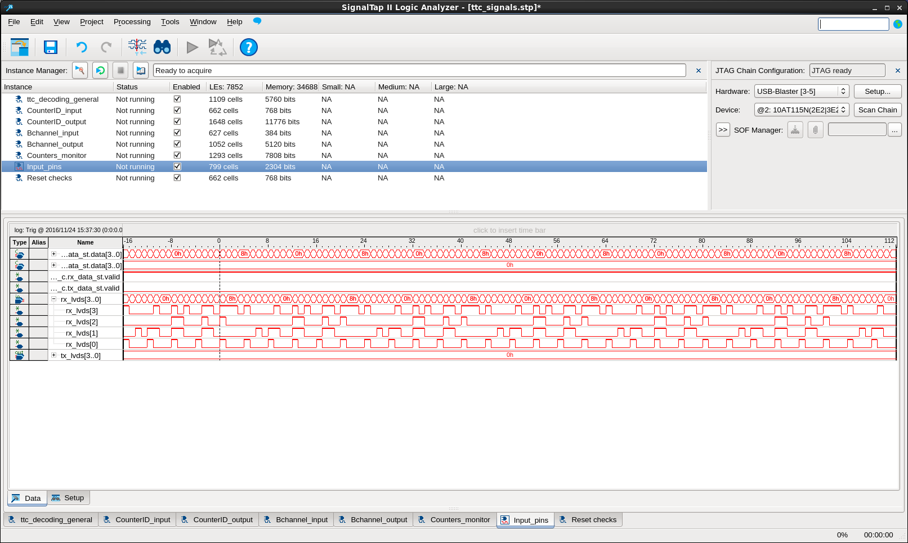
SignalTap from EMF setup

Slide 5
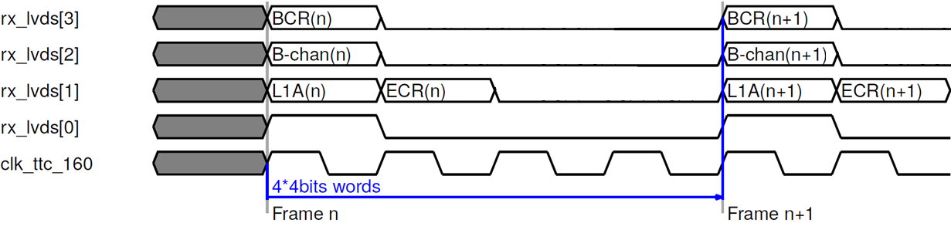
SignalTap from EMF setup

