Slide 1
TTC decoding tests in EMF
Alessandra Camplani – Università degli studi di Milano

Slide 2
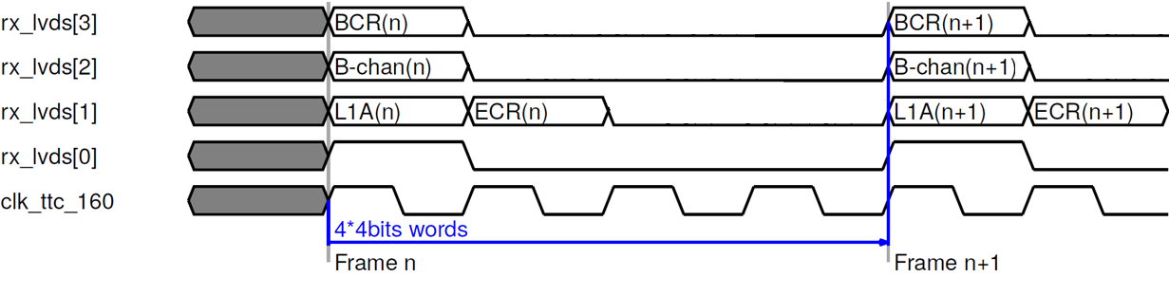
Aim of the test
The aim of the test was originally to verify the TTC decoding on LATOME board.
From the simulation point of view, the code is ready to decode the L1A, ECR, BCR and the Bchannel data coming from the Carrier.
As a reminder, this is the final protocol between Carrier and Latome.

Slide 3
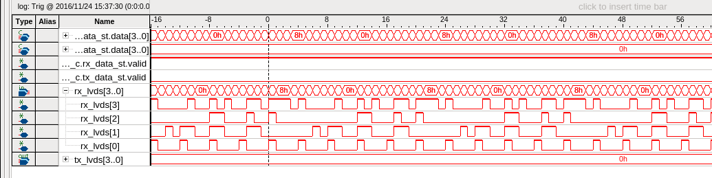
First test in EMF one week ago
There was a discrepancy between the protocol decided and the data saw on Latome.
Understood: the protocol used was slightly different (an older version).

Slide 4
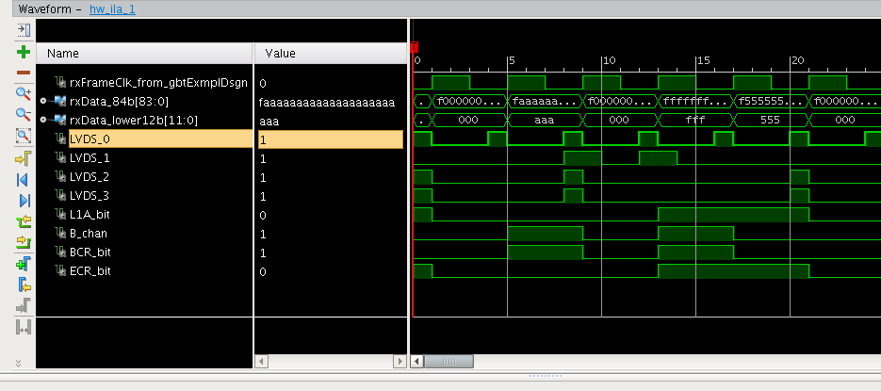
New Carrier files
Kade already prepared a new version of the Carrier project with the last decided protocol.
With Alexis we managed to find the proper .bit and .ltx files from xilinx/kgigliotti/GBT/cern/Carrier_GBT_port5_v4.1_amc​​
and to load them on the Carrier.

Slide 5
Then..
Then, looking at the TTC signals (using my SignalTap file from LATOME point of view + ILAs Xilinx tool provided by Ken and Kade from Carrier point of view) I noticed that there was no difference between the data received when the Phase1 (so the TTC) partition is running and when the partition is not running.
I would expect (accordingly to Guy explanation) that when the partition is not running, only the BCR signal to appear.
! To be noticed that in our case ECR and BCR and swapped !
So on the ILAs tool (on Carrier) I should expect the ECR signal to be 1 every 89.1 us.
But sometimes is appearing every 25 ns also when Phase1 partition is running.

Slide 6


Comparison
TTC running
TTC not running

Slide 7
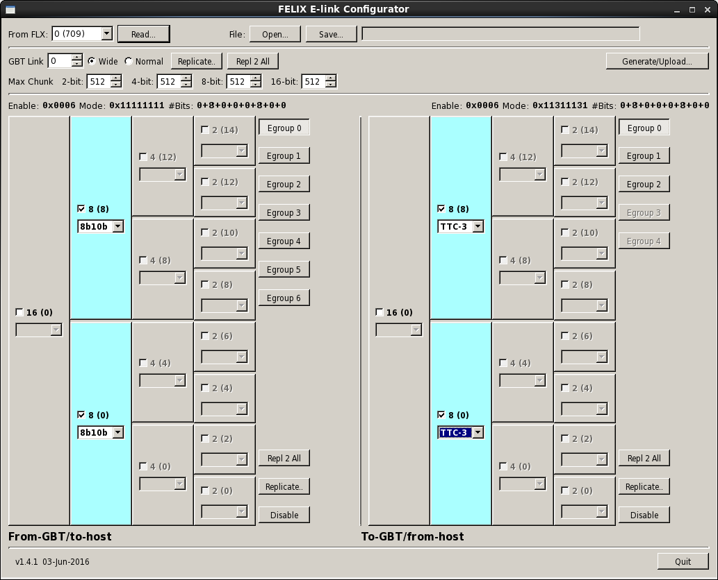
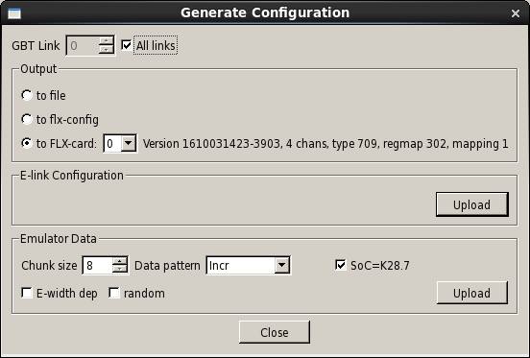
FELIX configuration
From Ken: during the tests in September, before FELIX was setup correctly, they were also seeing non-zero data in the GBT frames.
To solve this issue the elinkconfig tool was used to configure the central router to output the TTC data.
So thanks to Ken’s instructions I managed to setup this configuration.

Slide 8
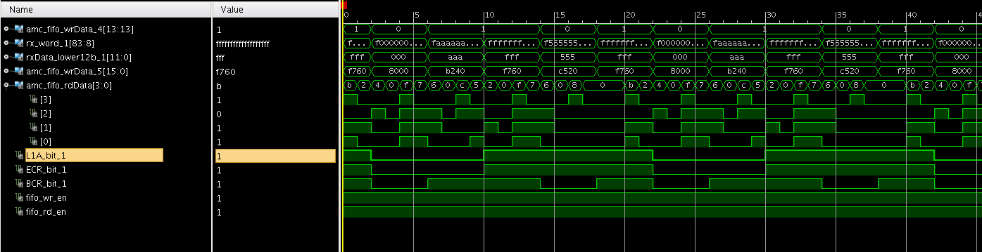

New comparison
TTC running
TTC not running

Slide 9
FELIX firmware to be used
Currently in contact with Daniele and Andrea to understand if the problem could have been related to FELIX firmware.
Daniele kindly created a Jira ticket FLXUSERS-44 about this topic.
But from what I understood the firmware version used on FELIX should be ok.

Slide 10
Conclusion
The protocol between Carrier and Latome seems to be ok now
From the Latome point of view I swapped (in the firmware) the ECR and BCR signal, in order to count on the proper values to generate EVID and BCID
Next steps:
Understand the origin of the problem: why there are signals coming when TTC is off?
There seems to be a pattern repeated over time, why?

