Slide 1
Opportunity Youth Household Structure (Preliminary)
Diego Rubi

Slide 2
Data Sources:
IPUMS USA
IPUMS at the University of Minnesota
IPUMS pre-processes PUMS files to enable / facilitate research
Example: NOC (U.S. Census) vs. NCHILD (IPUMS) are at household level and individual level respectively
U.S. Census Bureau
Raw PUMS files directly from the U.S. Census Bureau

Slide 3
Research Questions of Interest
Are Opportunity Youth caring for children?
At least one child
Number of children
What are the household income characteristics of Opportunity Youth?
Household income by household type
Total personal income
Mobility Status
Migration, mode of transportation, and average commute time
Pending
Food Stamps Recipients, Household Types, Number of Workers in Family, Same-Sex Households, Multi-generational Families

Slide 4
Results

Slide 5
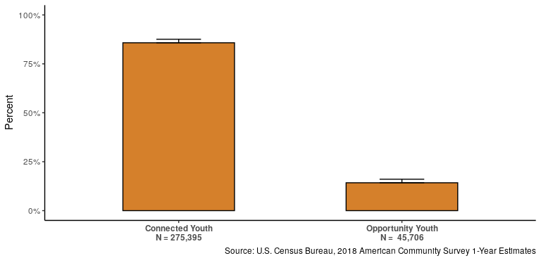
Refresher: Number of Opportunity Youth

Slide 6
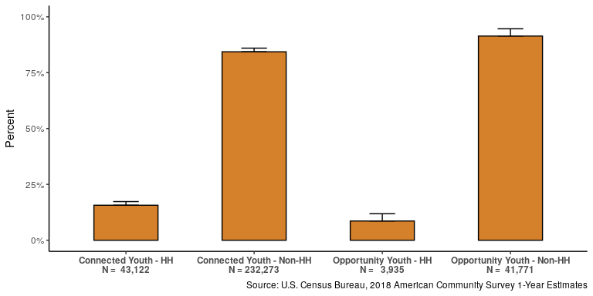
Heads of Household

Slide 7
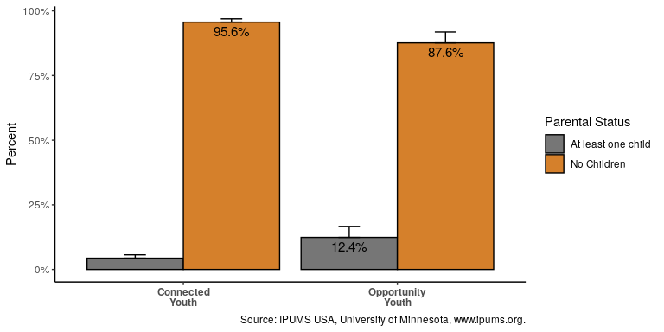
Do they have children?

Slide 8
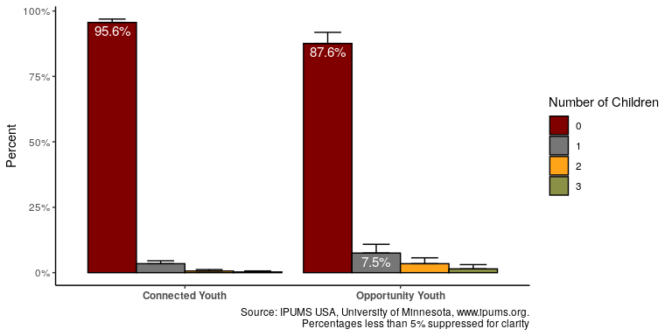
Number of Children

Slide 9
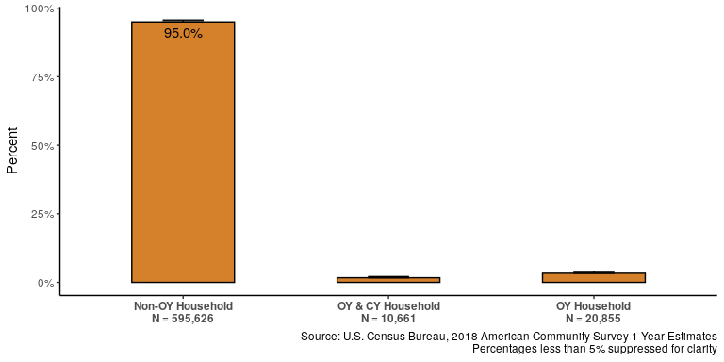
Type of Household

Slide 10
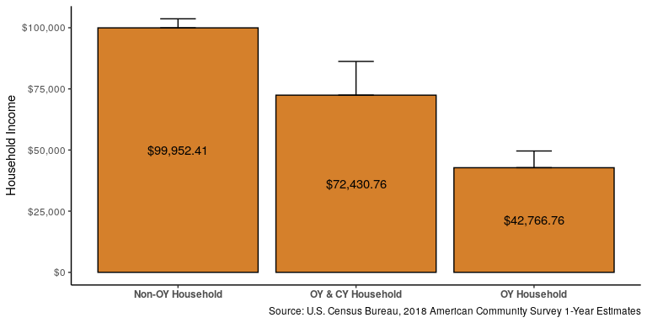
Income Characteristics: Household Income

Slide 11
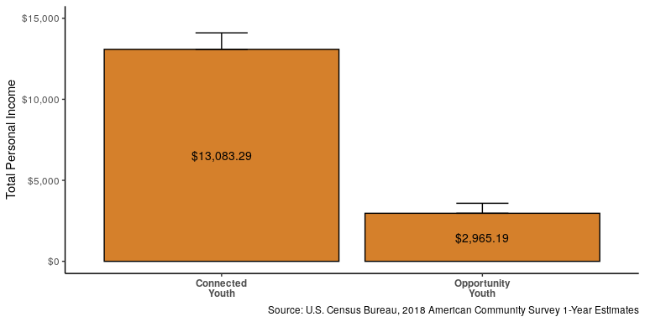
Income Characteristics: Total Personal Income

Slide 12
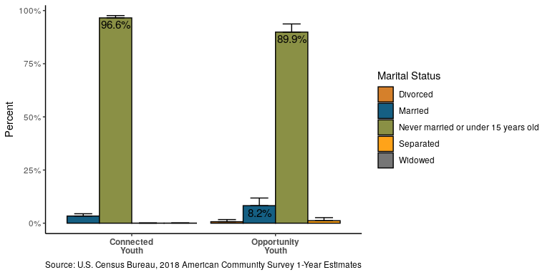
Marital Status / Partnered

Slide 13
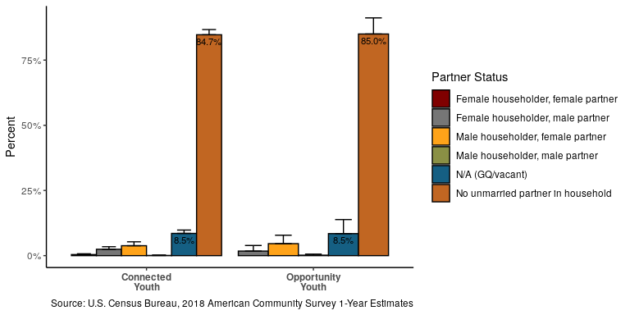
Partnered

Slide 14
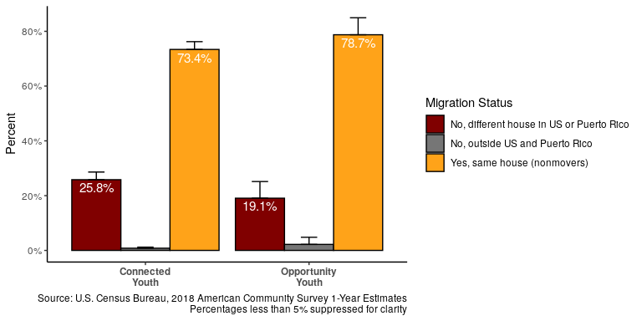
Mobility: Migration

Slide 15
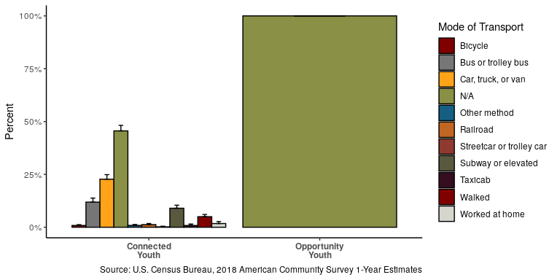
Mobility: Mode of Transportation

Slide 16
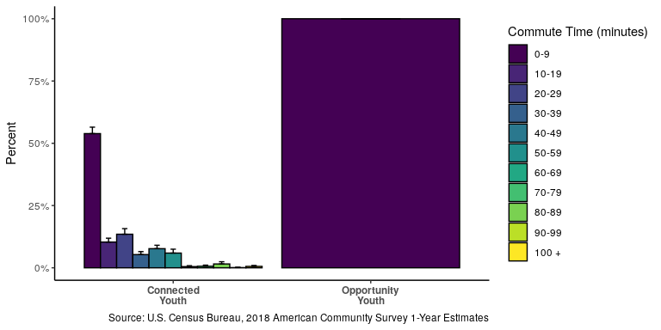
Migration: Average Commute Time

Slide 17
Pending Analyses

Slide 18
Income Characteristics: Food Stamps (Pending)

Slide 19
Household Type:(Pending)

Slide 20
Household Characteristics: Workers in Family (Pending)

Slide 21
Same-sex households (Pending)

Slide 22
Multi-generational Families (Pending)

Slide 23
Questions?

Slide 24
Thank you!

