Slide 1
Household Structure (Preliminary)
Diego Campos

Slide 2
Research Questions of Interest
Are Opportunity Youth caring for children?
What are the household income characteristics of Opportunity Youth?
Mobility Status

Slide 3
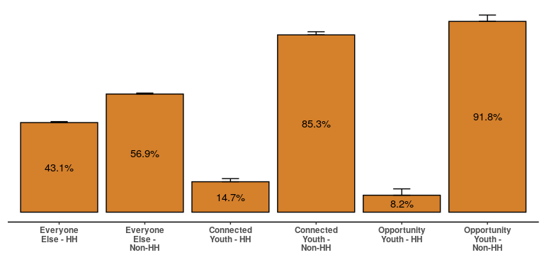
Heads of Household

Slide 4
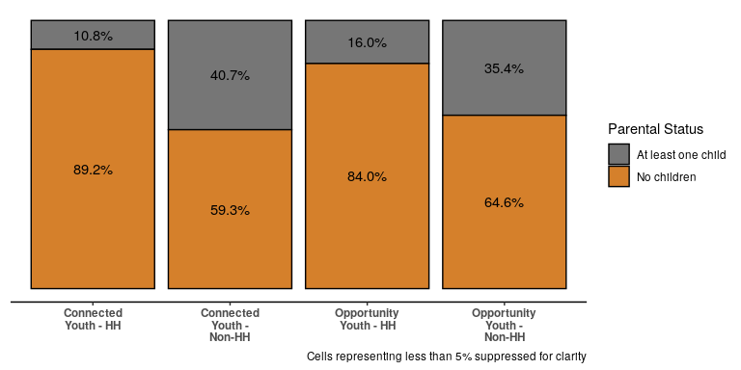
Do they have children?

Slide 5
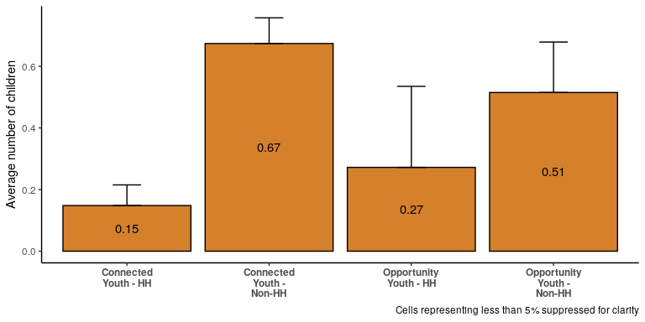
Number of Children

Slide 6
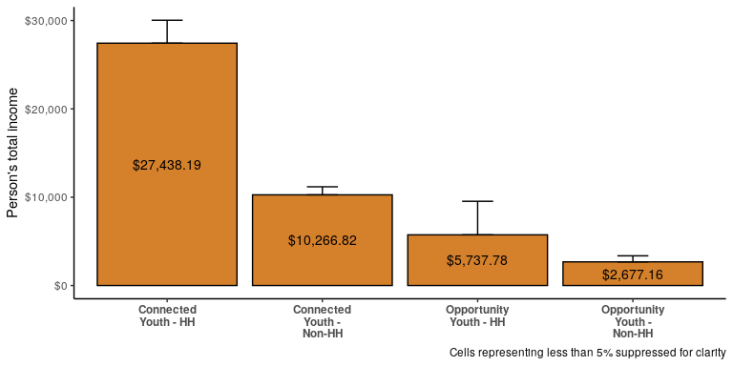
Income Characteristics: Total Person’s Income

Slide 7
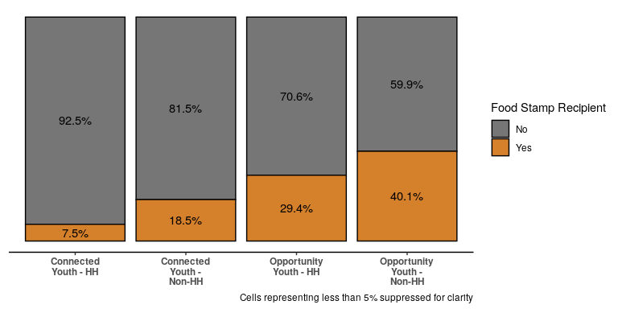
Income Characteristics: Food Stamps

Slide 8
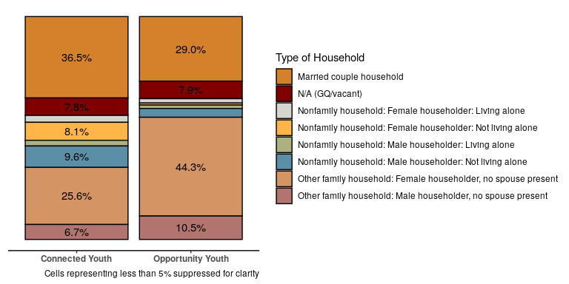
Household Type:

Slide 9
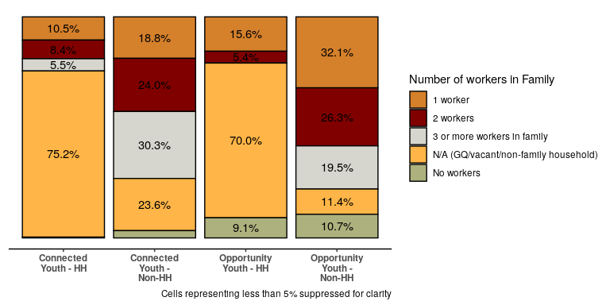
Household Characteristics: Workers in Family

Slide 10
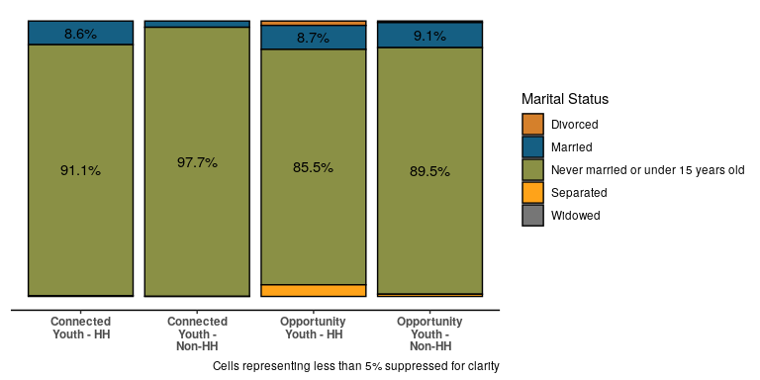
Marital Status / Partnered

Slide 11
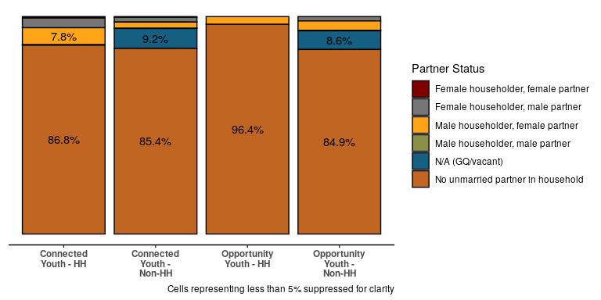
Partnered

Slide 12
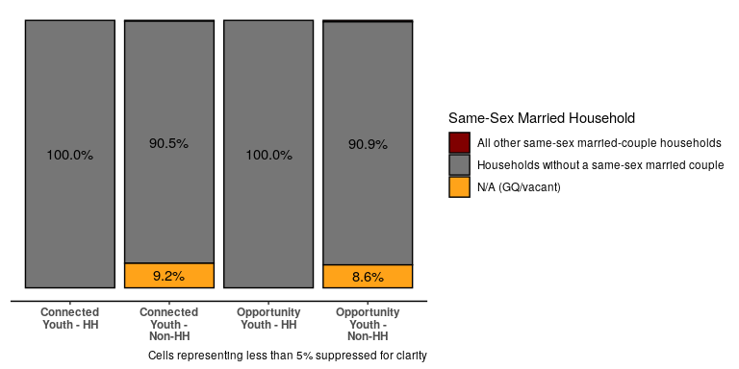
Same-sex households

Slide 13
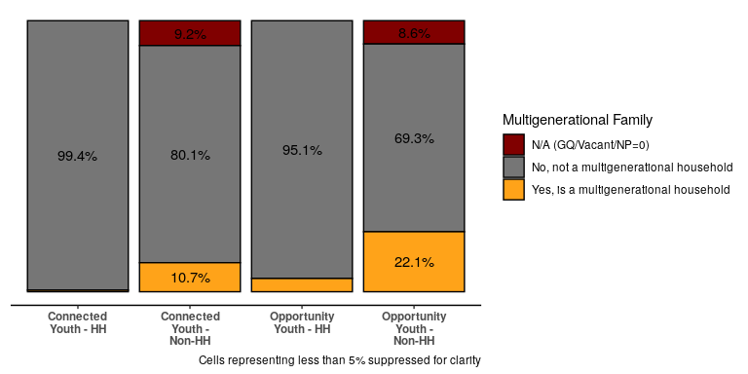
Multi-generational Families

Slide 14
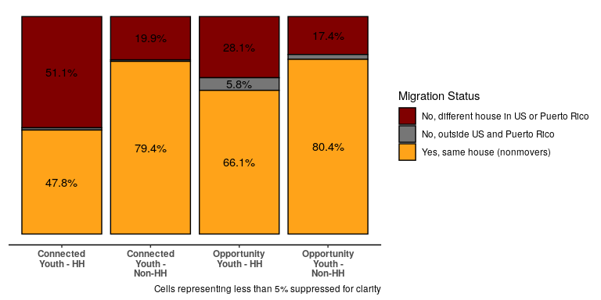
Mobility: Migration

Slide 15
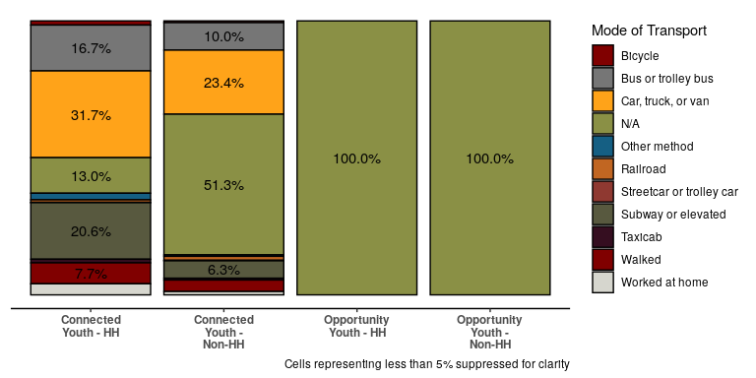
Mobility: Mode of Transportation

Slide 16
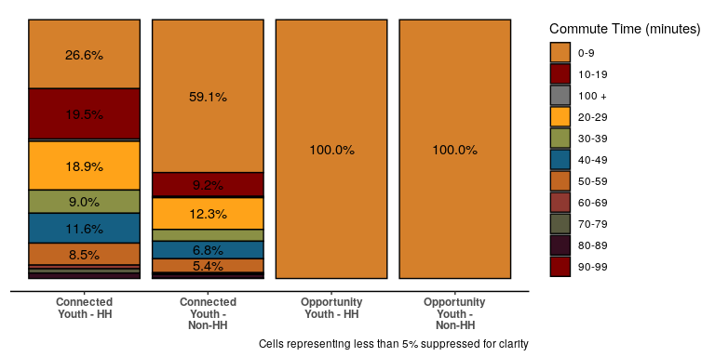
Migration: Average Commute Time

