Slide 1
Opportunity Youth Household Structure (Preliminary)
Diego Rubi

Slide 2
Data Sources:
IPUMS USA
IPUMS at the University of Minnesota
IPUMS pre-processes PUMS files to enable / facilitate research
Example: NOC (U.S. Census) vs. NCHILD (IPUMS) are at household level and individual level respectively
U.S. Census Bureau
Raw PUMS files directly from the U.S. Census Bureau

Slide 3
Research Questions of Interest
Are Opportunity Youth caring for children?
At least one child
Number of children
What are the household income characteristics of Opportunity Youth?
Household income by household type
Total personal income
What are the mobility characteristics of Opportunity Youth?
Migration, mode of transportation, and average commute time
Pending
Food Stamps Recipients, Household Types, Number of Workers in Family, Same-Sex Households, Multi-generational Families

Slide 4
Refresher

Slide 5
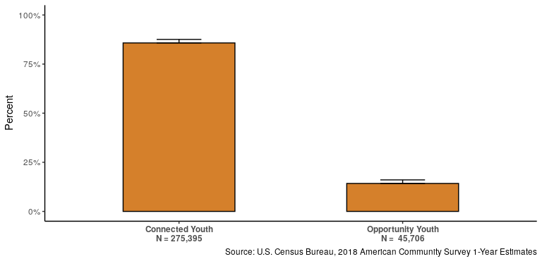
Number of Opportunity Youth

Slide 6
Definitions
Person-Level:
-Opportunity Youth: Individuals that are 16 to 24 years old who are simultaneously unemployed/ not in the labor force and not enrolled in school (disconnection) - Connected Youth: Individuals that are 16 to 24 years old who are either employed, enrolled in school, or both. - Everyone Else: Individuals outside of this age category who may be enrolled in school or employed
Household-level:
OY Household: There is at least one ‘Opportunity Youth’ in the household but no ‘Connected Youth’ in the household. There may be ‘Everyone Else’ in the household.
OY & CY Household: There are both ‘Opportunity Youth’ and ‘Connected Youth’ in the household and possibly ‘Everyone Else’.
CY Only Household: There are only ‘Connected Youth’ and no ‘Opportunity Youth’ or ‘Everyone Else’ in the household.

Slide 7
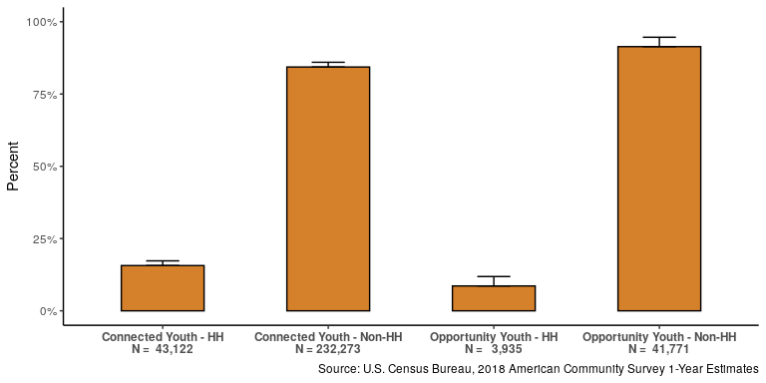
Person of Reference

Slide 8
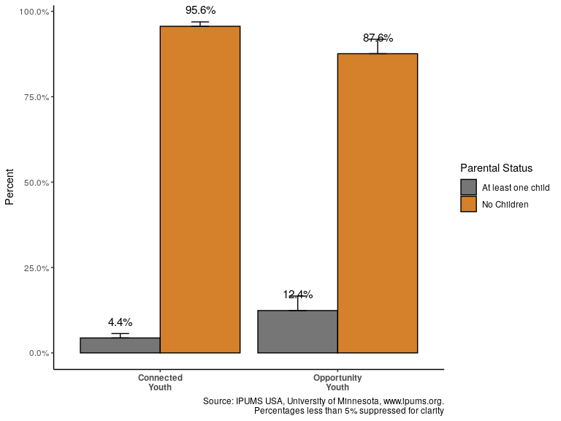
Do they have children?

Slide 9
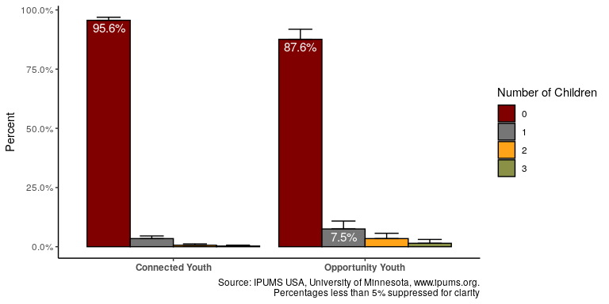
Number of Children

Slide 10
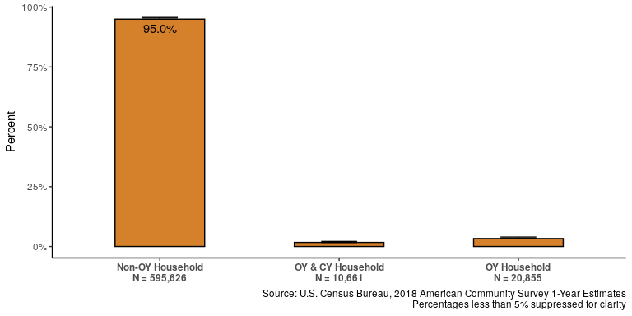
Type of Household

Slide 11
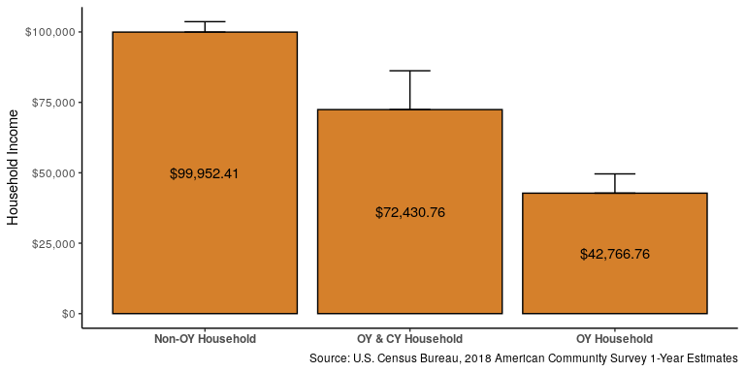
Income Characteristics: Average Household Income

Slide 12
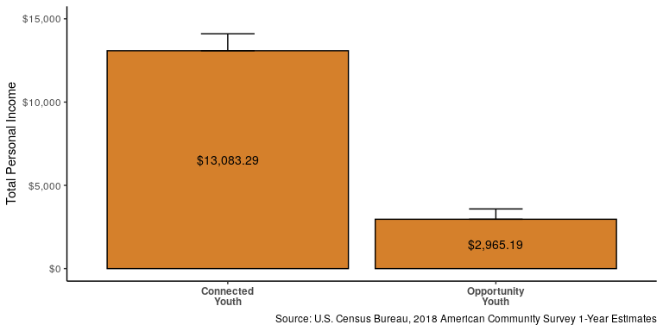
Income Characteristics: Total Average Personal Income

Slide 13
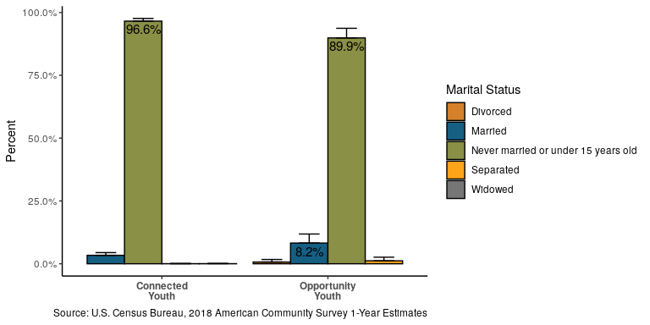
Marital Status

Slide 14
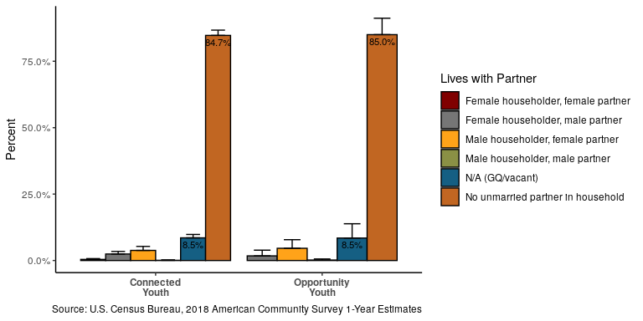
Partnered

Slide 15
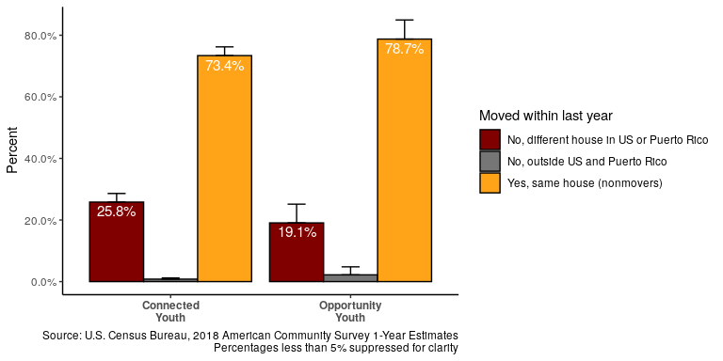
Mobility: Migration

Slide 16
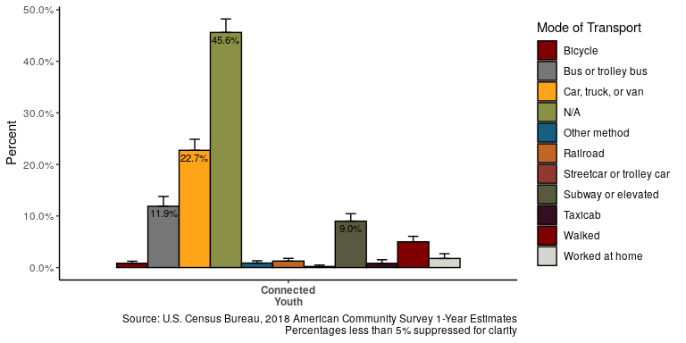
Mobility: Mode of Transportation for Connected Youth

Slide 17
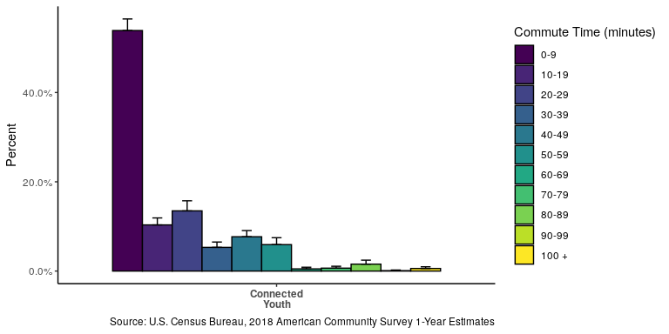
Migration: Average Commute Time for Connected Youth

Slide 18
Pending Analyses

Slide 19
Income Characteristics: Food Stamps (Pending)

Slide 20
Household Type:(Pending)

Slide 21
Household Characteristics: Workers in Family (Pending)

Slide 22
Same-sex households (Pending)

Slide 23
Multi-generational Families (Pending)

Slide 24
Questions?

Slide 25
Thank you!

