Slide 1
Opportunity Youth Household Structure (Preliminary)
Diego Rubi

Slide 2
Data Sources:
IPUMS USA
IPUMS at the University of Minnesota
IPUMS pre-processes PUMS files to enable / facilitate research
Example: NOC (U.S. Census) vs. NCHILD (IPUMS) are at household level and individual level respectively
U.S. Census Bureau
Raw PUMS files directly from the U.S. Census Bureau

Slide 3
Research Questions of Interest
Are Opportunity Youth caring for children?
How many Opportunity Youth have at least one child?
How many children do Opportunity Youth have?
What are the household income characteristics of Opportunity Youth?
What is average household income by household type?
What is an Opportunity Youth’s average total personal income?
What are the mobility characteristics of Opportunity Youth?
Have Opportunity Youth moved within the last year?
What are Connected Youths’ primary form of transportation?
What are Connected Youths’ average commute time?
Pending:
Food Stamps Recipients, Household Types, Number of Workers in Family, Same-Sex Households, Multi-generational Families

Slide 4
Refresher

Slide 5
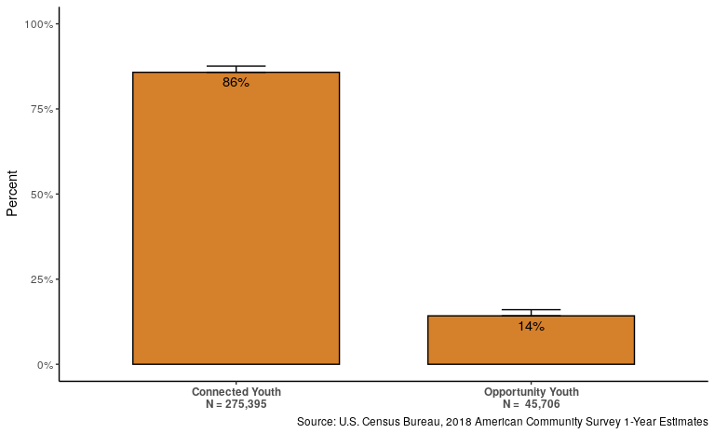
Number of Opportunity Youth

Slide 6
Definitions: Person Categorizations
Person-Level:
Opportunity Youth: Individuals that are 16 to 24 years old who are simultaneously unemployed/ not in the labor force and not enrolled in school (disconnection)
Connected Youth: Individuals that are 16 to 24 years old who are either employed, enrolled in school, or both.
Everyone Else: Individuals outside of this age category who may be enrolled in school or employed

Slide 7
Definitions: Household Categorizations
Household Type | Everyone Else | Connected Youth | Opportunity Youth
All Other Household | Present | Present | Present
CY Only Household | Present | Present | Not Present
OY Household | Present | Not Present | Present

Slide 8
Results

Slide 9
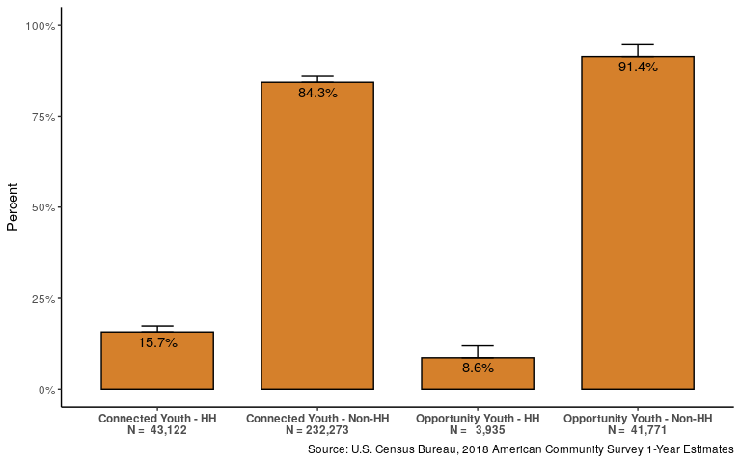
Self-identify as Reference Person

Slide 10
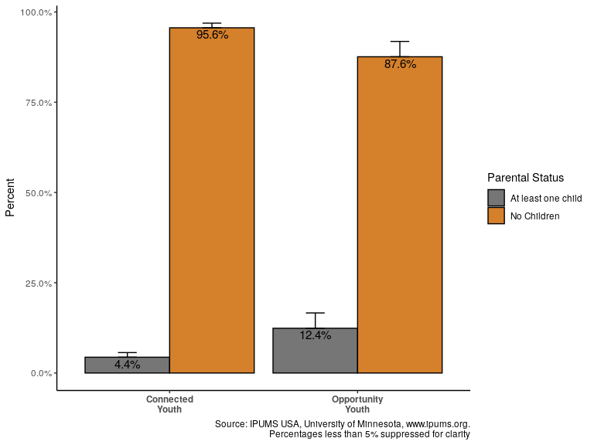
Presence of at least one child

Slide 11
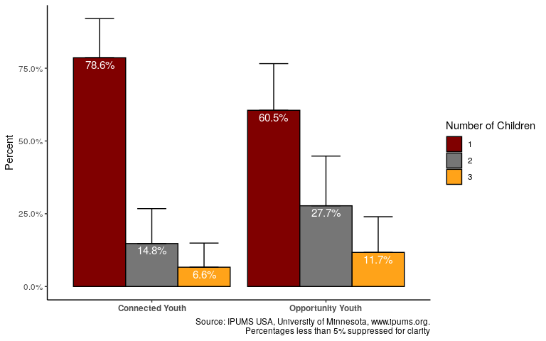
Number of Children

Slide 12
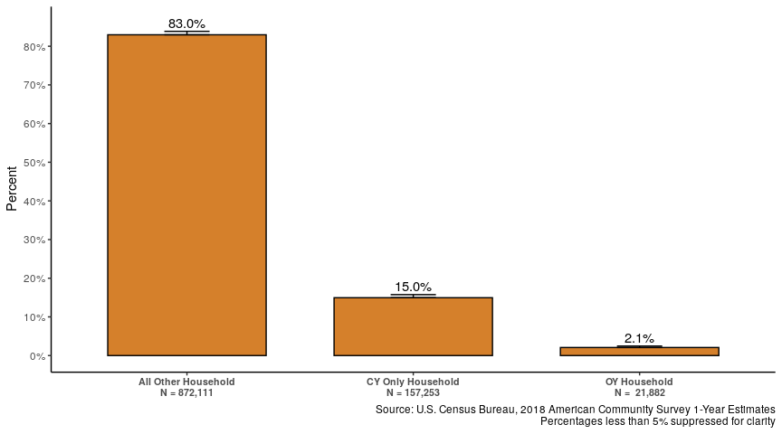
Type of Household Population Sizes

Slide 13
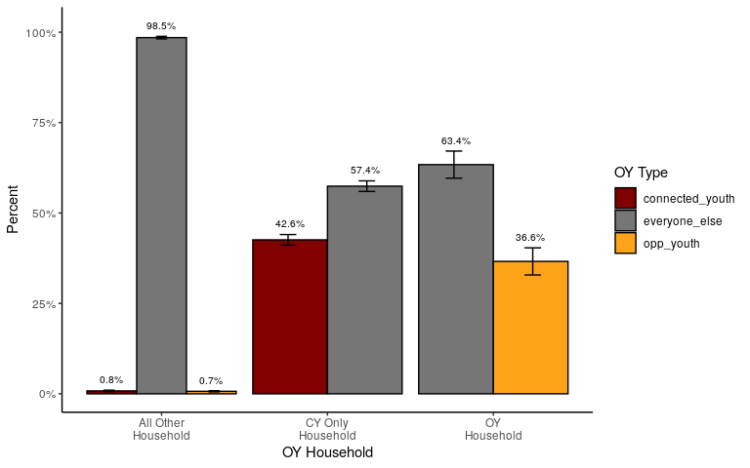
Household Composition

Slide 14
Household Composition: Alternate
Household Type | Everyone Else | Connected Youth | Opportunity Youth
All Other Household | 98.5% | 0.8% | 0.7%
CY Only Household | 57.4% | 42.6% | 0.0%
OY Household | 63.4% | 0.0% | 36.6%

Slide 15
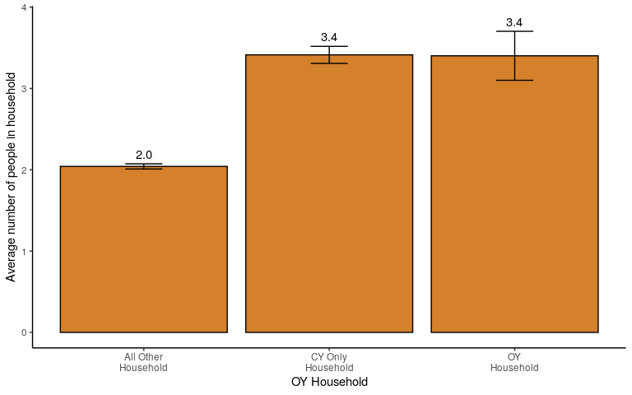
Average Household Size

Slide 16
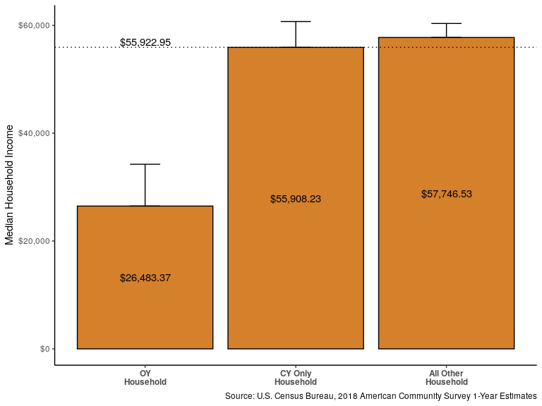
Income Characteristics: Household Median Income

Slide 17
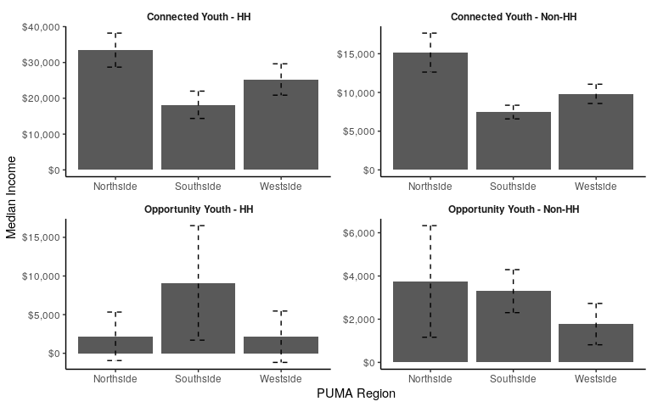
Median Income OY Reference Person by PUMA

Slide 18
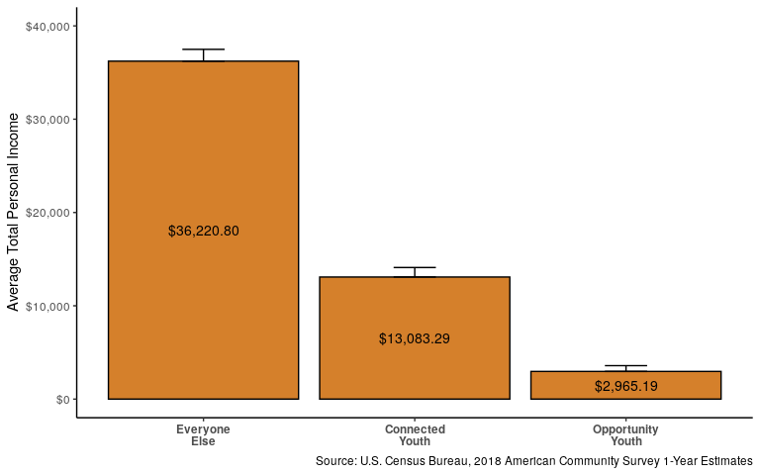
Income Characteristics: Total Average Personal Income

Slide 19
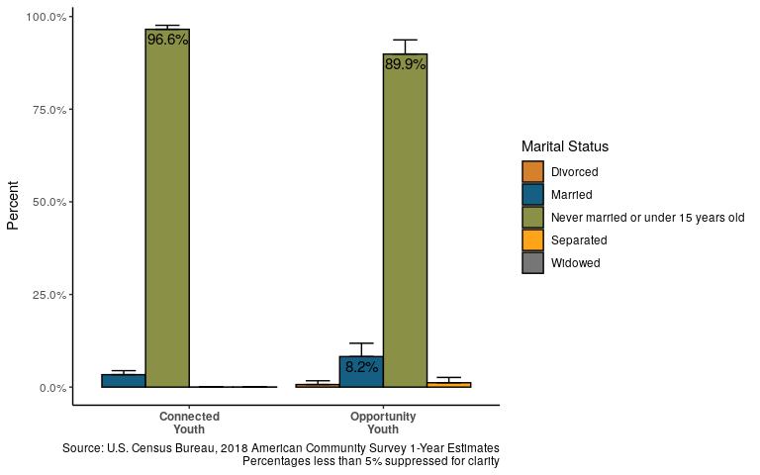
Marital Status

Slide 20
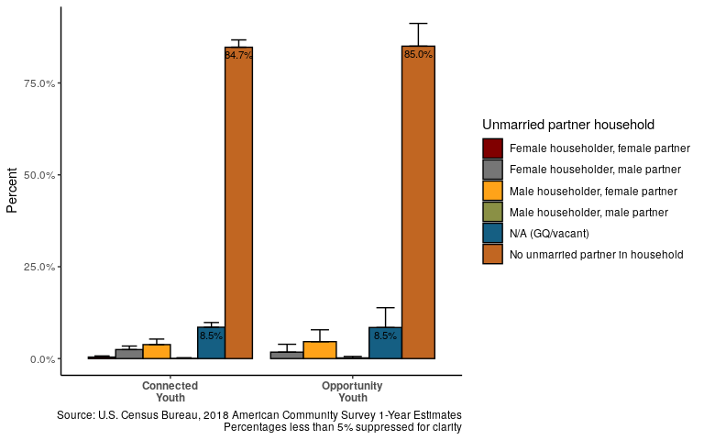
Partnered Status

Slide 21
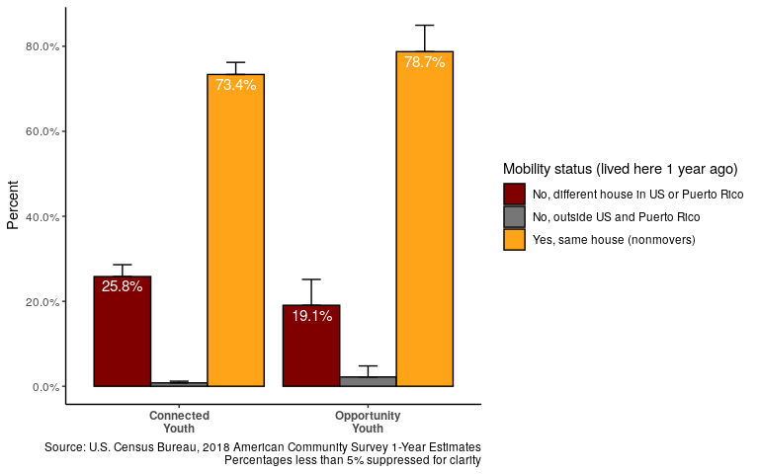
Mobility: Migration

Slide 22
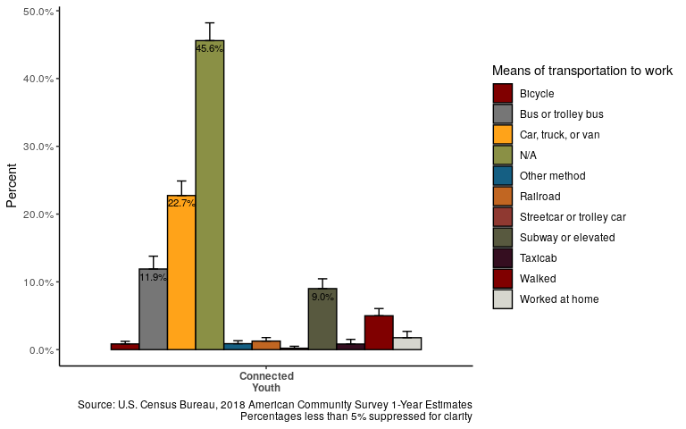
Mobility: Mode of Transportation for Connected Youth

Slide 23
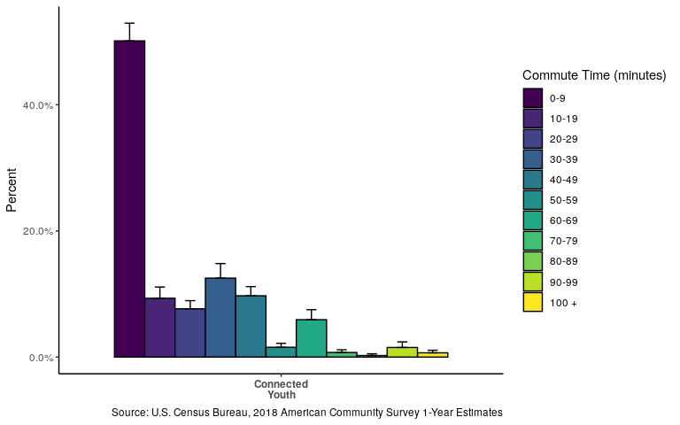
Mobility: Average Commute Time for Connected Youth

Slide 24
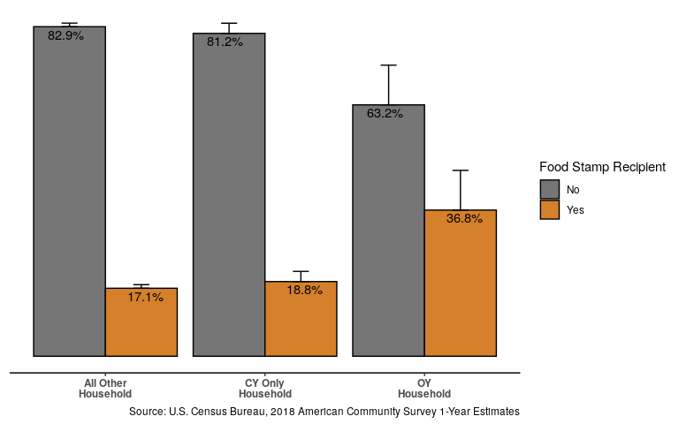
Food Stamp Recipient Households

Slide 25
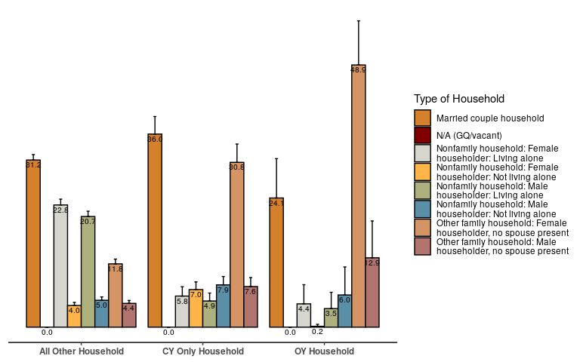
Household Type

Slide 26
Questions?

Slide 27
Thank you!

