Slide 1
Opportunity Youth Household Structure (Preliminary)
Diego Rubi

Slide 2
Data Sources:
IPUMS USA
IPUMS at the University of Minnesota
IPUMS pre-processes PUMS files to enable / facilitate research
Example: NOC (U.S. Census) vs. NCHILD (IPUMS) are at household level and individual level respectively
U.S. Census Bureau
Raw PUMS files directly from the U.S. Census Bureau

Slide 3
Research Questions of Interest
Are Opportunity Youth caring for children?
How many Opportunity Youth have at least one child?
How many children do Opportunity Youth have?
What are the household income characteristics of Opportunity Youth?
What is average household income by household type?
What is an Opportunity Youth’s average total personal income?
What are the mobility characteristics of Opportunity Youth?
Have Opportunity Youth moved within the last year?
What are Connected Youths’ primary form of transportation?
What are Connected Youths’ average commute time?
Pending:
Food Stamps Recipients, Household Types, Number of Workers in Family, Same-Sex Households, Multi-generational Families

Slide 4
Refresher

Slide 5
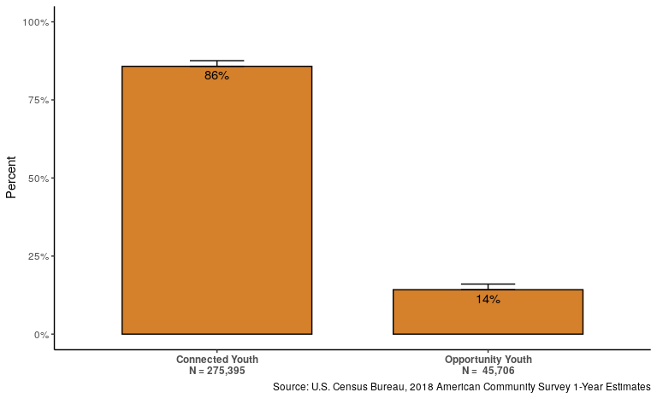
14% of 16 - 24 year olds are Opportunity Youth

Slide 6
Definitions: Person Categorizations
Person-Level:
Opportunity Youth: Individuals that are 16 to 24 years old who are simultaneously unemployed/ not in the labor force and not enrolled in school (disconnection)
Connected Youth: Individuals that are 16 to 24 years old who are either employed, enrolled in school, or both.
Everyone Else: Individuals outside of this age category who may be enrolled in school or employed

Slide 7
Definitions: Household Categorizations
Household Type | Everyone Else | Connected Youth | Opportunity Youth
All Other Households | Present | Present | Present
CY Only Household | Present | Present | Not Present
OY Only Household | Present | Not Present | Present

Slide 8
Results

Slide 9
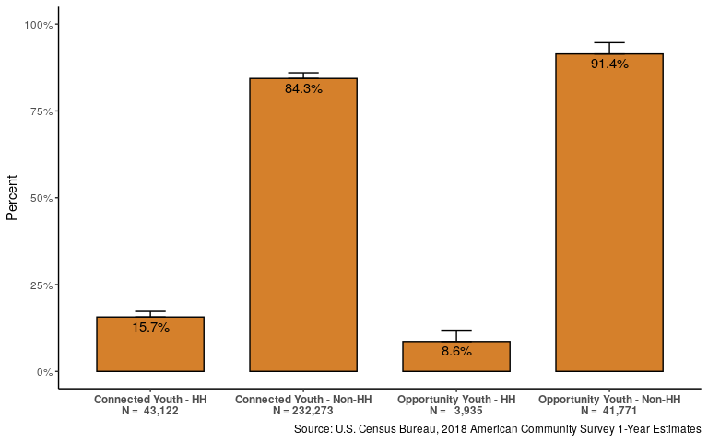
Opportunity Youth are half as likely as Connected Youth to be the reference person

Slide 10
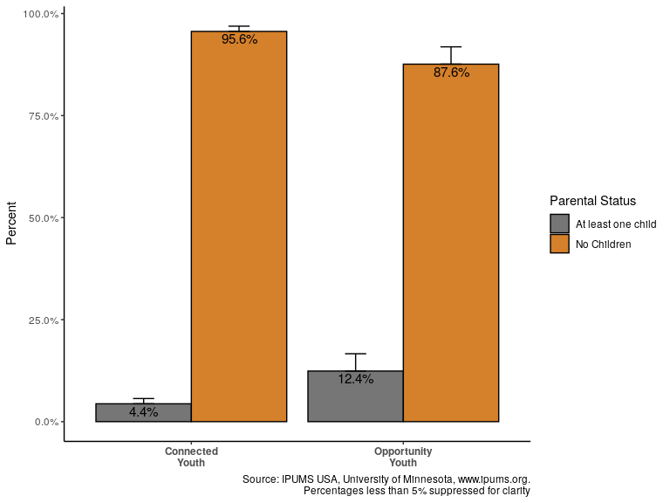
Opportunity Youth are three times as likely to have at least one child

Slide 11
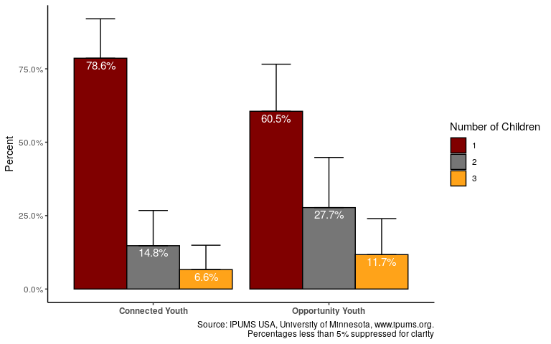
Opportunity Youth are more likely to have multiple children

Slide 12
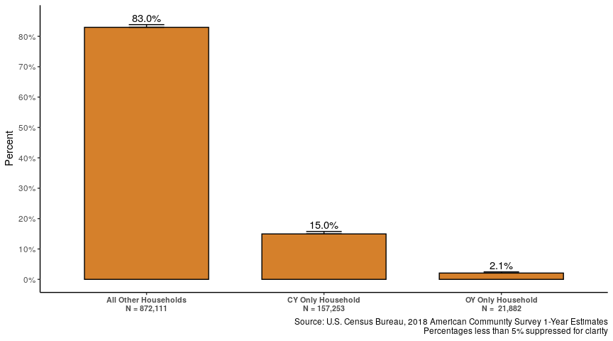
Less than 3% of households contain only Opportunity Youth

Slide 13
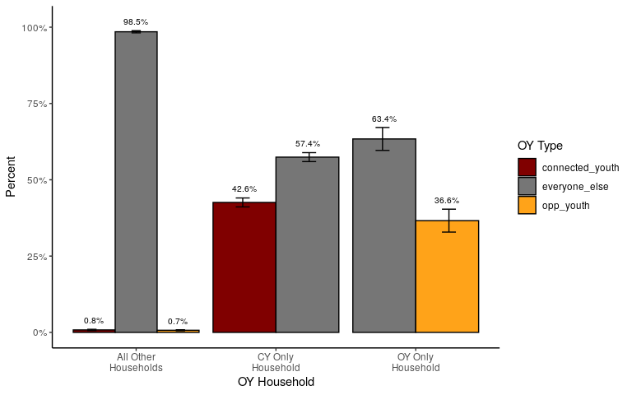
Opportunity Youth households are more likely to contain ‘Everyone Else’

Slide 14
Household Composition: Alternate
Household Type | Everyone Else | Connected Youth | Opportunity Youth
All Other Households | 98.5% | 0.8% | 0.7%
CY Only Household | 57.4% | 42.6% | 0.0%
OY Only Household | 63.4% | 0.0% | 36.6%

Slide 15
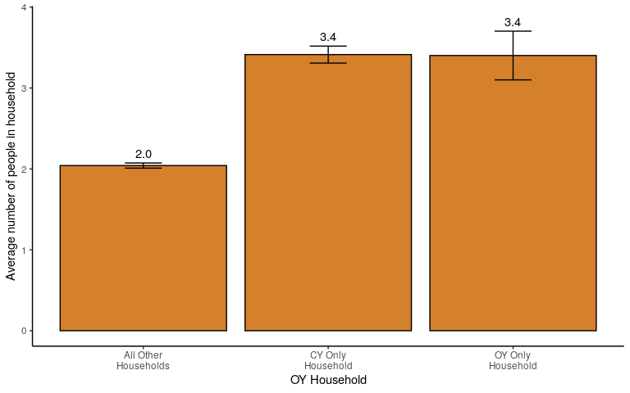
Both Connected Youth and Opportunity Youth live in larger households

Slide 16
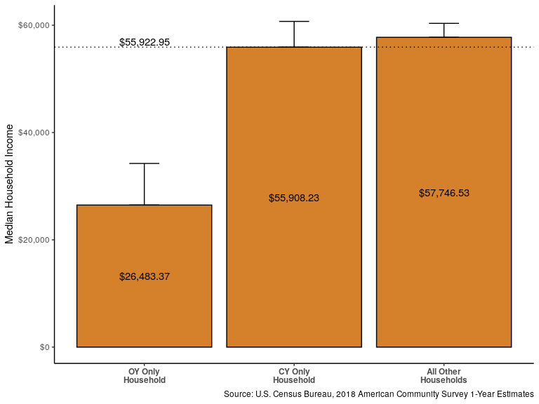
The median income of OY Only Households is less than half that of other households

Slide 17
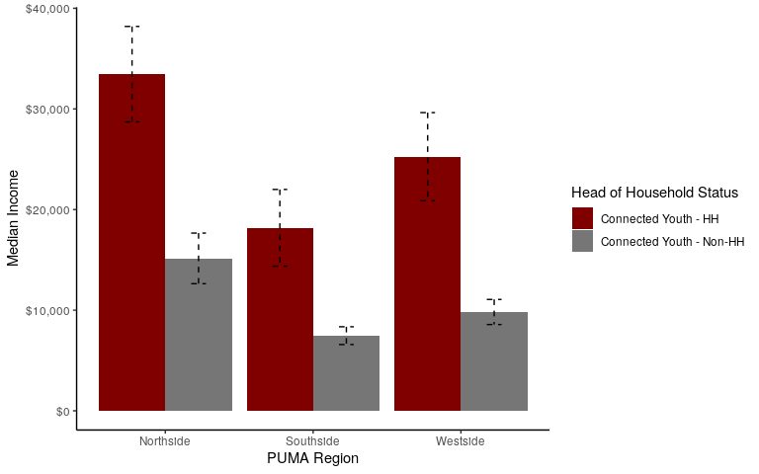
Median Income OY Reference Person by PUMA

Slide 18
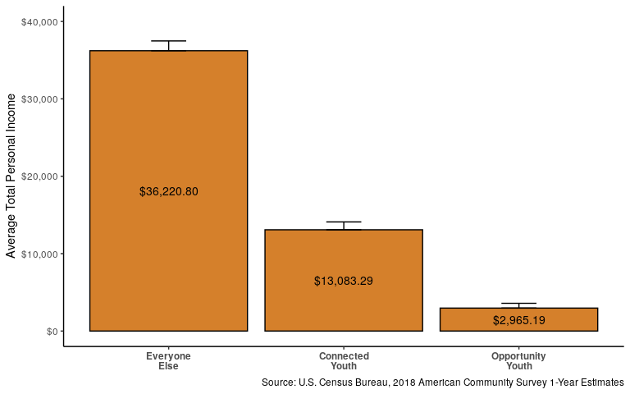
Opportunity Youth have 1/4th the total average personal income of Connected Youth

Slide 19
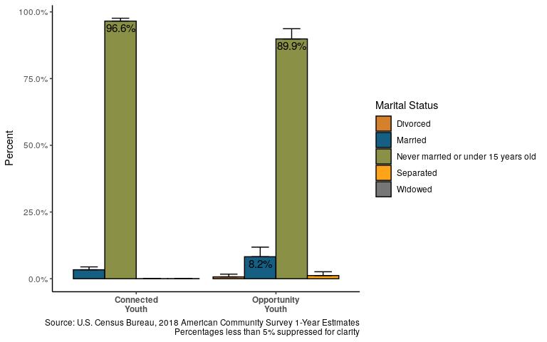
Opportunity Youth are more likely than Connected Youth to be married

Slide 20
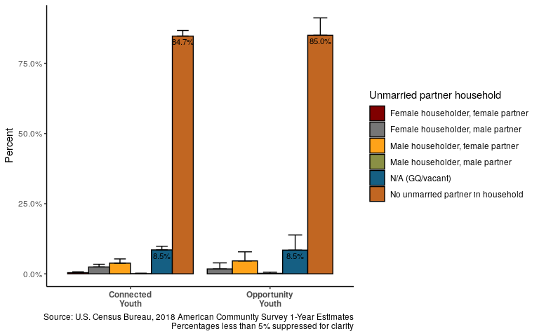
Partnered Status

Slide 21
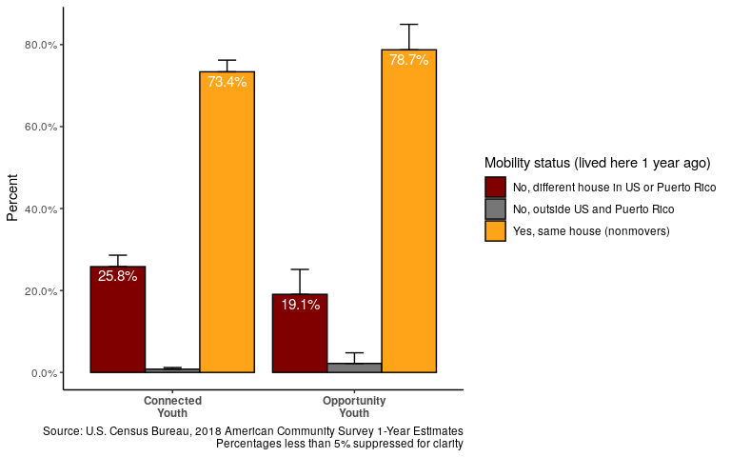
Opportunity Youth are more likely to have lived in the same house the prior year

Slide 22
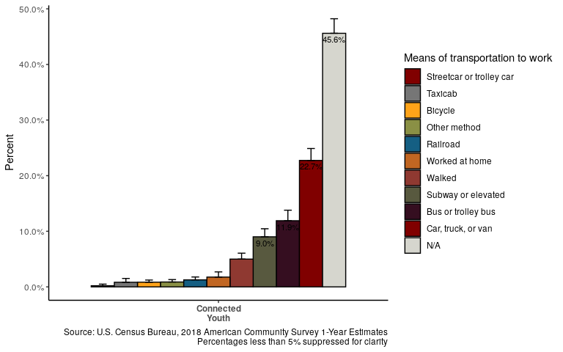
Mobility: Mode of Transportation for Connected Youth

Slide 23
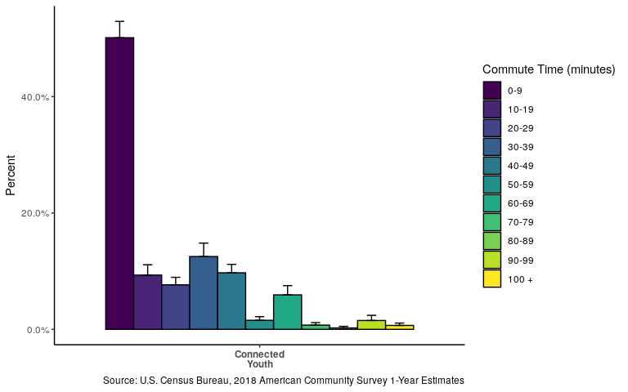
Most Connected Youth commute less than ten minutes to work

Slide 24
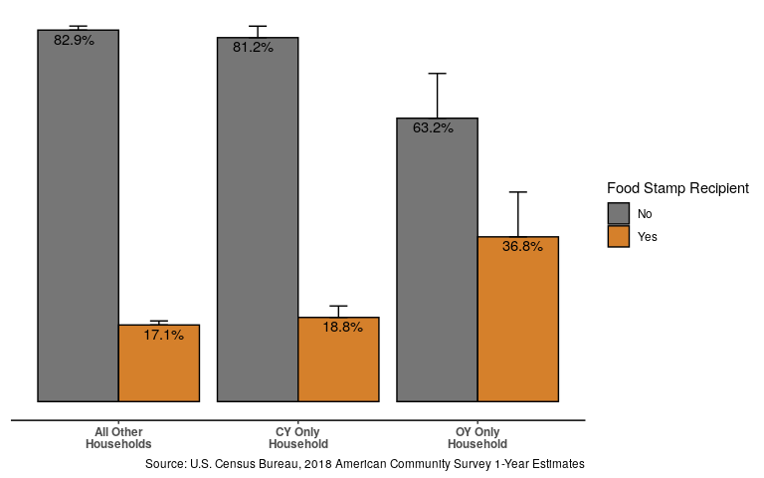
OY Only Households are twice as likely to receive foodstamps

Slide 25
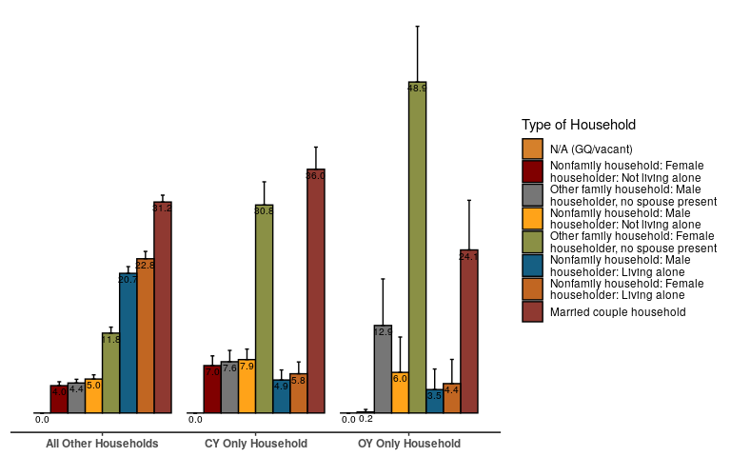
Household Type

Slide 26
Questions?

Slide 27
Thank you!

