Slide 1
Household Structure (Preliminary)
Diego Campos

Slide 2
Research Questions of Interest
Are Opportunity Youth caring for children?
What are the household income characteristics of Opportunity Youth?
Mobility Status

Slide 3
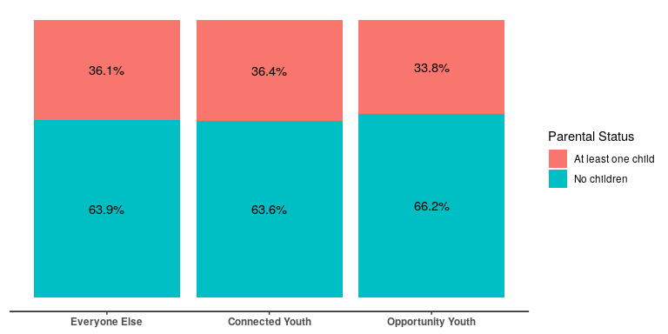
Do they have children?

Slide 4
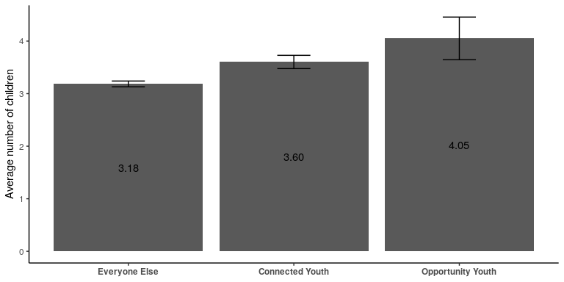
Number of Children

Slide 5
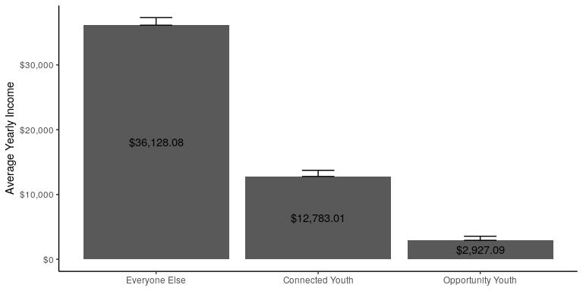
Income Characteristics: Household Income

Slide 6
Income Characteristics: Income Bracket

Slide 7
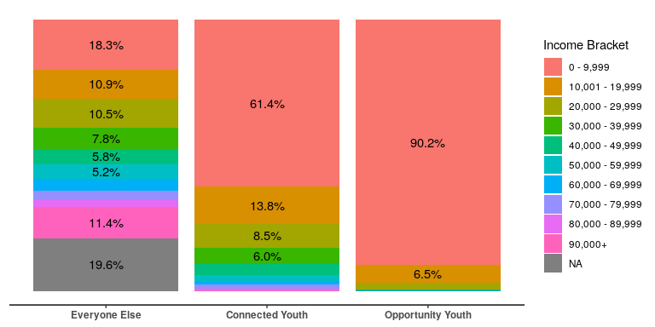

Slide 8
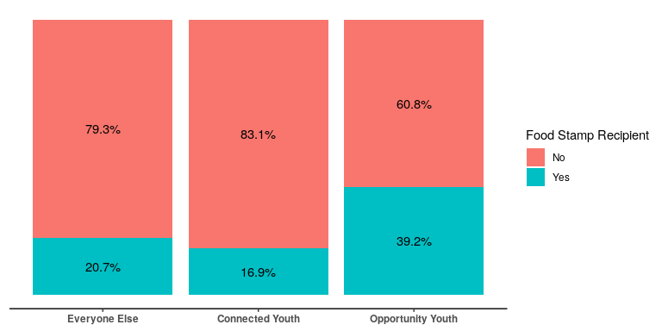
Income Characteristics: Food Stamps

Slide 9
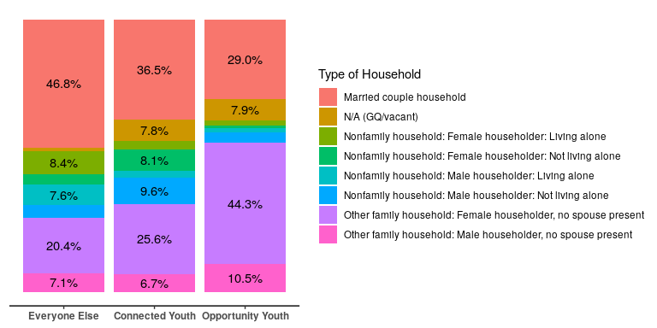
Household Type:

Slide 10
# Household Characteristics: Workers in Family

Slide 11
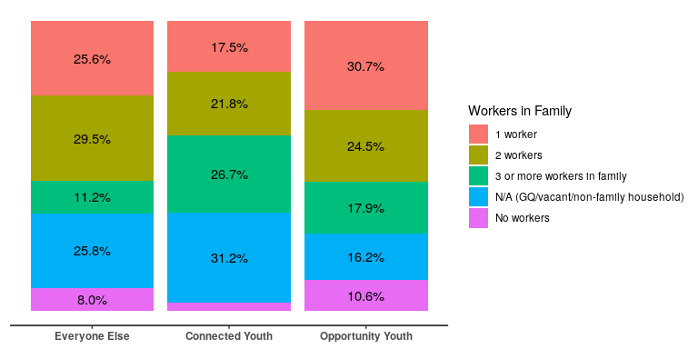

Slide 12
Marital Status / Partnered

Slide 13
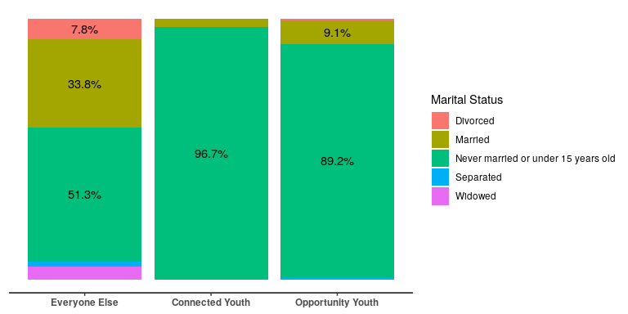

Slide 14
Partnered

Slide 15
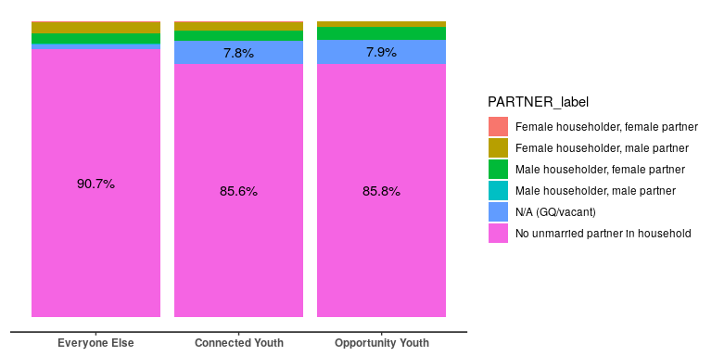

Slide 16
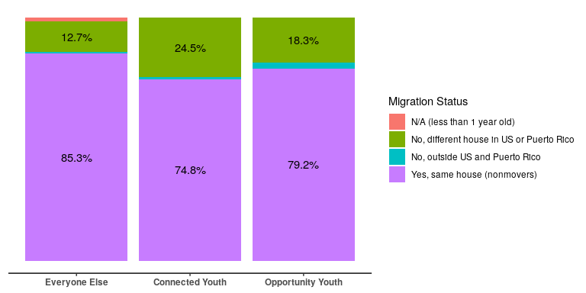
Mobility: Migration

Slide 17
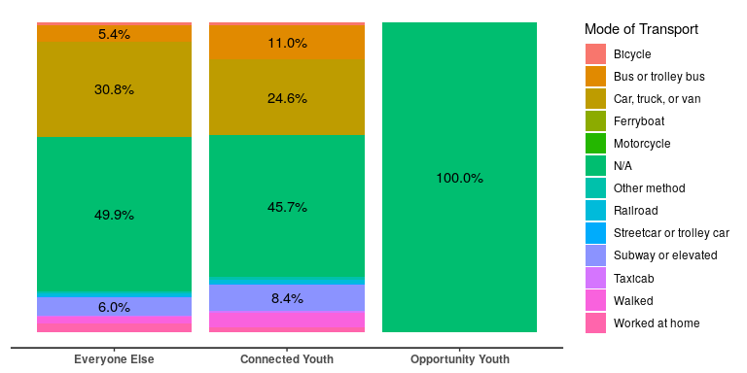
Mobility: Mode of Transportation

Slide 18
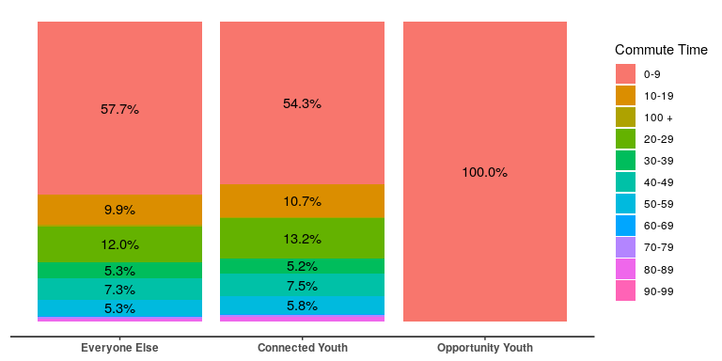
Migration: Average Commute Time

Slide 19
## [1] "partnered" "edu_attained" "food_stamps" ## [4] "married" "hh_language" "hh_type" ## [7] "transportation_mode" "migration" "multigen" ## [10] "income_bracket" "same_sex_married" "hh_type" ## [13] "workers_in_fam" "parental_employment" "children" ## [16] "commute_bracket" "average_income" "num_children" ## [19] "travel_time_to_work"

