Slide 1
Household Structure (Preliminary)
Diego Campos

Slide 2
Research Questions of Interest
Are Opportunity Youth caring for children?
What are the household income characteristics of Opportunity Youth?
Mobility Status

Slide 3
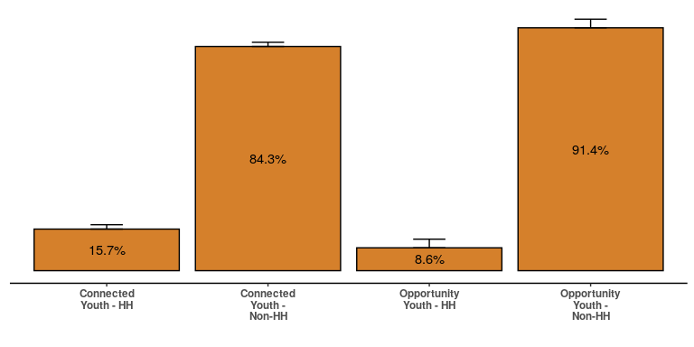
Heads of Household

Slide 4
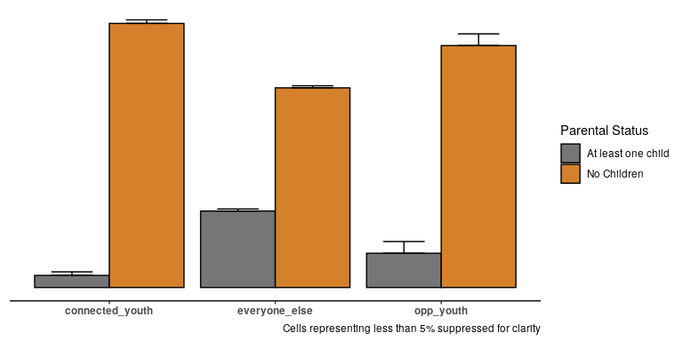
Do they have children?

Slide 5
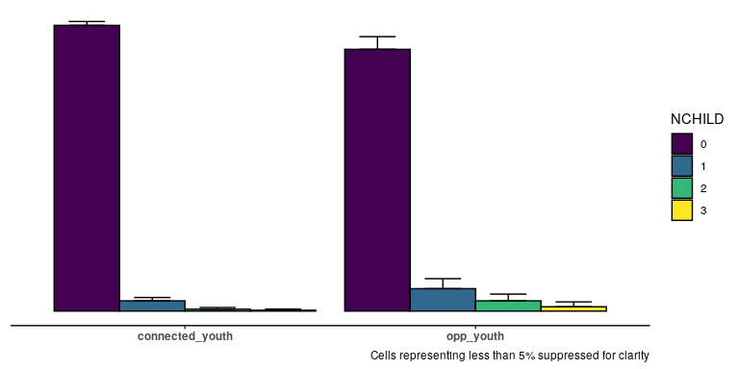
Number of Children

Slide 6
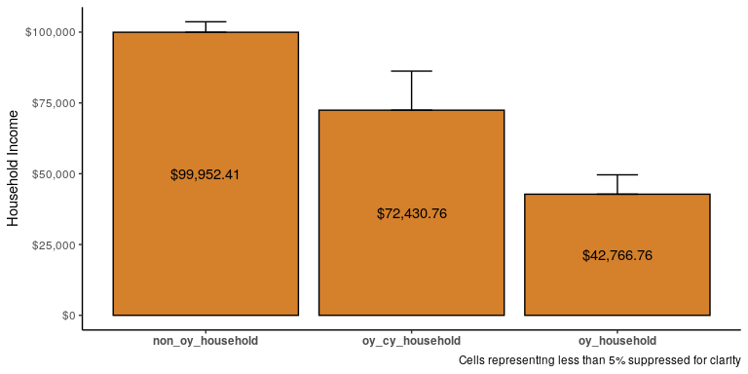
Income Characteristics: Household Income

Slide 7
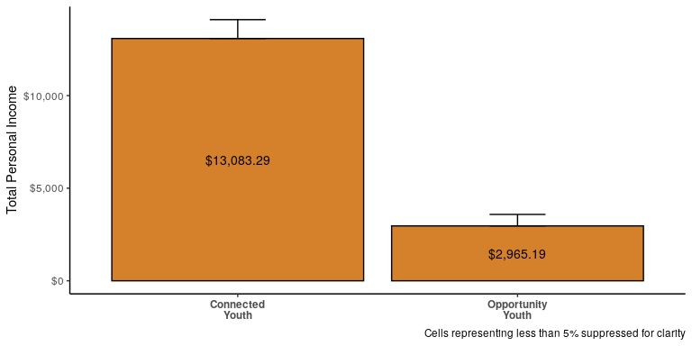
Income Characteristics: Total Personal Income

Slide 8
Income Characteristics: Food Stamps (Pending)

Slide 9
Household Type:(Pending)

Slide 10
Household Characteristics: Workers in Family (Pending)

Slide 11
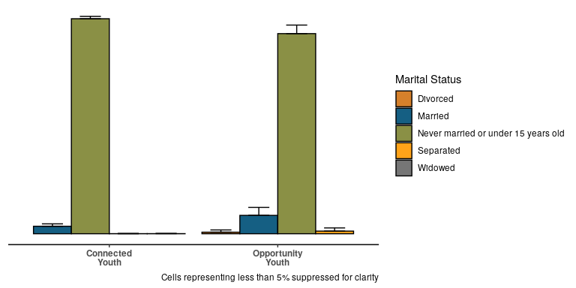
Marital Status / Partnered

Slide 12
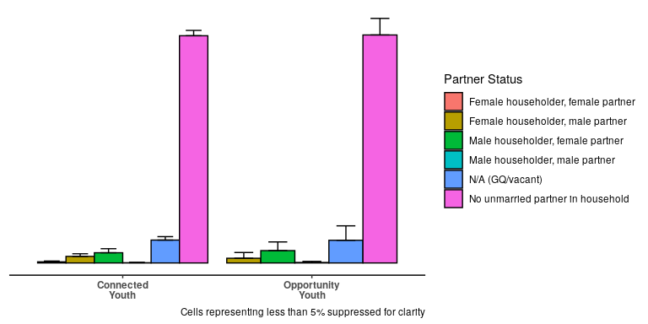
Partnered

Slide 13
Same-sex households (Pending)

Slide 14
Multi-generational Families (Pending)

Slide 15
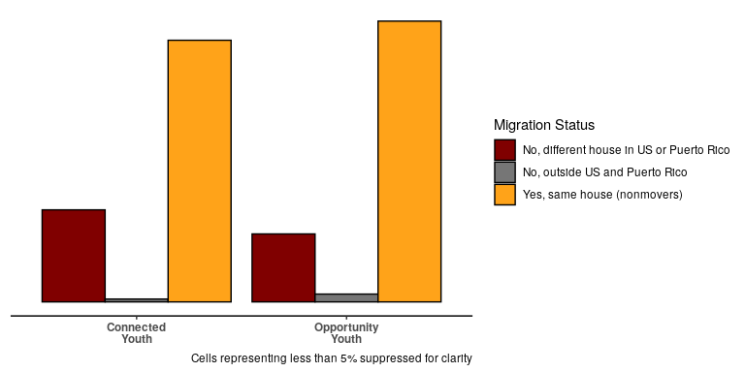
Mobility: Migration

Slide 16
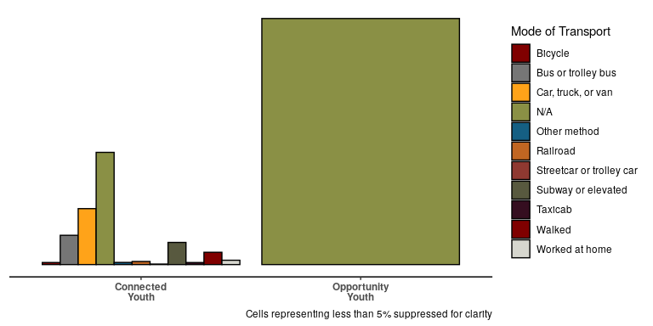
Mobility: Mode of Transportation

Slide 17
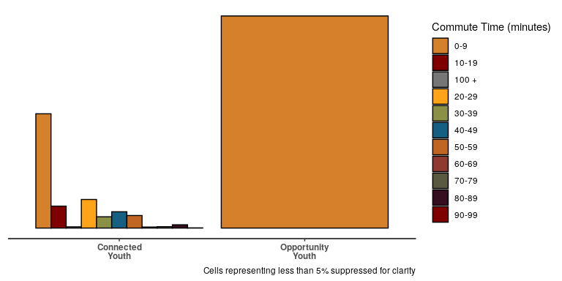
Migration: Average Commute Time

