Slide 1
Opportunity Youth Household Structure (Preliminary)
Diego Rubi

Slide 2
Data Sources:
IPUMS USA
IPUMS at the University of Minnesota
IPUMS pre-processes PUMS files to enable / facilitate research
Example: NOC (U.S. Census) vs. NCHILD (IPUMS) are at household level and individual level respectively
U.S. Census Bureau
Raw PUMS files directly from the U.S. Census Bureau

Slide 3
Research Questions of Interest
Are Opportunity Youth caring for children?
How many Opportunity Youth have at least one child?
How many children do Opportunity Youth have?
What are the household income characteristics of Opportunity Youth?
What is average household income by household type?
What is an Opportunity Youth’s average total personal income?
What are the mobility characteristics of Opportunity Youth?
Have Opportunity Youth moved within the last year?
What are Connected Youths’ primary form of transportation?
What are Connected Youths’ average commute time?
Pending:
Food Stamps Recipients, Household Types, Number of Workers in Family, Same-Sex Households, Multi-generational Families

Slide 4
Refresher

Slide 5
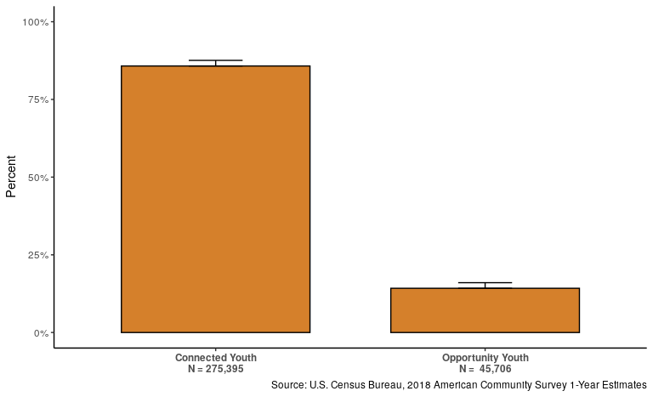
Number of Opportunity Youth

Slide 6
Definitions: Person Categorizations
Person-Level:
Opportunity Youth: Individuals that are 16 to 24 years old who are simultaneously unemployed/ not in the labor force and not enrolled in school (disconnection)
Connected Youth: Individuals that are 16 to 24 years old who are either employed, enrolled in school, or both.
Everyone Else: Individuals outside of this age category who may be enrolled in school or employed

Slide 7
Definitions: Household Categorizations
Household Type | Everyone Else | Connected Youth | Opportunity Youth
Combined Household | Present | Present | Present
CY Only Household | Not Present | Present | Not Present
CY-EE Only Household | Present | Present | Not Present
EE Only Household | Present | Not Present | Not Present
OY Only Household | Not Present | Not Present | Present
OY-CY Only Household | Not Present | Present | Present
OY-EE Only Household | Present | Not Present | Present

Slide 8
Results

Slide 9
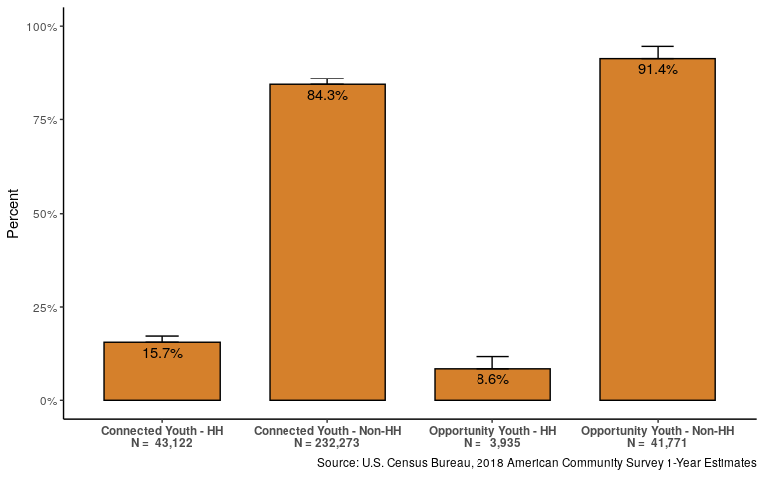
Who identifies as ‘Reference’ Person on the ACS?

Slide 10
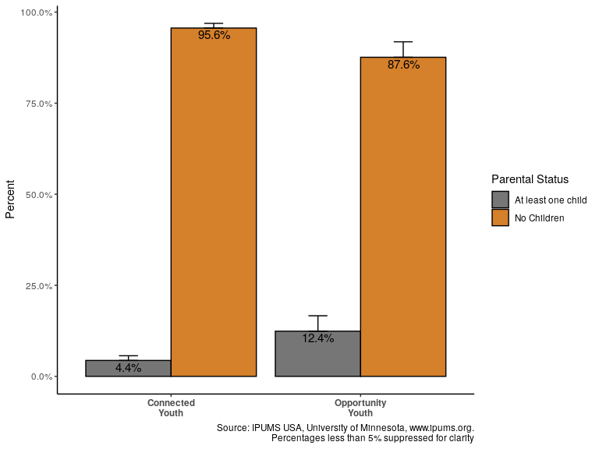
Do they have children?

Slide 11
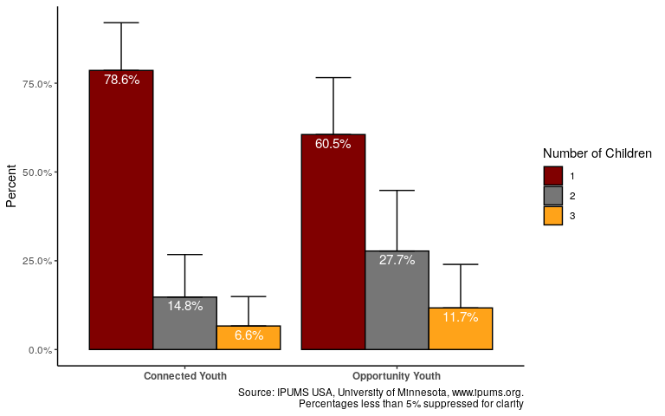
Number of Children

Slide 12
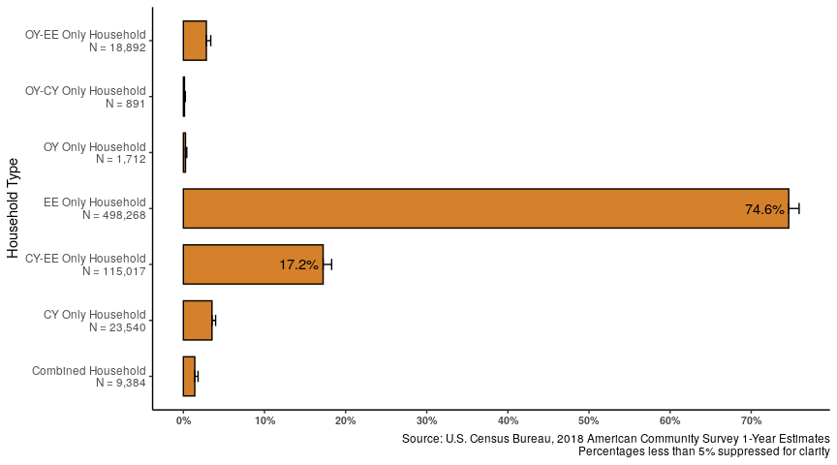
Type of Household

Slide 13
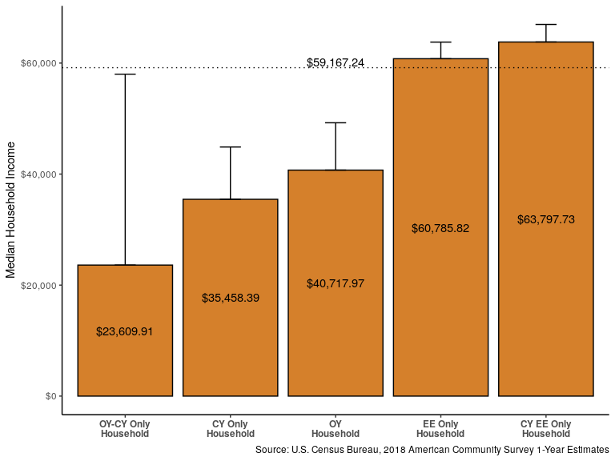
Income Characteristics: Household Median Income

Slide 14
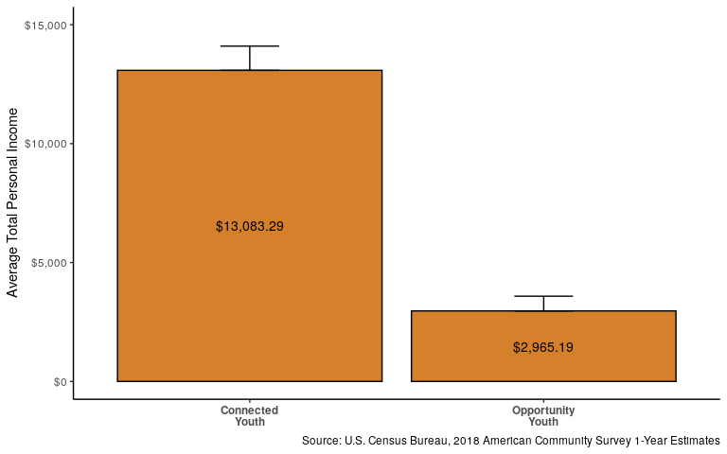
Income Characteristics: Total Average Personal Income

Slide 15
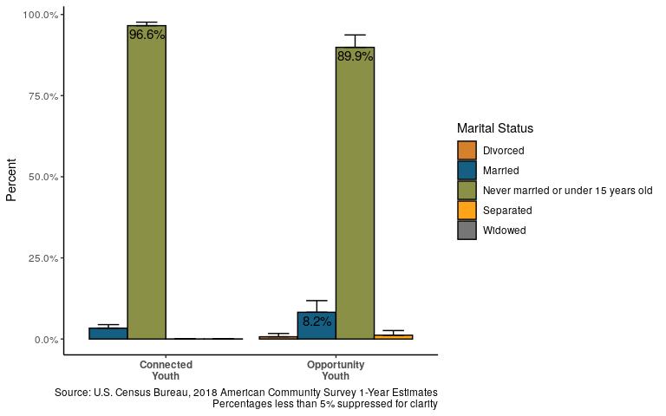
Marital Status

Slide 16
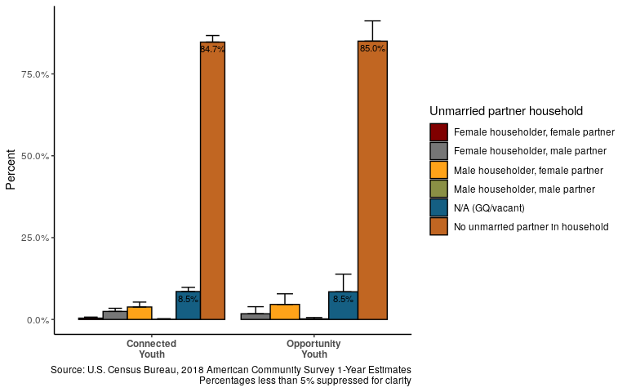
Partnered

Slide 17
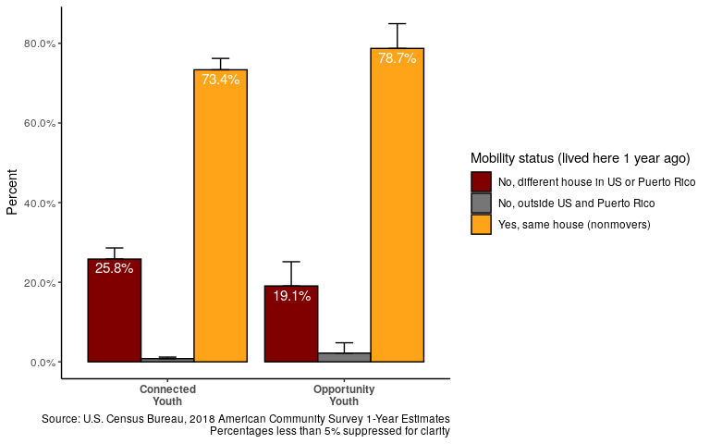
Mobility: Migration

Slide 18
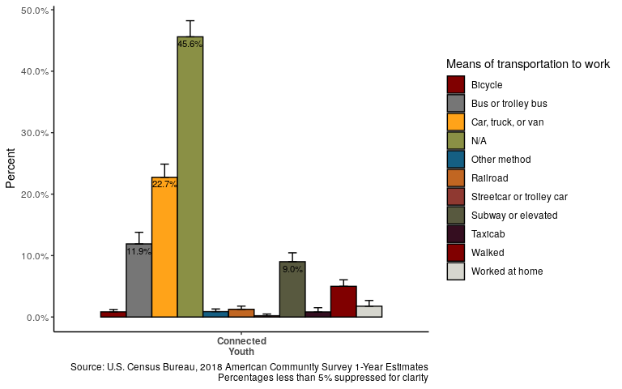
Mobility: Mode of Transportation for Connected Youth

Slide 19
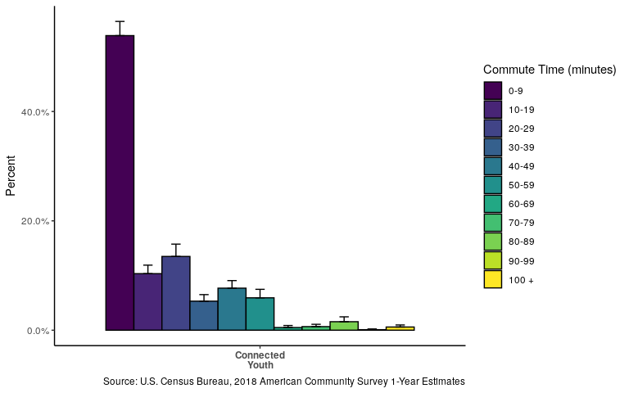
Migration: Average Commute Time for Connected Youth

Slide 20
Pending Analyses

Slide 21
Income Characteristics: Food Stamps (Pending)

Slide 22
Household Type:(Pending)

Slide 23
Household Characteristics: Workers in Family (Pending)

Slide 24
Same-sex households (Pending)

Slide 25
Multi-generational Families (Pending)

Slide 26
Questions?

Slide 27
Thank you!

