Slide 1
Opportunity Youth Household Structure (Preliminary)
Diego Rubi

Slide 2
Data Sources:
IPUMS USA
IPUMS at the University of Minnesota
IPUMS pre-processes PUMS files to enable / facilitate research
Example: NOC (U.S. Census) vs. NCHILD (IPUMS) are at household level and individual level respectively
U.S. Census Bureau
Raw PUMS files directly from the U.S. Census Bureau

Slide 3
Research Questions of Interest
What is each household type, and what is their composition?
What is the average household size for each type of household?
What is average household income by household type?
What is an Opportunity Youth’s average total personal income?
What percentage of households are food stamp recipients?
How many youth identify as the reference person?
How many youth have at least one child?
How many youth have multiple children?
What is the household median income for each household type?
What is the median income by Chicago region for reference persons?
What are youth’s average total personal income?

Slide 4
Research Questions (cont.)
How many youth are married?
How many youth are partnered?
How many households are foodstamp recipients?
What type of households do
What percentage of each household has broadband access?
What percentage of each household has computer access?
Have Opportunity Youth moved within the last year?
What are Connected Youths’ primary form of transportation?
What are Connected Youths’ average commute time?

Slide 5
Refresher

Slide 6
How are Opportunity Youth defined?
Opportunity Youth: Individuals that are 16 to 24 years old who are simultaneously unemployed/ not in the labor force and not enrolled in school (disconnection)
Connected Youth: Individuals that are 16 to 24 years old who are either employed, enrolled in school, or both.
Everyone Else: Individuals outside of this age category who may be enrolled in school or employed

Slide 7
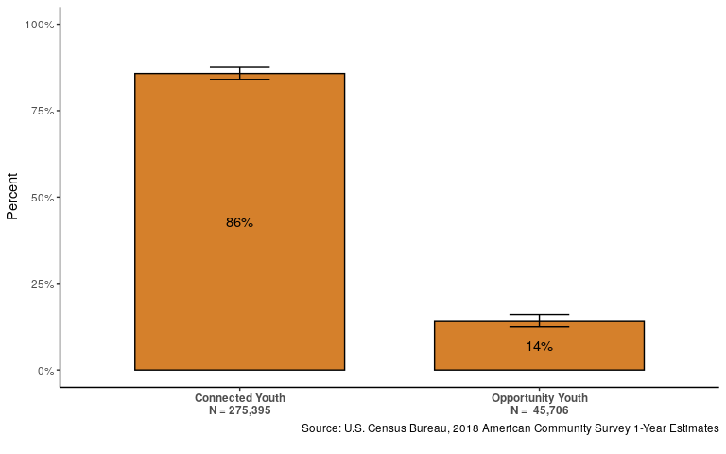
14% of 16 - 24 year olds are Opportunity Youth

Slide 8
Results

Slide 9
How are households categorized?
Household Type | Everyone Else | Connected Youth | Opportunity Youth
All Other Households | Present | Present | Present
Household w/Only CY | Present | Present | Not Present
Household w/Only OY | Present | Not Present | Present

Slide 10
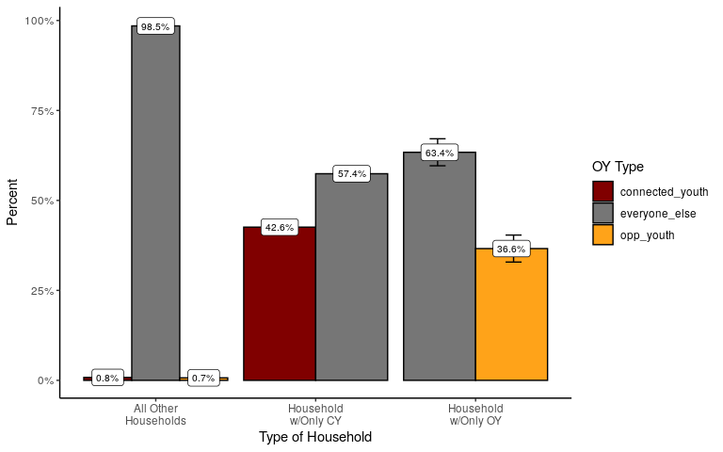
Opportunity Youth households are more likely to contain ‘Everyone Else’

Slide 11
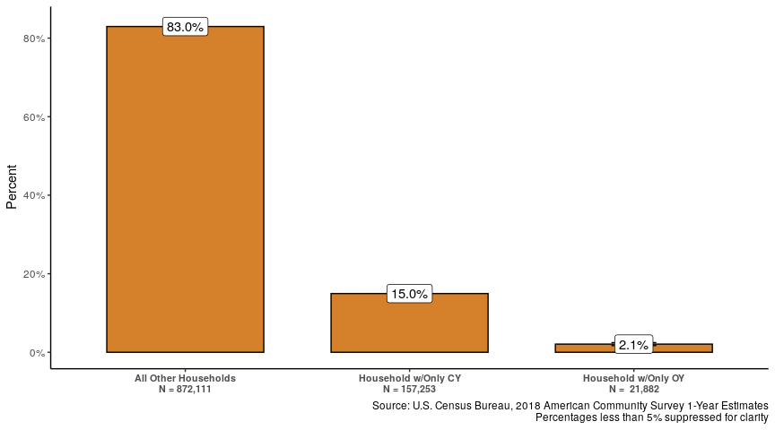
Less than 3% of households contain only Opportunity Youth

Slide 12
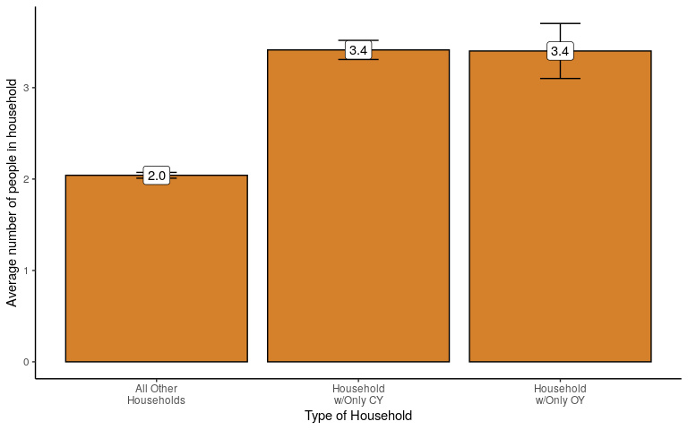
Both Connected Youth and Opportunity Youth live in larger households

Slide 13
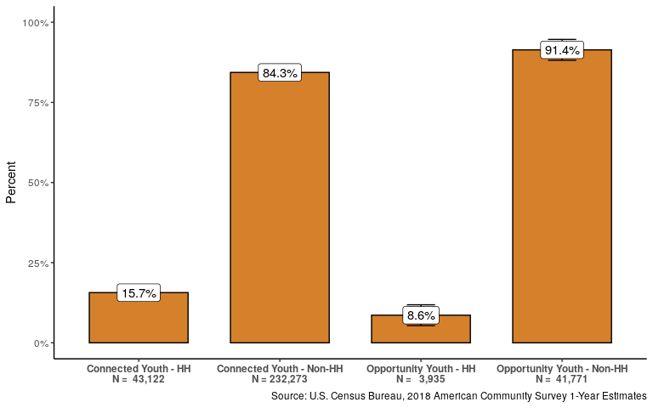
Opportunity Youth are half as likely as Connected Youth to be the reference person

Slide 14
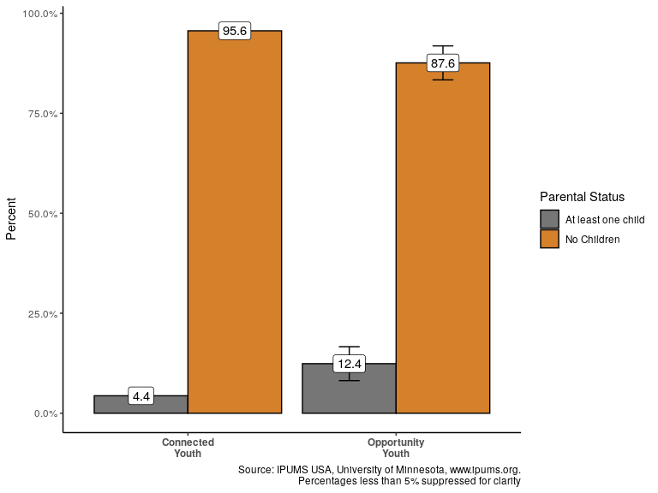
Opportunity Youth are three times as likely to have at least one child

Slide 15
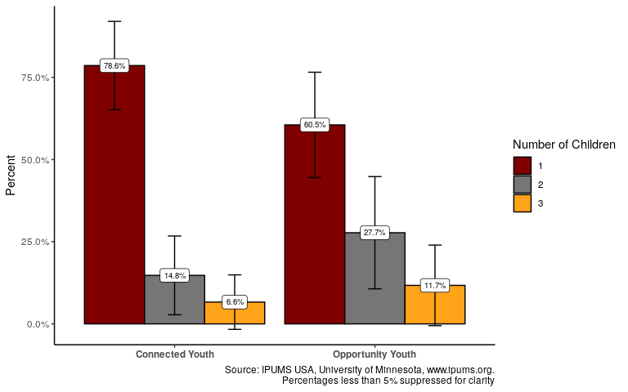
Opportunity Youth are more likely to have multiple children

Slide 16
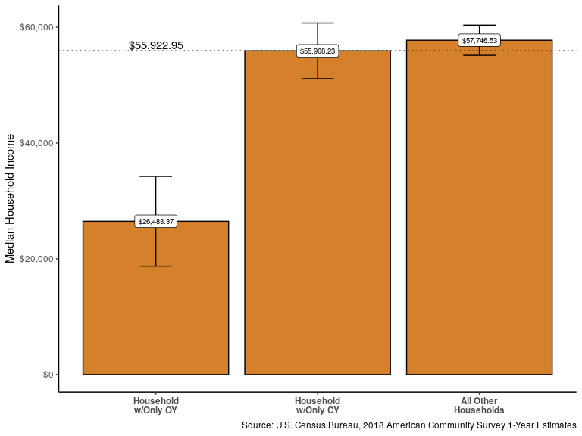
The median income of OY Only Households is less than half that of other households

Slide 17
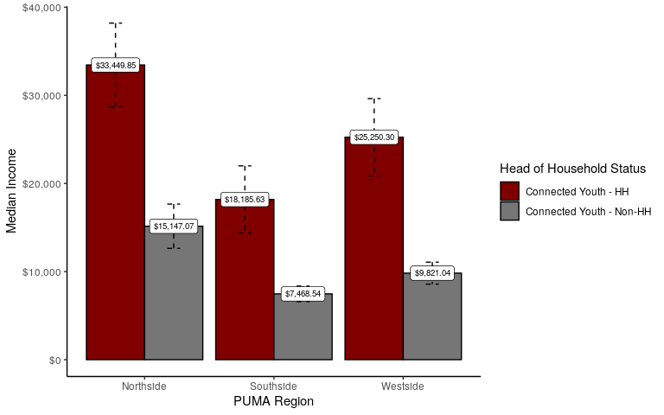
Median Income OY Reference Person by PUMA

Slide 18
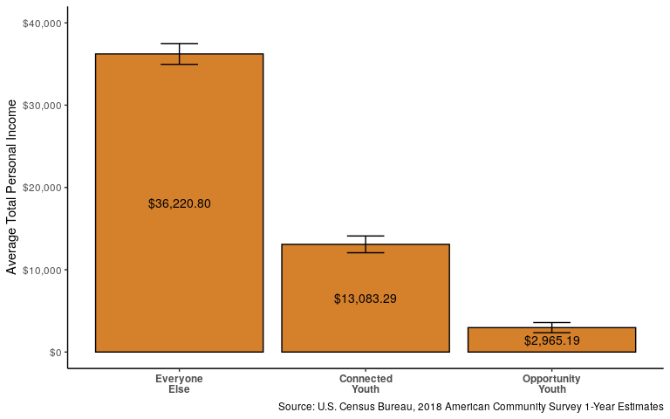
Opportunity Youth have 1/4th the total average personal income of Connected Youth

Slide 19
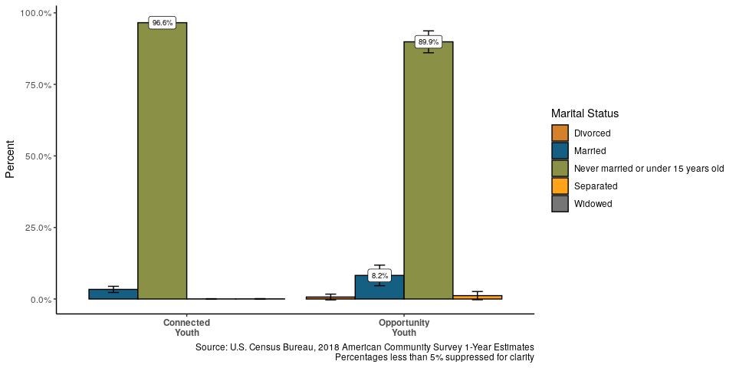
Opportunity Youth are unlikely to be in a relationship

Slide 20
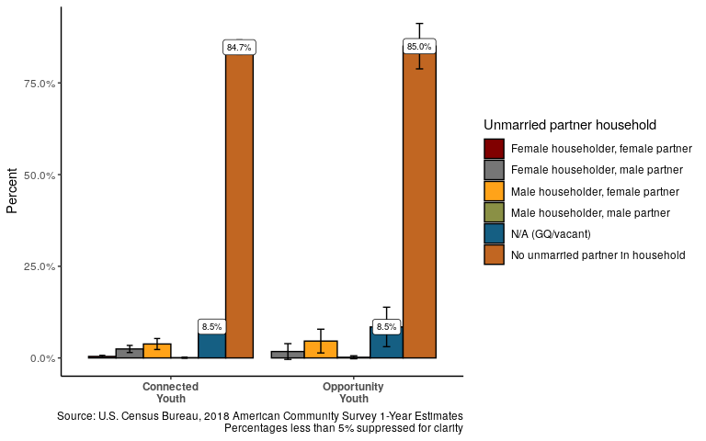

Slide 21
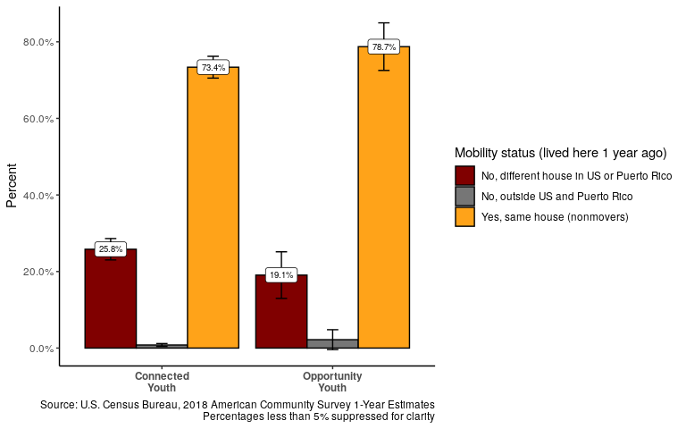
Opportunity Youth are more likely to have lived in the same house the prior year

Slide 22
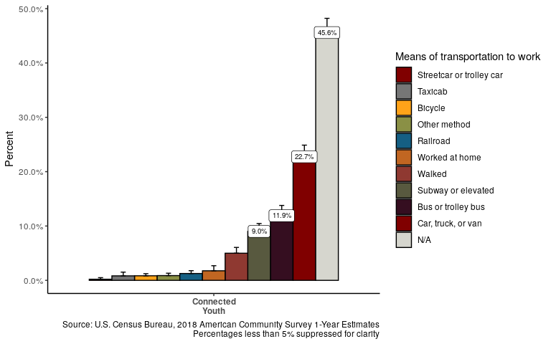
Mobility: Mode of Transportation for Connected Youth

Slide 23
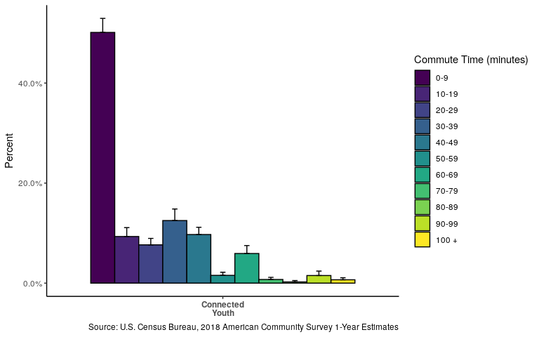
Most Connected Youth commute less than ten minutes to work

Slide 24
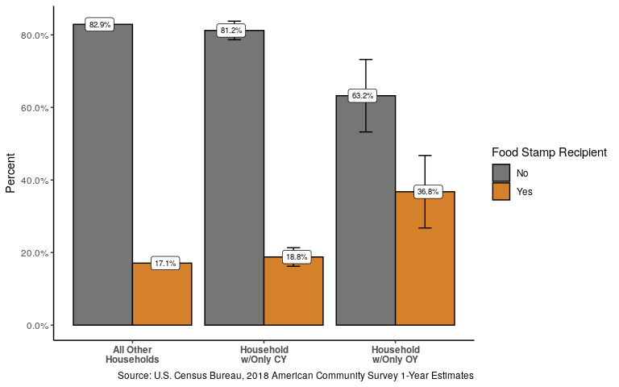
OY Only Households are twice as likely to receive foodstamps

Slide 25
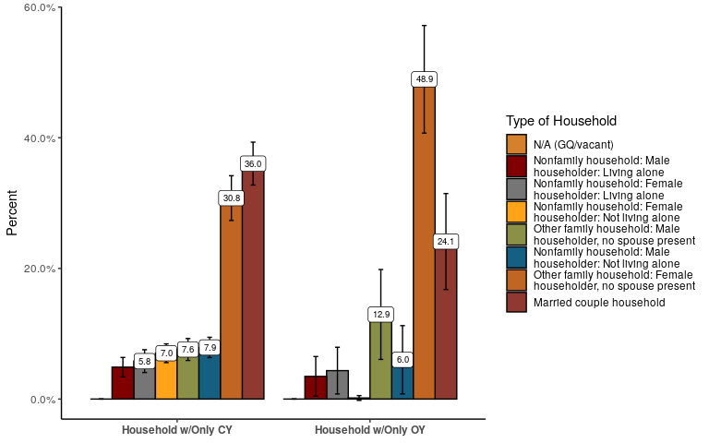
Household Type

Slide 26
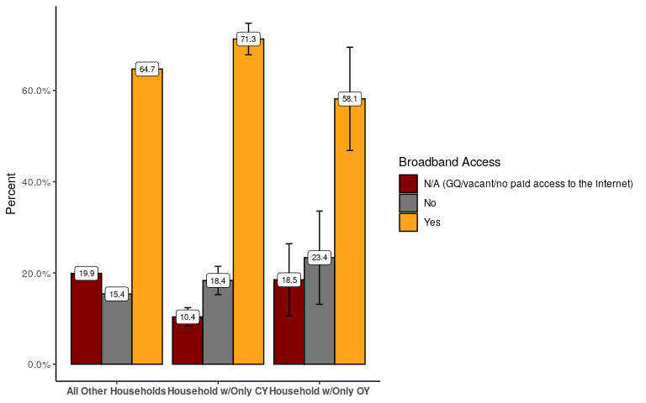
OY Only Households are less likely to have access to broadband internet

Slide 27
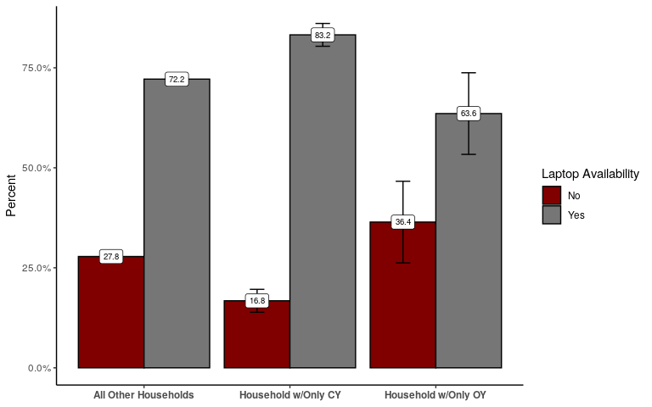
OY Only Households are less likely to have laptop access

Slide 28
Questions?

Slide 29
Thank you!

