Slide 1
Opportunity Youth Population Estimates and Demographics (Preliminary)
Diego Rubi

Slide 2
Today’s Agenda
Population of Chicago by Age Bracket
Total Number of Opportunity Youth in Chicago
Race and Ethnicity Distribution
Gender distribution
Disability distribution
Age Bracket
Pending analyses:
Race & Gender
Population by PUMA

Slide 3
Methodology
2018 American Community Survey Public Use Microdata
Limited to Chicago relevant Public Use Microdata Areas (PUMA)
Opportunity Youth are individuals who respond as follows to questions about school enrollment, employment, and age:
AGE: Between 16 - 24
School Enrollment: Have not attended school within the last three months
Employment: Are ‘unemployed’ or ‘not in the labor force’

Slide 4
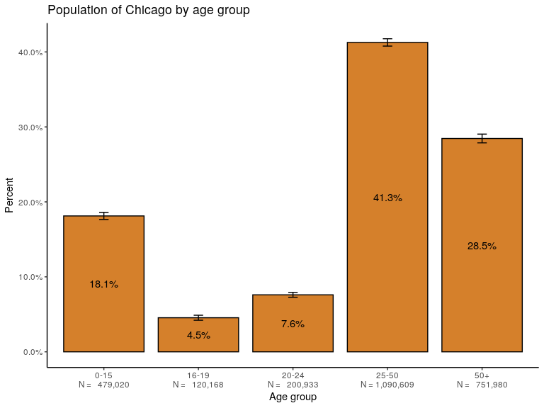
About 12% of Chicago’s population is within 16 and 24 years of age

Slide 5
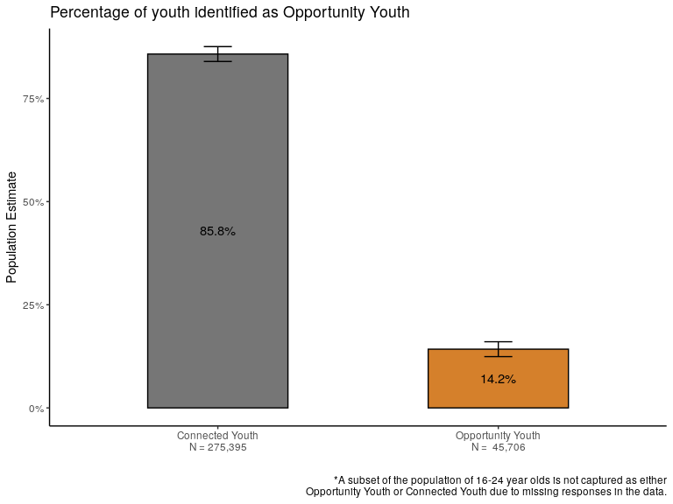
About 14% of 16 to 24-year olds are Opportunity Youth

Slide 6
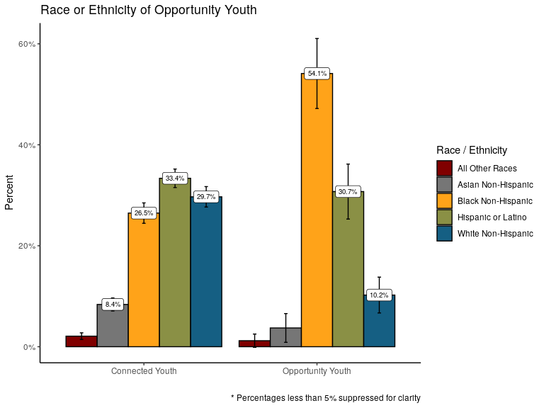
More than half of all Opportunity Youth are Black, Non-Hispanic

Slide 7
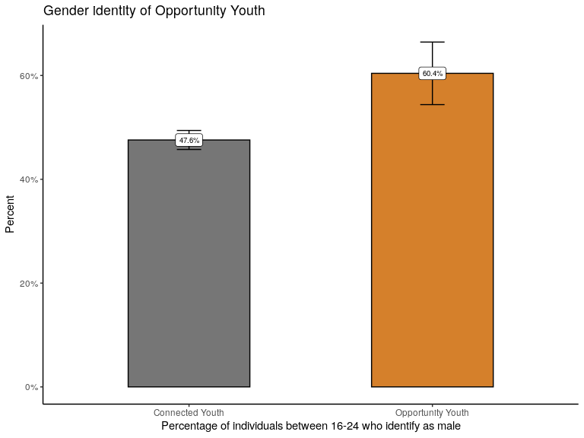
Nearly 60% of Opportunity Youth identify as male

Slide 8
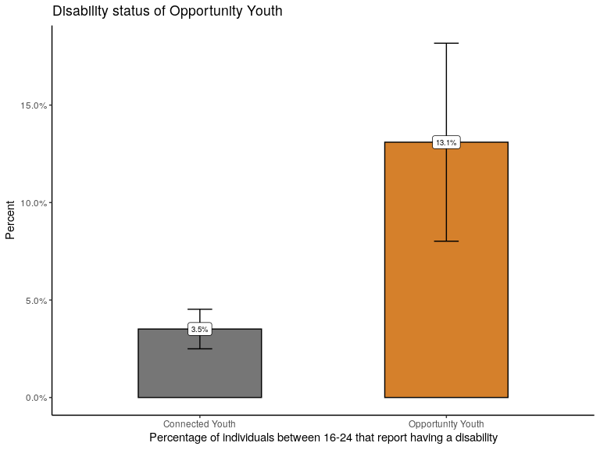
Nearly 13% of Opportunity Youth report having a disability

Slide 9
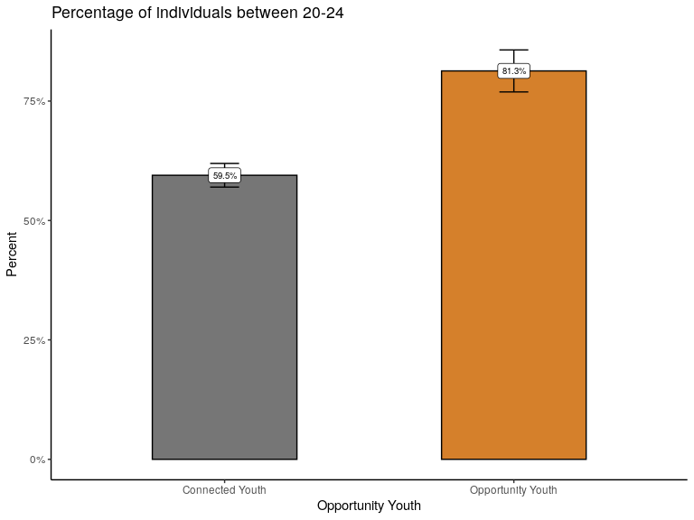
Opportunity Youth are more likely to be older

Slide 10
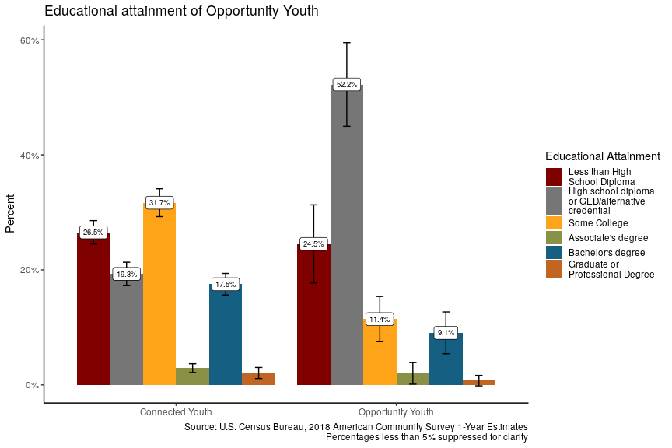
Nearly 75% of Opportunity Youth have graduated from high school

Slide 11
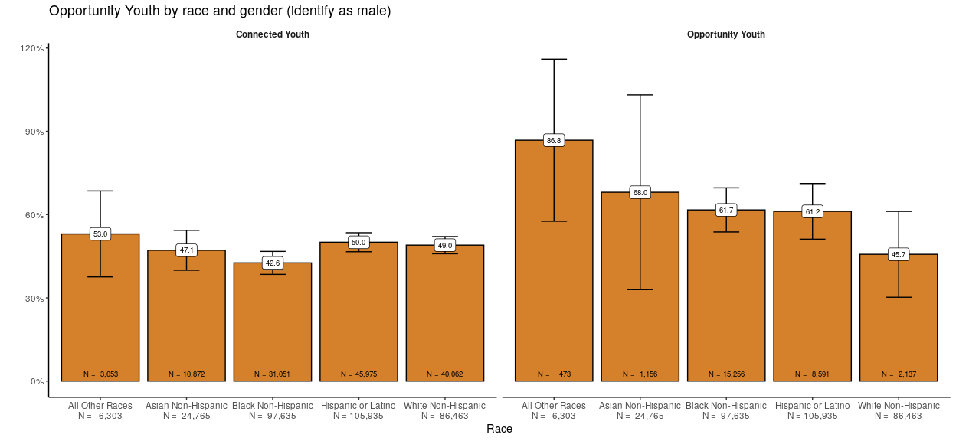
Across nearly all races, most Opportunity Youth identify as male

Slide 12
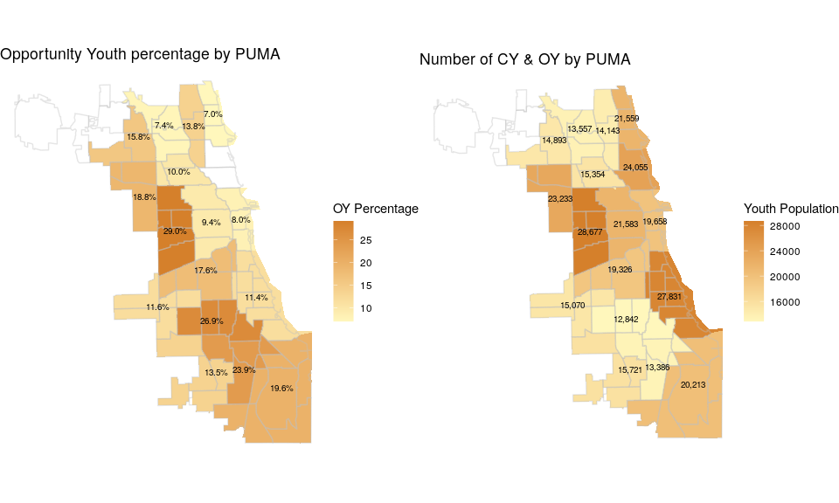
Opportunity Youth are concentrated on Chicago’s South and West Sides

Slide 13
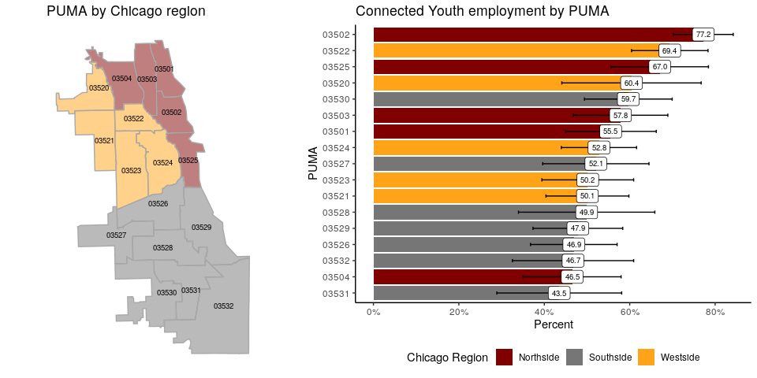
Among all connected youth, those on the South Side are less likely to be employed

Slide 14
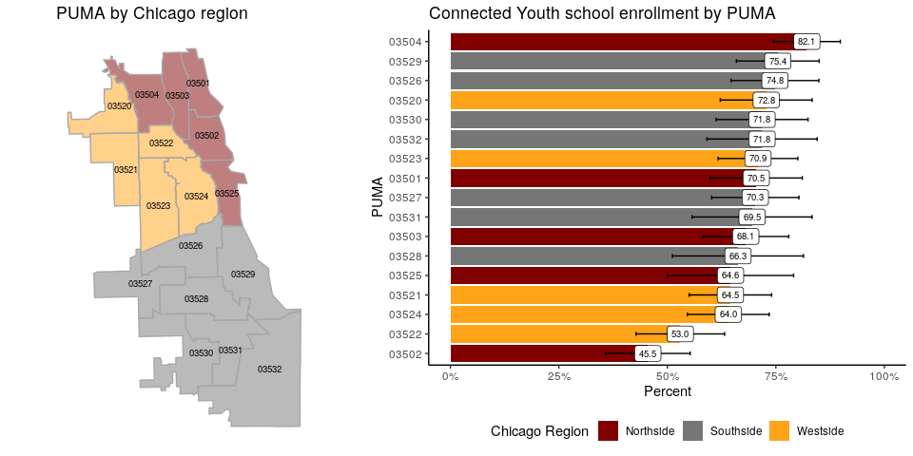
Among all Connected Youth, those on the Wesetside are less likely to be enrolled in school

