Slide 1
Opportunity Youth Household Structure (Preliminary)
Diego Rubi

Slide 2
Data Sources:
IPUMS USA
IPUMS at the University of Minnesota
IPUMS pre-processes PUMS files to enable / facilitate research
Example: NOC (U.S. Census) vs. NCHILD (IPUMS) are at household level and individual level respectively
U.S. Census Bureau
Raw PUMS files directly from the U.S. Census Bureau

Slide 3
Research Questions of Interest
What is each household type, and what is their composition?
What is the average household size for each household type?
What is average household income by household type?
What is an Opportunity Youth’s average total personal income?
What percentage of households are food stamp recipients?
How many youth identify as the reference person?
How many youth have at least one child?
How many youth have multiple children?
What is the household median income for each household type?
What is the median income by Chicago region for reference persons?
What are youth’s average total personal income?

Slide 4
Research Questions (cont.)
How many youth are married?
How many youth are partnered?
How many households are foodstamp recipients?
What type of households do
What percentage of each household has broadband access?
What percentage of each household has computer access?
Have Opportunity Youth moved within the last year?
What are Connected Youths’ primary form of transportation?
What are Connected Youths’ average commute time?

Slide 5
Refresher

Slide 6
How are Opportunity Youth defined?
Opportunity Youth (OY): Individuals that are 16 to 24 years old who are simultaneously unemployed/ not in the labor force and not enrolled in school (disconnection)
Connected Youth (CY): Individuals that are 16 to 24 years old who are either employed, enrolled in school, or both.
Everyone Else (EE): Individuals outside of this age category, regardless of employment or school enrollment status

Slide 7
How are households categorized?
Household Type | Everyone Else | Connected Youth | Opportunity Youth
All Other Households | Present | Not Present | Not Present
Households with Only CY | Present | Present | Not Present
Households with OY | Present | Present | Present

Slide 8
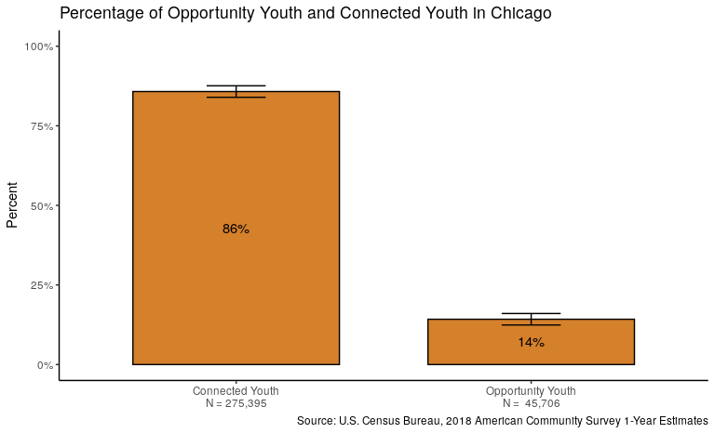
14% of 16 - 24 year olds are Opportunity Youth

Slide 9
Results

Slide 10
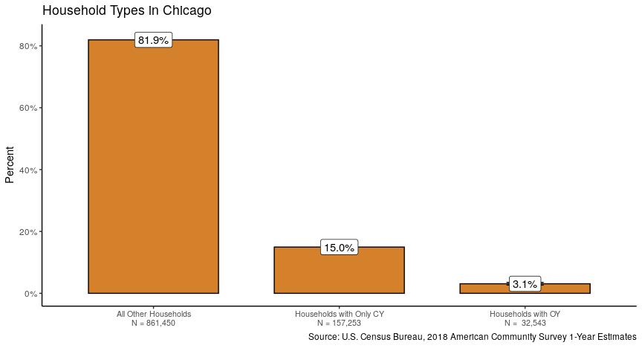
About 3% of households contain Opportunity Youth

Slide 11
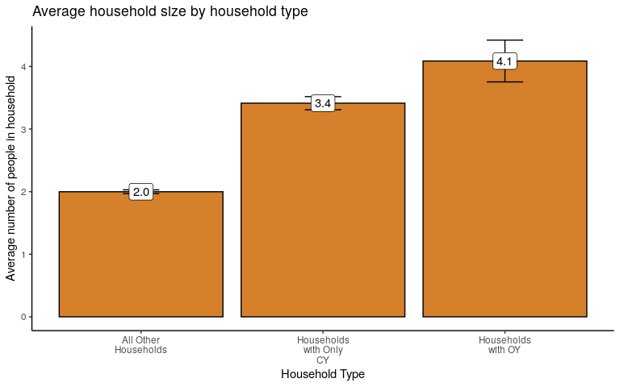
Both Connected Youth and Opportunity Youth live in larger households

Slide 12
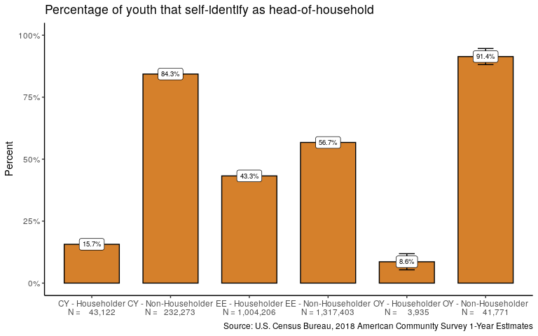
Opportunity Youth are half as likely as Connected Youth to householders

Slide 13
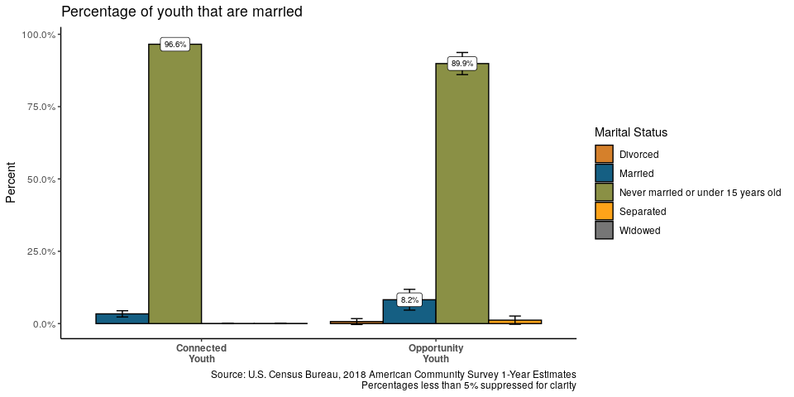
Opportunity and Connected Youth are both unlikely to be married

Slide 14
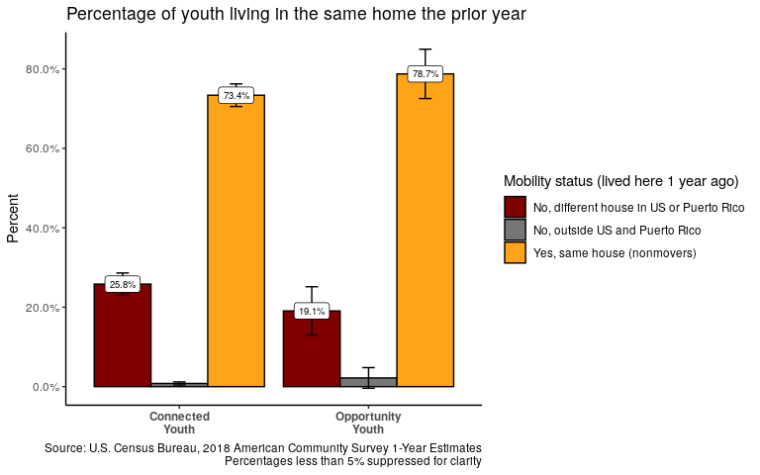
Opportunity Youth are more likely to than Connected Youth to have lived in the same house the prior year

Slide 15
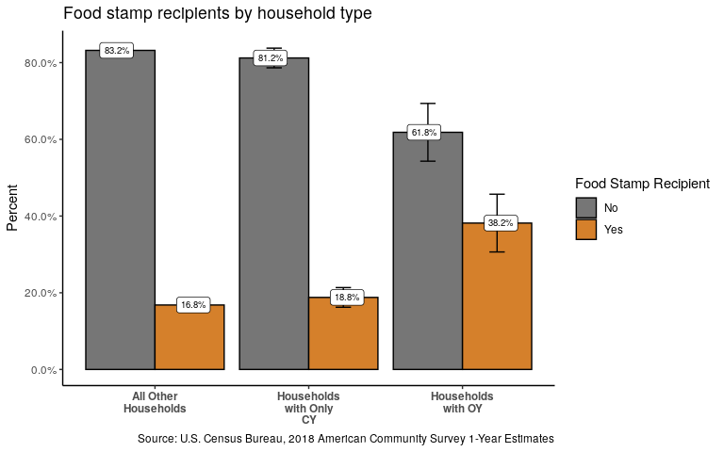
Households w/OY are almost twice as likely to receive foodstamps than all other households

Slide 16
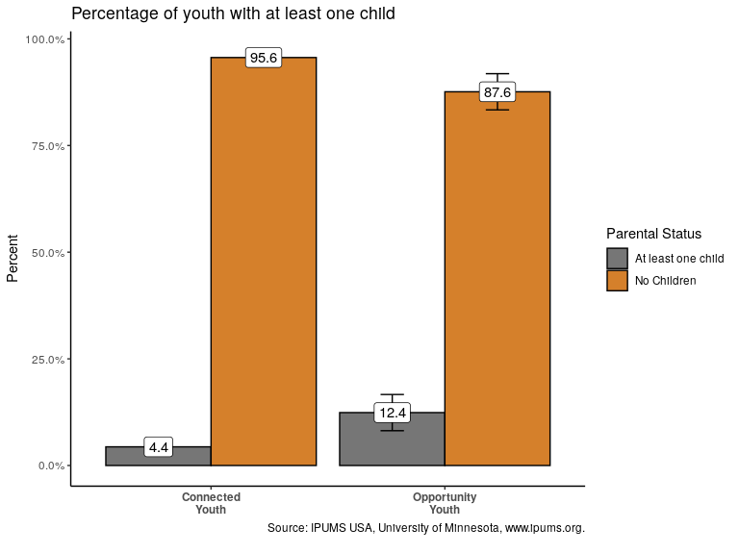
Opportunity Youth are three times as likely to have at least one child

Slide 17
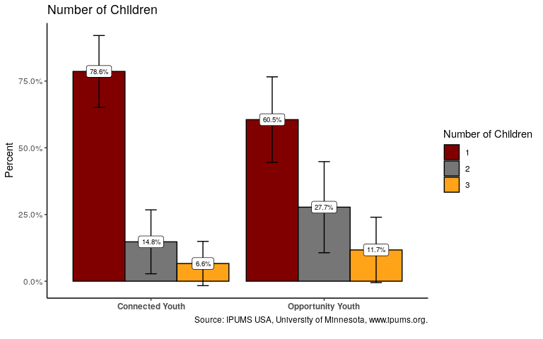
Opportunity Youth are more likely to have multiple children

Slide 18
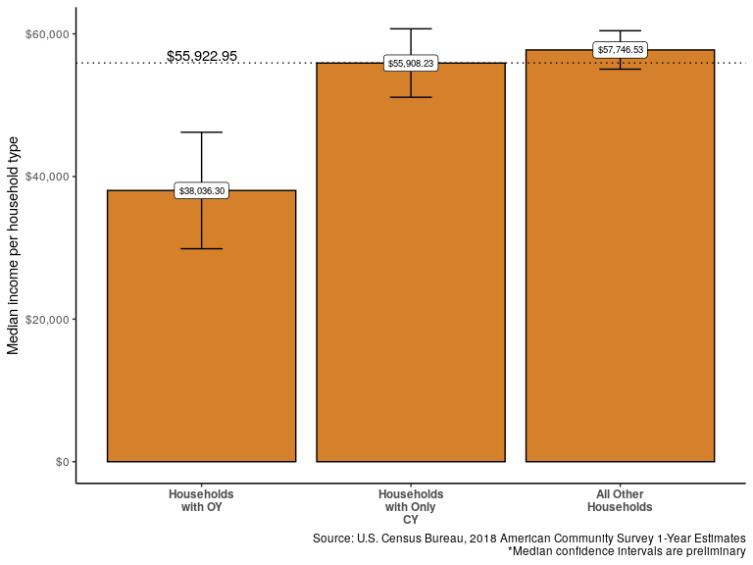
The median income of ‘Households with Only OY’ is less than half that of other households

Slide 19
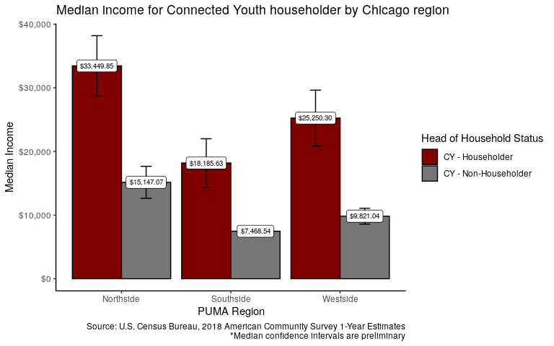
Median Income by Reference Person by Chicago region

Slide 20
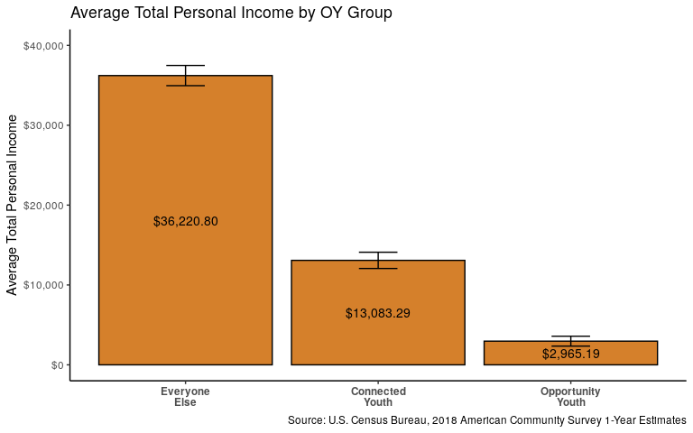
Connected Youth earn nearly four times the amount of Opportunity Youth

Slide 21
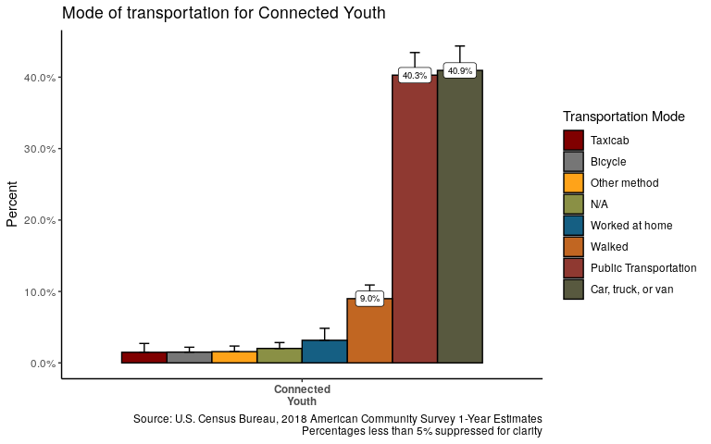
Most employed Connected Youth travel by car, truck, van or public transportation

Slide 22
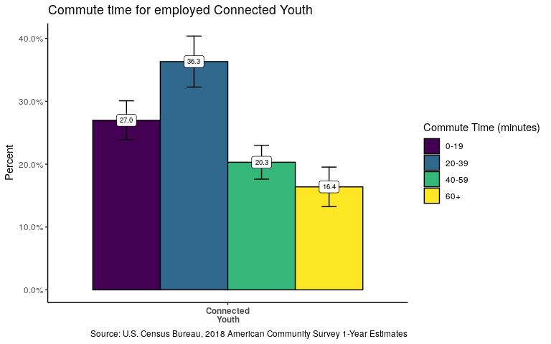
Many Connected Youth are between 20 and 40 minutes from their employer

Slide 23
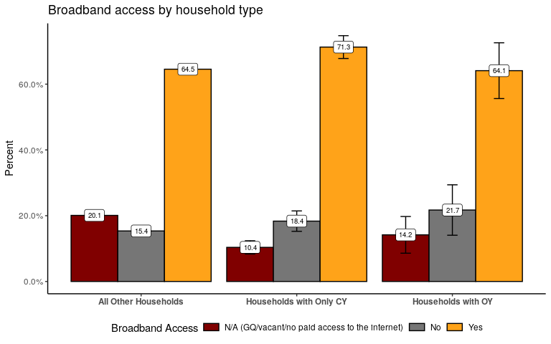
Almost 1 in 4 households with OY lack access to broadband internet

Slide 24
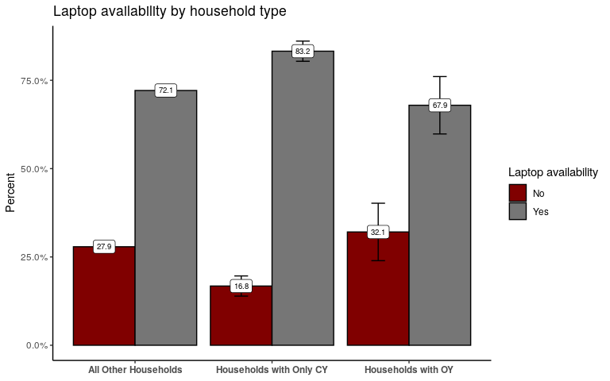
More than 1 in 3 households with OY do hot have access to a laptop

Slide 25
Questions?

Slide 26
Thank you!

