Slide 1
Geodetic Acoustic Rays Solutions in the Time Domain
IR&D Results and Conclusions
November 14, 2006
Rob Goff, Sector Manager
John Bell, Division Manager
Sean Reilly, Principal Investigator (401) 841-7219
Matt Nowicki, Group Controller (757) 240-5358

Slide 2
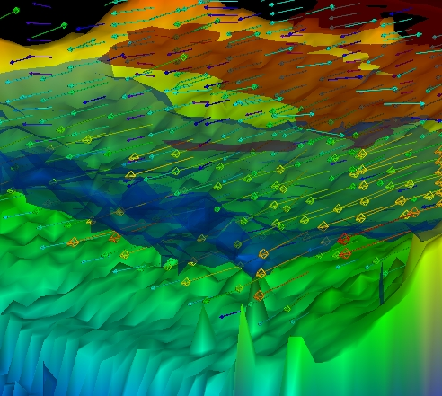
Program Concept
A faster acoustic model for highly dynamic simulations, based on prior works in the field and reworked into an innovative, high performance, time-domain, 3-D processing model optimized for the littoral environments and tactics of current interest to the Navy.
Water Column Visualization

Slide 3
Customer / Value
Anticipated Customers/Customer Base
  US Navy
    Simulation Community
    Research Community
Value to Customer
  Acoustic Modeling in areas not covered by precursor models, principally high performance broadband 3-D modeling in littoral environments.

Slide 4
Overall Program Objectives
Optimize for littoral environments and tactics of current interest.
Fully 3-D acoustic propagation
Time domain / broadband propagation model.
Use Gaussian beam techniques
  transmission loss
  lower frequency regimes.
Leverage technological advances
  Processor Architecture
  Software
Establish modern extensible OO software framework / architecture
Advance SOTA in terms of speed/accuracy and reusable software components over existing offerings (e.g., GRAB, FeyRay)
Notes:
Most of the Navy’s acoustic models stem from 1960’s computer modeling research. By re-visiting the basic requirements of acoustic propagation, our aim has been to construct a model that is optimized for the littoral environments and tactics of current interest.
Acoustic propagation is conducted in a fully 3-D environment to support out-of-plane reflection from the ocean bottom. Models that use 2-D environments over a series of radials can not support this littoral effect
Gaussian beam techniques for transmission loss calculation are used to extend the applicability of ray theory to lower frequency regimes.
Establishment of a Vertical Software Framework Architectures provides systems integrators and software developers a key reusable vertical integration suite.
Cumulative advances in modern MicroProcessor architectures combined with advances in computer languages have provided opportunities for newly designed software to achieve levels of computational performance as well as design reuse not available in previous generations.

Slide 5
Planned Major Features
Publication of quality research paper on new approach
Hi-Performance Matrix and Vector Math
Gridded NetCDF Datasets
  Environmental Data Standardization
  High Performance Interpolation via Processor/Software Technological Advances
Fully 3-D Ray Propagation Engine
Eigenray Estimation
Gaussian Beam Intensity
3-D Visualization
Notes:
The uBLAS component of the Boost open source project uses generic programming and expression templates to achieve performance levels equivalent to processor-specific, assembly-language linear algebra libraries. Our work in this area has extended the uBLAS library of matrix and vector routines to support higher order operations including exponential, logarithmic, and trigonometric functions.
Alion is currently working to verify the anticipated significant performance enhancements over conventional techniques which will accrue from these extensions.
A visualization suite will provide for the needed engineering graphics designed to greatly enhancement assessment of the computational acoustics scenario.

Slide 6
Principle Risk Areas
Requires the development of completely new modeling approaches to underwater acoustic propagation.
  Ability to achieve appropriate design tradeoffs among accuracy, performance, not guaranteed.
Notes:
This is such an unusual treatment of acoustic ray theory that all derivations were traced back to first principles to ensure a complete understanding of the underlying physics.
Program would benefit greatly from substantial follow-on DTE to fully explore various design and performance trade-offs which will be necessary to provide systems integrators and other developers the practical options they will need to satisfy varying profiles of engineering requirements.

Slide 7
Alion IRAD Risk Mitigation Thrust
Analysis of Algorithm Theory
Framework Architecture Design and Development
Performance Comparisons to Existing Models
  Limited to FeyRay for now.
Notes:
Critical concerns about improving the underlying physics model, improving software design, and computational performance in terms of speed and accuracy have been satisfied by IRD efforts to date.
With significant effort, Alion has developed a first-principles physics solution for 3-D time-domain acoustics.
Alion has also developed a comprehensive Object-Oriented Software Framework Architecture which will save future systems integrators and other developers time by allowing them to focus on specific modeling tasks which can be integrated in a predefined manner to a stable architectural backbone which provides for full 3-D acoustic propagation, interaction with boundary models, environmental data models, etc.
Alion has focused performance comparison efforts to date against the FeyRay computational engine used in AtLos, as well as developed it’s own analytical solutions from first principles in order to establish basic measures of performance and effectiveness.

Slide 8
Analysis of Algorithm Theory
Produced Peer Reviewed Theoretical Paper detailing new Acoustic Modeling Concept
Analytical Verification via fresh first principles physics analysis of Gaussian Beam and 3-D broadband ray propagation
  More robust Adams-Bashforth 2nd/3rd order numerical integrators
  Improved 3-D collision detection and boundary reflection impulse models
  Analytical corrections to original 3-D propagation equations
Development of Analytical Ray Path Solutions for various SVPs
Notes:
Alion has validated the computational efficacy of this new approach by demonstrating robust and stable 3-D numerical integration of the acoustic ray trajectory based on its new physics model.
Comparisons of the computed ray trajectory against analytical solutions for various standard sound velocity profiles have demonstrated excellent agreement with theory.

Slide 9
Prototype Development
Implementation of 3-D Geodetic Ray Propagation Prototype Engine
Comparisons of computed Ray Path against Analytical Ray Path Solutions
Initial performance comparisons against existing AtLos FeyRay ray propagation core
Initial accuracy comparisons against existing AtLos FeyRay ray propagation core
Notes:
Alion has also validated the run time performance of its 3-D acoustic ray equations by developing a prototype ray propagation engine based on the new physics analysis and has performed detailed comparisons against FeyRay for speed and accuracy of computation. In all cases the Alion 3-D Geodetic Ray Propagator has demonstrated marked improvements in both measures of performance, further demonstrating the advantages of this new modeling approach.

Slide 10
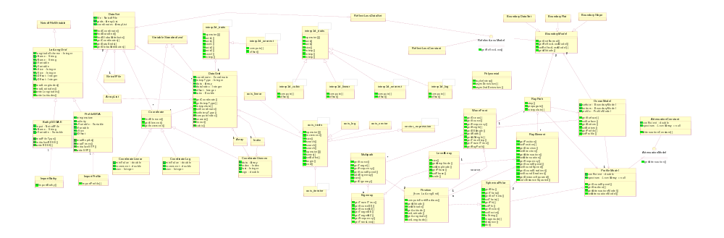
A Modern and Extensible OO Framework for
3-D Ray Acoustics

Slide 11
Framework / Architecture Establishment
Development of Extensible O-O Framework Architecture
  3-D Ray Propagation with 3-D boundary reflections
  NetCDF/COARDS Environmental data
  Pre-defined connections for custom models for
    Attenuation / loss
    Boundary Reflections
    Data Grids
    Interpolation
Notes:
Alion has designed and is currently implementing a comprehensive reusable object-oriented vertical framework of cooperating classes in C++ designed to provide the systems integrator or developer with a baseline system for further specific modeling in areas such as attenuation, reflections, boundary definitions, data grids, interpolation algorithms, etc.

Slide 12
IRAD Preliminary DTE Results
Performance Improvements
  Speed of Execution
  Ray Path Accuracy

Slide 13
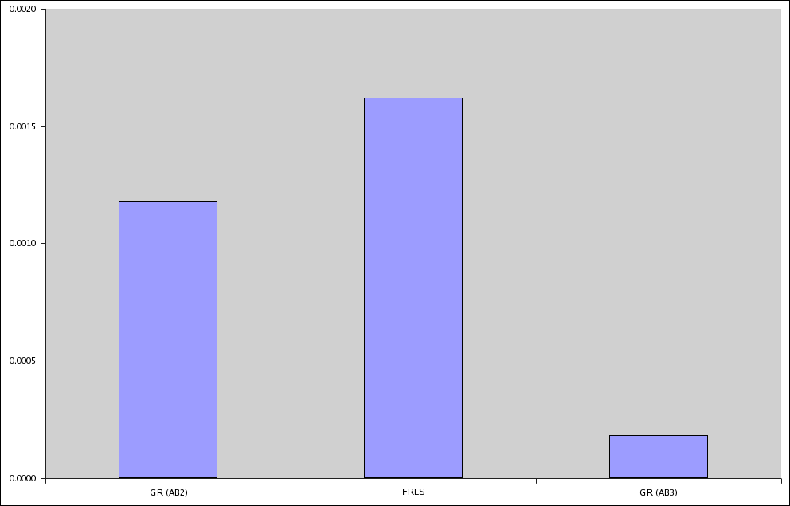

Speed of Execution (Munk SVP)
Notes:
Alion has used prototyping efforts to validate theoretical performance advantages latent in its new physics and geometry model. Current baseline measurements of computational performance show significant performance improvements over the existing AtLos/FeyRay.

Slide 14
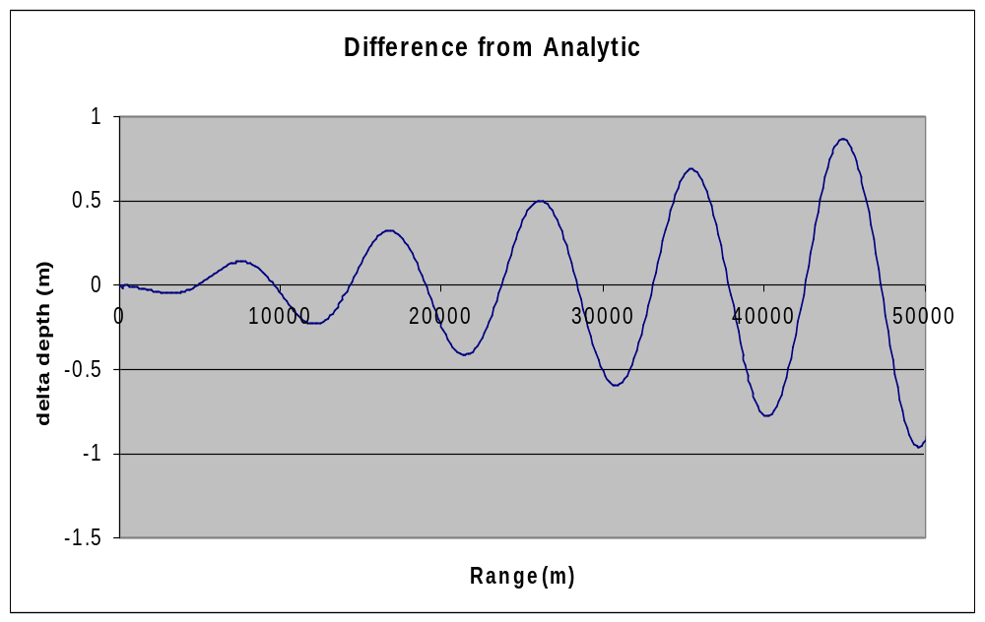
Accuracy Comparison of
Analytic Solution and Computed Solution
For Purely Refractive Long Range Propagation
Notes:
Results from Alion’s prototyping efforts validate the accuracy of its new ray propagation model compared to theoretical solutions especially for propagation scenarios which allow comparison at very long ranges.

Slide 15
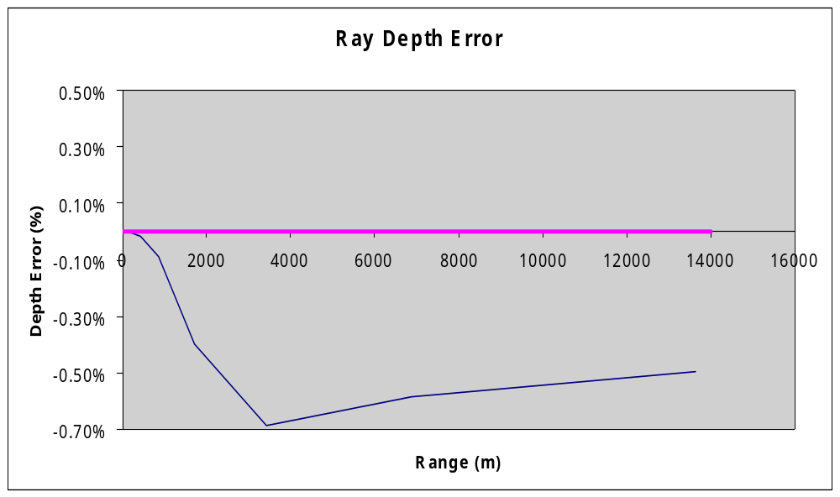
Accuracy Comparison (N^2 Linear SVP)
Geodetic Ray FeyRay
Notes:
Compared to FeyRay, the new achievements in ray path accuracy show negligible differences from theoretical solutions for many standard sound velocity profiles.

Slide 16
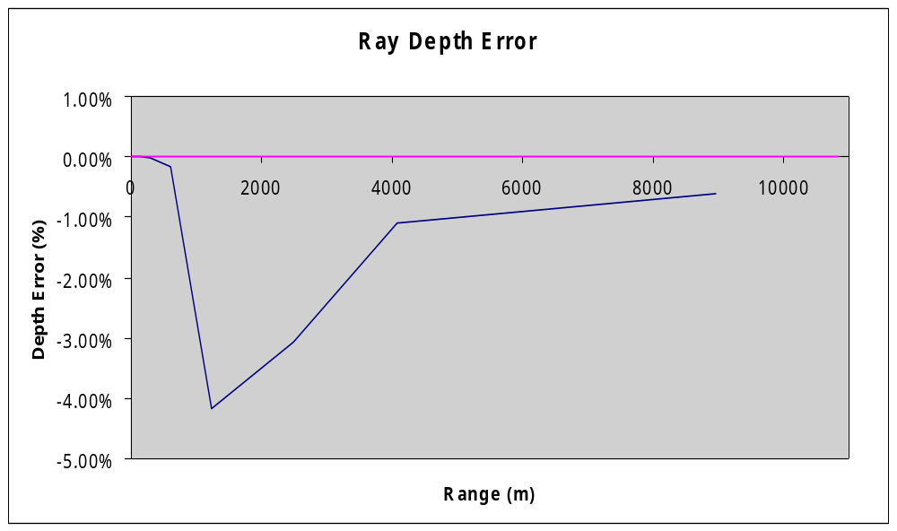
Accuracy Comparison (N^2 Linear SVP)
Geodetic Ray FeyRay

Slide 17
The Way Ahead - Remaining Work
Implementation
  NetCDF Data Sets
  Eigenray Estimation
  Gaussian Beam Intensity
  Transmission Loss
  3-D Visualization
  Integrated Reverberation
Evaluation
  Replicate the results of the 40 SWAM99 test cases for range-dependent acoustic propagation models.
  Produce research paper on evaluation

