Slide 1
Deploy twisted-based win32 services with bdist_msi
Braudel Maqueira

Slide 2
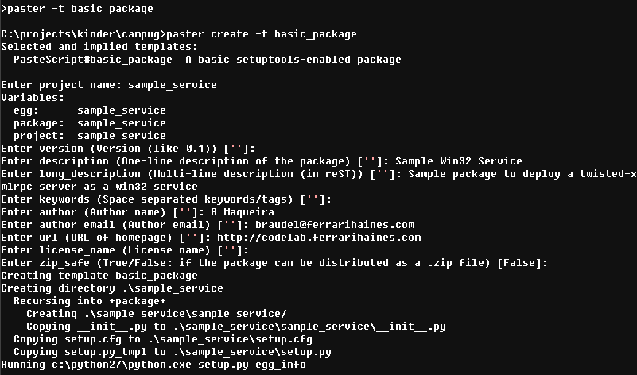
Create package

Slide 3
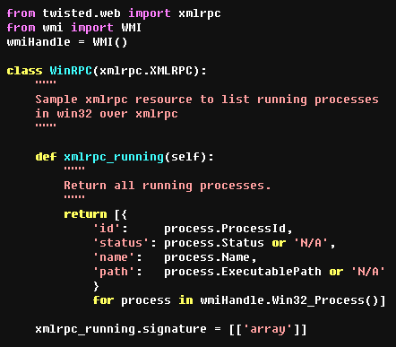
Create the xmlrpc resource

Slide 4

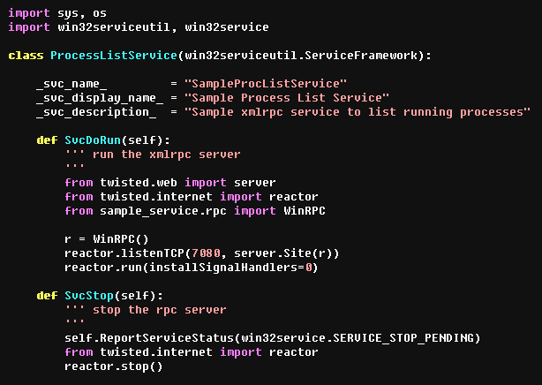
Create the service script I/II
Can’t install handlers from non-main thread
Notify shutdown in progress

Slide 5
Create the service script II/II
At this point we could call:
proclist_service.py install
proclist_service.py start/stop
proclist_service.py remove

Slide 6
Create the service script II/II
Starting with Python 2.3, a post-installation script can be specified
with the --install-script option….
This script will be run at installation time on the target system
after all the files have been copied, with argv[1] set to -install,
and again at uninstallation time before the files are removed
with argv[1] set to -remove.

Slide 7
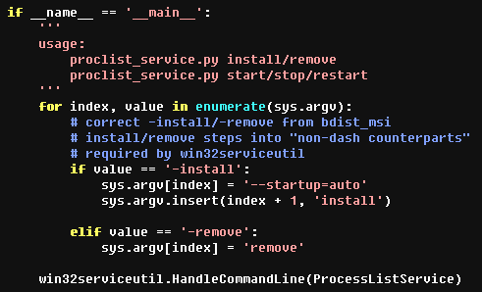
Create the service script II/II

Slide 8
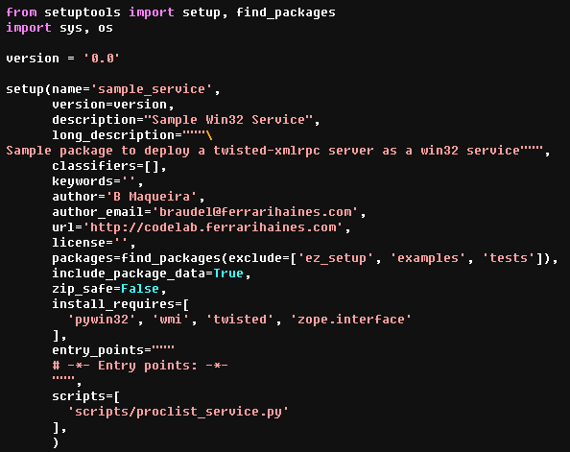
Edit setup.py

Slide 9
Patch bdist_msi
http://bugs.python.org/issue15797
http://bugs.python.org/file27033/patch1.diff

Slide 10
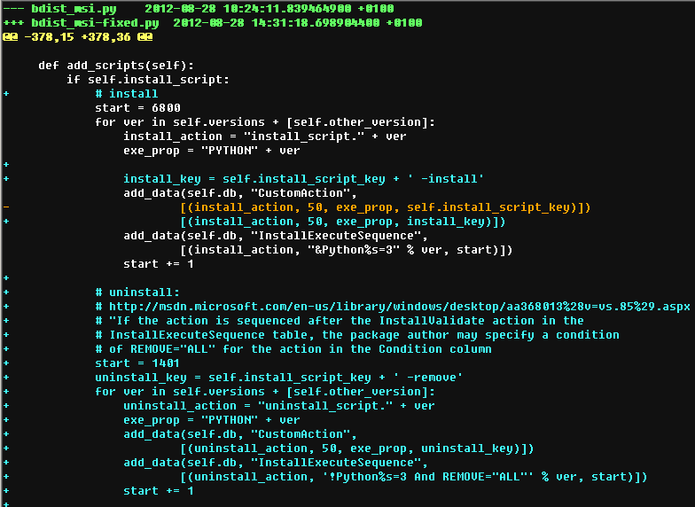
Patch bdist_msi

Slide 11
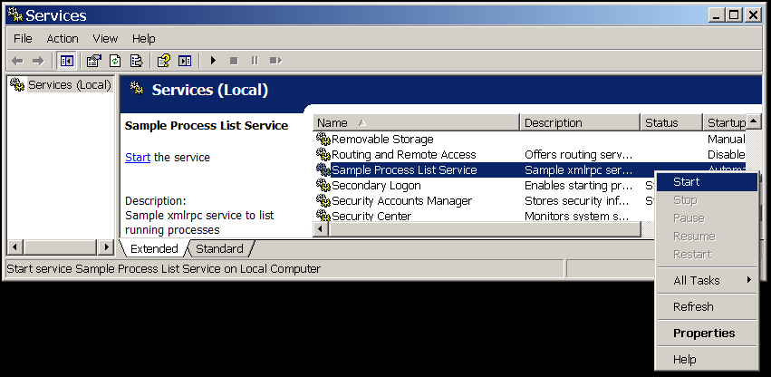
Build package & install
python setup.py bdist_msi --install-script=proclist_service.py
cd to \dist and double click on sample_service-0.0.win32.msi
go to Start > Settings > Control Panel > Administrative Tools > Services
right click on “Sample Process List Service” -> “Start”

Slide 12

Use it

