Slide 1
CSE7302 - INTERNSHIP Review-4 Presentation Project Title: CampusCore - University ERP System Domain: Full Stack Web Development
Student Details
Name | JAYANTH D R
Roll No | 20221CSE0636
Section | 8CSE13
Under the Supervision of,
Mrs. Senthil Kumar Associate Professor
Presidency School of CSE
Presidency University
Name of the Program: B-Tech CSE
Name of the HOD: Dr. Asif Mohammed
Name of the Program Internship Coordinator: Mr. Sakthi S
Name of the School Internship Coordinator: Dr. Md Ziaur Rahman

Slide 2
Content
About Company or Organization
Working domain or the technology
About your team and reporting Manager
Challenges Faced in Internship
Objectives of the work
Literature Review
Proposed System
Problem Statement
System Requirements
Advantages of Proposed System/Work
System Design
System Implementation
Internship Roadmap
Github Link

Slide 3
About Company or Organization
Company / Organization Name: Rail Wheel Factory (RWF)
Organization Type: Government of India Enterprise(Under Ministry of Railways)
Location: Yelahanka, Bengaluru, Karnataka
Overview: Rail Wheel Factory (RWF) is a premier manufacturing unit of Indian Railways, established to manufacture cast steel wheels and axles used in railway rolling stock across India.

Slide 4
Working domain or the technology
Internship Domain: Full Stack Web Development
Technologies Used:
Frontend: HTML, CSS, JavaScript
Backend: Python, Flask (REST API Architecture)
Database: Microsoft SQL Server
Tools: VS Code, Postman, GitHub
The project follows a Three-Tier Architecture (Frontend → Backend → Database).

Slide 5
About your team and reporting Manager
• Internship carried out under organizational supervision
• Regular progress reviews
• Independent project-based development
My Responsibilities:
• Database schema design
• Writing SQL queries
• Developing Flask APIs
• Frontend integration
• Authentication system implementation
• Debugging and testing

Slide 6
Challenges Faced in Internship
• Designing normalized relational database
• Creating proper primary and foreign key relationships
• Handling SQL join operations
• Debugging Flask–SQL Server connection errors
• Managing session-based authentication
• Fixing frontend-backend API integration issues
Learning Outcome:
• Improved problem-solving skills
• Strong understanding of REST API architecture
• Better debugging and system design knowledge

Slide 7
Objectives of the work
• Develop centralized University ERP system
• Manage student and teacher data efficiently
• Implement secure admin authentication
• Perform CRUD operations
• Track attendance records
• Manage student fee details
• Reduce manual paperwork and human errors

Slide 8
Literature Review
Traditional student management systems are:
• Manual or semi-automated
• Prone to data duplication
• Difficult to maintain
• Not centrally accessible
Research shows:
• Centralized database systems improve integrity
• REST APIs improve system communication
• Flask framework supports lightweight scalable backend
• SQL-based systems ensure structured data storage
Hence, a full-stack ERP solution was proposed.

Slide 9
Proposed System / Work
CampusCore – University ERP System includes:
• Admin Authentication Module
• Student Management Module
• Teacher Management Module
• Attendance Management System
• Fee Management Module
• Dashboard for data overview
The system provides secure login and role-based data handling.

Slide 10
Problem Statement
Manual record management leads to:
• Data redundancy
• Inconsistency
• Time-consuming updates
• Lack of centralized control
• Security risks
There is a need for:
• Secure
• Centralized
• Scalable
• Web-based ERP solution

Slide 11
System Requirements
Software Requirements:
• Python 3.x
• Flask Framework
• Microsoft SQL Server
• HTML/CSS/JavaScript
• VS Code
Hardware Requirements:
• Standard Computer System
• Internet Connectivity

Slide 12
System Design
System Architecture:
The project follows a Three-Tier Architecture:
Presentation Layer
→ Frontend (HTML, CSS, JavaScript)
2. Application Layer
→ Flask REST APIs
→ Business logic handling
3. Data Layer
→ Microsoft SQL Server Database

Slide 13
System Design
Database Tables:
• Admin
• Students
• Teachers
• Attendance
• Fees
Relationships:
• One Student → Multiple Attendance Records
• One Student → Multiple Fee Records
• Admin manages all modules
Database is designed using primary keys and foreign keys to maintain referential integrity

Slide 14
System Implementation (At least 50%)
Completed Features:
✅ Database schema fully designed
✅ Student CRUD operations implemented
✅ Teacher CRUD operations implemented
✅ Admin login authentication working
✅ REST API endpoints created
✅ Frontend and backend integrated
✅ Attendance module partially implemented
✅ Fee management module implemented
Current Completion Status: Approximately 65%
Remaining Work:
• Advanced reports
• UI enhancements
• Input validations
• Data visualization

Slide 15
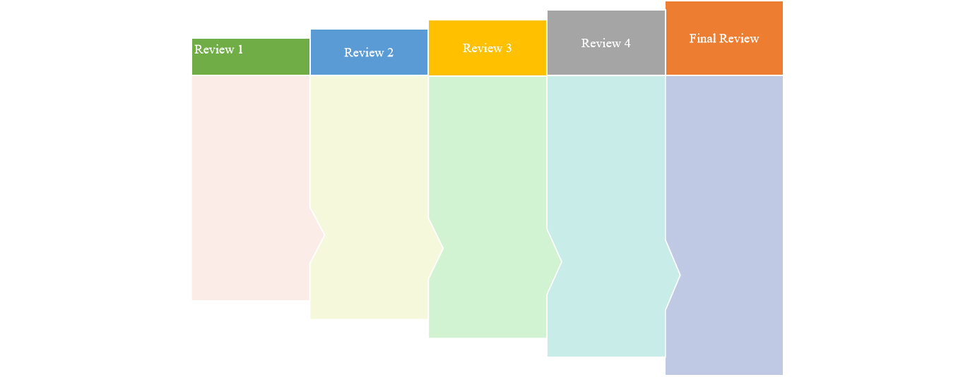
Internship Road Map
Understanding Full Stack concepts
Database schema design
Basic CRUD implementation
Complete student management system
Authentication system
Full frontend-backend integration
• Teacher module completion
• Attendance system integration
• Fee management implementation
• System architecture finalization
• 60–70% project completion

Slide 16
Github Link
URL: https://github.com/campuscore-erp/CampusCore

Slide 17
Q&A

Slide 18
Thank you !!

