Slide 1
How Does Technology Affect our Relationship with God?
Cameron Sentieri

Slide 2
Why HCI?

Slide 3


Human Computer Interaction in a Nutshell
Study of how Humans and Computers interact
Human Centered Design
Notes:
HCD - choices being made in a design process are being made to tailor to the user’s needs, goals, and preferences.
Instagram example

Slide 4


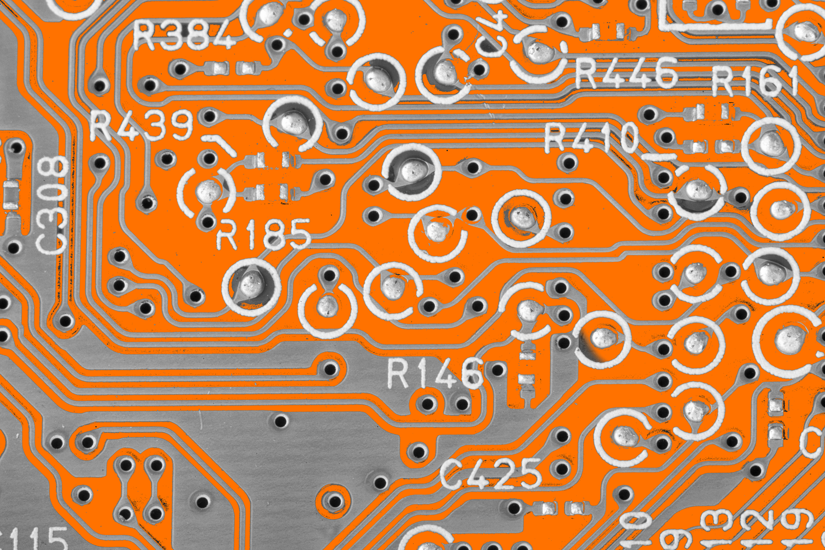

User Interfaces
“The only part of a system that is used by real people doing real tasks in real settings…research on User Interfaces is a cross-disciplinary effort with contributions from computer science, electrical engineering, design, and psychology”
Notes:
Human Computer Interaction has a lot of different angles and perspectives that cover it

Slide 5


Customer Smartphone Distraction (CSD)
Internet-connected smartphone competing for and compromising a user’s attentional resources that were originally directed toward another task
Notes:
As technology becomes increasingly absorbing, human cognitive capacity remains fixed

Slide 6
Spiritual Disciplines
Worship
Prayer
Scripture Reading
Fasting
Notes:
These activities take time, focus, and sustained attention

Slide 7
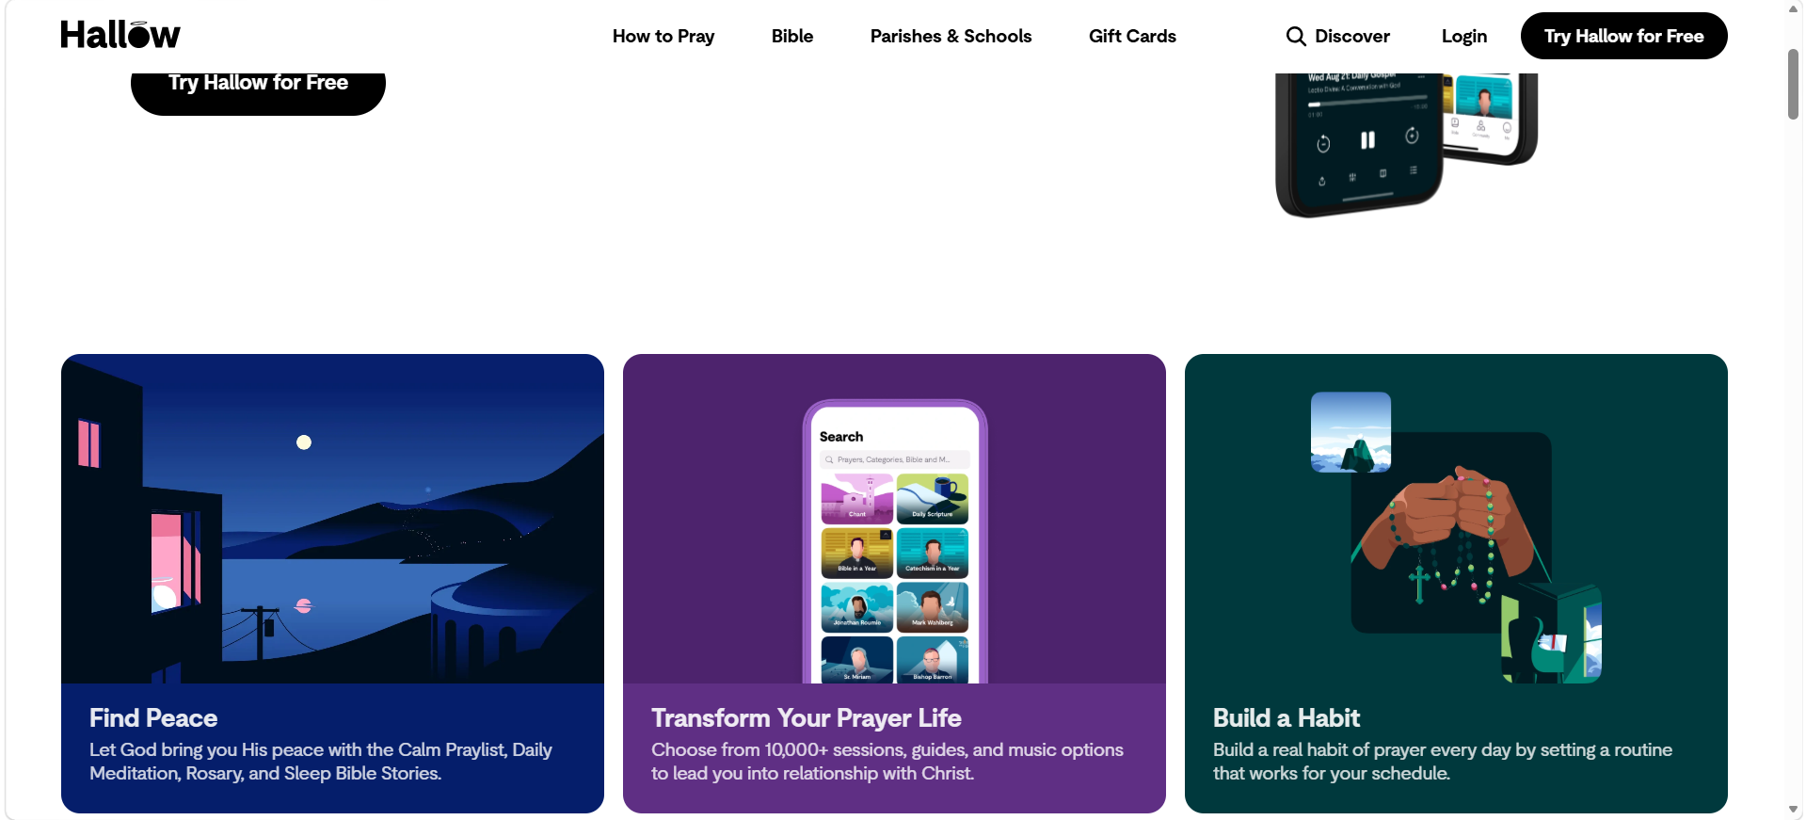
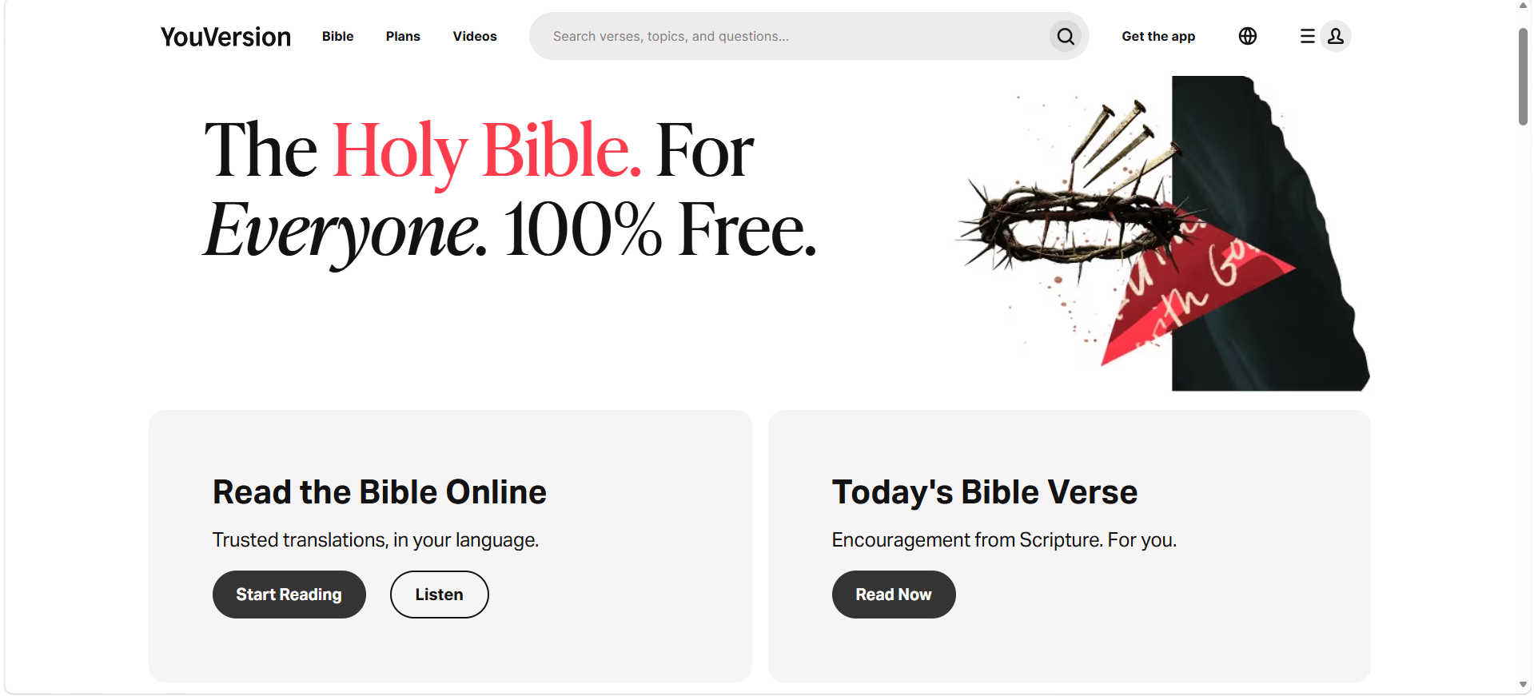
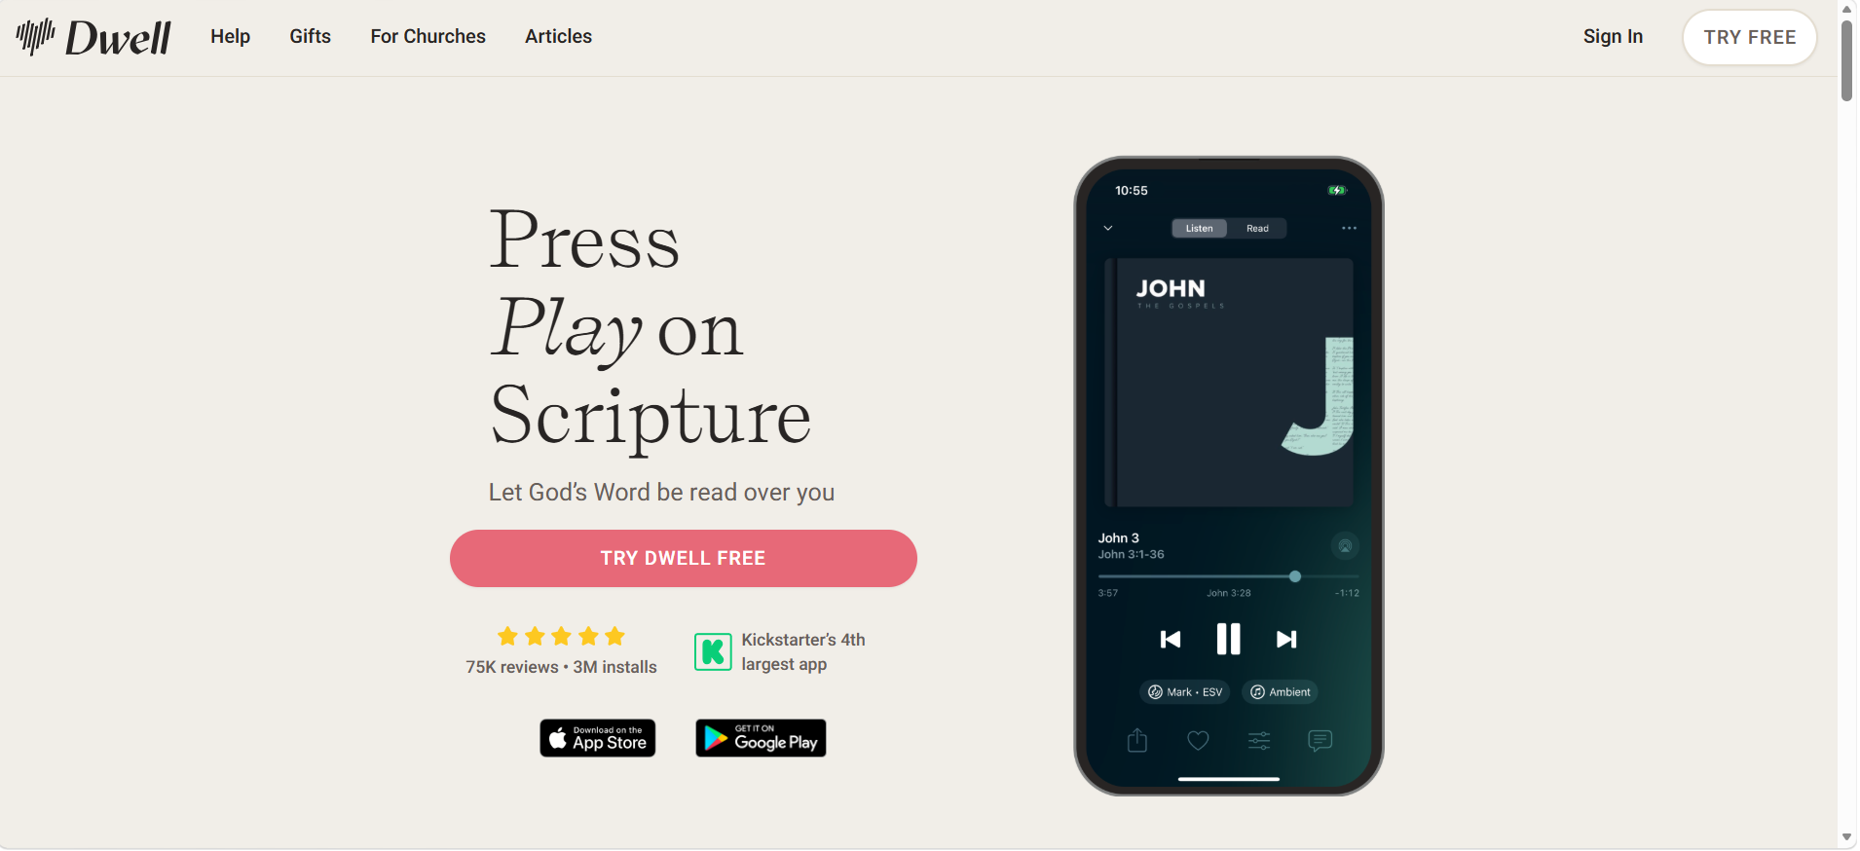
Technology In Spiritual Disciplines
Notes:
Hallow – Great for facilitating prayer (Jonathon Roumie, Mark Wahlberg), Mediation Music
YouVersion – Daily Verse, Thousands of different Bible translations across thousands of languages, Plans (ways to get you into your bible)
Dwell – “Press Play on Scripture” , “Let Gods word read over you”

Slide 8
Can a software application be designed to support spiritual disciplines and mitigate the distracting effects of technology on religious practice?
Open the app and explore its interface freely for 30–60 seconds. After exploring, identify what you believe the main purpose or primary feature of the application is.
Start a Stillness Session using the default settings. Allow the session to run until completion.
After the Stillness Session, complete a reflection using the app’s reflection feature and submit it.
Start a new Stillness Session using Strict Mode. Once the session begins, briefly leave the application (e.g., switch apps or return to the home screen), then return to the app and observe what happens.
Notes:
Likert Scale: Usability, Attention & Distraction, Task experience, Reflective/Spiritual Experience, and comparisons to typical apps
Open Ended: Likes/Dislikes, design choices affecting attention, comparisons to normal smartphone usage, whether or not this app could be influential

Slide 9
Demo Time!

Slide 10
Thanks! Questions?

