Slide 1
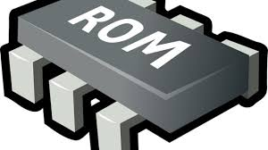
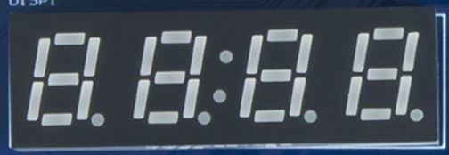


Address Decoder
Boot-ROM
Address[15:6]
Sys-Con
Address[5:2]
SPI1-Flash
WB-Axi Bridge
VeeR EL2
6-1 Multiplexer
Timer
GPIO1-LEDsSw
UART

